Slide 1
XSLT & Arena Promotions
A flexible approach to web promotions
Nick Airdo
Software Engineer
Central Christian Church
Email: nick.airdo@cccev.com
Twitter: @airdo
#RefreshCache

Slide 2
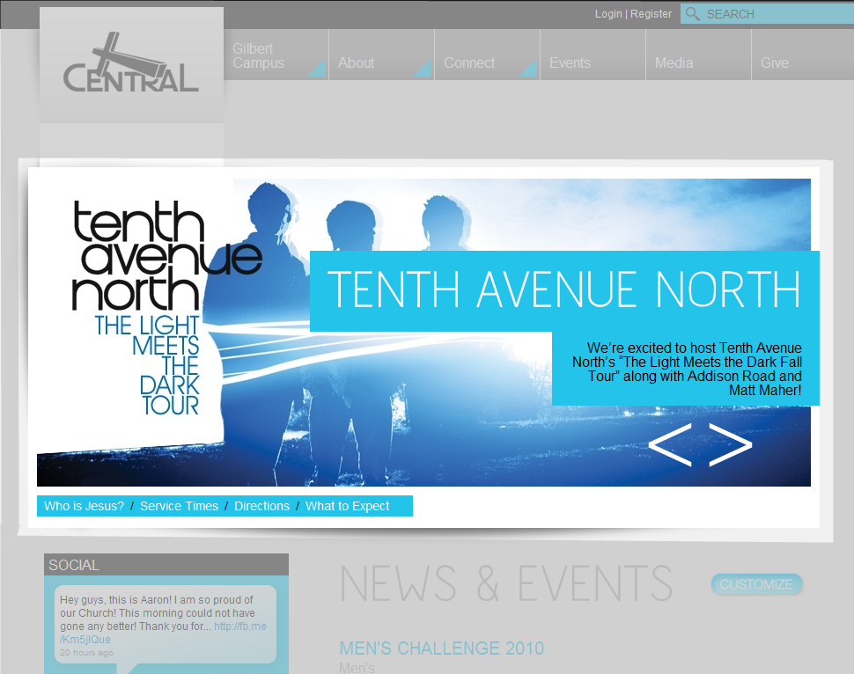
The Goal
Notes:
With our new website, this was what the HomePage promotions needed to look like
Using the standard promotion thumbnail display will be a challenge

Slide 3
Promotion Thumbnail Display
<table id="ctl08_ctl05_dlPromotions" class="promotionThumbDisplay" cellspacing="0" border="0" style="border-collapse:collapse;">
<tr>
<td class="promotionThumbItemStyle">
<div class="promotionThumb">
<div class="promotionThumbImg"><a href="default.aspx?page=3341&amp;promotionId=862"><img src='cachedblob.aspx?guid=fa1bfc86-de17-4e4f-b6ed-e7ace8cfa3bc&amp;width=600&amp;height=400' border='0' alt='' /></a></div>
<div class="promotionThumbTitle"><a href="default.aspx?page=3341&amp;promotionId=862">Tenth Avenue North</a></div>
<div class="promotionThumbSummary">We’re excited to host Tenth Avenue North’s “The Light Meets the Dark Fall Tour” along with Addison Road and Matt Maher!<br></div>
<div class="promotionThumbMoreInfo"><a href="default.aspx?page=3341&amp;promotionId=862">Find Out More</a></div>
</div>
</td>
</tr>
</table>
Notes:
* The Promotion Thumbnail Display module creates this markup

Slide 4
CSS for Styling & Layout
promotionThumbItemStyle - the TD style which contains the promotionThumb for the odd rows
promotionThumbAltItemStyle - same as above, but for alternating rows
promotionThumb - DIV container that holds the:
image (promotionThumbImg)
title (promotionThumbTitle)
summary text (promotionThumbSummary)
more info box (promotionThumbMoreInfo)
promotionThumbImg - wraps the thumbnail image
promotionThumbTitle - wraps the title and is also a link so it has associated "a" and "a:hover" styles.
promotionThumbSummary - wraps the summary text
promotionThumbMoreInfo - wraps the "more info" text and is also a link so it has associated "a" and "a:hover" styles.
Notes:
These are the classes that decorate the HTML (which is a particular table markup)
Ok, but not enough control for my needs
You can only do so much with CSS

Slide 5

featureShow
Found several cool slideshow plug-ins…
…but many expect that you control the markup
Notes:
I wanted to use some cool jQuery plug-ins but they wanted the markup to look a certain way
So I basically needed my markup to look like… (next slide)

Slide 6
Final XHTML
<ul id="feature-slider">
<li>
<a href="default.aspx?page=4222&amp;eventId=4430">
<img width="879" height="350" src="CachedBlob.aspx?guid=05e964e4-e18b-43e8-b984-d14f8dd71a2c&amp;width=897&amp;height=350" alt="Tenth Avenue North">
</a>
<div class="feature-text">
<a href="default.aspx?page=4222&amp;eventId=4430">
<h1 class="heading"> Tenth Avenue North</h1>
</a>
<a href="default.aspx?page=4222&amp;eventId=4430">
<p class="caption">We’re excited to host Tenth Avenue North’s “The Light Meets the Dark Fall Tour” along with Addison Road and Matt Maher!</p>
</a>
</div>
</li>
<!– etc., etc., etc. -->
</ul>
Notes:
The final HTML needs to look like this

Slide 7
PromotionsViaXSLT was Born
Has most of the standard features plus:
weighted randomize
image effects…
Notes:
The Promotion Module to End All Others

Slide 8
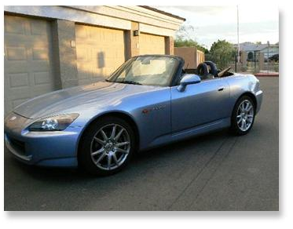
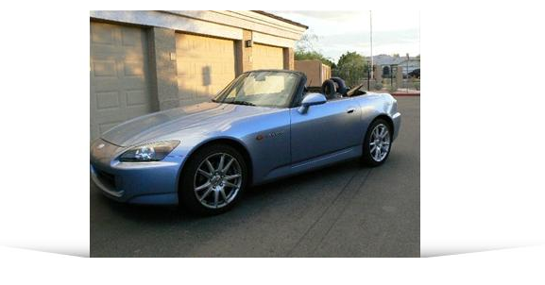
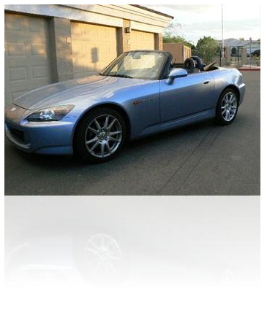
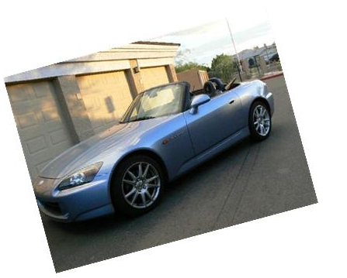
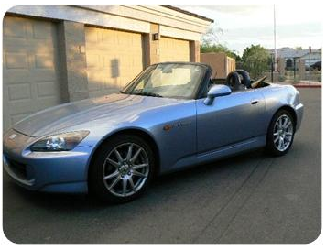
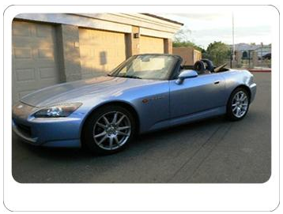
Arena’s CachedBlob Image Effects

Slide 9
PromotionsViaXSLT is Born
Has most of the standard features plus:
use alternate Document/Media Type
weighted (by priority) randomized
image effects…
cache results (configurable)
use Person’s campus option
priority level filtering
configurable XSLT file
Notes:
The Promotion Module to End All Others

Slide 10
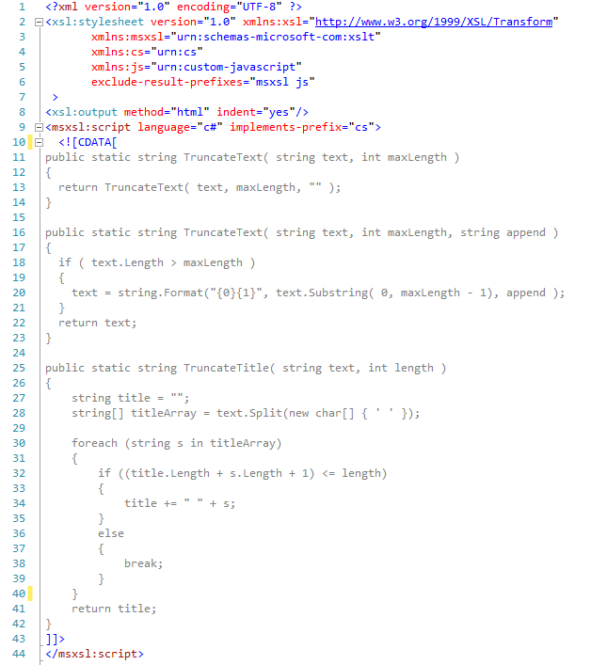
My XSLT
Notes:
You can use even use C# for code/logic

Slide 11
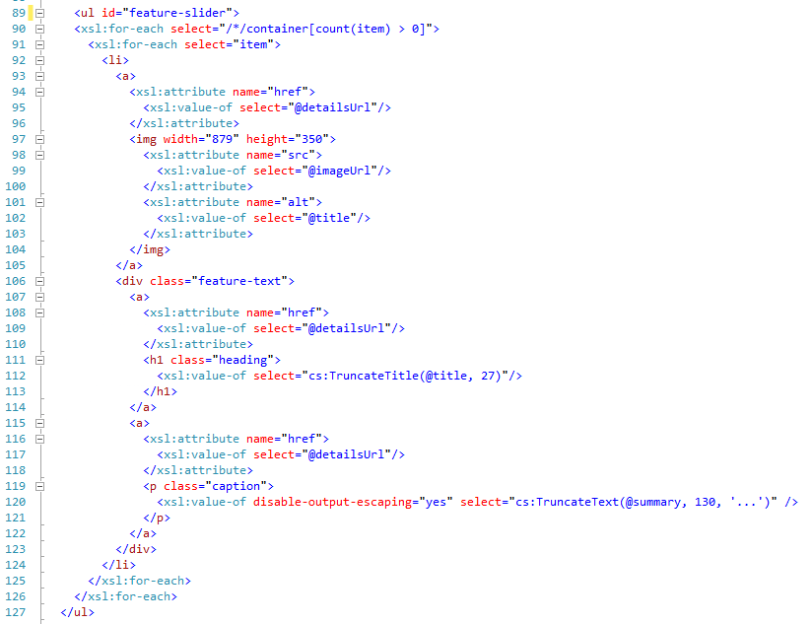
My XSLT (cont.)
Notes:
The main markup
Note: the calls to our C# functions
Note: The “disable-output-escaping” -- important if your content will include HTML

Slide 12
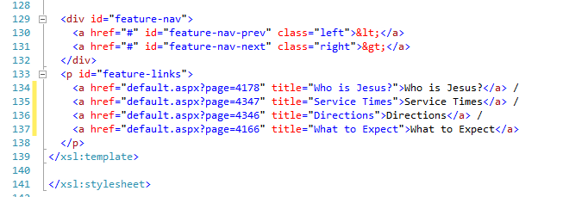
My XSLT (cont.)
Notes:
Outside our loops, the end of the markup -- the footer

Slide 13
Module’s XML Output
<arenapromotions> <container> <item id="[ID]" topic="[the TopicArea value]" title="[the Promotion's title]" summary="[the Promotion's web summary]" imageUrl="[the URL to the web summary image or document type image via CachedBlob]" detailsUrl="[the URL of the Promotion's external URL (if any), event details page, or promotion details page]" /> <item /> <item /> <item /> </container> </arenapromotions>
(If you’re writing your own XSL, this is all you need to worry about )
Notes:
If you’re writing your own XSL, this is all you need to worry about.

Slide 14
this slide intentionally left blank

Slide 15
Contribute
Now that we have a true shared repository…
It’s our intention to begin donating certain modules to the RC community so that you guys can edit, add features, fix bugs, etc.
Notes:
The END

Slide 16
One More Thing…

Slide 17
Promotions Via WS was Born
Needed a way to fetch promotions via AJAX
Wrote a jQuery plug-in with a Module interface
Fetches via WS webservices/custom/cccev/web2/promotionservice.asmx
Fetch in response to “CAMPUS_UPDATED” event
Module uses micro-templating (type=text/html) http://ejohn.org/blog/javascript-micro-templating/

Slide 18
Recall: Event Pooling
CALENDAR_INFO_CHANGED : triggered by a component when filters or other input utilized by a calendar are changed.
CALENDAR_VIEW_CHANGED : Indicates that a calendar view has changed. This is triggered by a calendar view module.
CAMPUS_UPDATED : Indicates that a person's selected campus has been changed (completed).
CAMPUS_UPDATING : Indicates that a person's selected campus is being changed. This is triggered by a component responsible for changing and/or recording a change with a person's selected campus.
CONTENT_RENDERED : Indicates that page content has changed and is ready for post processing. For example, this event would typically be bound to a cufon type module that needs to update the font canvas.
TOPICS_UPDATED : Indicates that a person's selected Arena Topic Areas has been changed (completed). This is triggered by a component responsible for changing and/or recording a change with a person's preferred topics.
TOPICS_UPDATING : Indicates that a person's selected campus is being changed. This is triggered by a component responsible for changing and/or recording a change with a person's selected campus.
USER_LOGGED_IN : Indicates that a person's has completed logging into the site.
Note: The "*_UPDATING" events are useful for binding to when you wish to fade out or hide some content area that is being changed in order to give the viewer a visual clue that some action is going to have an effect on .

Slide 19
John Resig’s JS Micro Templating
<script type="text/html" id="promotion-template">
<li>
<a href="{%= detailsUrl %}">
<img height="350" width="653" alt="{%= title %}" src="{%= imageUrl %}">
</a>
<div class="feature-text">
<a href="{%= detailsUrl %}">
<h1 class="heading">{%= title %}</h1>
</a>
<a href="{%= detailsUrl %}">
<p class="caption">{%= summary %}</p>
</a>
</div>
</li>
</script>
my JSON array
$("#promotion-template").render( promotions ).appendTo( aPlaceholderElem );
Notes:
A quick primer on JS Micro Templating…
This goes in the page head as <script type=“text/html”…>
Later, you bind some results data (JSON) to the template
And stuff the results into some placeholder in your markup body

Slide 20
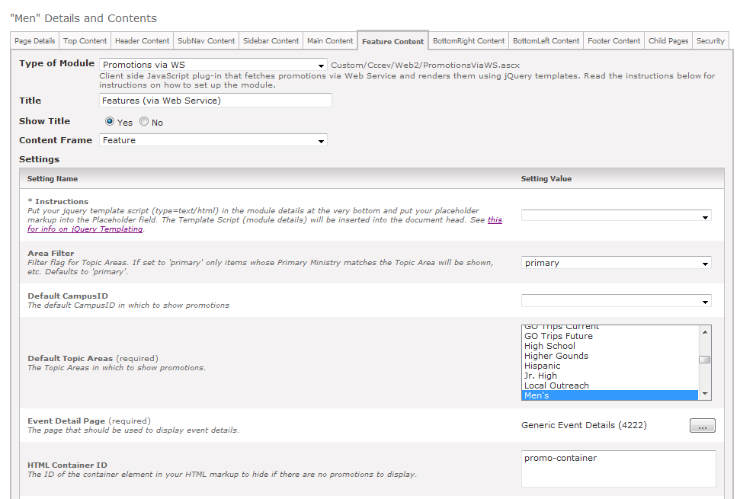
via the Module & it’s Settings
module settings

Slide 21
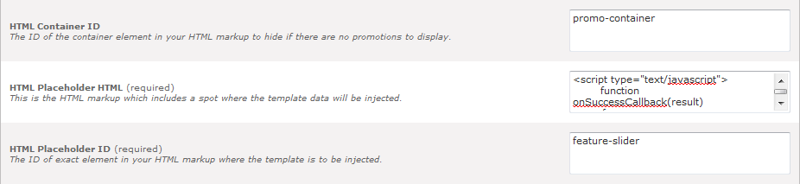
module settings (cont.)
<script type="text/javascript">
function onSuccessCallback(result)
{
$("#feature-nav-prev").unbind('click');
$("#feature-nav-next").unbind('click');
$("#feature").featureShow({
prevId: 'feature-nav-prev',
nextId: 'feature-nav-next',
auto: true,
continuous: true,
speed: 2000,
pause: 9000,
textMaxWidth: 500
});
}
</script>
<div id="promo-container" style="display:none">
<div id="feature">
<ul id="feature-slider"></ul>
</div>
<div id="feature-nav">
<a href="#" id="feature-nav-prev">&lt;</a>
<a href="#" id="feature-nav-next">&gt;</a>
</div>
</div>

Slide 22
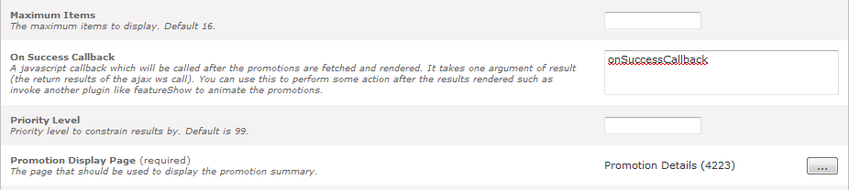
module settings (cont.)
You can define an On Success Callback which will be called after the results are rendered
Notes:
In my example, I’m using this to rebind my jQuery slideshow plug-in to the

Slide 23
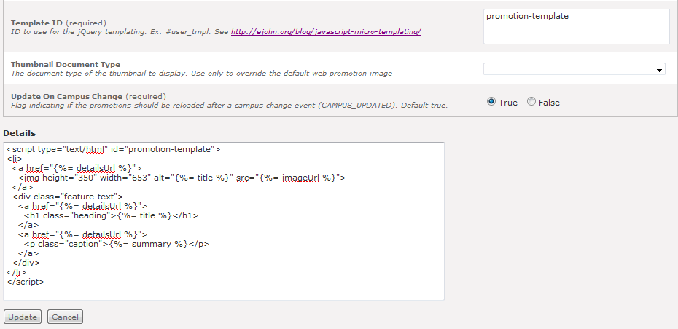
module settings (cont.)
Your micro-template goes into the module details section
Notes:
In my example, I’m using this to rebind my jQuery slideshow plug-in to the

Slide 24
included in jQuery 1.5 core
Oct 4th, MS Templates plugin officially accepted
But will be included in upcoming 1.5 core
Templating syntax is slightly different: <script id="movieTemplate" type="text/x-jquery-tmpl"> {{tmpl "summaryTemplate"}} <tr><td>Director: ${Director}</td></tr> </script>

Slide 25
A Random tip
And now for something completely different…

Slide 26
Hacking Admin Modules ™
Add this inside your standard UserControls/Admin/moduleinstancelist.ascx
<script type="text/javascript" src="Custom/Cccev/js/autoresize.jquery.min.js"></script>
<script type="text/javascript">
$(document).ready(function()
{
$("[id$='tbDetails']").autoResize({
// On resize:
onResize : function() {
$(this).css({opacity:0.8});
},
// After resize:
animateCallback : function() {
$(this).css({opacity:1});
},
// Quite slow animation:
animateDuration : 300,
// More extra space:
extraSpace : 20
});
$("[id$='tbDetails']").focus(function()
{
$("[id$='tbDetails']").attr('Rows', 20 ); // set to 20 rows at first
});
});
</script>
* in your swag bag

Slide 27
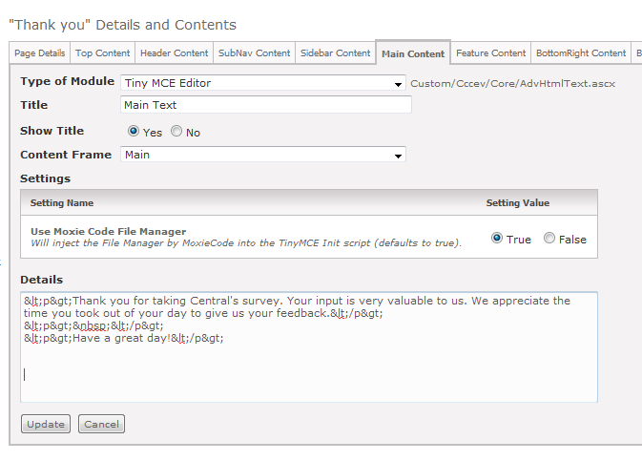
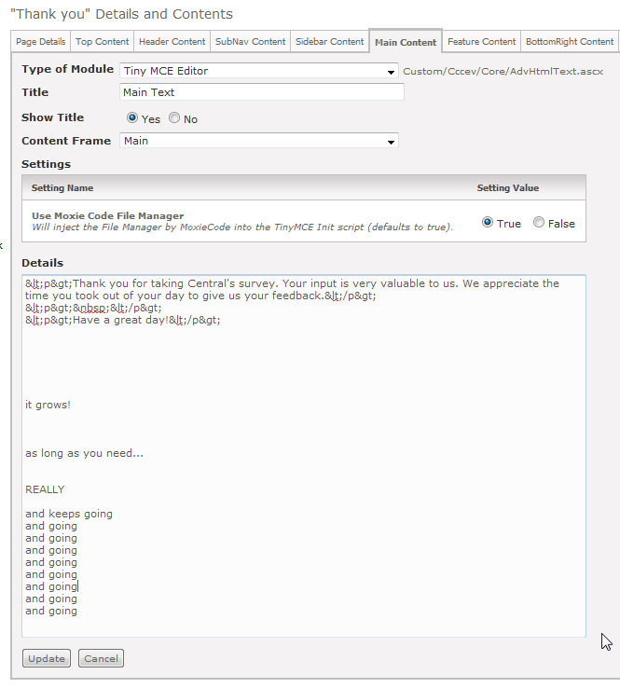
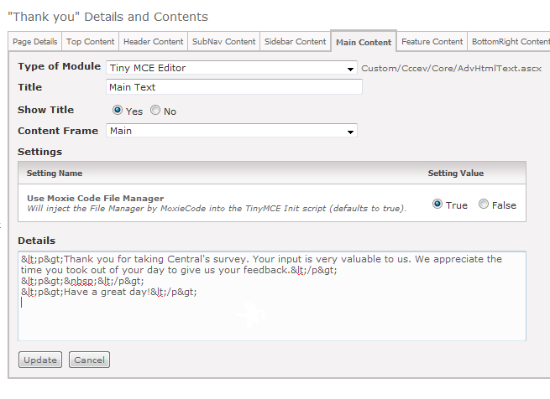
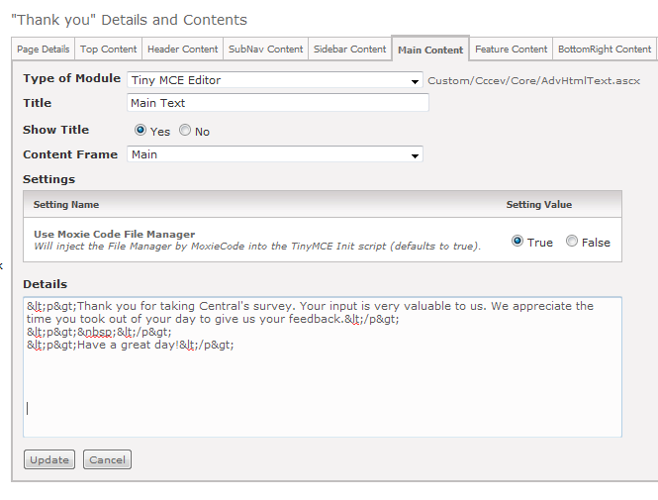
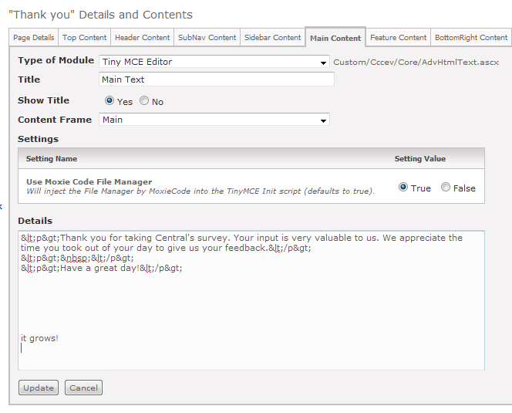
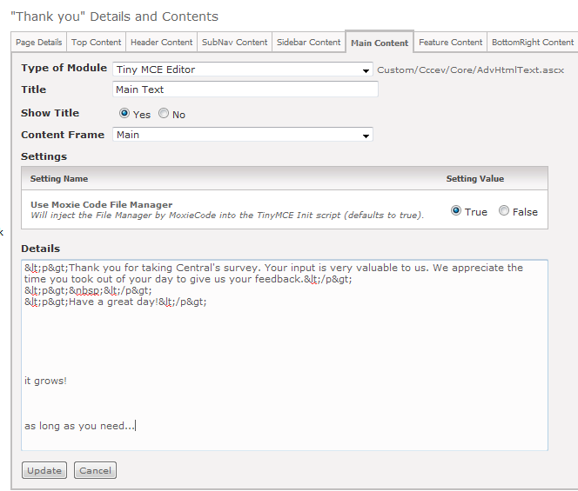
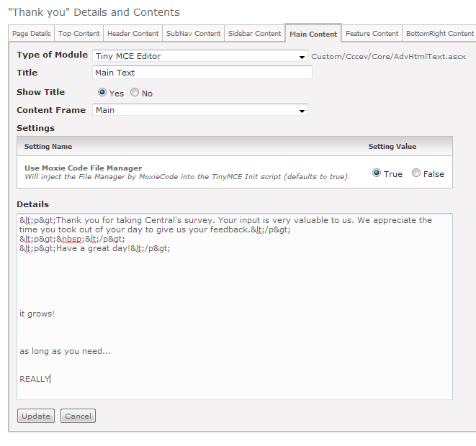
Hacking Admin Modules ™
To get a auto resizing Module Details textbox:

Slide 28
References
Image Effects http://community.arenachms.com/files/folders/documents/entry176.aspx
jQuery Templates http://api.jquery.com/category/plugins/templates/

