Slide 1
Custom Module Architecture
And now for something completely different…

Slide 2
Development Limitations
Limitations that make TDD with Arena more difficult
Data layer is often tightly coupled to the entity model
UI code (ascx code-behind files) often contains business logic

Slide 3
Arena’s Flexibility
The great thing about Arena as a development platform is that we can deviate from the Arena standard and implement more modern patterns with little risk.

Slide 4
Making Arena More MVC
Working with ASP.NET MVC inspired me a bit to add better separation of concerns and DRY (Don’t Repeat Yourself) principles into my Arena development
Implementing an MVC-like approach to Arena module development just requires a couple new classes and different pattern

Slide 5
Core Principles
Fat Models, Skinny Controllers
Move all of your business logic lower in the abstraction tree, farther away from the UI and controllers.
UI should only manage presenting information to the user.
Controllers should only manage the flow of the application.
Dependency Inversion to allow for TDD
Flipping the relationship between the application logic and the data access code (controller has a reference to repository, rather than data access code being referenced by the entity model directly). This allows us to test components independently.

Slide 6
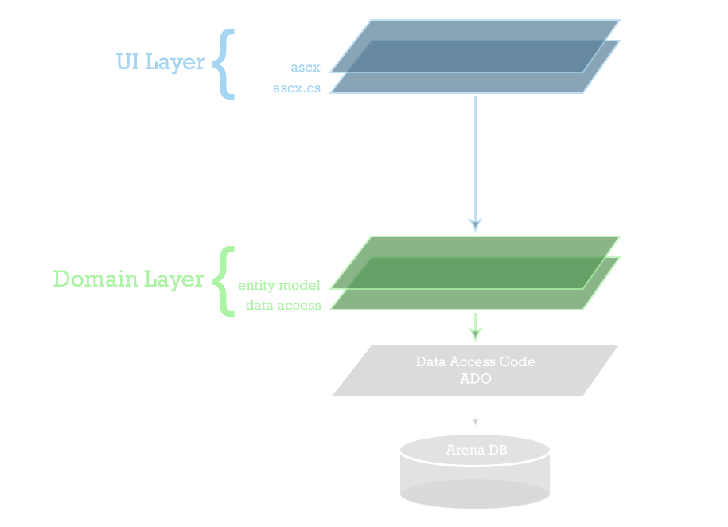
Notes:
While in the UI layer technically, the ascx.cs file encompasses much of the application logic. Occasionally, the ascx.cs file will directly reference data access code to populate databound user controls.
Tightly coupling the entity to the data layer locks us into a single implementation for data access.
While this implementation is simple and gets the job done very well, it limits what we can do if we want to bring TDD into Arena.

Slide 7
Simplicity vs Flexibility
The traditional approach to Arena module development is fairly simple. However, this simplicity comes at a price, since can be less testable and reusable.
With a little added complexity in our architecture, we can gain a lot of flexibility in terms of TDD and code reuse.

Slide 8
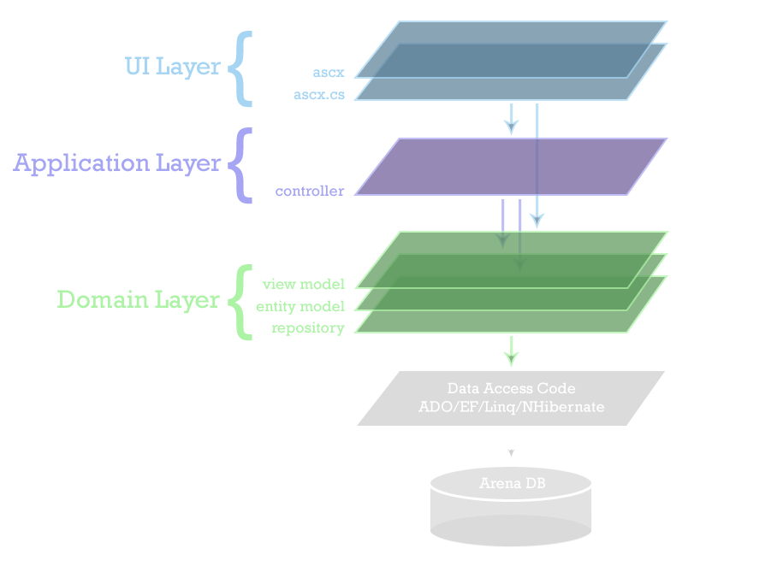
Notes:
With the addition of a controller class to manage all the application logic, we gain portability in that we can expose the underlying functionality in more than one way (web pages, web service api, thick clients, etc).
Addition of View Model class keeps the UI separated from the underlying business logic. It has access to the data resulting from the underlying code execution.
The use of a repository for data access code that is completely decoupled from the entity allows us to invert our dependency and push a reference to the repository up to the controller. This gives us the flexibility to write cleaner, more testable code. It also gives us the ability to easily swap out data providers and data access techniques.

Slide 9
What the…?
Show me some code!

