Slide 1
“CSS Hacks”
Or Kung fu
Jeff Schinella
Web Guy
CCV
jeffschinella@ccvonline.com
Twitter: No thank you

Slide 2
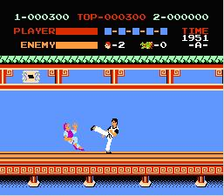
Why We Need Them
Notes:
Developers working with outside web designers. – multiple coders building
Class names/code not standardized.
Browsers don’t play nice
We wan visual consistency

Slide 3
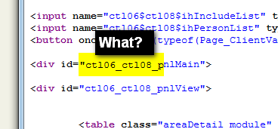
Why We Need Them
Notes:
Web forms can add unpredictable code

Slide 4
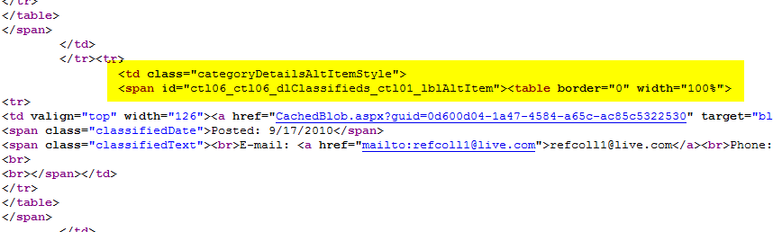
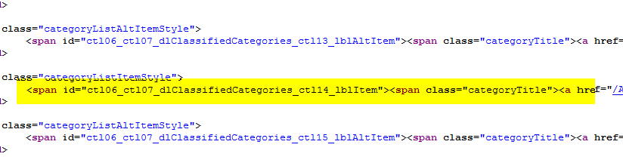
Why We Need Them
Notes:
The Spam/span tag
Class names and mark up aren’t always under our control.
CSS(2) doesn’t quite do what we want it to ALL of the time.

Slide 5
Examples

Slide 6
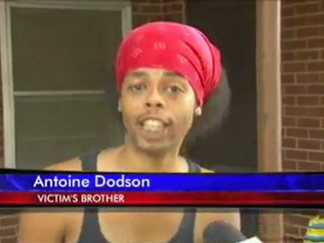

Examples
More !important than yo mama!
Notes:
Overrides inline styles!
Just watch over-use…can lead to css superiority complex.
Apply to items with specific class/id, not global selectors.
IE6 ignores, if you care.

Slide 7
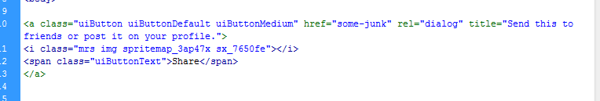
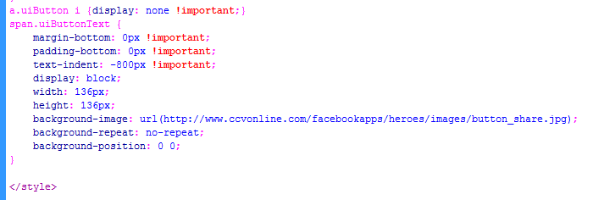
Examples
text-indent, you can eat your cake.
Notes:
Perfect for block elements using background image as graphic in restricted environments. Plugins, Facebook API, etc.
E.g. pagination links

Slide 8
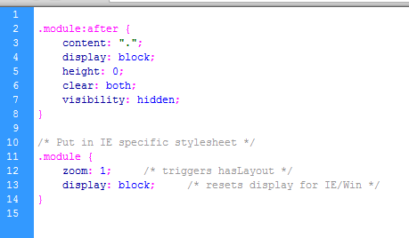
Examples
float your boat.
Notes:
Covers most browsers.
Use on global module class

Slide 9
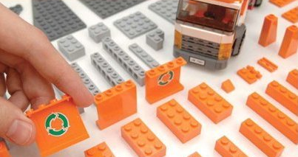
Examples
Have a global class for modules and other repeatable content types.
Notes:
Global class with default properties. (float clearing, etc) Does the work up front.
Time saver for rapid prototyping…you don’t want to waste time when you developing your functionality, that’s my job.

Slide 10
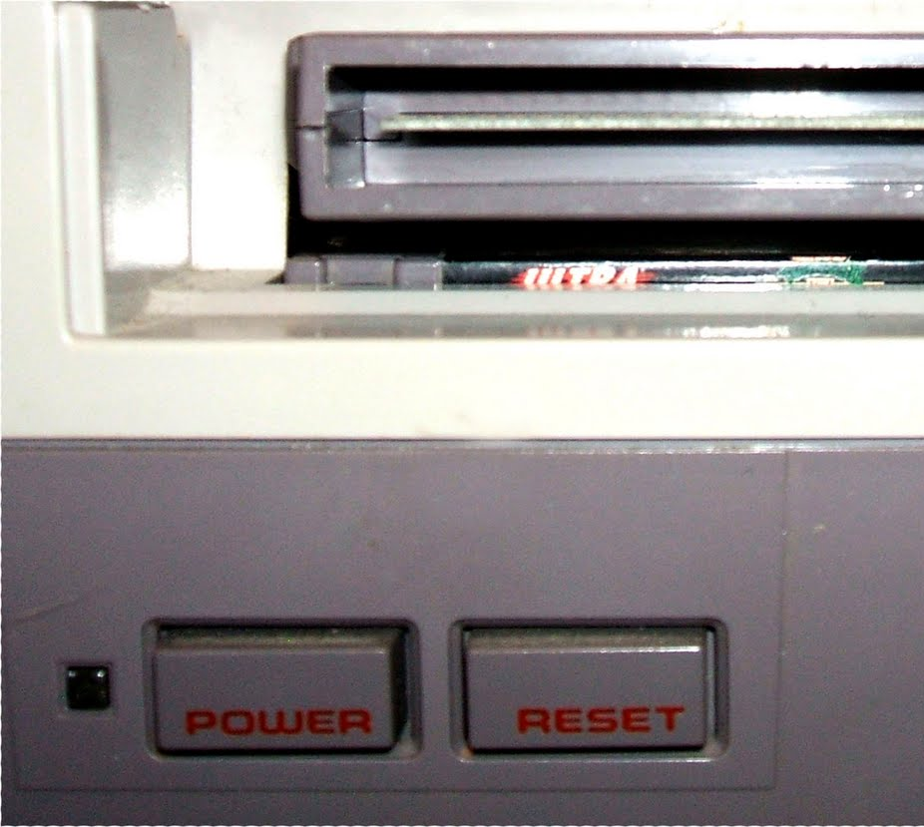
Examples
Notes:
Remove the browser rendering discrepancies.
Reset.css
Erik Meyer, Blueprint, Base CSS

Slide 11
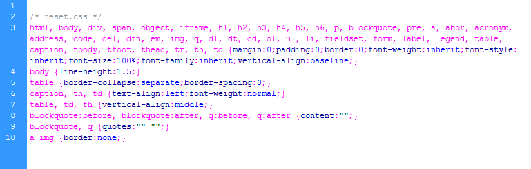
Examples
Notes:
Padding/margin reset, default line height, other global elements.

Slide 12

Examples
All in the family, Sibling & Child selectors
Notes:
All In The Family – Siblings and children

Slide 13
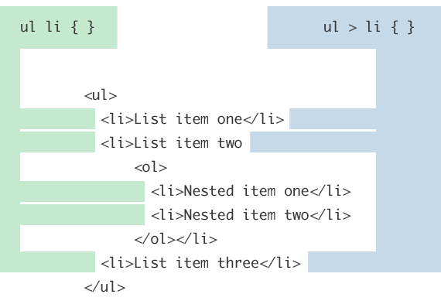
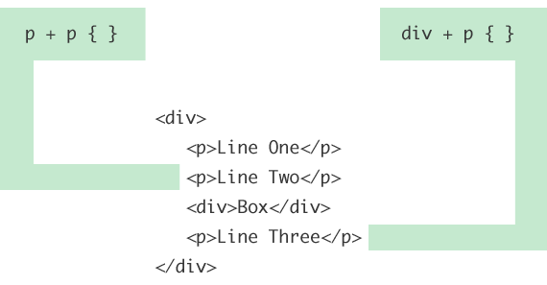
Examples
Notes:
All In The Family – Siblings and children
Child combinator
Adjacent Sibling

Slide 14
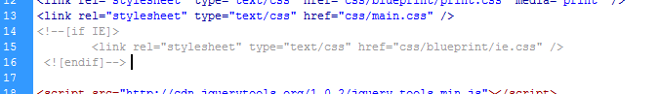
Examples
When all else fails – targeting browsers IE.

Slide 15

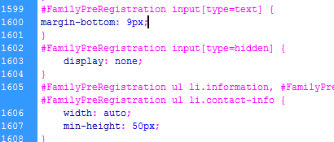
Examples
Notes:
Common use Attribute Selectors
input[type=text] { padding: 3px; } input[type=radio] { float: left; }

Slide 16




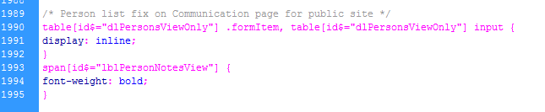
Examples
Notes:
Expressions

Slide 17
Questions & Discussion

