Slide 1
In Your Facebook
Jeff Schinella
Web Guy
CCV
jeffschinella@ccvonline.com
Twitter: No thank you
Notes:
Specifically what CCV has done and how. Mainly JavaScript/graph api integration.

Slide 2
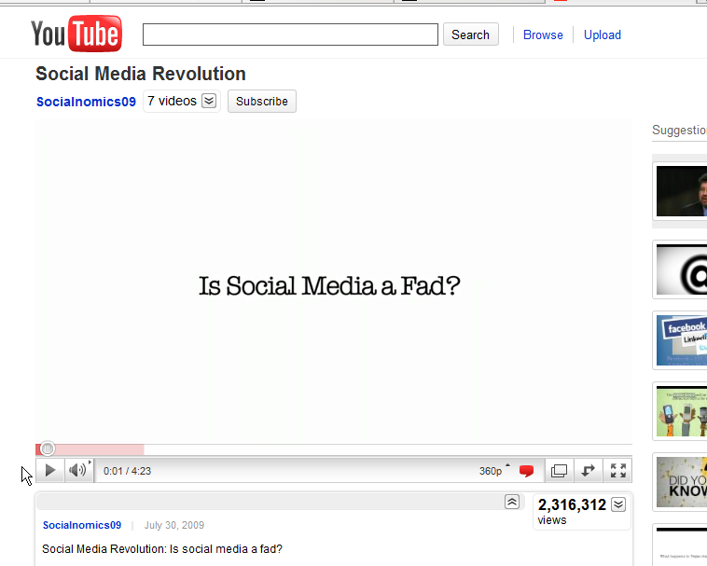
Why
Why CCV does it
Notes:
Social Media Revolution Video: http://www.youtube.com/watch?v=sIFYPQjYhv8
1/8 Couples married in U.S. (2008) met via social media.
Facebook would be the 4th largest country.
1.5 million content items shared daily.

Slide 3
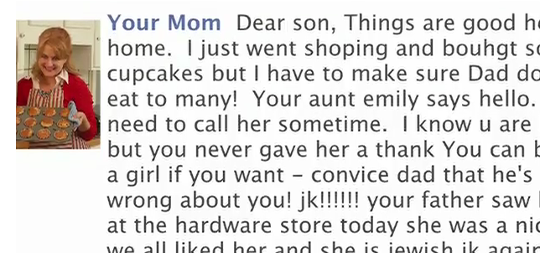
Why
Even your mom’s on Facebook.
Notes:
can provide the appearance of being personal.
Everyone's on it

Slide 4
Why
Fast & easy simple tools to connect.
Notes:
JavaScript/graph api
Why isn't it easy

Slide 5
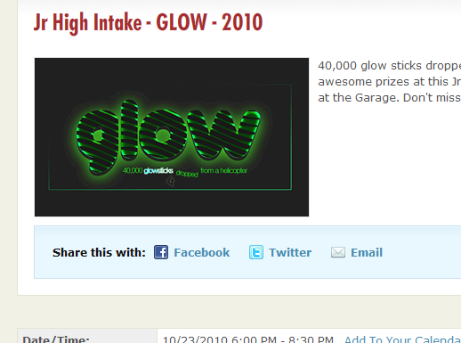
What
Notes:
Basic sharing – Arena Events, promotions
Staff profiles?
Registration completion?
Giving/donation on wall?
Other touch points

Slide 6
What
iamrevolutionary.org
Notes:
“application”
1st attempt beyond basic sharing.

Slide 7
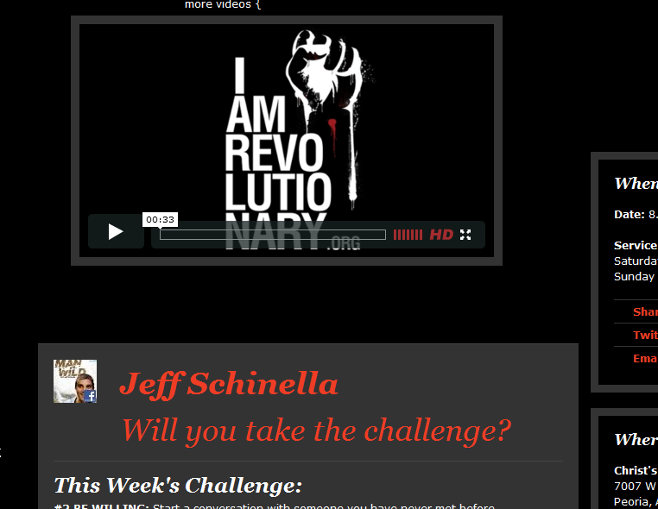
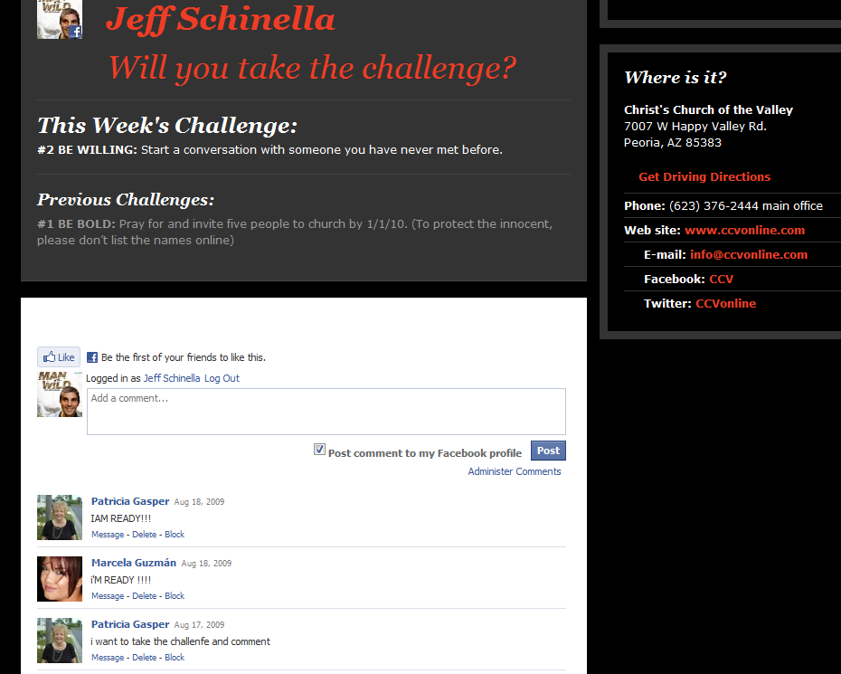
What
Notes:
User profile detection, personalization.
Commenting module.
Authentication request/default view.

Slide 8
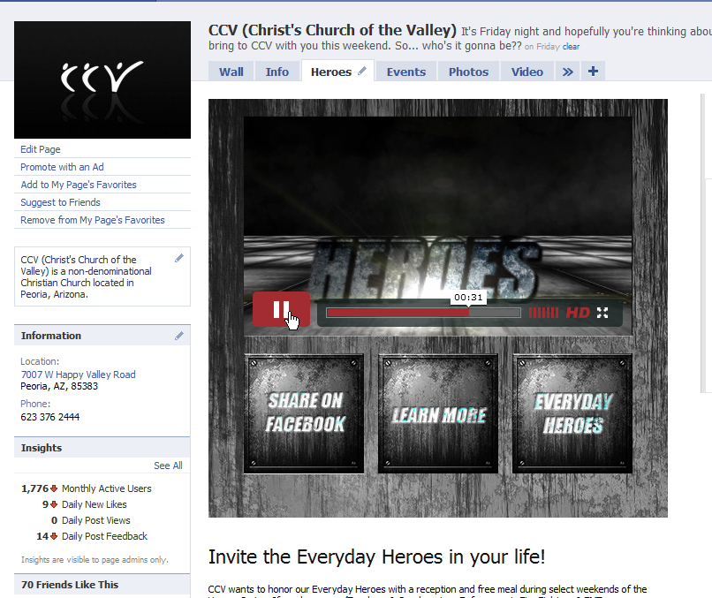
What
Facebook.com/ccvonline Tab application
Notes:
Tab application.
New visitors default view
Higher restrictions on tab application vs canvas.

Slide 9
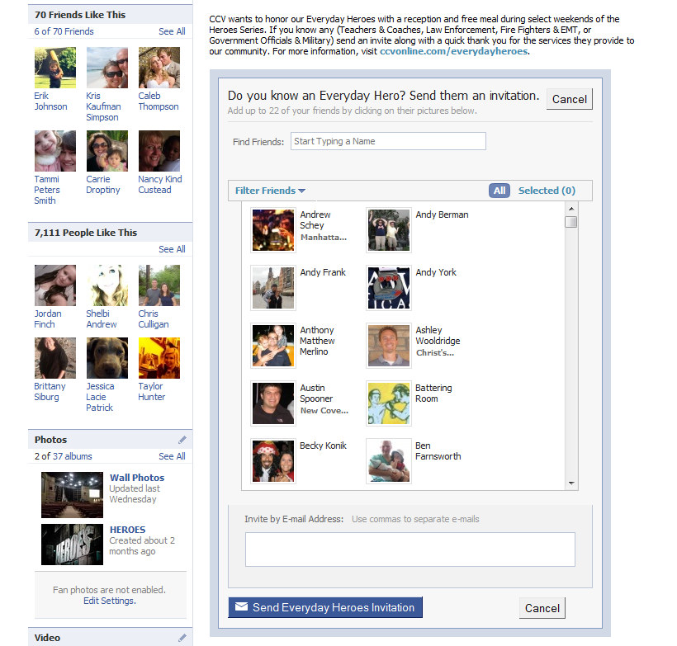
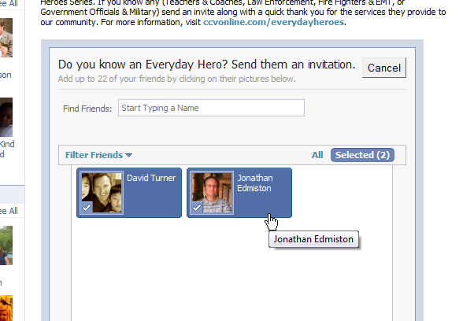
What
Notes:
Invitation form
Pulls friend list
Native to Facebook.

Slide 10
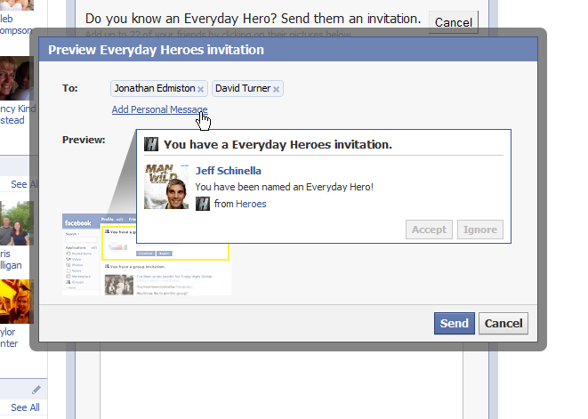
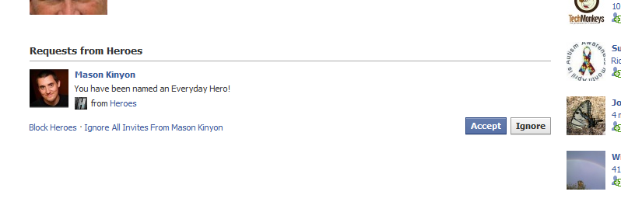
What
Notes:
Personal message
Request page/list on invitees profile.

Slide 11
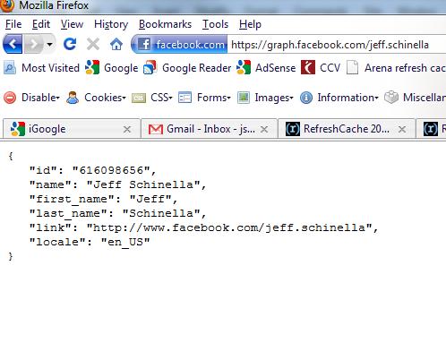
How
Graph.facebook.com/your.name
Notes:
Get App/dev key
JavaScript/Graph api
Privacy setting specific
?metadata=1 – get more links

Slide 12
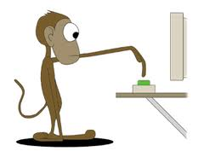
How
Notes:
Code demo/walkthrough. Hopefully, you didn’t forget to set up the apps/screens before starting the pres.

Slide 13
Questions
Notes:
Code demo

