Slide 1
Hack Night
let’s get ready to code
Nick Airdo
Señor Developer
Central Christian Church
Email: nick.airdo@cccev.com
Twitter: @airdo

Slide 2
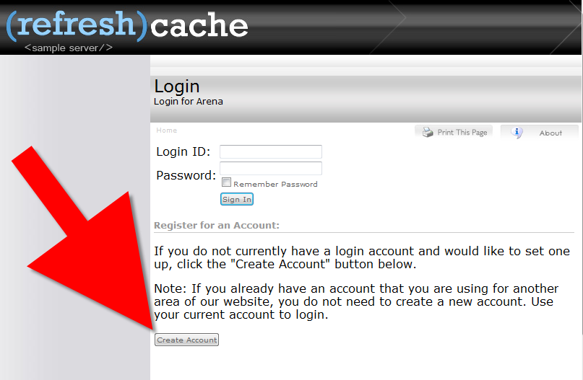
Create Account @ RefreshCache
http://arena.refreshcache.com

Slide 3
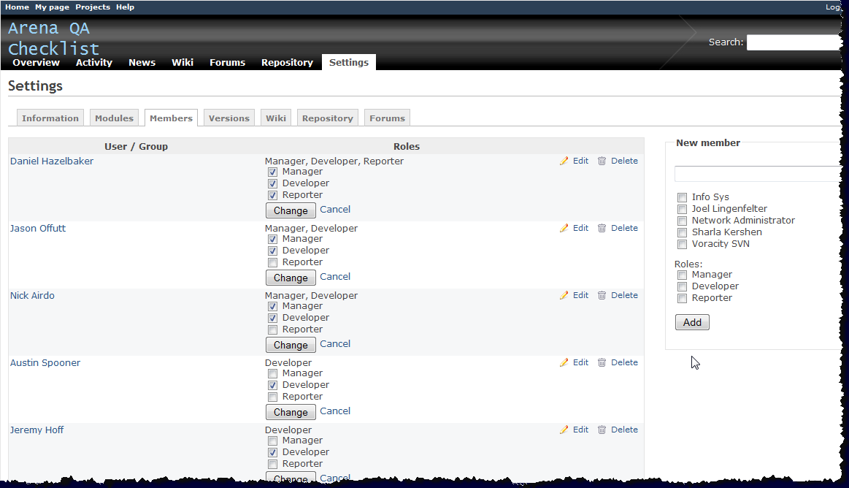
Project Mgr Tasks
Then I add you as a developer to the project

Slide 4

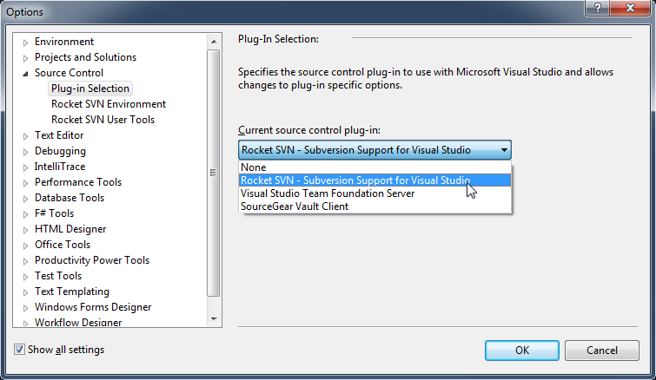
SubVersioN
Download & Install :
http://www.axosoft.com/rocketsvn
Configure VS: Tools->Options

Slide 5
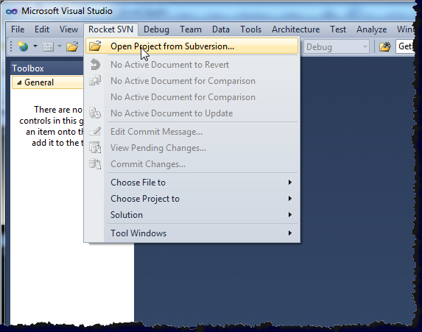
Fetch the Source
Open Project from Subversion…

Slide 6
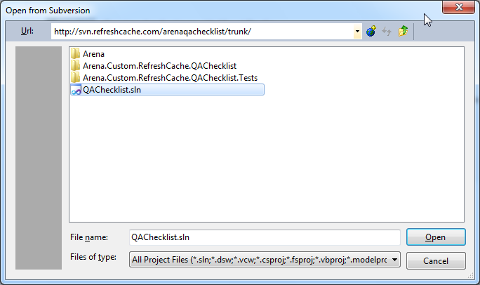
URL of repository:
http://svn.refreshcache.com/arenaqachecklist
Choose the solution file

Slide 7
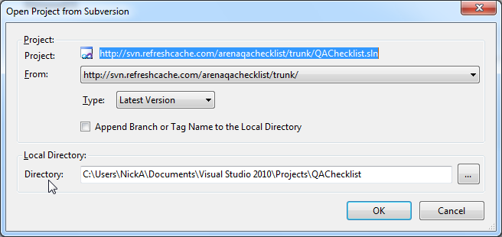
Almost Done
Set or use the default Local Directory value

Slide 8
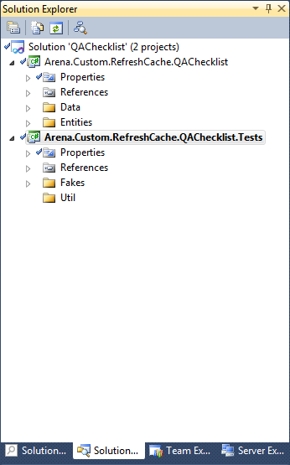
Done!
Your solution should now show the two projects as seen here

Slide 9
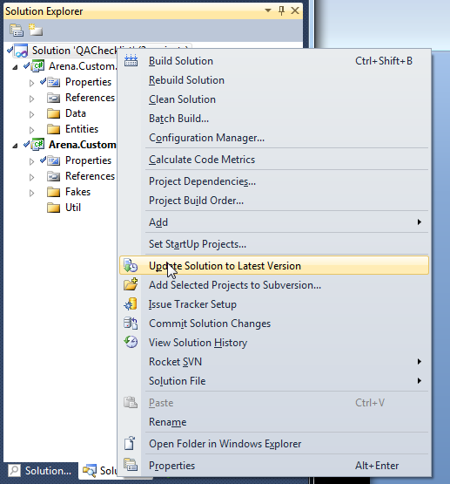
Next Time, To Get Latest…
Right-click solution
Choose “Update Solution to Latest Version”

Slide 10
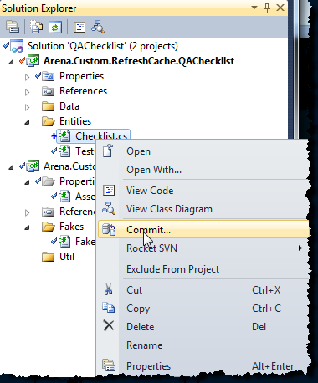
Commit Your Changes…
New classes and/or changes to existing

Slide 11
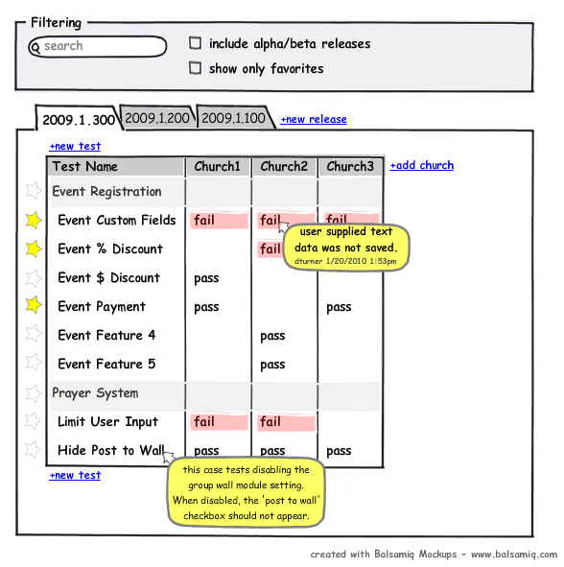
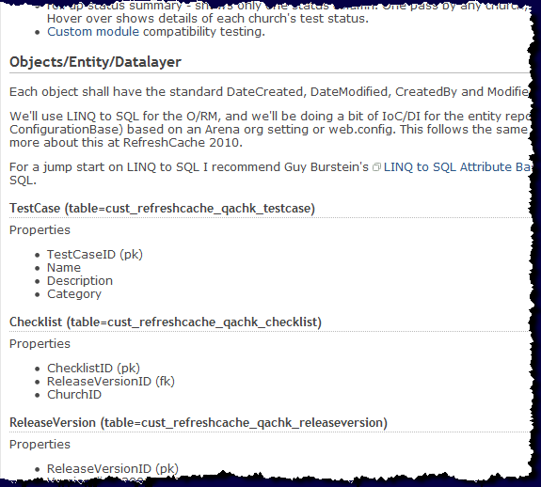
QA Checklist Wiki
For details on the project, classes, UI, etc: http://redmine.refreshcache.com/projects/arenaqachecklist/wiki

Slide 12
SVN, and our Suggestions
A little information about…

Slide 13
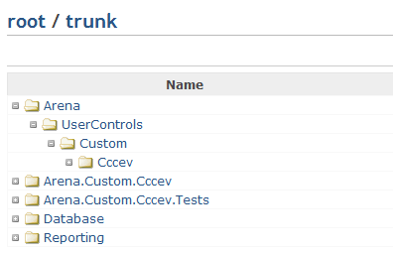
Suggested Trunk Structure
<ORGID>
<ORGID>
<ORGID>.Tests
Notes:
* In the future, when creating your own project in your own trunk, this is a suggested folder structure
* UserControls go under

Slide 14
What is Trunk, Branch, Tag
Trunk would be the main body of development, originating from the start of the project until the present.
Branch will be a copy of code derived from a certain point in the trunk that is used for applying major changes to the code while preserving the integrity of the code in the trunk. If the major changes work according to plan, they are usually merged back into the trunk.
Tag will be a point in time on the trunk or a branch that you wish to preserve. The two main reasons for preservation would be that either this is a major release of the software, whether alpha, beta, RC or RTM, or this is the most stable point of the software before major revisions on the trunk were applied.
The most voted/favored definitions as seen at StackOverflow

Slide 15
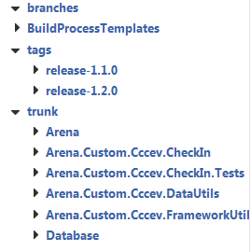
Example
full folder structure from another project

Slide 16
References
SVN Manual http://svnbook.red-bean.com/
Rocket SVN (SVN client for Visual Studio) http://www.axosoft.com/rocketsvn
Tortise SVN (SVN client for Windows shell extension) http://tortoisesvn.tigris.org/

