Slide 1
Test Driven Development
Arrange, Act, Assert… Awesome
Jason Offutt
Software Engineer
Central Christian Church
Email: jason.offutt@cccev.com
Twitter: @JasonOffutt
#RefreshCache

Slide 2
What is TDD?
It’s a development methodology
Write automated test cases to define what your code should be doing
Write/Refactor code to satisfy test requirements

Slide 3
How does it work?
Write test case first
Run test (should fail)
Write/Refactor code to satisfy test expectations
Run test again (should pass)
???
Profit

Slide 4
How does it work?
To run these automated tests, we need a test framework.
MS Test
Microsoft’s testing framework
Able to run tests from within Visual Studio’s GUI
Comes out of the box with Visual Studio (Professional or higher)
NUnit
Simpler/Cleaner syntax than MS Test
Comes with it’s own client to run tests, just point it at an assembly
Free to download and use
3rd party tools like ReSharper allow NUnit tests to be executed directly in Visual Studio

Slide 5
Test First
The goal is to write test cases to define expectations on how our code should behave.
The result is that you end up with code that behaves in a predictable manner.
In the end, you’ll have an entire suite of tests to prove your code works “correctly”.
The first time we run a test, it should fail. We haven’t written any implementation to satisfy the test’s requirements yet.

Slide 6
What does a test look like?
[Test]
public void IsValid_Should_Return_True_When_Foo_Has_Name()
{
// Arrange
var foo = new Foo();
foo.Name = "Charlie";
// Act
var result = foo.IsValid;
// Assert
Assert.IsTrue(result);
}

Slide 7
What does a test look like?
Unit of code we’re testing
[Test]
public void IsValid_Should_Return_True_When_Foo_Has_Name()
{
// Arrange
var foo = new Foo();
foo.Name = "Charlie";
// Act
var result = foo.IsValid;
// Assert
Assert.IsTrue(result);
}
Expectations for our code
Single assert, single outcome for test

Slide 8
Tips for writing good unit tests
Each test should isolate a single unit of code
You usually don’t want to have more than one or two asserts per test.
If you have several assertions in your tests, you are probably testing more than one thing, and could break it out into more than one test.
Use “Arrange, Act, Assert” pattern to help keep your tests clean and simple
Verbose test method names can help you keep track of exactly what expectations you’re testing for

Slide 9
Implement
Now, we write the code to satisfy our test’s expectations
public class Foo
{
public string Name { get; set; }
public bool IsValid
{
get { return !string.IsNullOrEmpty(Name); }
}
}

Slide 10
Test Again
After implementing the test case’s requirements in our code, we run the test again.
It should pass this time.
Move on to the next test case.

Slide 11
Unit Tests vs Integration Tests
Integration Tests incorporate outside elements into testing (e.g. – databases, web services, etc).
Unit Tests should be designed to completely isolate your code from everything else.
Both are VERY valuable. If you can, do both.

Slide 12
Keeping Unit Tests Clean
To isolate our code, use Dependency Inversion to create a “seam” so we can inject a fake object.
public class FooController
{
private readonly IFooRepository repository;
public FooController() : this(new ArenaFooRepository()) { }
public FooController(IFooRepository repository)
{
this.repository = repository;
}
}

Slide 13
Keeping Unit Tests Clean
To isolate our code, use Dependency Inversion to create a “seam” so we can inject a fake object.
public interface IFooRepository
{
Foo GetFooByID(int id);
IEnumerable<Foo> GetFooList();
void Create(Foo foo);
void Delete(Foo foo);
void Save();
}

Slide 14
Keeping Unit Tests Clean
To isolate our code, use Dependency Inversion to create a “seam” so we can inject a fake object.
// Called from test code
// Pass fake repository class to simulate database
// Implements IFooRepository
var controller = new FooController(new FakeFooRepository());
// Called from production code
// Default constructor uses ArenaFooRepository object that knows about Arena DB
var controller = new FooController();

Slide 15
Types of Fake Objects
Stub
A simple fake object you could write by hand. Intended to fake a component (e.g. – act as a database/repository substitute).
Intended to be very simple.
Mock
Often generated by a framework like Rhino Mocks or Moq.
More robust than Stubs in that they can track what pieces of code from the object they’re faking are being used.
Suited well to faking more complex object structures (e.g. - HttpContext Request/Response).

Slide 16
But why go to all that trouble?
This approach allows us to test our code more thoroughly. We can test application components and layers independently from each other.
Test data access code (integration tests)
Test entities/domain layer (unit tests)
Test business/application logic layer (unit tests)

Slide 17
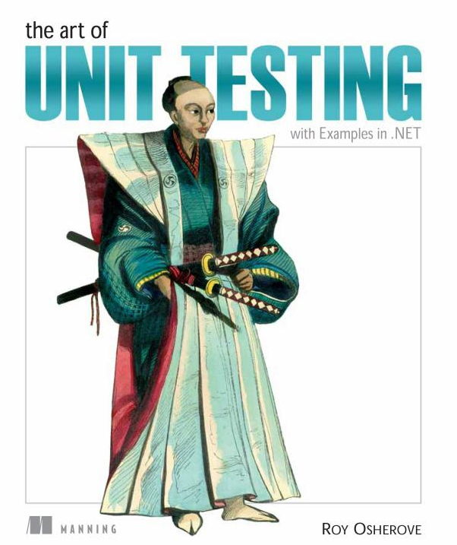
Resources
NUnit
Rhino Mocks
Moq
Tacky cover = good book

