Slide 1
JavaScript Tricks
Things you may not have
realized you could do
Nick Airdo
Señor Software Monkey
Central Christian Church (AZ)
Email: Nick.Airdo@centralAZ.com
Twitter: @airdo
Notes:
Just a few things to get you thinking…

Slide 2

Firebug
A must have Firefox plugin
http://getfirebug.com/

Slide 3
Adv Html Text
Add it to the page in question
P.S. Use the auto-resize trick from RC 2010…

Slide 4
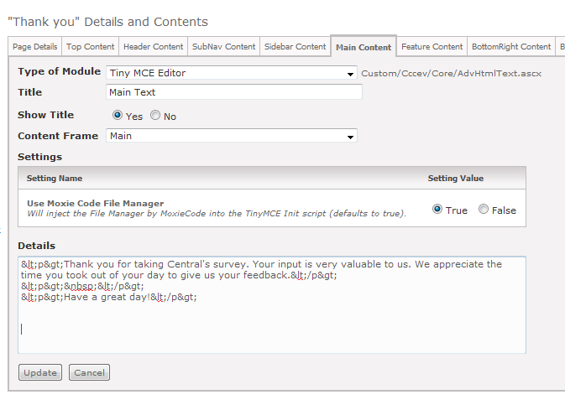
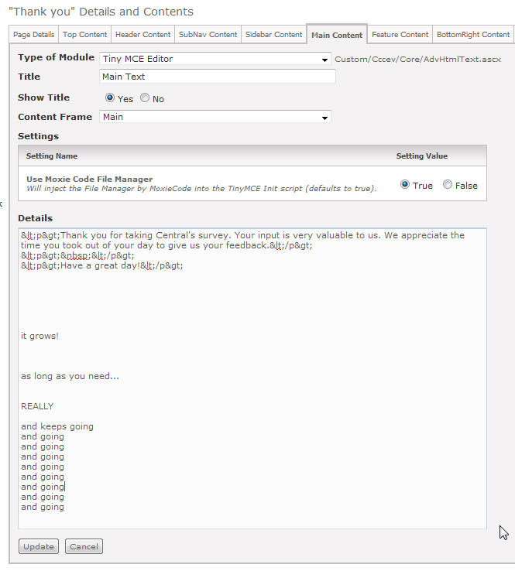
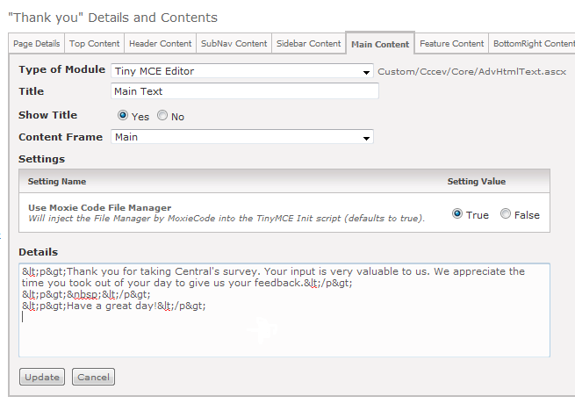
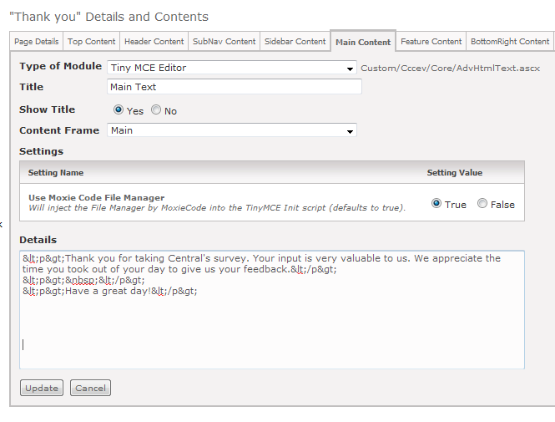
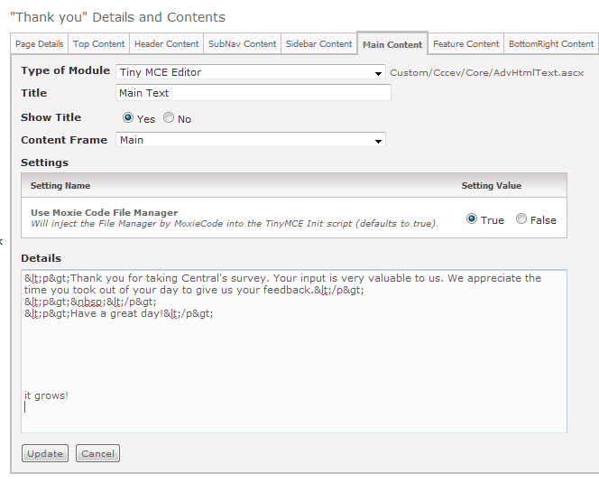
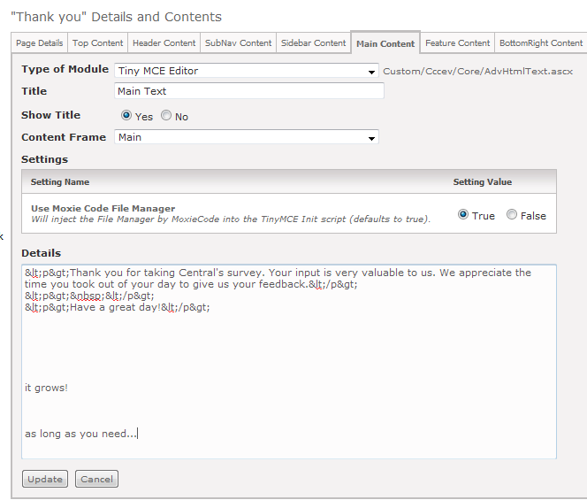
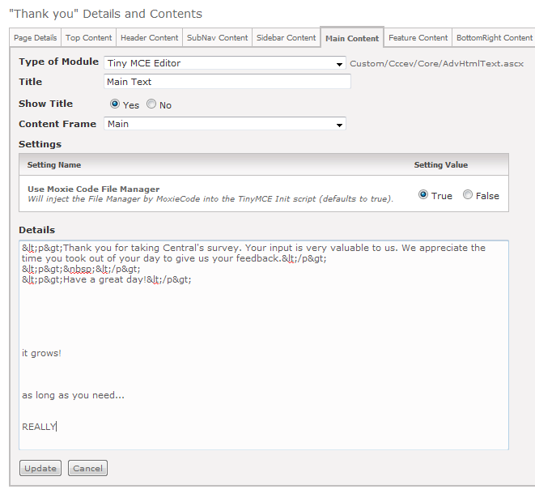
Hacking Admin Modules ™
To get a auto resizing Module Details textbox:
RC 2010

Slide 5
Hacking Admin Modules ™
Add this inside your standard UserControls/Admin/moduleinstancelist.ascx
RC 2010
<script type="text/javascript" src="Custom/Cccev/js/autoresize.jquery.min.js"></script>
<script type="text/javascript">
$(document).ready(function()
{
$("[id$='tbDetails']").autoResize({
// On resize:
onResize : function() {
$(this).css({opacity:0.8});
},
// After resize:
animateCallback : function() {
$(this).css({opacity:1});
},
// Quite slow animation:
animateDuration : 300,
// More extra space:
extraSpace : 20
});
$("[id$='tbDetails']").focus(function()
{
$("[id$='tbDetails']").attr('Rows', 20 ); // set to 20 rows at first
});
});
</script>
* in your swag bag
Notes:
Or add it to the page where that module lives.

Slide 6
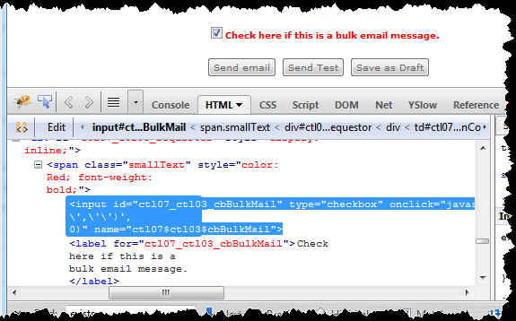
Auto Check Bulk Email
Page 21
Inspect Element
with Firebug to
find input control
ID
Notes:
Using Firebug, find the name of the input checkbox ID

Slide 7
Auto Check Bulk Email
Add this to the Adv Html Text module details on the “New Communication” page (21)
<script type="text/javascript">
$( function() {
var $cb = $('input[id$=_cbBulkMail]');
if ( $cb.length != 0 ) {
$cb.attr('checked','checked');
$cb.checked = true;
}
});
</script>
The last part of the ID
So I’m using the ends with selector

Slide 8
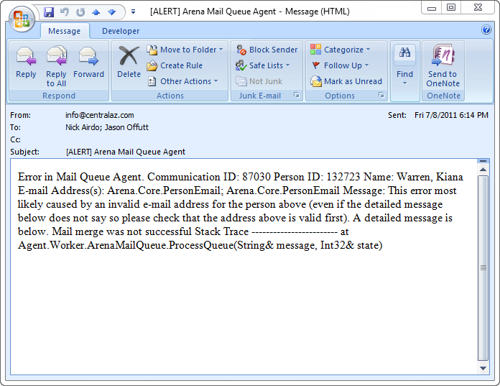
Email Validation
Tired of waiting for SCRUM to provide email address validation on event registration?

Slide 9
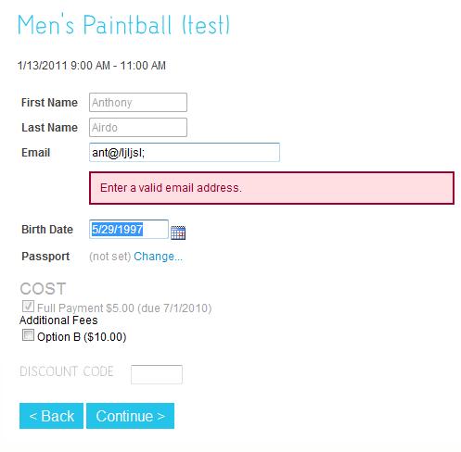
Wait No More!

Slide 10
This goes into an Adv Html Text module on “Event Registration Page 3”
<script type="text/javascript">
function validEmail() {
$email = $("input[id$=stdField_EM]");
if ( $email.length == 0 ) { return true; }
$(".error").hide();
var hasError = false;
var emailReg = /^([\w-\.]+@([\w-]+\.)+[\w-]{2,4})?$/;
if( $email.val() == '' ) {
$email.after('<span class="error">Please enter a valid address.</span>');
hasError = true;
}
else if( ! emailReg.test( $email.val() ) ) {
$email.after('<span class="error">Enter a valid email address.</span>');
hasError = true;
}
if( hasError == true ) { return false; }
}
.
.
.
First we’ll just define a validEmail checking function…
Feel free to remove this part if you don’t want to require it
Notes:
Add this on your Event Registration Page 3

Slide 11
.
.
.
$(document).ready( function() {
$('input[id$=stdField_EM]').blur(function() {
validEmail();
});
$('input[id$=btnNext]').click(function() {
if ( validEmail() == false ) {
alert( "Please enter a valid email address.");
$("input[id$=stdField_EM]").focus();
return false;
}
});
});
</script>
For when the user tabs out of the field…
For when the user tries to click to the “next” step…
Notes:
Add this on your Event Registration Page 3

Slide 12
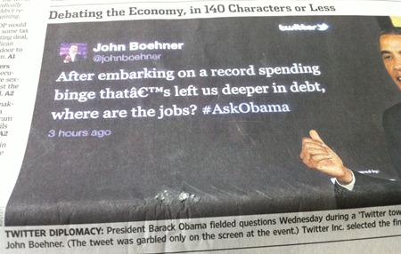

Been Burned?
Yeah, I’ve seen the â€™ bug in emails…

Slide 13
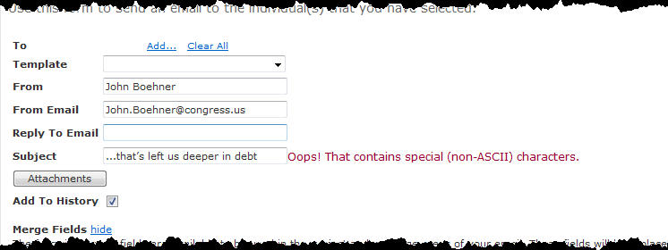
Woulda Shoulda Coulda
Notes:
On page 21

Slide 14
Put into an Adv Html Text module on New Communications (page 21)
<script type="text/javascript">
function hasNonAscii( $item ) {
var nonAscii = /[^\u0000-\u007F]/;
if( nonAscii.test( $item.val() ) ) {
if ( $item.next(".error").length == 0 ) {
$item.after('<span class="error errorText"> Oops! That contains special (non-ASCII) characters.</span>');
}
} else {
$item.next(".error").remove();
}
}
$(document).ready( function() {
$('input[id$=_tbSubject]').blur(function() {
hasNonAscii( $(this) );
});
});
</script>
Any non-ascii character
“this” is the tag element but
“$(this)” is the jQuery object
Notes:
Add this on your Event Registration Page 3

Slide 15
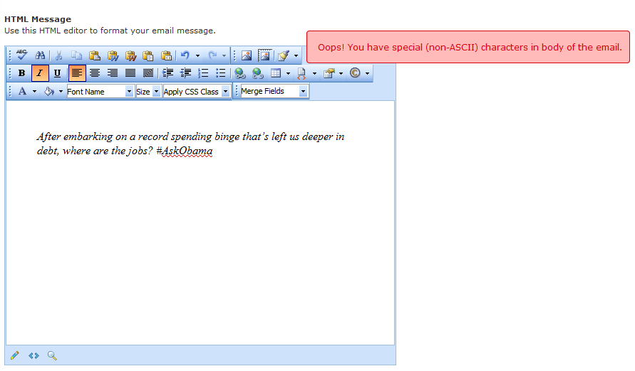
And the body…

Slide 16
…trickier because of the RAD Editor
I had to dig around over in Telerik’s old documentation
  http://www.telerik.com/help/aspnet/editor/gethtml.html
We’ll also be editing the mailmerge.ascx directly (not ideal)… but hey, at least you can!

Slide 17
NOTE: Regarding editing .ascx
Not ideal!
First choice
  Make custom copy of .ascx but still have it extend the original .cs class. Ex:
  <%@ control language="c#" inherits="ArenaWeb.UserControls.MailMerge, Arena" %>
  Register in Arena as new module and use it where you used the original module.
Second choice, edit original but make a copy called *.ascx.cust for when you upgrade. (search for *.cust after upgrades and do diff/merge)

Slide 18
Inside the UserControls\mailmerge.ascx file
.
.
.
<radE:RadEditor OnClientLoad="OnClientLoad" ID="radEditor“ …
.
.
.
Had to jam this in there
Notes:
This part could probably go anywhere, but why would you?

Slide 19
Inside the UserControls\mailmerge.ascx file
<script type="text/javascript">
var $errorArea = $("div[id$=_pnlHtmlMessage] > div:nth-child(1)");
var nonAscii = /[^\u0000-\u007F]/;
var errorsDetected = false;
function OnClientLoad(editor) {
editor.AttachEventHandler("onkeyup", function() {
if( nonAscii.test( editor.GetText(false) ) ) {
if ( ! errorsDetected ) {
errorsDetected = true;
$errorArea.after('<span class="error errorText" style="float: right"> Oops! You have special (non-ASCII) characters in body of the email.</span>');
$errorArea.next(".error").hide().show('slide', {direction: 'right'}, 500);
}
} else {
errorsDetected = false;
$errorArea.next(".error").fadeOut(500, function(){ $errorArea.next(".error").remove(); });
}
});
}
</script>
Here’s our function
Just a little flair
Notes:
This part could probably go anywhere, but why would you?

Slide 20
Inside the UserControls\mailmerge.ascx file
<style type="text/css">
.info, .success, .warning, .error
{
border: 1px solid;
margin: 10px 0px;
padding:15px 10px 15px 15px;
background-repeat: no-repeat;
background-position: 10px center;
-moz-border-radius: 4px;
}
.error
{
color: #D8000C;
background-color: #FFBABA;
}
</style>
Just some styling.
P.S. we should try to get Arena to add these** common styles into the main arenaBasic.css
**Adapted from http://css.dzone.com/news/css-message-boxes-different-me
Notes:
This part could probably go anywhere, but why would you?

