Slide 1
NuGet
THE Open Source Package Management System for .NET
Nick Airdo
Community Developer Advocate
Central Christian Church AZ (cccev)
Nick.Airdo@CentralAZ.com
@airdo

Slide 2
What Is NuGet?
“NuGet is a Visual Studio extension that makes it easy to install and update open source libraries and tools in Visual Studio.”
Can copy library files, source, add references, change config files, etc.

Slide 3
So What?

Slide 4
I’ll tell you…

Slide 5
Ever Hear of CPAN?
The Comprehensive Perl Archive Network
Called Perl’s “killer app”.
Was a game changer
Caused an explosion in the Perl world
Bottom line:
Made development faster & easier
Made modules shareable & discoverable

Slide 6
Others
JSAN http://openjsan.org/about.html
RubyGems http://rubygems.org/gems
NPM (node) http://search.npmjs.org/
PyPI (Python) http://pypi.python.org/pypi
Notes:
NPM == Node Package Manager.

Slide 7
Some Package Management Systems
As of April 2011
System | # of modules
CPAN | 91,968
RubyGems | 22,437
PyPI | 14,000
NPM | 1,533
NuGet | 1,080
PEAR | 568
* From Remi Taylor’s 2011 DCC presentation
Notes:
NuGet had 147 on Dec 1st.

Slide 8
Some Package Management Systems
As of Sept 2011
System | # of modules
CPAN | 99,741
RubyGems | 28,542
PyPI | 16,739
NPM | 3,987
NuGet | 2,930
PEAR | 570
* As of 9/20/2011

Slide 9
Growth!
Released January 13th of this year!
That’s nearly 3X more packages since April
Number of packages obtained via NuGet is incredible. Top four:
EntityFramework 81,661
jQuery 57,391
WebActivator 47,682
NUnit 34,180
http://nuget.org/List/Packages
* As of 9/20/2011

Slide 10
#3, WebActivator
A NuGet package that allows other packages to execute some startup code in web apps

Slide 11
NuGet Futures
“Streamlined package creation/deployment inside and outside of Visual Studio” *
Database migrations
* http://nuget.codeplex.com/wikipage?title=Specs

Slide 12
Could solve a problem…
Self updating modules, website, module gallery
Idea comes from Phil Haack: http://haacked.com/archive/2011/01/15/building-a-self-updating-site-using-nuget.aspx

Slide 13
Demo
(after these next two slides)

Slide 14

First, NuGet Command Line
Why?
You are hardcore
You like pain
You’re integrating building packages into your build system
You can use the NuGet Package Explorer
But, to each his own…
http://docs.nuget.org/docs/creating-packages/creating-and-publishing-a-package

Slide 15
NuGet Package Explorer
One-click Install
http://nuget.codeplex.com/releases/59864/clickOnce/NuGetPackageExplorer.application
Also in your Swag-Bag

Slide 16
Demo

Slide 17
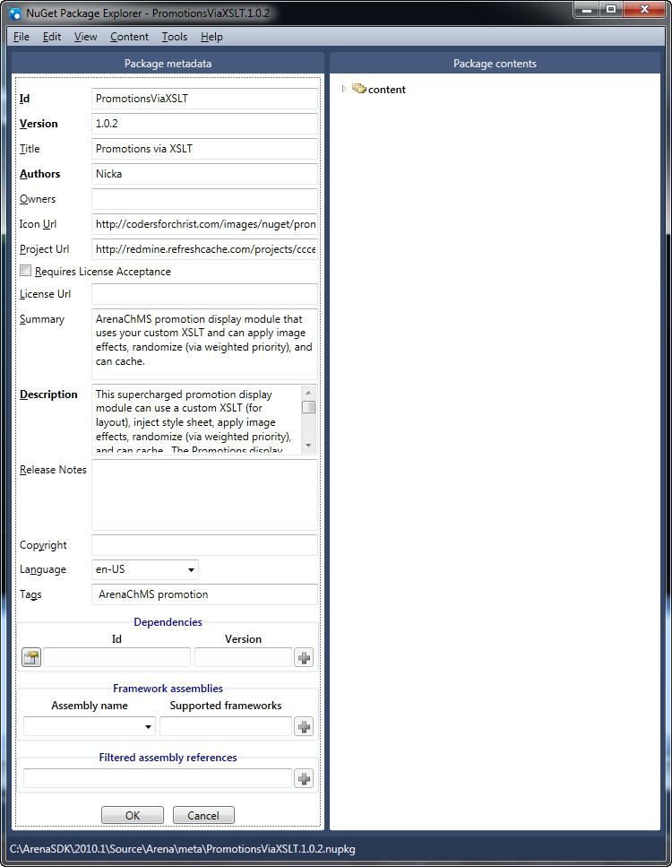
DEMO
Notes:
New Package,
Edit Package Metadata

Slide 18
DEMO

Slide 19
Recommed everyone use the following NuGet Tag Names:
ArenaChMS
RockBlock
DEMO
Notes:
Think of the Content folder as the root of your target application. For example, to add an image in the /images directory of the target application, make sure to place the image in the Content/images folder of the package.

Slide 20
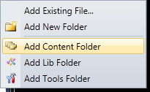
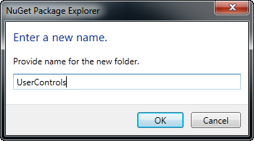
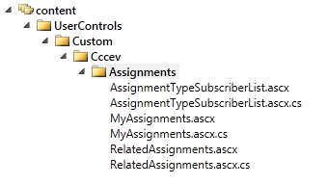
Add Content Folder
Add New Folder (under content)
Drag your module/block folder into your [Org] folder.
DEMO
Notes:
Think of the Content folder as the root of your target application. For example, to add an image in the /images directory of the target application, make sure to place the image in the Content/images folder of the package.

Slide 21
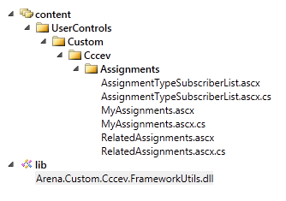
Drag any DLLs you reference in your module/block (it will prompt you and put them where they really go)
DEMO

Slide 22
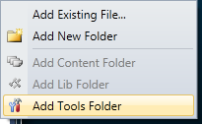
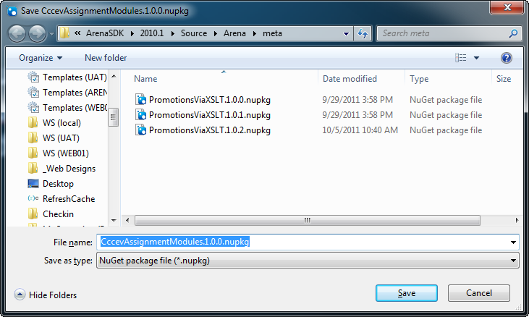
Add Tools Folder if you have powershell scripts you need executed upon install/uninstall
Save
& Save Metadata too
DEMO
Notes:
tools - The tools folder of a package is for powershell scripts and programs accessible from the Package Manager Console. After the folder is copied to the target project, it is added to the `$env:Path (PATH) environment variable.

Slide 23
*.nuspec file
<?xml version="1.0"?>
<package xmlns="http://schemas.microsoft.com/packaging/2010/07/nuspec.xsd">
<metadata>
<id>CccevAssignmentModules</id>
<version>1.0.0</version>
<title>Assignment Module Collection (Cccev)</title>
<authors>nicka</authors>
<owners />
<requireLicenseAcceptance>false</requireLicenseAcceptance>
<description>A collection of Assignment type modules for doing things like viewing the subscribers of an assignment type and an alternate MyAssignments module intended for use in a Arena Portal DockContainer module.</description>
<summary>This is a test</summary>
<language>es-US</language>
<tags>ArenaChMS</tags>
</metadata>
<files>
<file src="content\UserControls\Custom\Cccev\Assignments\AssignmentTypeSubscriberList.ascx" target="content\UserControls\Custom\Cccev\Assignments\AssignmentTypeSubscriberList.ascx" />
<file src="content\UserControls\Custom\Cccev\Assignments\AssignmentTypeSubscriberList.ascx.cs" target="content\UserControls\Custom\Cccev\Assignments\AssignmentTypeSubscriberList.ascx.cs" />
<file src="content\UserControls\Custom\Cccev\Assignments\MyAssignments.ascx" target="content\UserControls\Custom\Cccev\Assignments\MyAssignments.ascx" />
<file src="content\UserControls\Custom\Cccev\Assignments\MyAssignments.ascx.cs" target="content\UserControls\Custom\Cccev\Assignments\MyAssignments.ascx.cs" />
<file src="lib\Arena.Custom.Cccev.FrameworkUtils.dll" target="lib\Arena.Custom.Cccev.FrameworkUtils.dll" />
</files>
</package>
DEMO

Slide 24
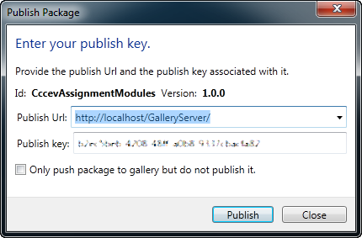
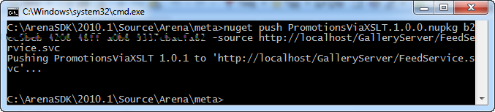
Publish Key
Get your Publish key from the NuGet Gallery server or other
Publish
Via GUI
Or via cmd line
Or via Gallery http://localhost/GalleryServer/upload/package
DEMO

Slide 25
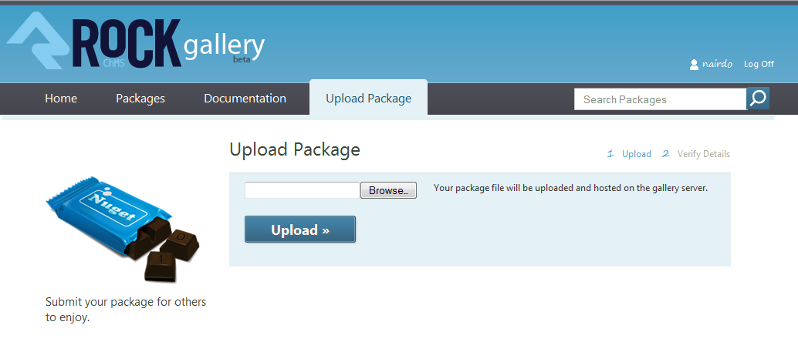
DEMO

Slide 26
Piece of freaking cake!
Couldn't be any easier
Now go see your published package
DEMO

Slide 27
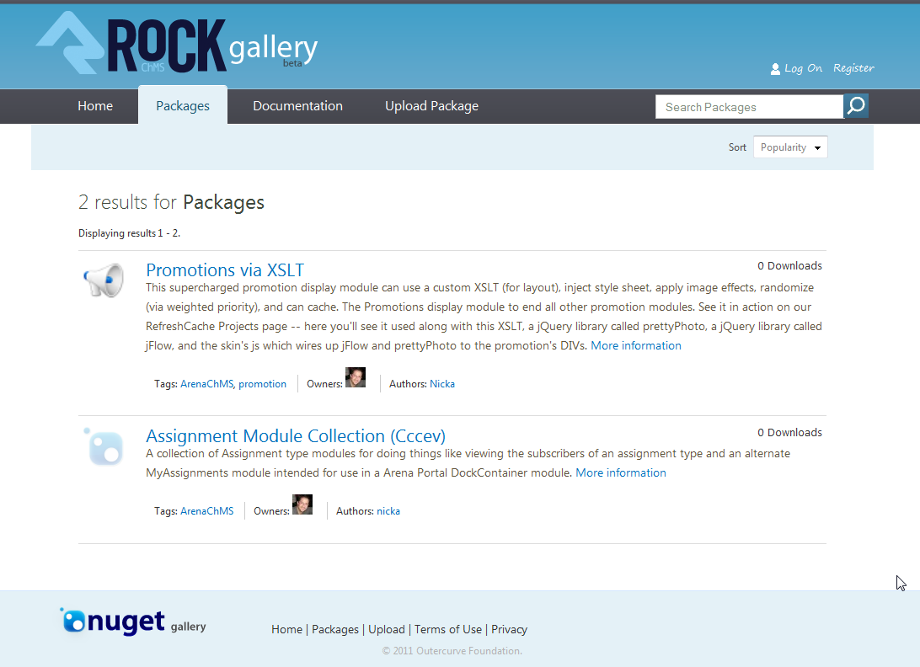
DEMO

Slide 28
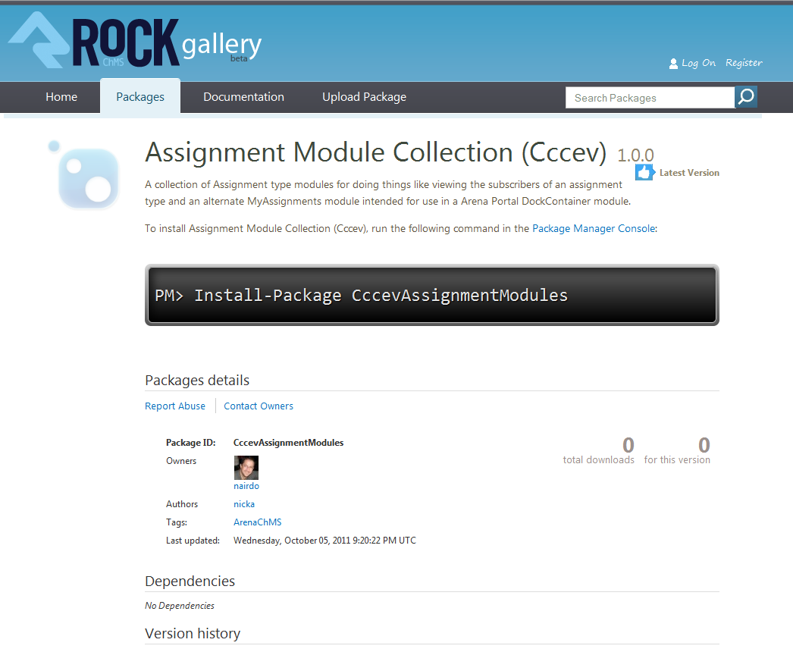
DEMO

Slide 29
Now the cool part…
Using Fabio Franzini’s work which used Phil Haack’s work…
DEMO

Slide 30
(open VS solution)
NuGet.Package.WebManager block and someday an Arena module
When Arena moves to .NET 4.0
DEMO

Slide 31
PackageSources.config
<sources>
<source url="http://refreshcache.com/nuget/nuget" displayname="RefreshCachePackages" filterpreferred="false" />
<source url="C:\Misc\NuGetGallery\Website\App_Data\Packages" displayname="RockChMS Blocks" filterpreferred="false" />
…
</sources>
DEMO

Slide 32
DEMO

Slide 33
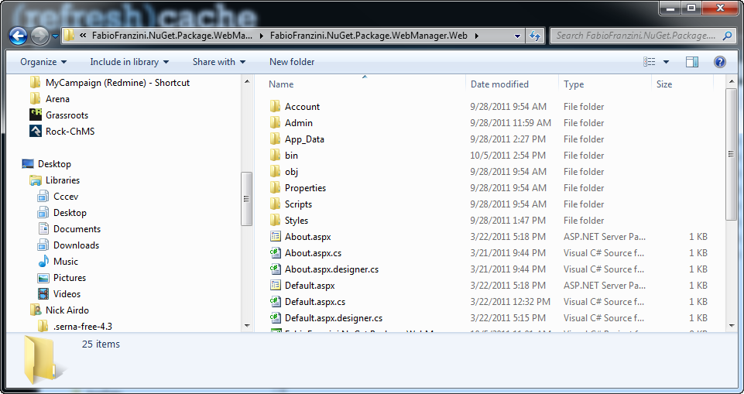
Before install
DEMO

Slide 34
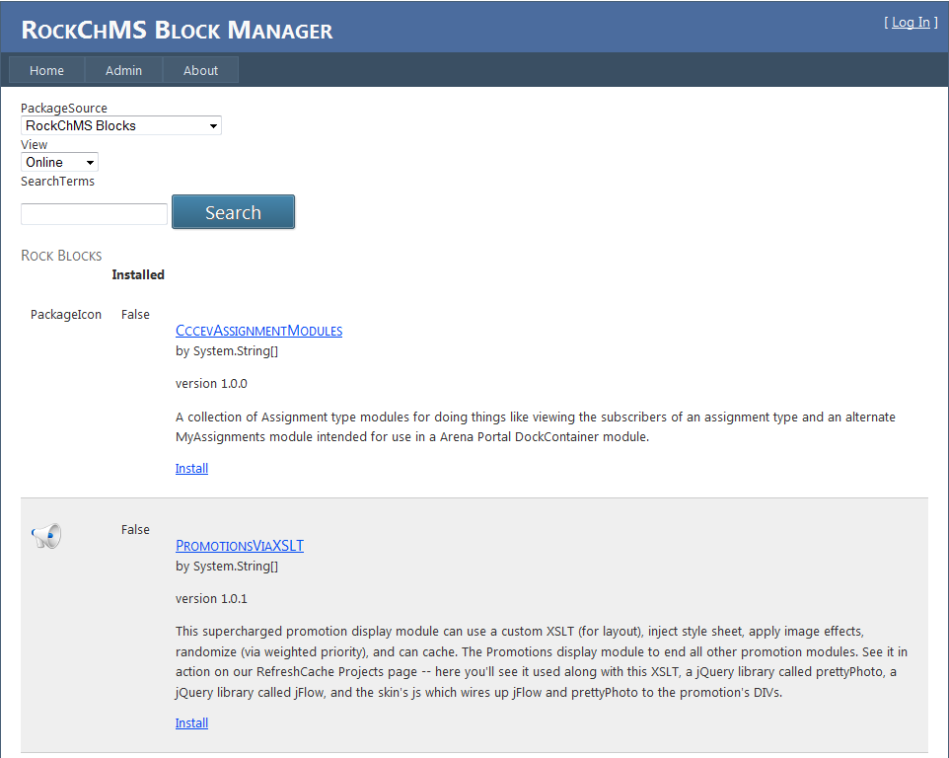
DEMO

Slide 35
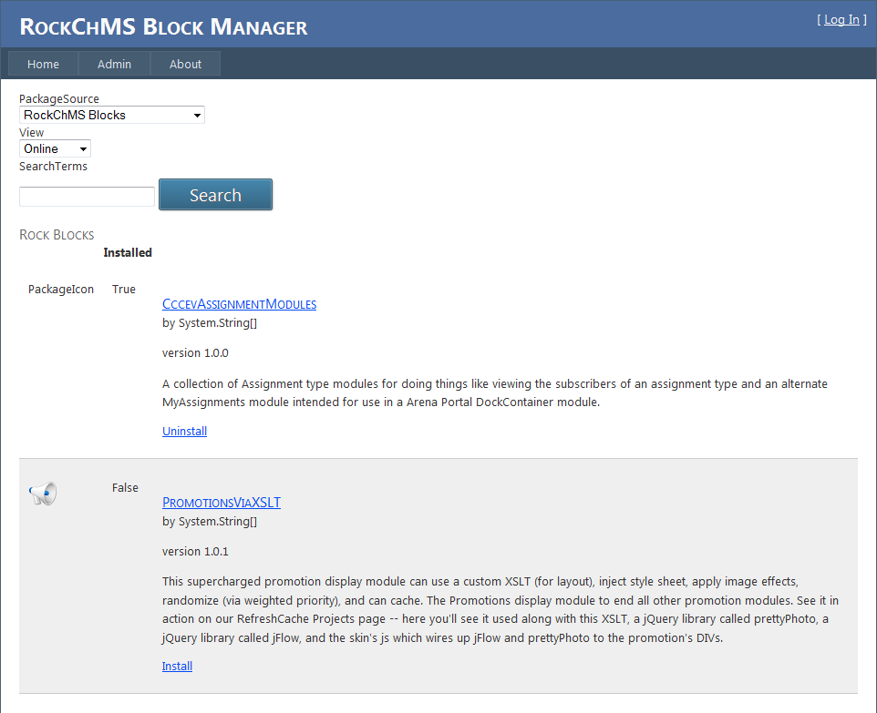
DEMO

Slide 36
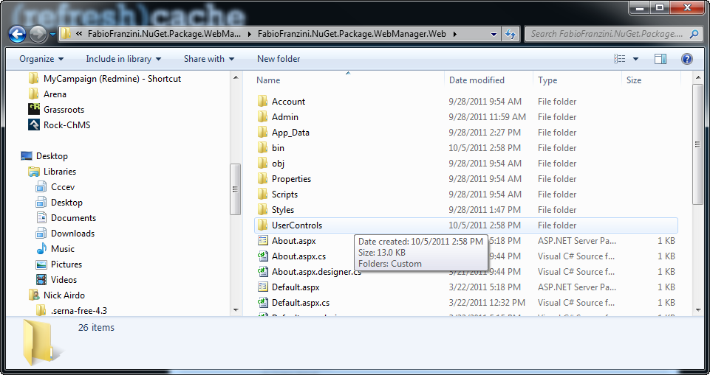
After install
DEMO

Slide 37
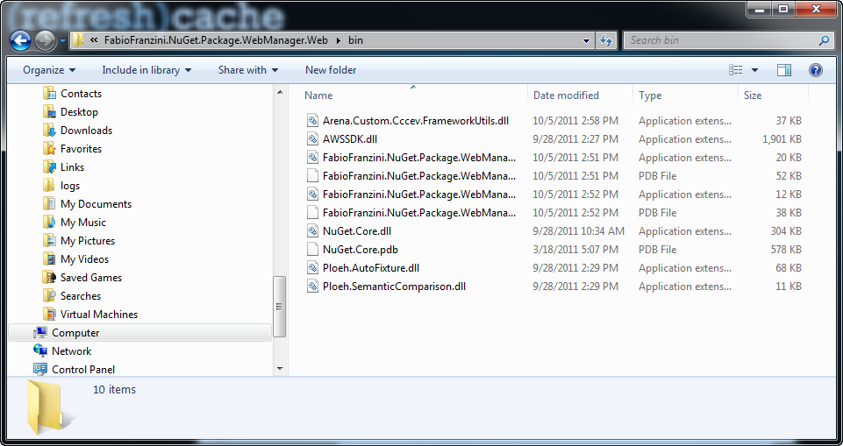
DEMO

Slide 38
DEMO

Slide 39
After uninstall
DEMO

Slide 40
Also have RefreshCache NuGet.Server (not fully working yet)
http://refreshcache.com/nuget/
http://refreshcache.com/nuget/nuget/ (package source)
DEMO

Slide 41
References
Much of my initial understanding of NuGet came from a Desert Code Camp (DCC) presentation in April by “remi” Taylor:
https://github.com/remi/presentations/tree/master/2011/DCC
Everything else comes from Phil Haacks blog (http://haacked.com/) and the NuGet Docs http://docs.nuget.org/

