Slide 1

Community Keys (Redux)
key features you (the developer) should know about
Nick Airdo
Software Engineer
Central Christian Church
Email: nick.airdo@cccev.com
Twitter: @airdo
#RefreshCache

Slide 2
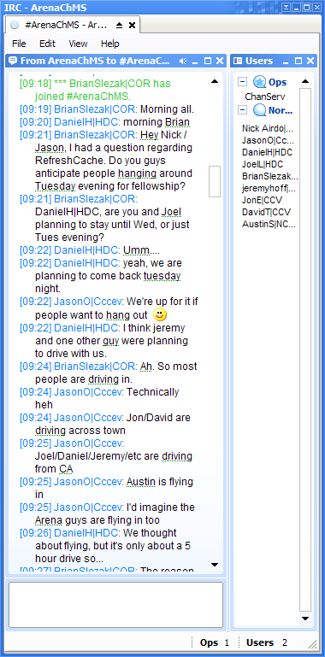
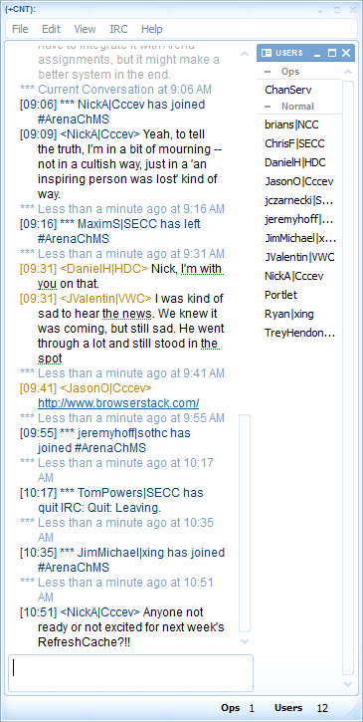
#ArenaChMS on IRC
Thanks to Brian Slezak!
One of the best things that’s happened to the community
If you only take away one thing from R.C. this is it!!

Slide 3
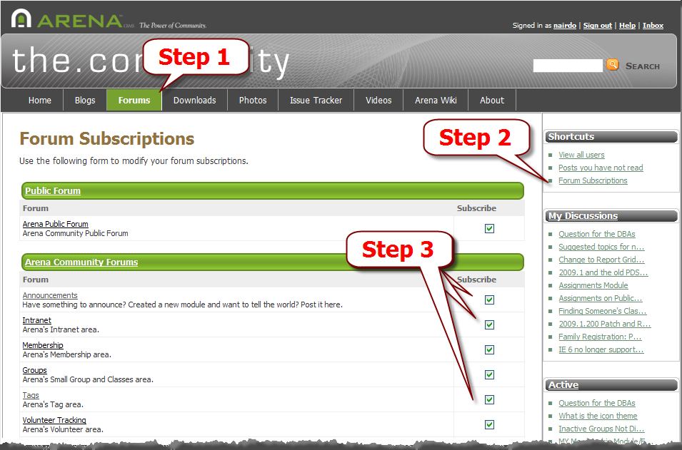
Subscriptions
Your forum subscriptions on the.Community site
Now crucial since there is so much going on now

Slide 4
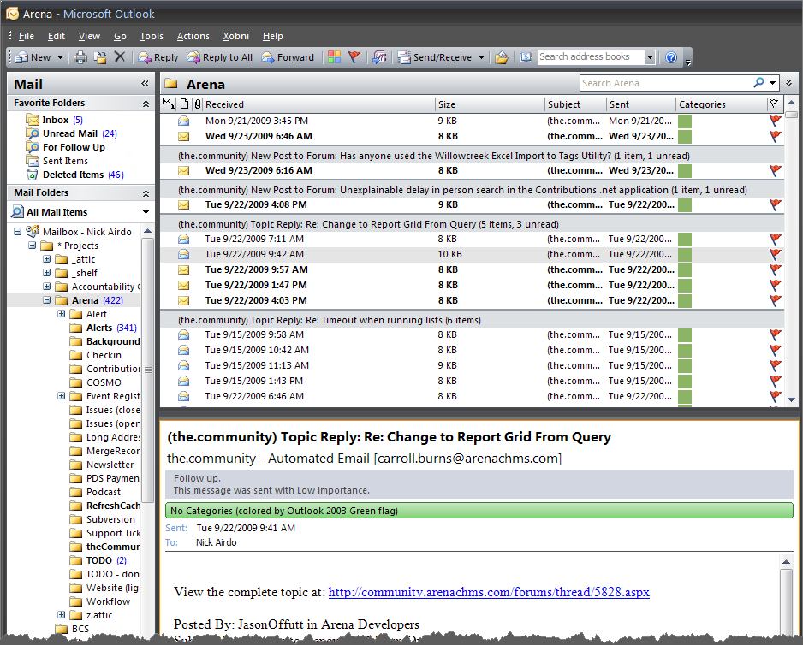
Email Rules
Useful with Outlook’s Arrange By Conversation
Notes:
Take or leave this tip. It’s just a suggestion.

Slide 5
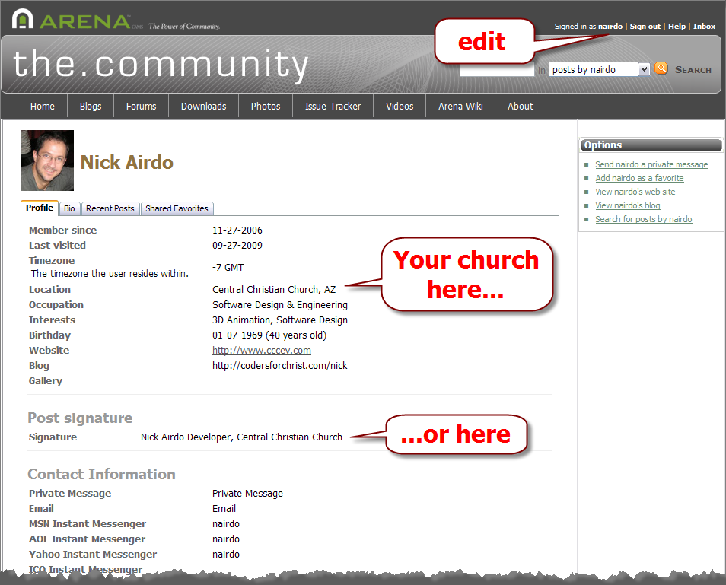
Your Profile
Let people know who you are
Sadly, still not enough people doing this.

Slide 6
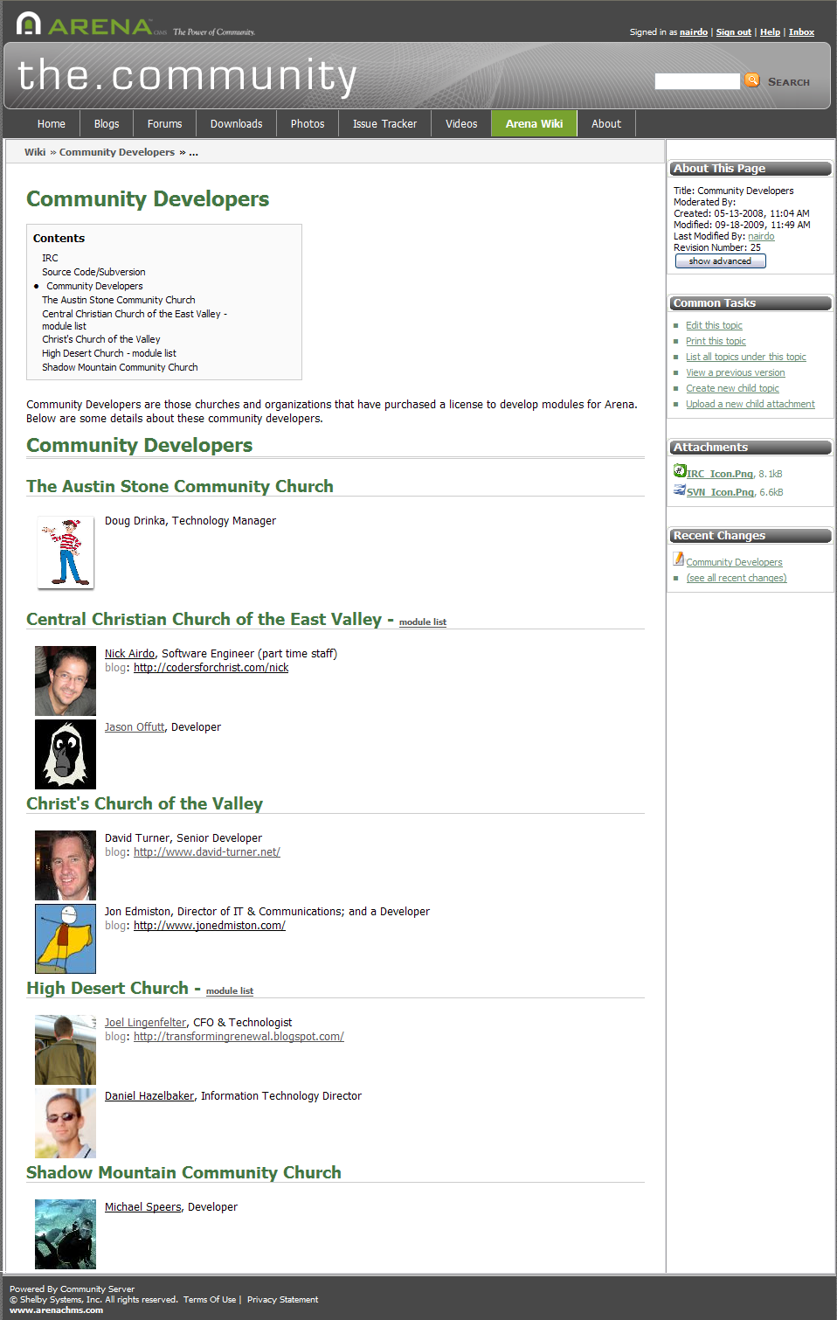
Community Developers
Create/update your section on the Community Developers wiki page
Sadly, still not enough people doing this.

Slide 7
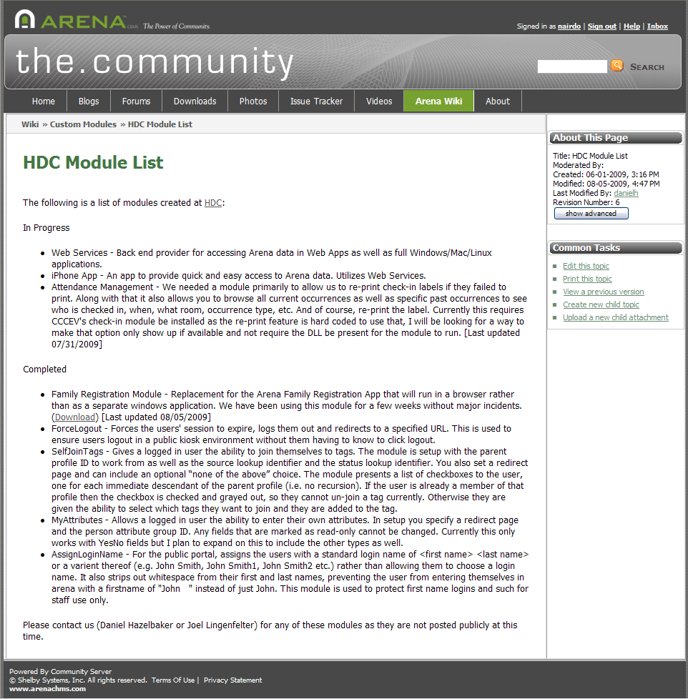
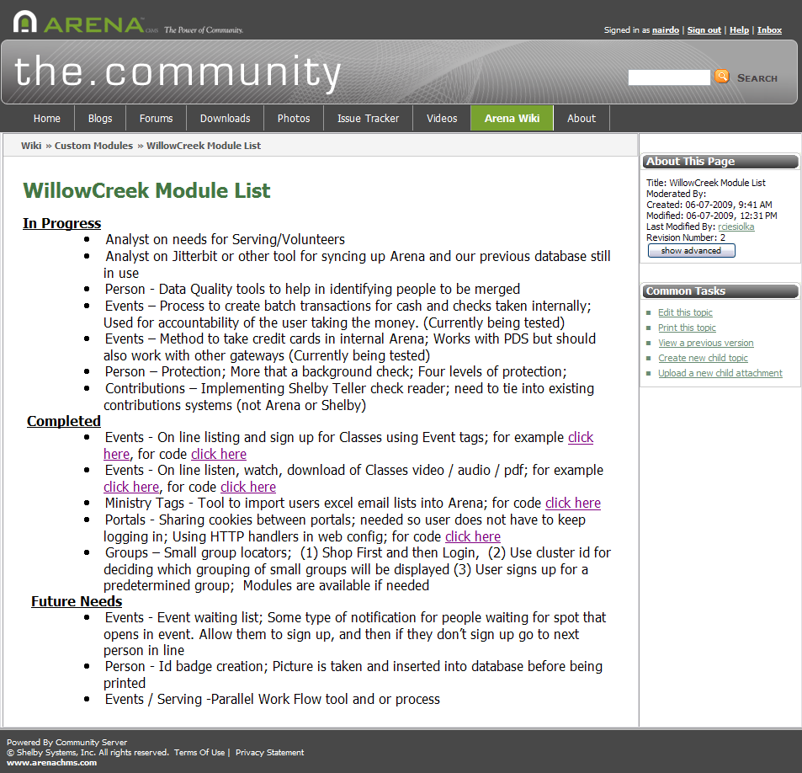
Your Plan
Let us know what you’re working on

Slide 8
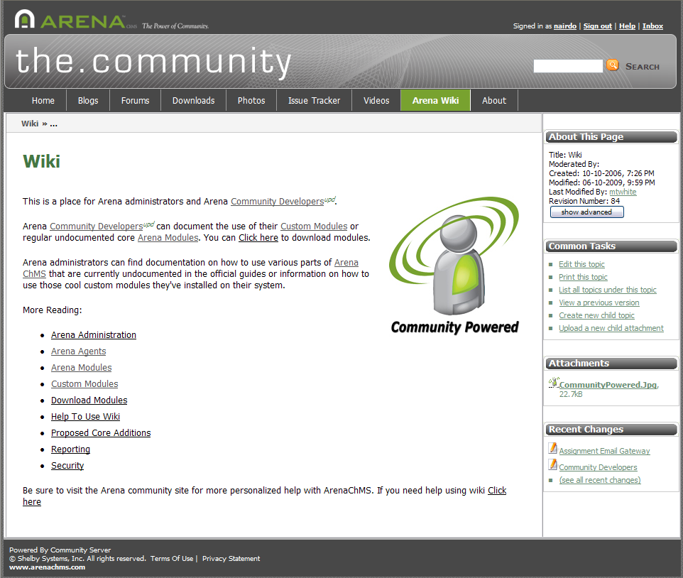
The Wiki
Don’t be shy
It’s community powered
i.e., no one else is going to do it

Slide 9
Wiki Change Notifications
RSS Feed!

Slide 10
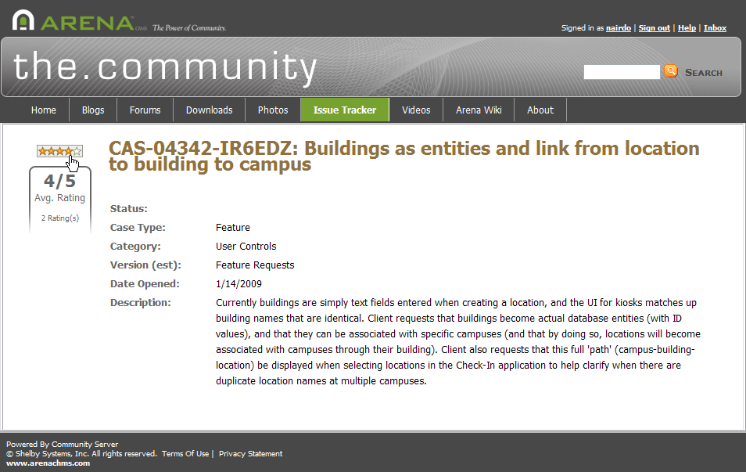
Feature Voting
Vote by clicking the rating stars:

Slide 11
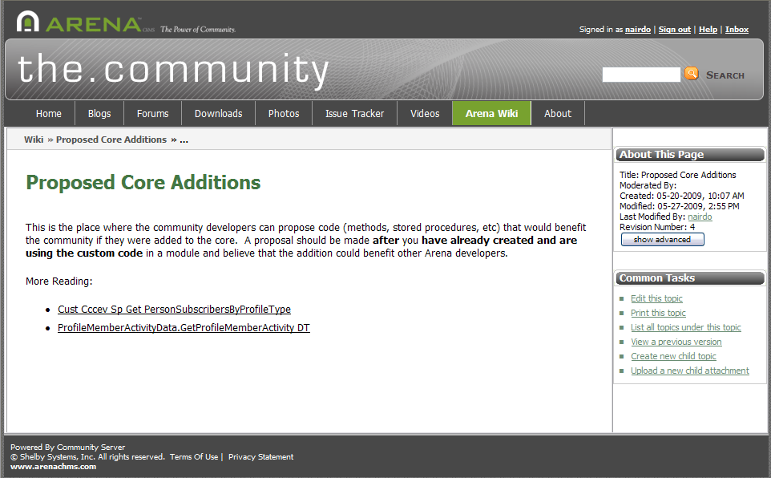
Proposed Core Additions
Use this page

Slide 12
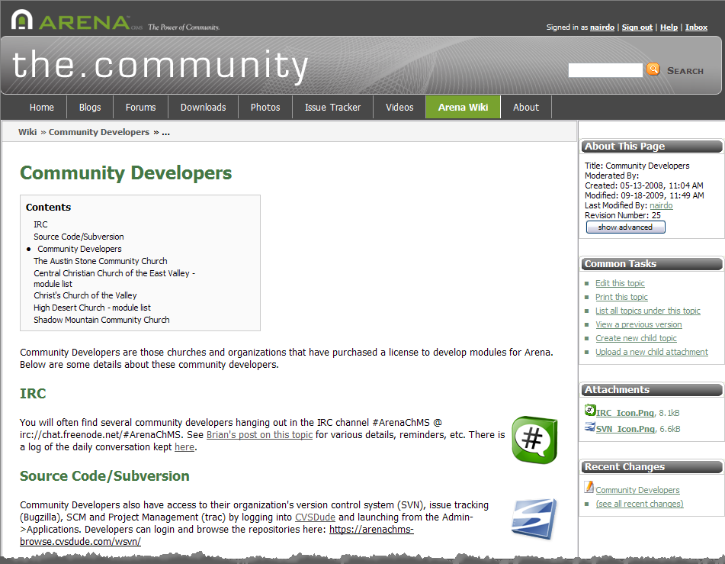
Source Code Repo/SVN
Details on the Community Developers page
Now MORE THAN
100% better
with Redmine!
Notes:
This is now Redmine.refreshcache.com

Slide 13
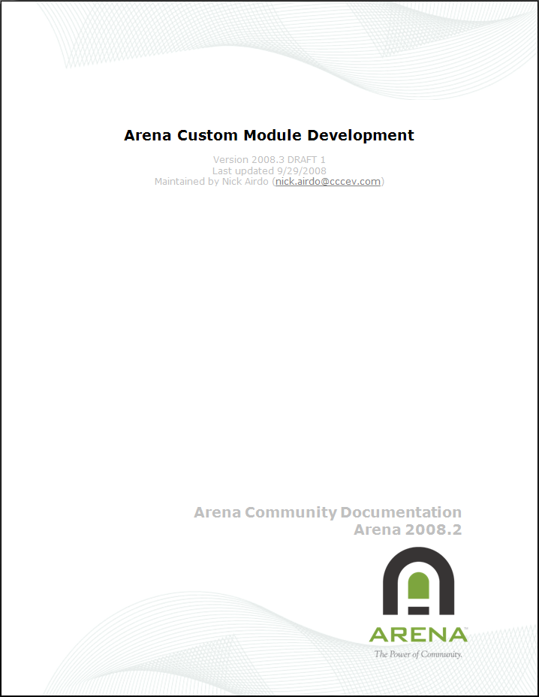
ACMD Guide
Arena Custom Module Development guide
http://redmine.refreshcache.com/projects/arenaqachecklist/repository/entry/trunk/ArenaCustomModuleDevelopment.pdf

Slide 14
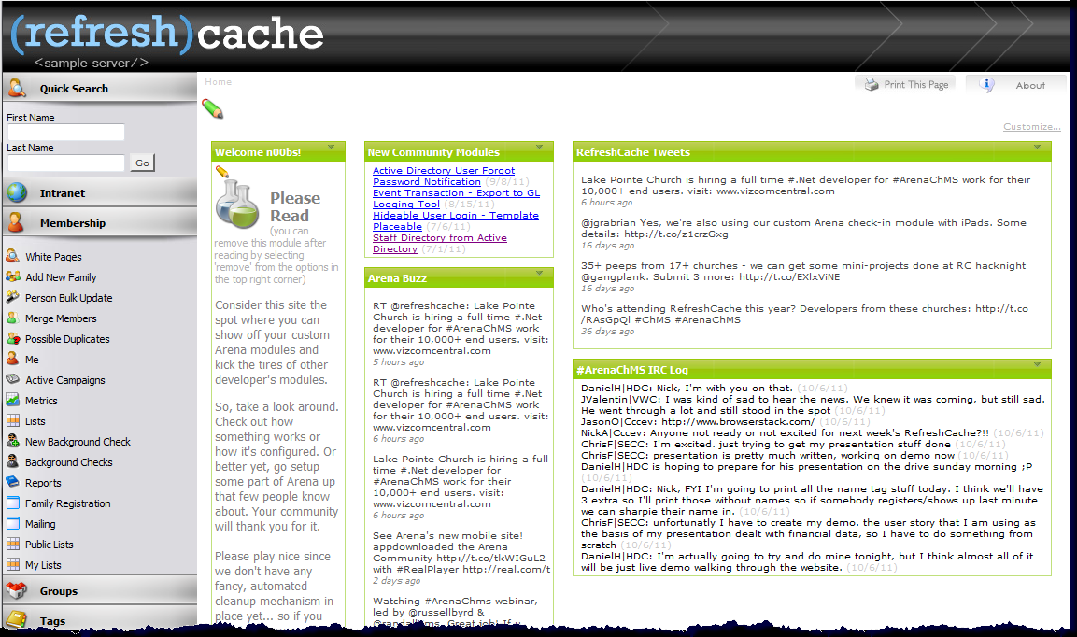
The <sample server />
http://arena.refreshcache.com/

Slide 15
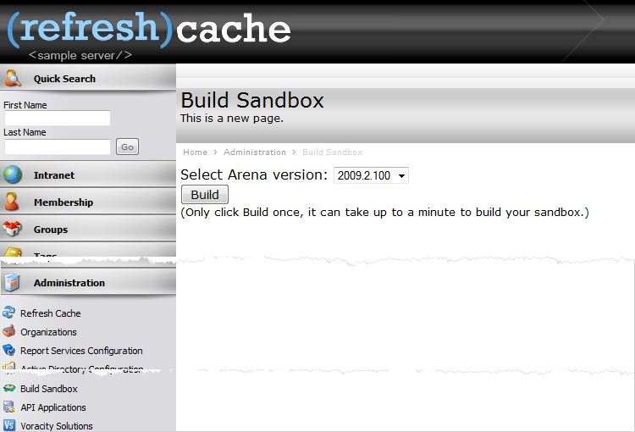
The Build Sandbox
From the mind of Daniel H!

Slide 16
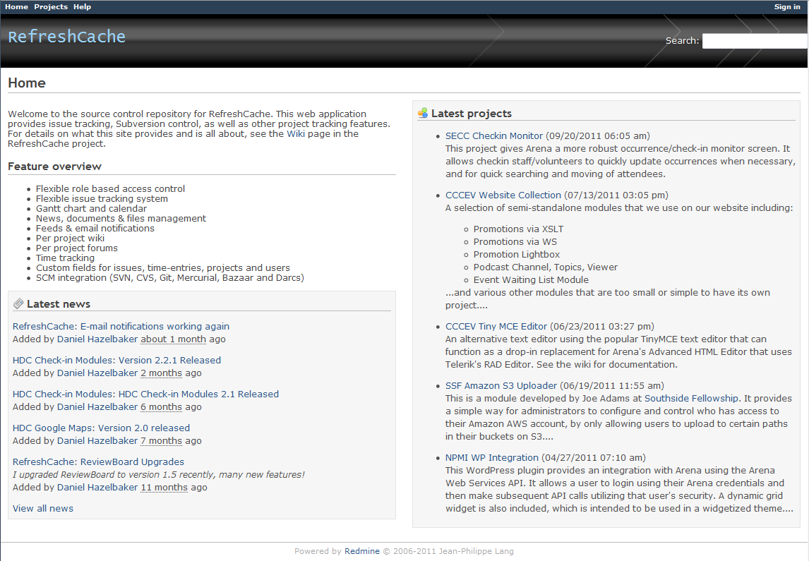
Redmine
http://redmine.refreshcache.com

Slide 17
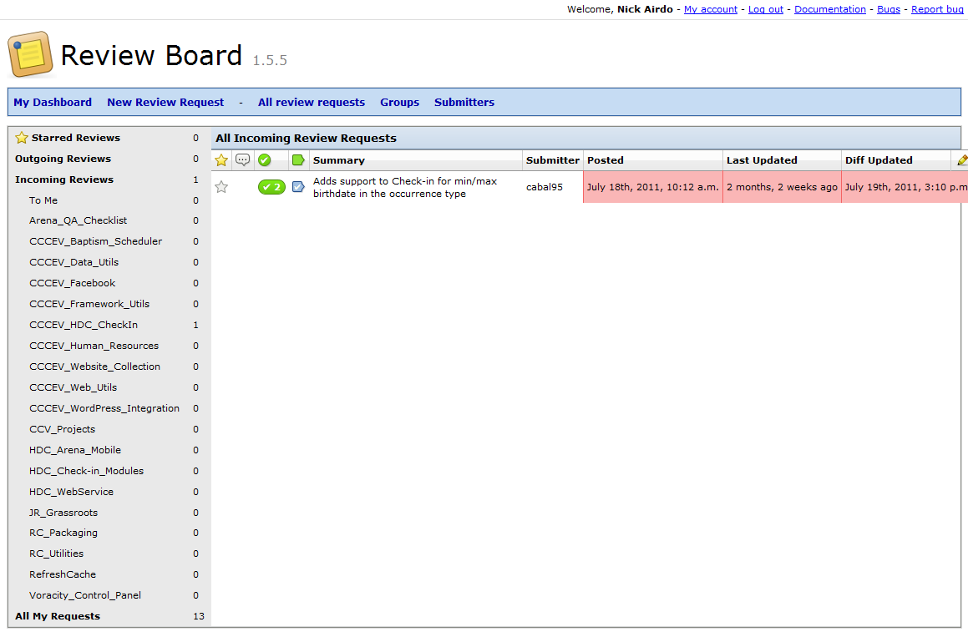
Review Board
http://reviewboard.refreshcache.com
Notes:
But I could be getting ahead of myself here… This is for the advanced developer who is collaborating with other churches

