Slide 1

Arena Infrastructure
Wayne Helsby
Maintenance Developer
North Point Ministries, Inc.
Email: wayne.helsby@northpoint.org
Twitter: @waynehelsby
#RefreshCache

Slide 2
  Disclaimer
  Arena Environments
  Development Process
  Documentation and Tools
  Infrastructure
Notes:
Web Infrastructure (2-3 minutes)
Arena Environments (2-3 minutes)
Arena Data Refreshes and Upgrades (10 minutes)
Documentation (2-3 minutes) and Source Control (quick)

Slide 3
Arena Environments
PRODUCTION
STAGING
TRAINING
TEST
DEVELOPMENT
Notes:
Colors - Green to Red
Development - Local Developer/SDK
Test - (dev)

Slide 4

Development Environment
  .NET development with SDK
  Unit Testing
Notes:
Visual - Play on your own, make a mess

Slide 5

Test Environment
  Portal Development
    Pages
    Module Placement
    Permissions
    Security Roles
    Small Group Structure
  Report Development
  Integration Testing
Notes:
Visual - play nice with others

Slide 6

Staging Environment
  Define and Finalize Deployment Process (Certification)
  Deployed from SVN
  Regression Testing
  User Acceptance Testing (UAT)
Notes:
Visual - On Deck

Slide 7
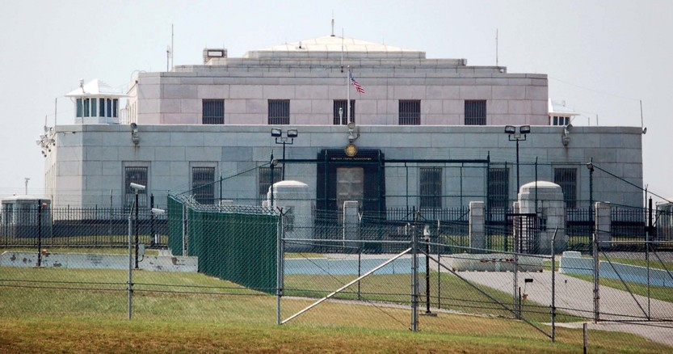
Production Environment
  Arena WebApp
  Shelby Teller Server
  Automation Agents
  NPM Contribution Import Service
  NPM Bar Code Attendance
  HDC/NPM CheckIn
  HDC/NPM API
Notes:
Visual - Fort Knox, protected, stay out

Slide 8

Training Environment
  New/Transitioned Staff Trainings
  Limited Communications
  Disabled Agents
Notes:
Visual

Slide 9
Ideal Dev Cycle
PRODUCTION
STAGING
TRAINING
TEST
DEVELOPMENT
Notes:
Full Cycle
Custom/Community Module
Started in Test
SSRS
Started in Staging
Quick Module Setting Change
Started in Production
Hopefully not much

Slide 10
Data Refresh
PRODUCTION
STAGING
TRAINING
TEST
DEVELOPMENT

Slide 11

Arena ChMS Upgrade
PRODUCTION
STAGING
TRAINING
TEST
DEVELOPMENT

Slide 12
High Impact Development
PRODUCTION
STAGING
TRAINING
TEST
DEVELOPMENT

Slide 13
Tips
  Visual Environment Distinctions
  Access Control
  Sensitive Data
  Keep Your Environments Up-To-Date

Slide 14
Documentation & Tools
  Google Docs
  SQL Scripts
  SQL Examiner and SQL Data Examiner
  WinMerge
  Diff
  SVN
  VM Snapshots
  VMware Fusion
Notes:
Google Docs
Install/Config
Custom Apps
Support Docs
Processes
SQL Scripts
(Cornerstone, Versions, RocketSVN)

Slide 15
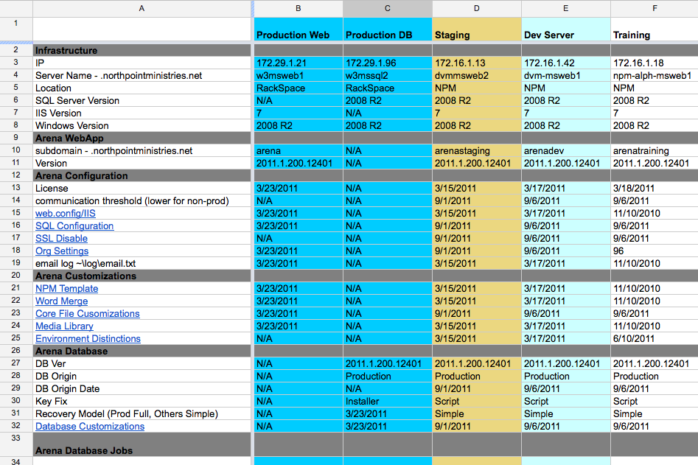
Notes:
Arena Environments

Slide 16
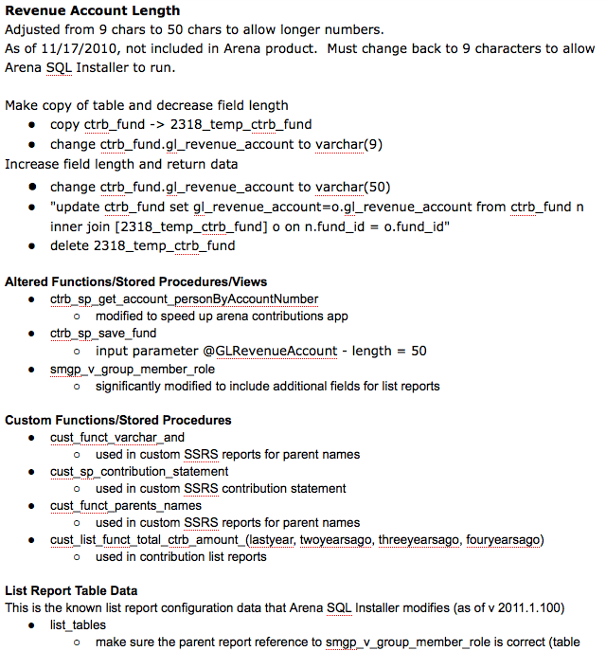
Notes:
Database Customizations

Slide 17
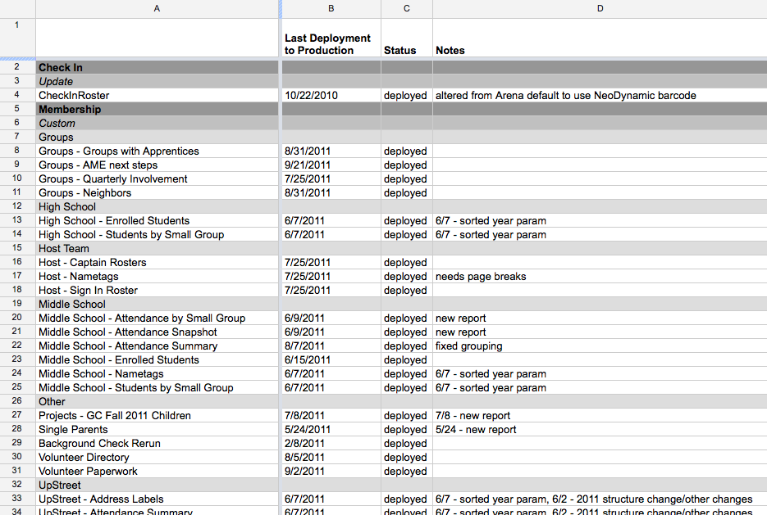
Notes:
SSRS Reports

Slide 18
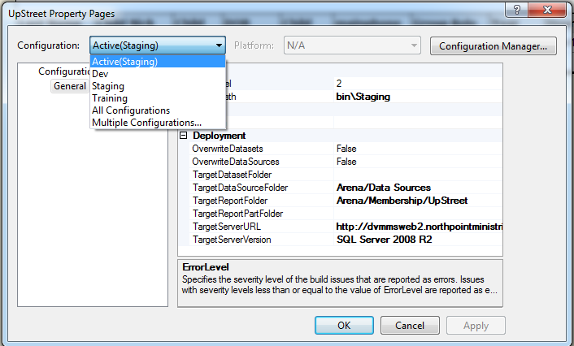
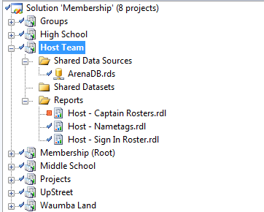
SSRS Deployment & SVN

Slide 19
Infrastructure
  RackSpace Managed Private Cloud
    Leased Hardware
    Licensing
    24/7 Support with Subject Matter Experts
    Managed Backup
    Monitoring
  NPM Virtualized Hosting
Notes:
Cost
High Opportunity Cost

Slide 20

Managed Private Cloud

Slide 21
NPM Virtualized Hosting
  similar setup
  approx 20 virtualized servers
    Arena Dev/Staging/Training Environments
    Accounting
    Active Directory

Slide 22
Infrastructure Tips & Next Steps
  Tips
    Infrastructure Manager
    K.I.S.S.
  Next Steps
    Cloud
    Hybrid Hosting
Notes:
Tips
Infrastructure Manager - RackSpace = do what you ask us to do
K.I.S.S. - load balanced, failover, mirroring
Working On
RackConnect - connect dedicated and cloud platforms to build a scalable, flexible compute solution that offers the performance of dedicated servers with the flexibility and scalability of cloud.

