Slide 1

PCI Compliance
Do I really have to?
Date

Slide 2
In a word - Yes
Q: Do organizations using third-party processors have to be PCI compliant?
A: Yes. Merely using a third-party company does not exclude a company from PCI compliance. It may cut down on their risk exposure and consequently reduce the effort to validate compliance. However, it does not mean they can ignore PCI.

Slide 3
But we don’t keep card #’s!
Q: What is defined as ‘cardholder data’?
A: Cardholder data is any personally identifiable data associated with a cardholder. This could be an account number, expiration date, name, address, social security number, etc. All personally identifiable information associated with the cardholder that is stored, processed, or transmitted is also considered cardholder data.

Slide 4
What if I don’t bother?
Q: What are the penalties for noncompliance?
A: The payment brands may, at their discretion, fine an acquiring bank $5,000 to $100,000 per month for PCI compliance violations. The banks will most likely pass this fine on downstream till it eventually hits the merchant. Furthermore, the bank will also most likely either terminate your relationship or increase transaction fees. Penalties are not openly discussed nor widely publicized, but they can catastrophic to a small business.

Slide 5
Sigh. OK, what do I have to do?
Find a provider & pay them
Fill out a vulnerability survey once per year
Allow your network to undergo a vulnerability scan once a month
Print out the certificate
Sleep better at night

Slide 6
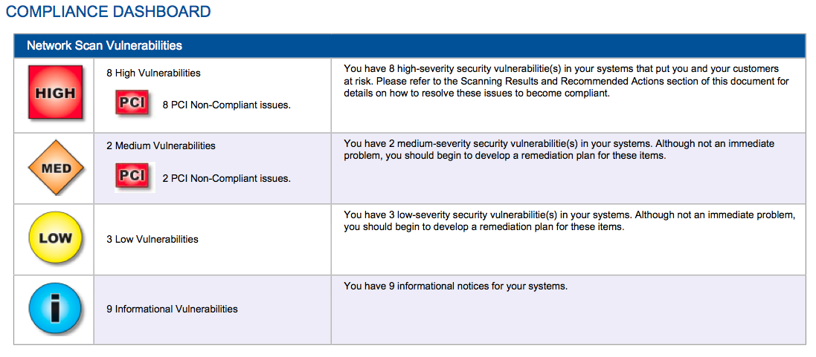
What does the scan do?

Slide 7
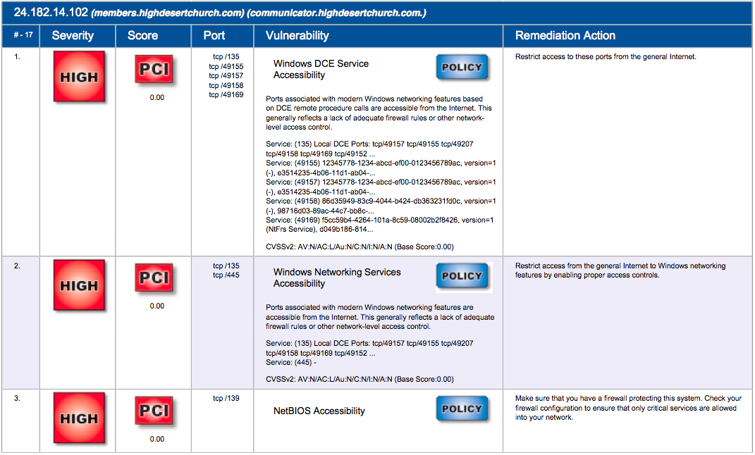
Don’t be afraid...

Slide 8
Suggestions
For more information see: http://www.pcicomplianceguide.org
HDC uses trustkeeper: https://www.trustkeeper.net
Our cost is $250 per year for PCI Compliance

