Slide 1




Arena + WordPress
(with a side of bacon)
Russell Todd
Solutions Architect
North Point Ministries
Email: russell.todd@northpoint.org
Twitter: @rtgolf
#RefreshCache

Slide 2

Why Worry?
  Existing Infrastructure & Investment in other technologies (esp. WordPress with 35+)
  Want to enhance these sites with tools and data that use Arena
  Provide new functionality quickly
arena.northpointministries.org blog.buckheadchurch.org blog.startingpoint.combrownsbridge.org/baptismbrownsbridgeproduction.org buckheadchurch.org/baptismbuckheadproduction.orgcaseydarnell.comcontent.northpointministries.netdriveconference.comdriveinternacional.orgdriveinternational.orgfantastic5.northpointministries.org
feed.northpointministries.org fivethingsgoduses.comfusion.northpointministries.org goglobalx.org gwinnettchurch.org howtoberich.org insidenorthpoint.orginsideoutstudents.orgkidstuf.comlifelessonsoverlunch.com marriedlifeonline.commy.northpointministries.org
northpoint.org/baptismnorthpointmusic.org northpointonline.tvnpccproduction.org parentstuf.orgstaff.northpointministries.nettheopraxis.orgtheintersectproject.orgtoddfields.comtransitstudents.orgwatermarkechurch.com
Notes:
Why
- existing infrastructure / investment in open source technologies
- especially wordpress, mention EE/cake/CI?
- list / show all of our WP sites
provide tools and more informative sites on top of these existing investments
- maybe even functionality like tying our event registration system into Arena

Slide 3
Why, Part 2
  Use Arena for what it’s best at
    Managing people, groups, contributions, etc.
    As a single sign on system
  Use WordPress for what it’s best at
    Better, More flexible CMS *
    Large Development Community
    Open Source
    Downloads > 9,000,000
* Shelby uses WordPress for their new website
Notes:
Why, Part 2
- use Arena as a single sign-on system and database of record for people / groups / contributions - NOT events, etc
- better, more flexible CMS with larger developer community - *** Arena uses it for their website
- WP downloads approaching 9 million
- b/c it’s there? (Mt Everest)

Slide 4
WordPress Extensibility
“WordPress is infinitely extensible. One of the core philosophies of WordPress is to keep the core code as light and fast as possible but to provide a rich framework for the huge community to expand what WordPress can do, limited only by their imagination.”
- Mainly through Plugins & Themes
Notes:
WP extensibility ??
- plugins, widgets and themes

Slide 5

Plug It In
  WordPress Plugins allow easy modification, customization, and enhancement to a WP site
    New functionality
    Override core functionality without touching the core
Notes:
Plugin basics
-WordPress Plugins allow easy modification, customization, and enhancement to a WordPress blog. Instead of changing the core programming of WordPress, you can add functionality with WordPress Plugins
- so a plugin is definitely the way to go - we don’t want to alter the core WP code

Slide 6
Plug It In, Part 2
  Pluggable functions - all functions in pluggable.php can be overridden by a plugin
  WordPress loads default ONLY if no override
  wp-includes/pluggable.php - function signatures and default code
    wp_authenticate
    wp_logout
    get_user_by_email
    get_userdata
    get_avatar
    ...
Notes:
Pluggable
- These functions let you override certain core functions via plugins
- WordPress loads the default functions ONLY if an override was not found in your plugins
- go to wp-includes/pluggable.php to get exact function signature
- use the default code where needed
- wp_authenticate
- wp_logout
- get_user_by_email
- wp_set_password
- get_avatar
- get_userdata (id)

Slide 7
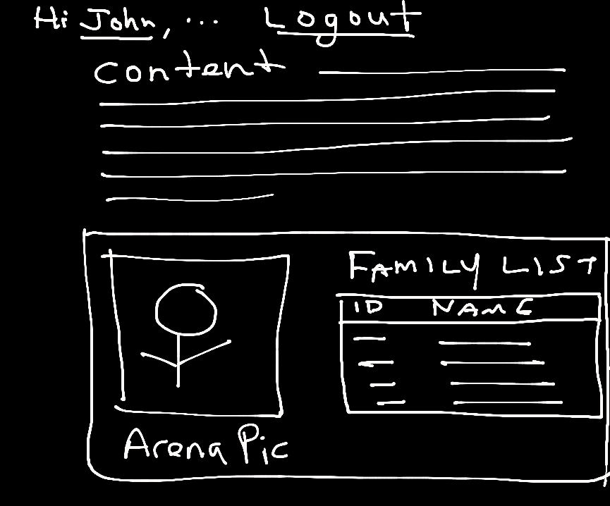
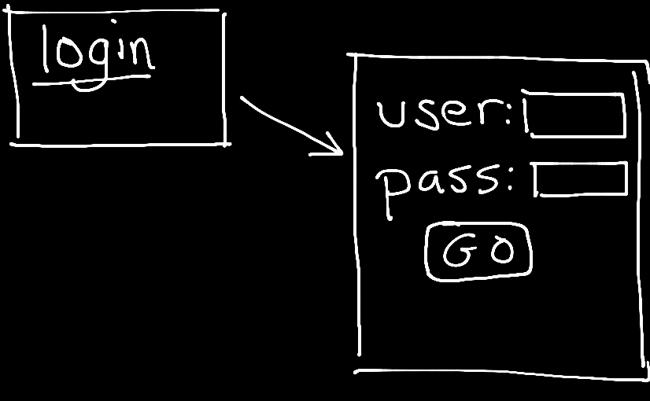
Wireframe
Protected WP page displaying user data from Arena
Notes:
Our Requirements
- a protected page
- login through Arena
- custom page with Arena data
NOTE: There are better ways to do private / public pages in WP, this is for demonstration purposes

Slide 8
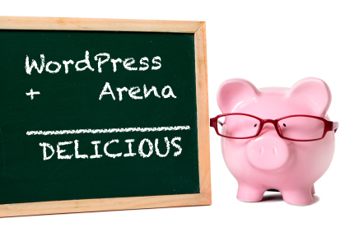
Spec Me Out
Override default wp_authenticate
Add local WordPress user if it doesn’t exist
Sync existing WP user with profile data from Arena
Use Arena person photo for avatar
Provides function to call
other Arena API methods,
e.g. from templates
Notes:
Our Plugin specs
- overrides wp_authenticate to login a user by id and password
- creates a WP user with profile data from Arena if a user doesn’t exist
- updates existing user after each login
- uses Arena photo for get_avatar
- provides a function to get other data from Arena - list of groups, family?
- INSPIRED BY JASON O

Slide 9
Plugin Design
OVERRIDE
wp_authenticate
CUSTOM
arena_authenticate
OVERRIDE
get_avatar
CUSTOM
call_arena
Arena API
TEMPLATE
call_arena
TEMPLATE
call_arena
TEMPLATE
call_arena

Slide 10
Logging In - Step 1
Step 1: Override the default authenticate function (Requirement #1)
if ( !function_exists('wp_authenticate') ) :
/** * Override the wp_authenticate function * * @return WP_User object if login successful, otherwise WP_Error object. */function wp_authenticate($username, $password) {
// call Arena in step 2
    }
endif;
Notes:
Login
- override wp_authenticate
- best practice to do function_exists to avoid collisions with other plugins

Slide 11
Logging In - Step 2
Step 2: Let WP worry about supers
// see if this is a super admin: if so, use WP authentication$supers = get_super_admins();if ($supers && in_array($username,$supers)){$user = wp_authenticate_username_password($user,$username, $password);} else { $user = arena_authenticate($user,$username,$password);}
Notes:
Login
- let wordpress authenticate super admins
- custom function otherwise
- good safeguard in case Arena goes down (or changes their API on you)

Slide 12
Logging In - Step 3
Step 3: Call Arena Web Services API
function arena_authenticate($user = null, $username = null, $password = null) {
$sessionXml = call_arena("post", "login",
array("username" => $username, "password" => $password));$sessionID = (string)$sessionXml->SessionID;// now call back and get user data$personXml = call_arena("get", "person/list", array("api_session" => $sessionID, "loginid" => $username) );$person = $personXml->Persons->Person[0];
Notes:
Login
two calls: login, then get person info
login only returns session ID
** this is inside my arena_authenticate
callArena method comes later

Slide 13
Logging In - Step 4
Step 4: Create WP User
// now see if that user has already logged in and has an existing WP User$user_id = username_exists($username);
if (!$user_id) {$email = (string)$person->FirstActiveEmail;
$user_id = wp_create_user($username, $password, $email);
  if (is_wp_error($user_id))return $user_id;
  }
Requirement #2
Notes:
if the username doesn’t exist in WordPress we need to create that user account
WordPress needs this local user account

Slide 14
Logging In - Step 5
Step 5: Populate User’s profile with Arena data & return!
update_user_meta($user_id, 'first_name', (string)$person->FirstName);wp_update_user(array('ID' => $user_id,
'display_name' => (string)$person->NickName));
        wp_update_user(array('ID' => $user_id,
'user_email' => (string)$person->FirstActiveEmail));
        $arenaMeta = array ( // Arena-specific meta data in one field as an array
'session' => $sessionID,'familyId' => (int)$person->FamilyID,'personId' => (int)$person->PersonID);update_user_meta($user_id,'arena_info',$arenaMeta);return new WP_User($user_id);
Requirement #3
Notes:
- Populate the user profile
- wordpress fun figuring out which function to use for which fields
- can customize what user data we want to save with the WP user

Slide 15
Calling Arena WS API -1
call_arena Function handles server-side API calls to Arena
function call_arena($method = "get", $uri = false, $args = null){
// these should be configured via plugin options - out of scope for this talk $baseUrl = 'http://arenadev.northpointministries.net/api.svc/'; $apiKey = '8a4393a6-1ad7-4283-85c9-3b2a669f7d22'; $apiSecret = '2d507e5e-9dc4-4ba9-b5ba-6e723d3fef49'; $args['api_key'] = $apiKey; // args could be null
if ($method == 'post') { $requestUrl = $baseUrl . $uri; $postArgs = array ( 'body' => $args, 'timeout' => 30 );
// wordpress function returns array $response = wp_remote_post($requestUrl,$postArgs);
Notes:
- Arena configuration should go in plugin options
- use wp web services post / get methods

Slide 16
Calling Arena WS API - 2
API calls (except Login) need the Arena API Session
if (!is_user_logged_in()) throw new Exception("not logged in");$user = wp_get_current_user();if (isset($user->arena_info) && // set in login step 5
array_key_exists('session',$user->arena_info)) $args['api_session'] = $user->arena_info['session'];else
throw new Exception("no arena session");

Slide 17
Calling Arena WS API - 3
Inspect the response code and return an XML object
if ( $response['response']['code'] == 200 ) {$xmlRs = $response['body'];
return simplexml_load_string($xmlRs); // XML Object from string
<PersonListResult xmlns:i="http://www.w3.org/2001/XMLSchema-instance">
<Persons>
<Person>
<Addresses>
<Address>
<AddressID>30286</AddressID>
....
</Addresses>
<BirthDate>1970-03-27T00:00:00</BirthDate>
<CampusName>Buckhead</CampusName>
Notes:
Login
- look at the response code to see if 200 or 400 (or something else) was returned
- response body contains the XML from the Arena API call
- SimpleXMLObject is easy way to parse, read, use XML in PHP

Slide 18
Calling Arena WS API - 4
Inspect the error code and figure out next steps
} else {
  /* return HTTP response code and any Arena error information from the body */
[body] => <Error><StatusCode>400</StatusCode><Message>username parameter is required</Message></Error>[response] => Array ( [code] => 400 [message] => Bad Request )
Notes:
Login
- look at the response code to see if 200 or 400 (or something else) was returned
- response body contains the XML error & HTTP status code

Slide 19
Calling Arena WS API - 5
Arena API Security voodoo for secure GET/POST calls
http://arenadev.northpointministries.net/api.svc/person/list?api_session=a3a53923-0ba7-45e7-8264-5cff16ca50a1&loginid=russellto&api_key=8a4393a6-1ad7-4283-85c9-3b2a669f7d22&api_sig=42a86dac0ac3f37ff5d253de1b6e715d
$requestUri = strtolower( $uri . "?" . http_build_query($args) );$apiSig = md5($apiSecret."_".$requestUri); $requestUrl = $baseUrl . $requestUri . "&api_sig=" . $apiSig;
1
Base URL
2
API URI
3
Query string
4
API Signature Hash
Notes:
1. Concatenate URI (2) and query string (3)
2. MD5 hash that string for the API Signature (4)
3. Concatenate all with the base URL

Slide 20
Calling Arena WS API -6
Now that we have the URL, get r done
$args['timeout'] = 30;$response = wp_remote_get($requestUrl,$args);
Notes:
GET
- use same method to interrogate response and return an XML object
- LOOK at a successful response or person/list call from previous page

Slide 21
Requirement #4
  Override the default get_avatar function and fetch the person’s photo from Arena
Notes:
- call Arena person/list and only ask for BlobLink - this will return full URL to the image on the Arena web server
- do some error handling to show a default avatar
- could use some PHP image libraries to pull in the binary image data and manipulate the size of the avatar

Slide 22
Get Avatar - Step 1
Step 1: Override the default get_avatar function
if ( !function_exists('get_avatar') ) :
/** * OVERRIDE: Retrieve the avatar for a user who provided a user ID or email address * * @return string <img> tag for the user's avatar */function get_avatar($id_or_email, $size = '96', $default = '', $alt = false) {
. . .
}
endif;
Notes:
override get_avatar
- best practice to do function_exists to avoid collisions with other plugins
- use code & signature from pluggable

Slide 23
Get Avatar - Step 2
Step 2: Call Arena and get the BlobLink for logged in user
try { $xml = call_arena("get", "person/list",
array("email" => $email, "fields" => "BlobLink") ); $imgUrl = (string)$xml->Persons->Person[0]->BlobLink; if ($imgUrl) { ?> <img src="<?php echo $imgUrl; ?>" class="avatar avatar-<?php echo $size; ?> photo" alt="<?php echo ($alt ? $alt : "nada"); ?>" /> <?php }} catch (Exception $e) {
Notes:
- call Arena person/list and only ask for BlobLink - this will return full URL to the image on the Arena web server
- do some error handling to show a default avatar
- could use some PHP image libraries to pull in the binary image data and manipulate the size of the avatar

Slide 24
Requirement #5
  Now that the plugin is complete, let’s call Arena from a page template
    page requires login
    use get_avatar to display photo from Arena
    make an API call to display family table
Notes:
- call Arena person/list and only ask for BlobLink - this will return full URL to the image on the Arena web server
- do some error handling to show a default avatar
- could use some PHP image libraries to pull in the binary image data and manipulate the size of the avatar

Slide 25
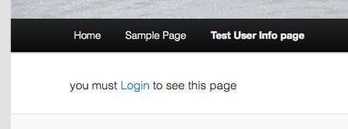
Call Arena from Template - 1
if (user_is_logged_in()) {
// call Arena and get some data (next slide)
} else {echo '<p>you must <a href="'. wp_login_url( get_permalink() ) .'" title="Login">Login</a> to see this page</p>'."\n";}
Notes:
- Other way to customize WP is through themes and custom page templates
- Don’t show this page unless the user is logged in
- this is one way to do it - could be a more global security

Slide 26
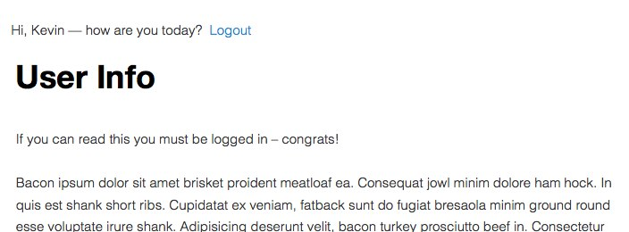
Call Arena from Template - 2
$user = wp_get_current_user(); ?>
<span id="userinfo"><?php echo get_avatar($user->id,32) ?>
  Hi, <?php echo $user->display_name; ?>&mdash;how are you today?</span>&nbsp<a href="<?php echo wp_logout_url( get_permalink() ); ?>" title="Logout">Logout</a>
<?php
get_template_part( 'content', 'page' );
Notes:
In your theme you can create custom templates that call Arena’s API for data

Slide 27
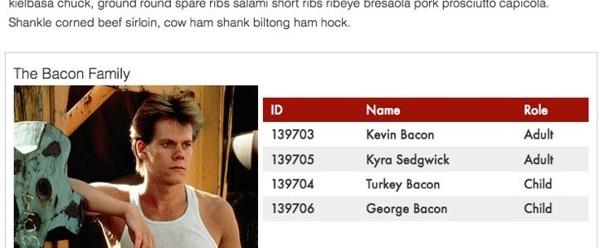
Call Arena from Template - 3
if (function_exists('call_arena')) {
$familyXml = call_arena("get", "family/". $user->arena_info['familyId']); ?> <h2>The <?php echo $familyXml->FamilyName; ?></h2>
<div class="left"><?php get_avatar($user->id); ?></div> <table><thead><tr><th>ID</th><th>Name</th><th>Role</th></tr></thead><tbody> <?php foreach ($familyXml->FamilyMembers->Person as $p) { ?> <tr> <td><?php echo $p->PersonID; ?></td> <td><?php echo $p->FullName; ?></td> <td><?php echo $p->FamilyMemberRoleValue; ?></td> </tr> <?php } ?> </tbody></table><?php } ?>
Notes:
In your theme you can create custom templates that call Arena’s API for data

Slide 28
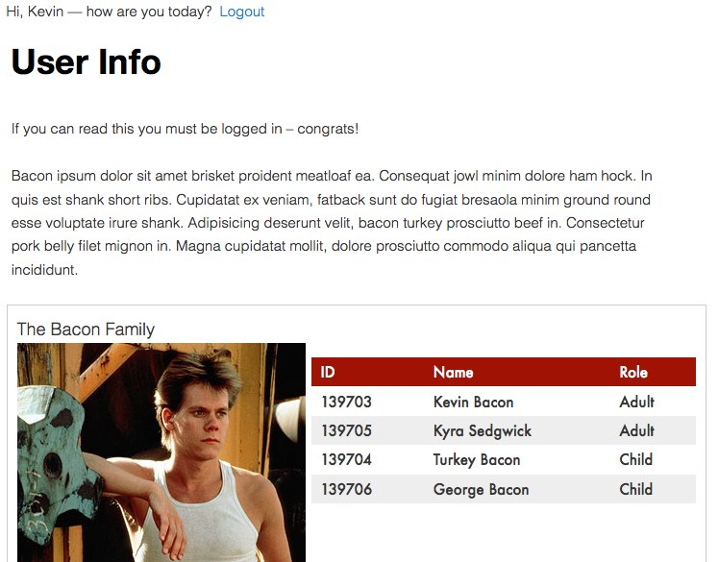
All Together Now
Notes:
In your theme you can create custom templates that call Arena’s API for data

Slide 29

Wrap-up
  Use the codex
  Setup logging - wordpress and plugin
  Ideas?
  Questions?
Notes:
We have this working in CodeIgniter apps, middleware
Other ideas for what uses?
- profile update - use WP my profile page and push the changes to Arena?
- custom web services based on HDC api
- widgets

