Slide 1


Integration Nation
TOPIC
When - Why - Who - How
DATE
OCT 5TH 2009
LOCATION
REFRESHCACHE 09

Slide 2

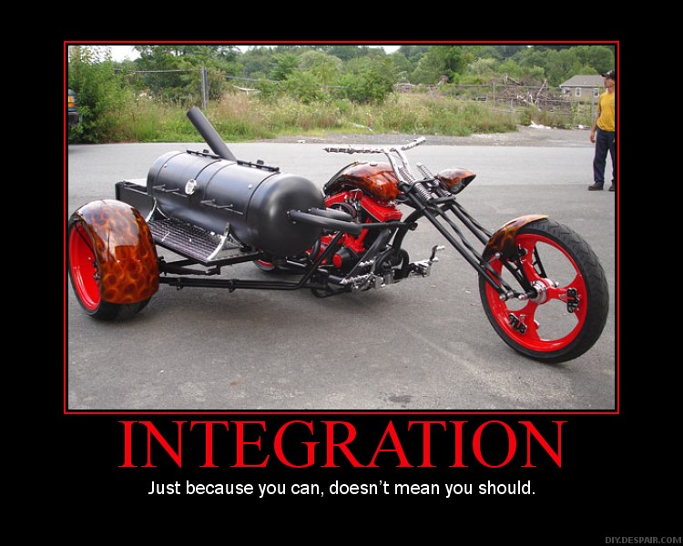

Slide 3
Guiding Principles

Slide 4


Blue Ocean

Slide 5


Unified Membership Experience
Notes:
Keyword: Membership

Slide 6


Close Tie To Membership Data

Slide 7


Easy
Notes:
This can’t be a crutch though
Think about on-going support of the integration (there’s 2 sides to support)

Slide 8




Who...

