Slide 1
Meaning Matters
Semantic Markup

Slide 2

What Is Semantic Markup?
Notes:
-it’s about meaning, not about looks.
-in markup, semantics is concerned with the meaning of an element, and how that element describes the content it contains
-The Basics: Code your control/page with no design pretenses…markup only, no CSS. Then ask yourself, do you understand which parts are more important than others, which texts are headings, which parts are connected to each other?
-

Slide 3
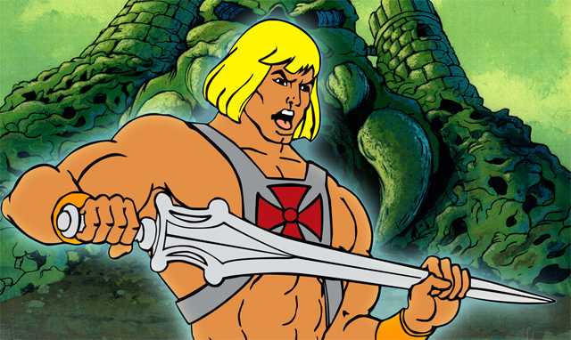
Why Use It?
Notes:
-More accessible to people seeing the document in an environment where CSS cannot be applied.
-Understandable and coherent to people having it read to them with the help of a screen reader.
-Better search engine ranking, since search engines can easier distinguish the importance level of the document’s different parts and what message is being conveyed.
-Easier for web developers to maintain the code, and to separate content (HTML) from presentation (CSS).
-In most cases, there will be less code, which isn’t cluttered by formatting, meaning that the web page will be faster to load.
-Better integration with 3rd party API’s, features and services (Sifr/Cufon, CSS Frameworks, jQuery, etc)

Slide 4



An Example From Arena

Slide 5

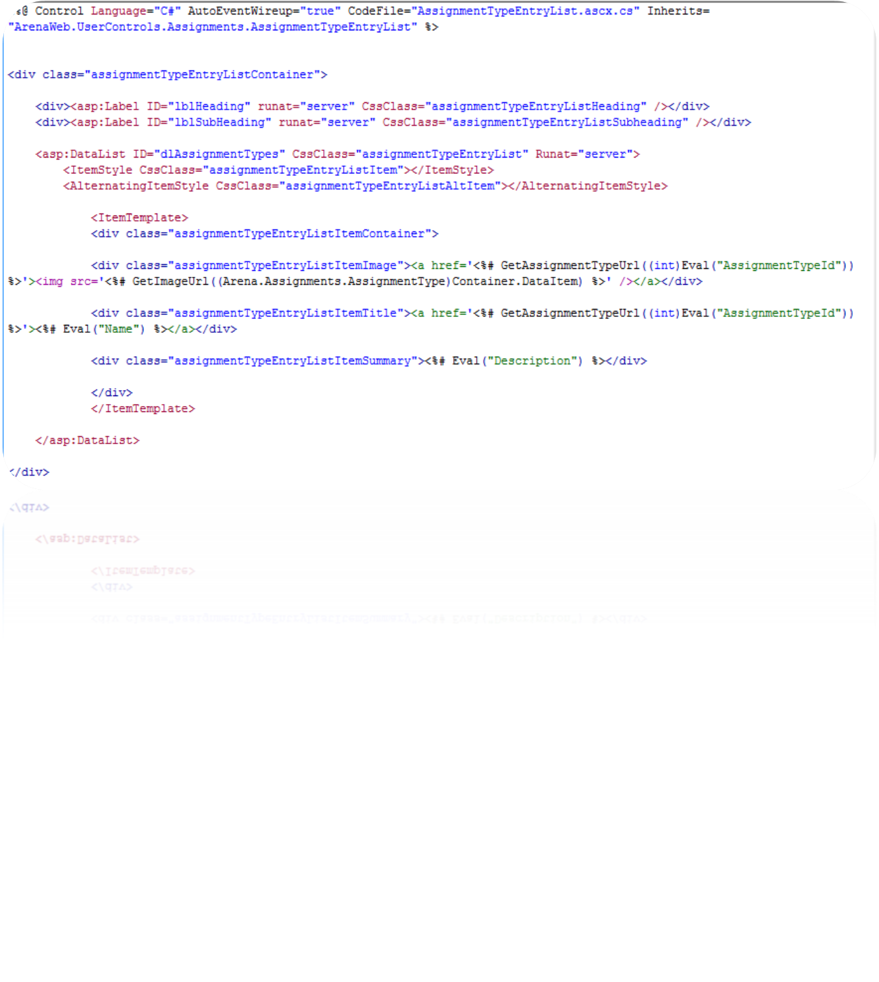
Sad Girl
Notes:
Divitis
DataList adds table tag
Awkward class name
Labels insert span tags

Slide 6

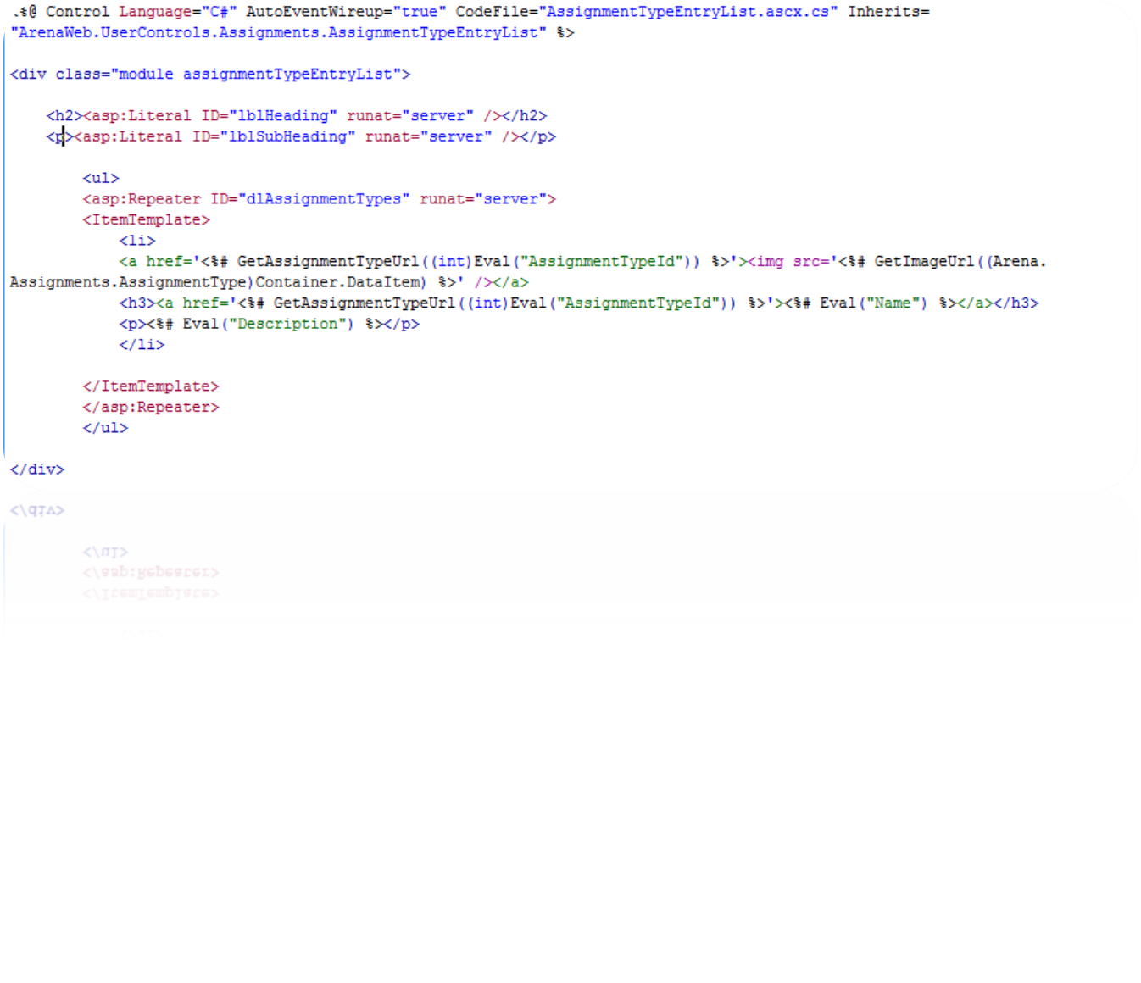
Happy Log!
Notes:
1. The first set of changes come at lines 4 & 5, where I remove the surrounding "div" tags from the heading and subheading Label's. According to the W3C specification, <div> tags are meant to define blocks/groups of content. A user control is just that, however titles and subtitles (inline text) are not. I used a more semantic framework of <h2> and <p> for the subtitles. These tags have more meaning to screen readers, allow for easier CSS control and development and render across different browser versions more consistently.
To style these elements, we simply take advantage of CSS's parent>child selectors (the "parent" is the class name used in the surrounding <div> of the control):
2. You may have noticed by now, I also converted the original asp:Label's into Literal's. (Madness, I know!) The reason being a Literal will not surround the incoming data with unnecessary <span> or <div> tags that Label does. We want to keep the code lean and clear of extra bloat, and it makes it easier to develop & debug when trying to develop your CSS.
3. The next modification isn't a CSS or html change, but another modification to the asp itself. I converted the asp:DataList object into a Repeater object. The DataList object is meant to return a matrix-like list of data (table) It was being used to simply return a one-dimensional list of information. Using the Repeater object made more sense in this particular case, as well as providing leaner code & mark-up.
4. The other modification relating to the Repeater, was simply instituting the appropriate list markup (<ul><li>...) for the content around and within the ItemTemplate. Remembering we don't need <div>'s unless we are separating out blocks of content, I removed the div's from around the titles, links and text, and replaced them with for semantic markup(h3, etc).

Slide 7

Use CSS To It’s Fullest
Notes:
Not every element needs a class name
parent>child selectors
Other selectors (pseudo-class, attribute, etc)

Slide 8
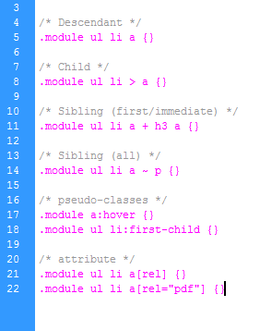
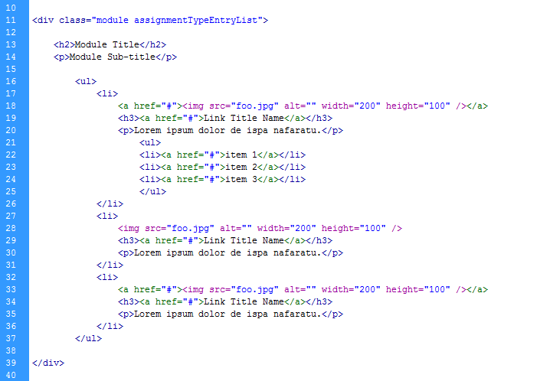
Parent Child Selectors
Notes:
All
First
Sibling

Slide 9
Parent Child Selectors
Notes:
All
First
Sibling

Slide 10
Parent Child Selectors
Notes:
All
First
Sibling

Slide 11
Parent Child Selectors
Notes:
All
First
Sibling

Slide 12
Parent Child Selectors
Notes:
All
First
Sibling

Slide 13
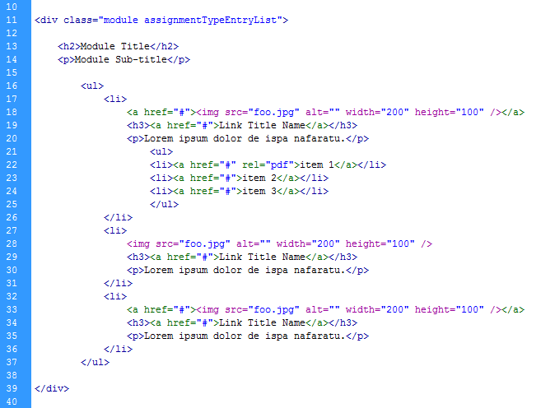
Other Useful Selectors

Slide 14
Other Useful Selectors

Slide 15
Other Useful Selectors

Slide 16

The Gist
jeffschinella@ccvonline.com
jschin@gmail.com
Notes:
-Don’t be a standards Nazi
-An feature that will add to the overall user experience and wow someone far out ways the validation badge or meaning for the machine.
1. User controls should have a single <div> that wraps all content within it (with a class name). All other markup should be coded with native xhtml tags (p, h1, a) and be referenced using CSS parent>child selectors.
2. Let the data type being called into the user control decide the type of asp control used to display it. E.g. Don't use tables for data not required of being displayed in a table, and don't use Label's or Placeholder's to call simple lines of text. If we know the data being called is the "title" of something, simply wrap it within an <h2> or <h3> (depending on the context...By default, we know that all of the Page titles should be <h1>. In my development, I can safely say titles for user controls should be <h2> and titles within controls <h3>. ).
3. Don't go class crazy. Applying a class/id name to every element on a page or block of code defeats the purpose of what CSS is for. They should be used sparingly.

