Slide 1
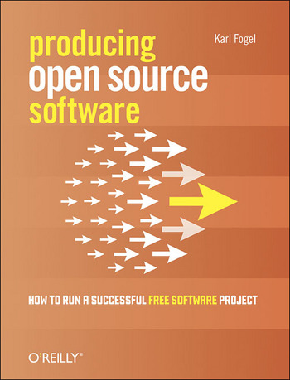
7 Important Things
from Producing Open Source Software

Slide 2
About the Author
Karl Fogel cofounded Cyclic Software, offering commercial CVS support
He added read-only access to CVS repo access
Works for CollabNet where he managed the creation & development of SVN
He works on various open source projects as module maintainer, patch contributor, and documentation writer

Slide 3
#1 Appearances Matter
Pg. 18
“Programmers, in particular, often don’t like to believe this.”
The very first thing a visitor learns about a project is what its website [or page] looks like.
(We’re talking about the project’s site – we haven’t even gotten to the application yet.)
Notes:
“Their love of substance over form is almost a point of professional pride.”

Slide 4
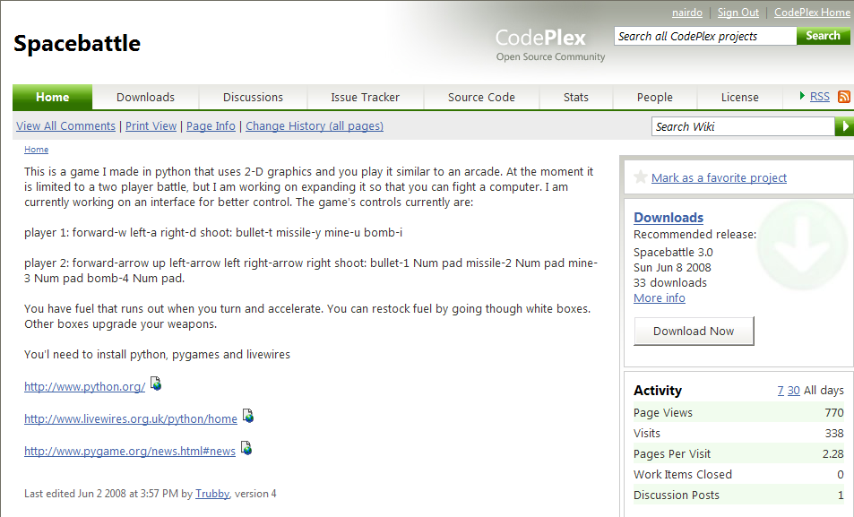
Spacebattle
10%

Slide 5
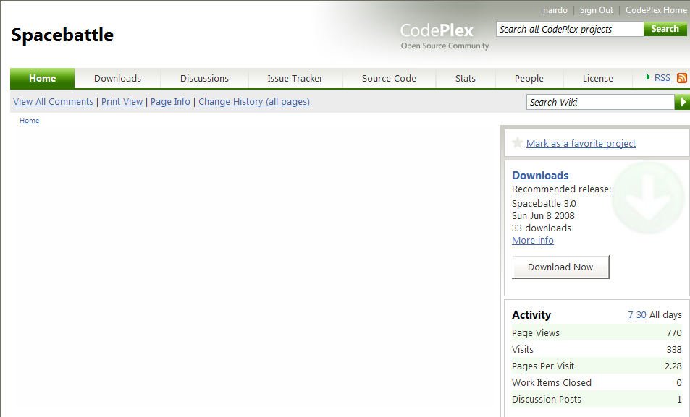
May as well have been this

Slide 6
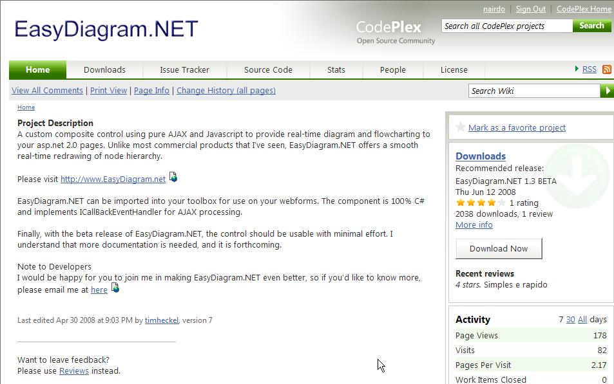
Where’s the Diagram?
Notes:
“Their love of substance over form is almost a point of professional pride.”

Slide 7
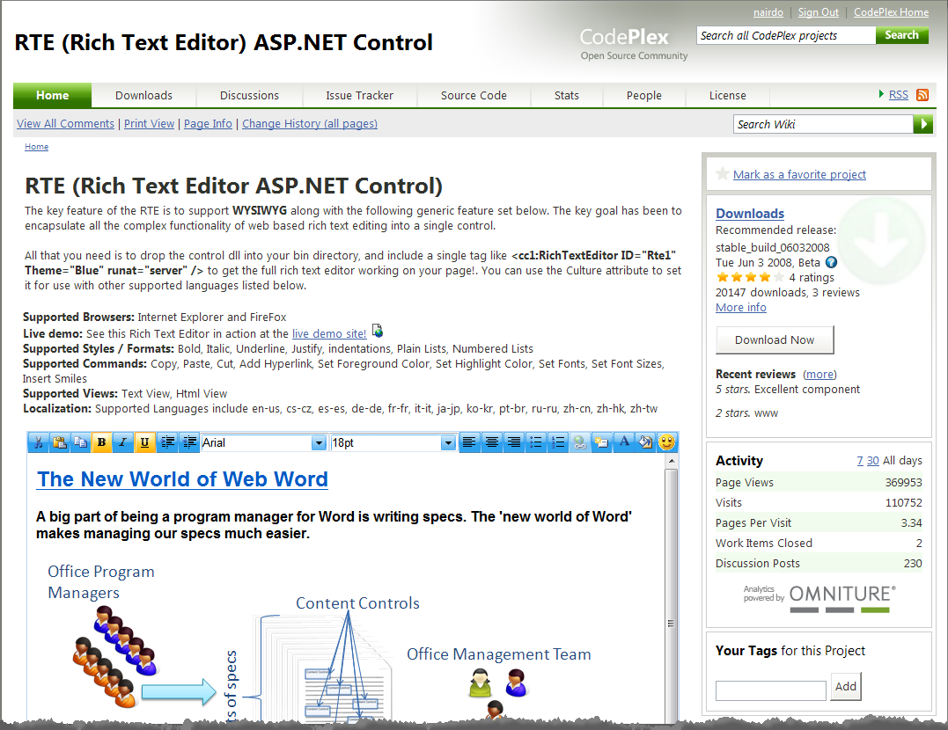
Better
18%

Slide 8
Before anything is read or content is comprehended, people will form an immediate first impression.
Was care taken to organize the project’s presentation?
This impression will carry over to the rest of the project by association.

Slide 9
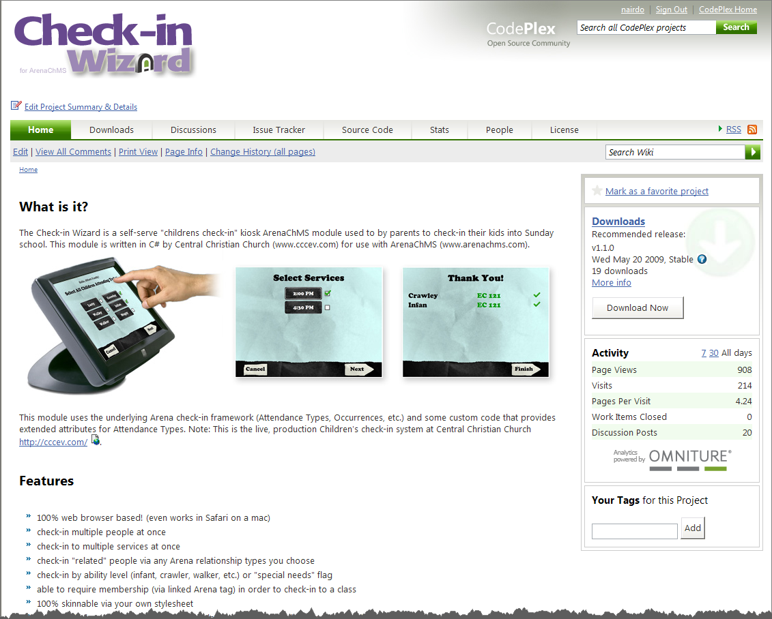
A.B. (after book)

Slide 10
#2 Documentation
Pg. 21
“…what is necessary is that enough investment be put into presentation that newcomers can get past the initial obstacle of unfamiliarity.”
First step in bootstrapping process
a.k.a. Hacktivation energy – the lower the better
Bring it down to a level that encourages people to get involved.
Notes:
“Their love of substance over form is almost a point of professional pride.”

Slide 11
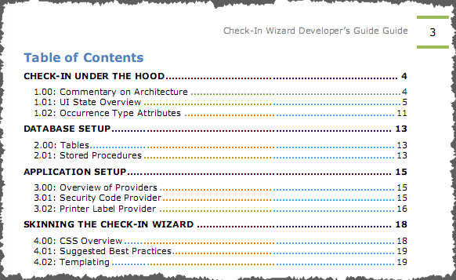
Ideal Example
Jason’s work on the Check-In Wizard Developer’s Guide

Slide 12
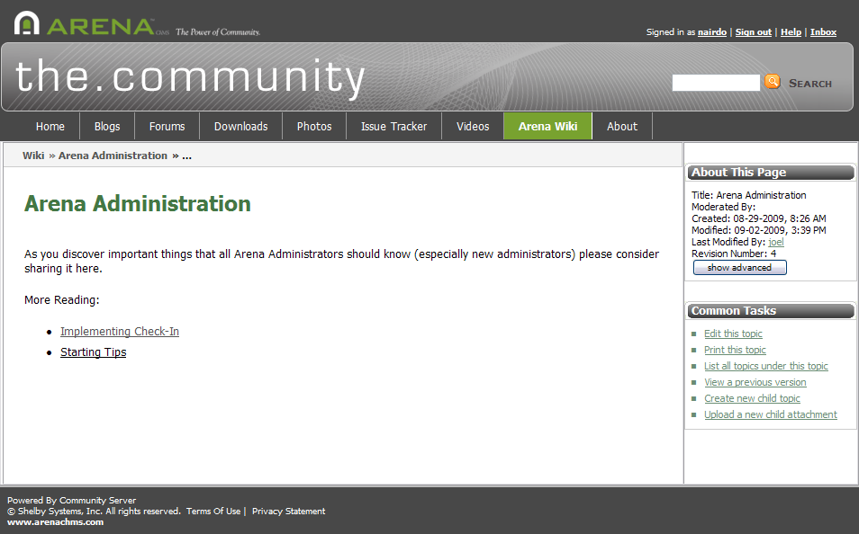
A Starting Point

Slide 13
#3 Avoid Private Discussions
Pg. 37
“Even after you’ve taken the project public, you and the other founders will often find yourselves wanting to settle difficult questions by private communications among an inner circle.”
Many reasons:
Delay of email conversations
Time to form consensus
Hassle of dealing with naïve newcomers
Don’t do it.
Notes:
Especially true in the early days when there are many decisions and few volunteers qualified to make them.
Your reasons will be many
Making private decisions is like spraying contribution repellent on your project.

Slide 14
Beneficial Side Effects
Public discussions will help train newcomers.
It will train you in the art of explaining technical issues to people less familiar with the topic.
Some would be observers are smarter than you and have something valuable to consider
The discussion and its conclusion will available in the public archives forever.

Slide 15
This slide intentionally left blank

Slide 16
#4 Nip Rudeness
Pg. 38
Maintain a zero-tolerance policy toward rude or insulting behavior
Never leave bad behavior slide by unnoticed
Call out bad behavior, but don’t demand an apology.
It gives people time to cool down and show their better side on their own next time.

Slide 17
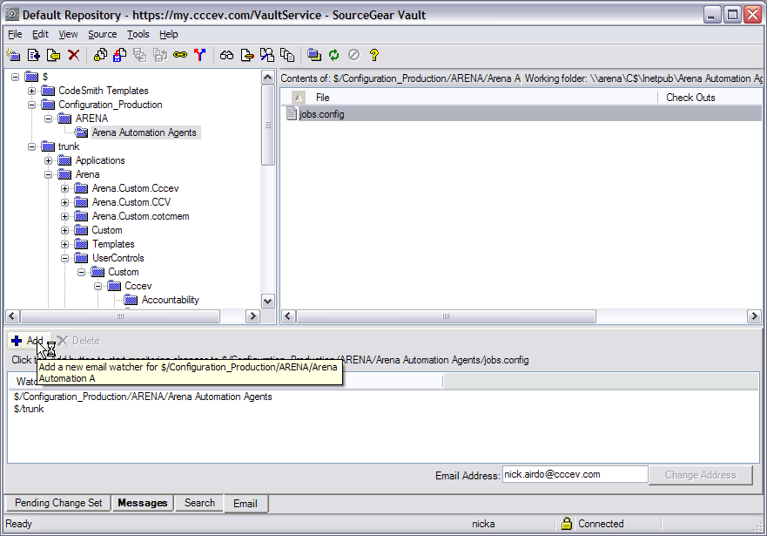
#5 Code Review
Pg. 39
Get people looking at each other’s code.
Enable ‘commit emails’ so you get notified when code is committed
Notes:
A good way to foster a productive development community

Slide 18
Tribal Leadership
Read from book, pg 40 about Greg Stein
“Pretty soon, other people, myself included, started reviewing commits regularly too.”
He had proven that reviewing code was a valuable was to spend time and was contributing as much to the project by reviewing others’ changes as by writing new code.

Slide 19
#6 What a Project Needs
Pg. 47
Website
Mailing Lists [forums]
Version control
Bug Tracking
Real-time chat
… and we’ve got them all!
Notes:
A good way to foster a productive development community

Slide 20
#7 Benevolent Dictators
Pg. 89
BD - the person who has the final decision-making authority (who is expected to use it wisely)
Community Approved Arbitrator
Put into use when no consensus can be reached and most of the group wants someone to make a decision
Notes:
A good way to foster a productive development community

Slide 21

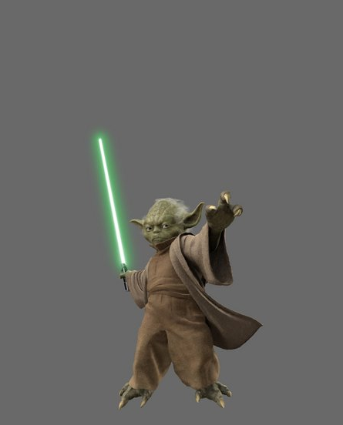
You Decide

