Slide 1

Community Keys
key features you should know about
Nick Airdo
Software Engineer
Central Christian Church
Email: nick.airdo@cccev.com
Twitter: @airdo
Tweet using #RefreshCache

Slide 2
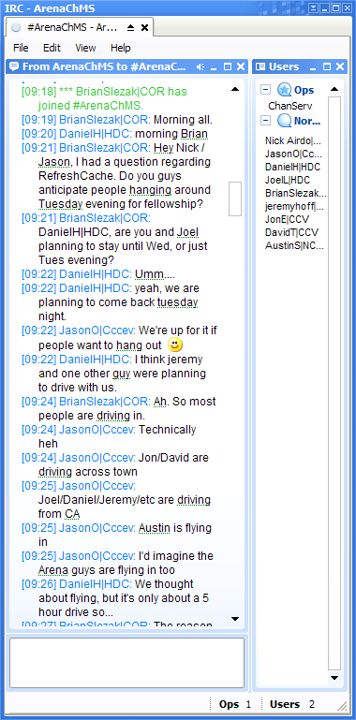
#ArenaChMS on IRC
Thanks to Brian!
The best thing that’s happened to the community in a year
If you only take away one thing from R.C. this is it!!

Slide 3
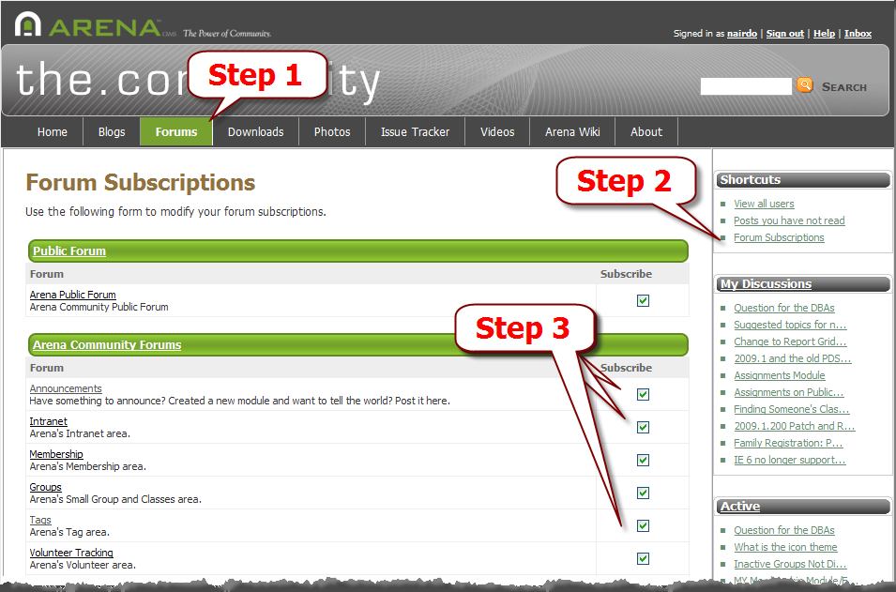
Subscriptions
Your forum subscriptions on the.Community site

Slide 4
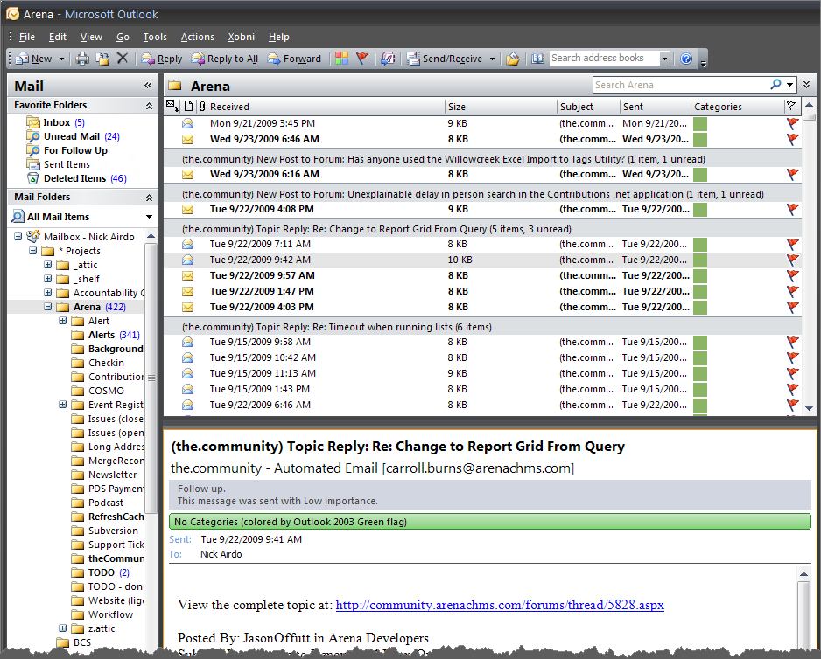
Email Rules
Useful with Outlook’s Arrange By Conversation

Slide 5
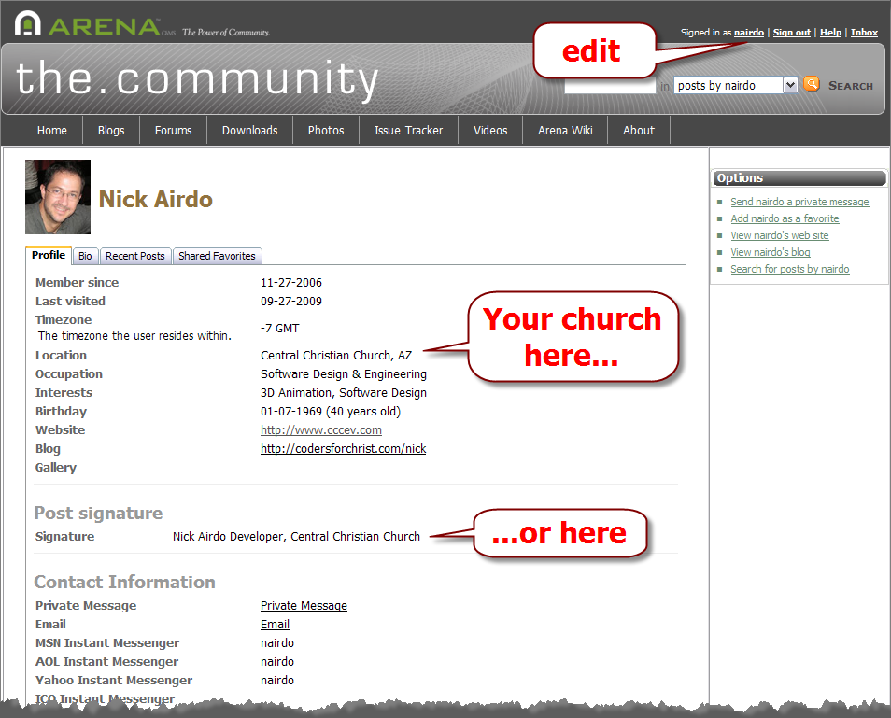
Your Profile
Let people know who you are

Slide 6
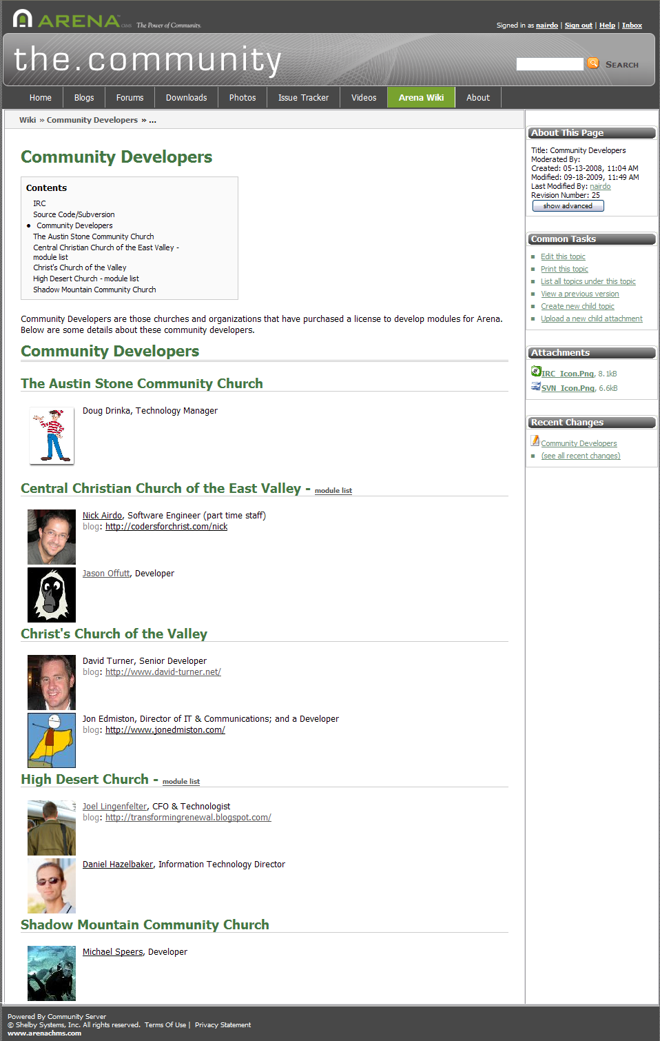
Community Developers
Create/update your section on the Community Developers wiki page

Slide 7
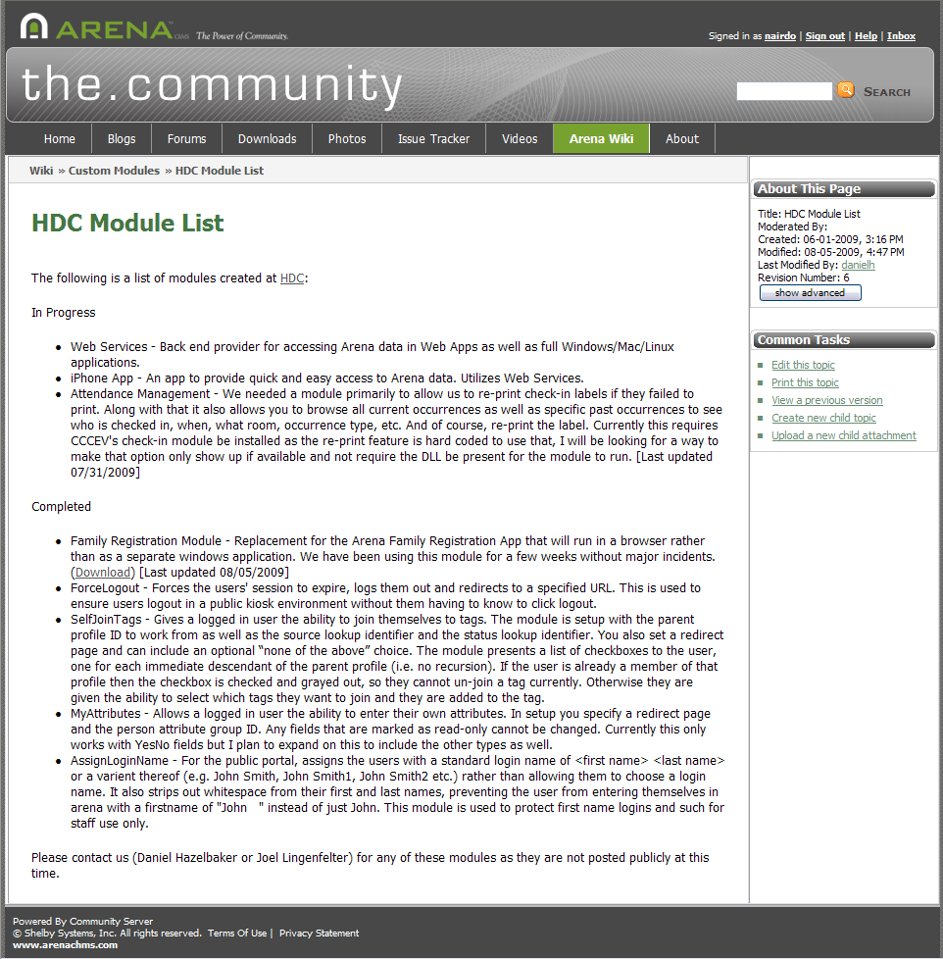
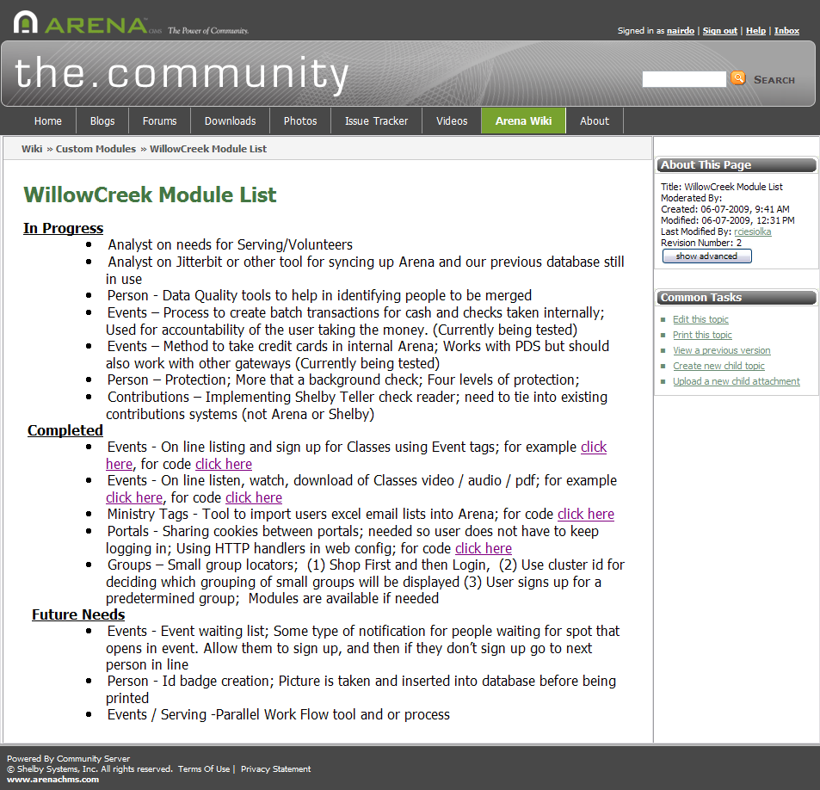
Your Plan
Let us know what you’re working on

Slide 8
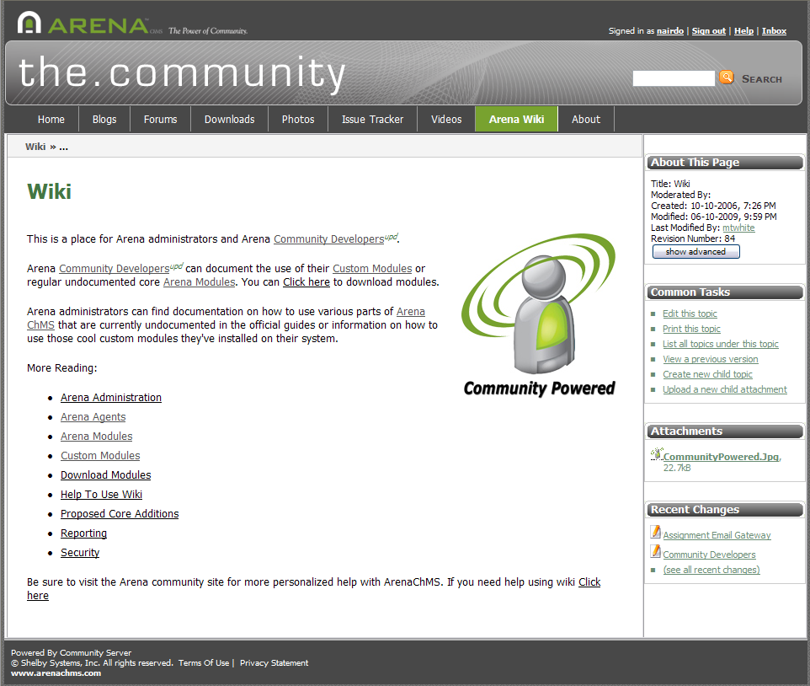
The Wiki
Don’t be shy
It’s community powered

Slide 9
Wiki Change Notifications
Recently discovered goodness…
RSS Feed!

Slide 10
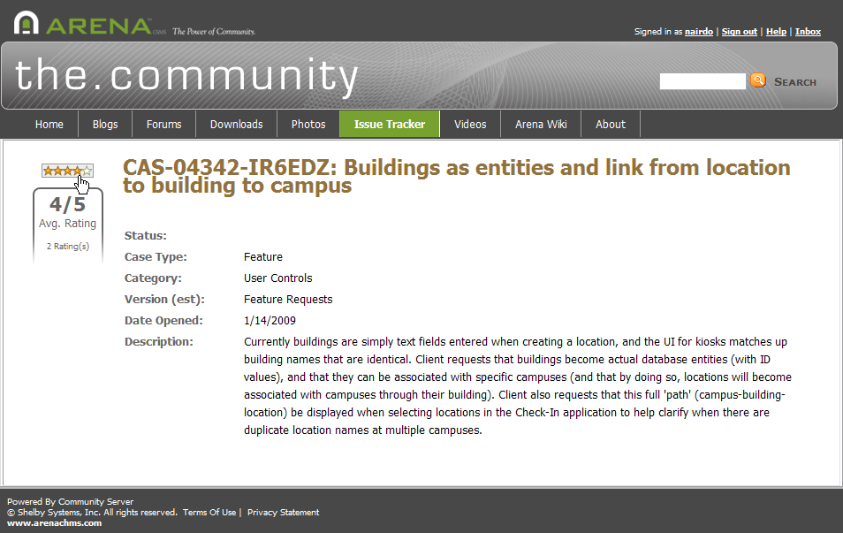
Feature Voting
Vote by clicking the rating stars:

Slide 11
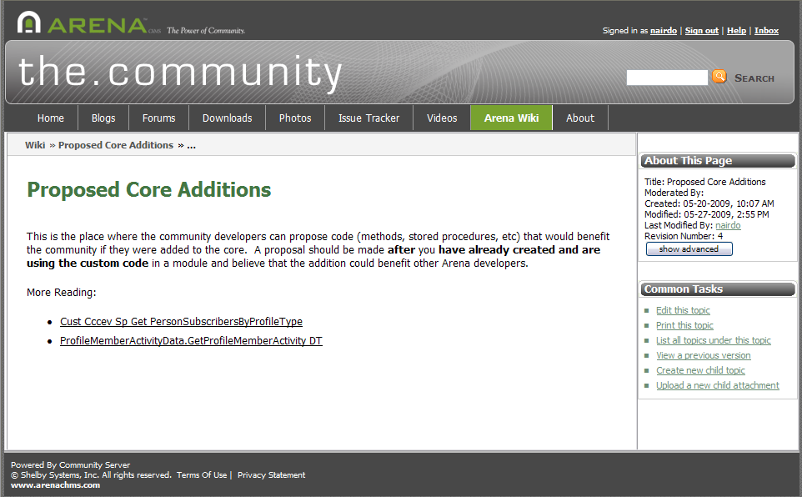
Proposed Core Additions
Until we have a better mechanism use this page

Slide 12
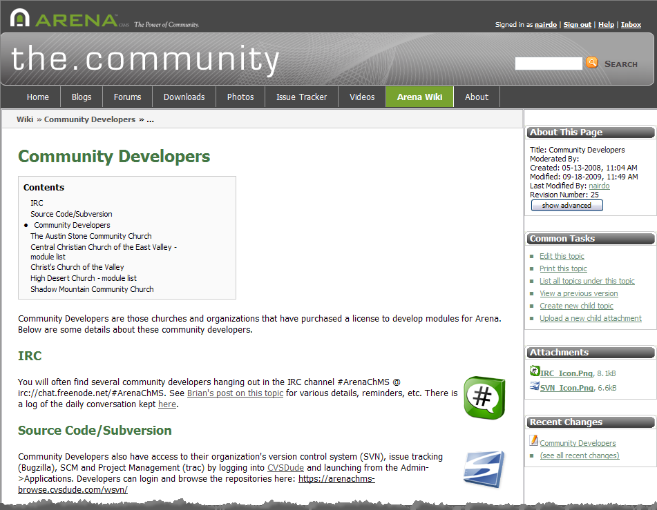
Source Code Repo/SVN
Details on the Community Developers page

Slide 13
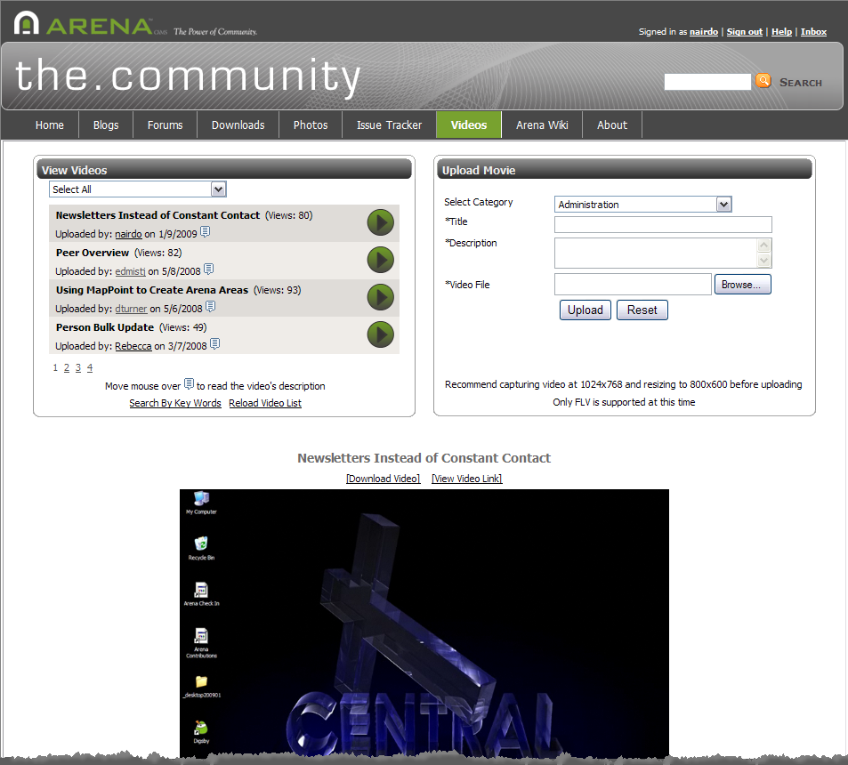
Video Demos
Upload your video demos here
Recommend capturing video at 1024x768 and resizing to 800x600 before uploading
Only FLV is supported at this time

Slide 14
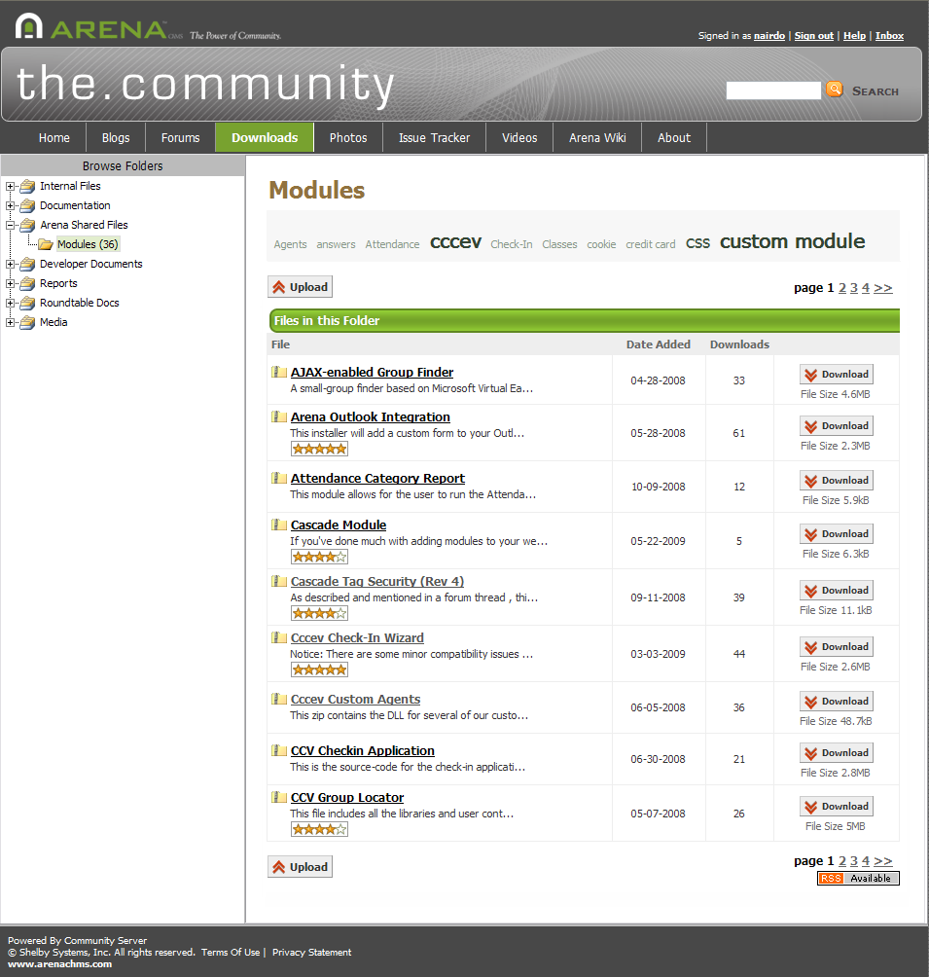
Current Module Repository
Zip it up and upload it here
Downloads > Arena Shared Files > Modules
More on this later…

Slide 15
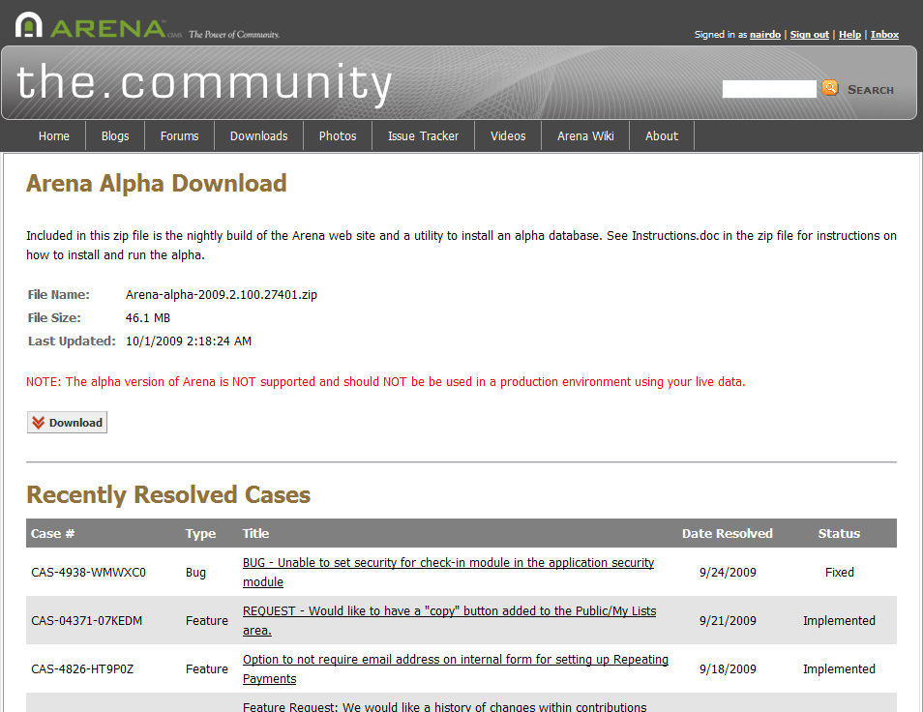
Alpha
http://community.arenachms.com/alpha/

Slide 16
And last but not least…

Slide 17
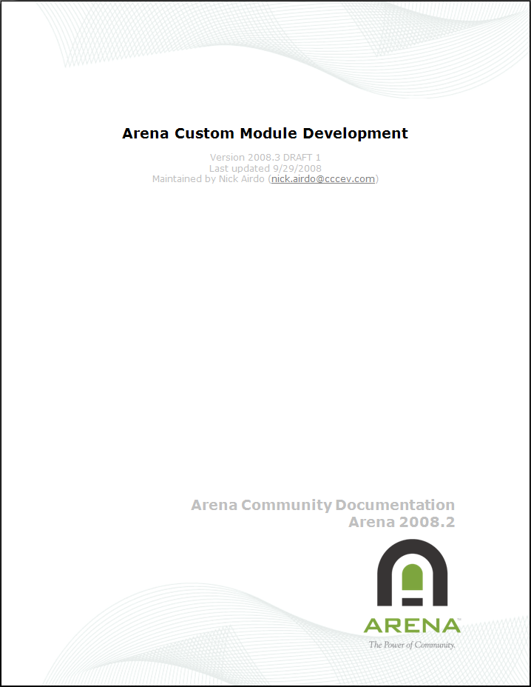
ACMD Guide
Arena Custom Module Development guide
More discussion on this later…

