Slide 1
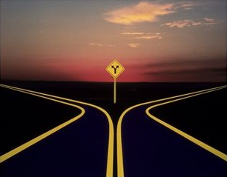
Beyond the Crossroad
The future is what we make it
Nick Airdo
Software Engineer
Central Christian Church
Email: nick.airdo@cccev.com
Twitter: @airdo
Tweet using #RefreshCache
We are here

Slide 2
Not a Conference
Something changed
Probably started with the events of this past winter/spring
The W.F. work between Jon, David, Doug (Austin Stone Church) & Arena
Working with Joel & Daniel, High Desert Church (HDC)
Branching of CCV and Arena
Voracity Solutions
Something clicked – locked in place
The potential became more clear, attainable
We struggled a bit with what “this” is
It’s not a conference – it’s a gathering.
of people with the same goals and extreme passion
of developers who have given their lives to Christ and as a result want to put their faith into action
It’s not a one way dialogue
I can’t convince you of what this is – you have to be it for yourself
Do you want to help others? I mean really. Do you want to help someone who might be struggling in the community to succeed?
We all have limited time and energy - being part of the community will cost you, if it doesn’t your not doing it right.
Notes:
Better to make more fisherman than to fish alone

Slide 3
Not a Conference
Don’t be concerned with the size of this team
Quality over quantity
Brief story: the debate; bigger != better
The people in this room are the leaders in this community – others will watch and follow your lead
So, encourage each other to lead
And be on the lookout for others that are “leaning in”
Unifying our efforts
Collaboration & co-operation over competition
Brief story: My WF idea vs. theirs
Notes:
Better to make more fisherman than to fish alone

Slide 4
What have we?
Arena is Unique
Only ChMS that allows this much control/customization
A small, small army of developers has sprung up (you)
There is a possibility of getting full source
We are not limited by the pace of our vendor
(It is a fallacy to think that you are)
We are limited only by our fear of collaboration and execution
Notes:
Better to make more fisherman than to fish alone

Slide 5
What are we?
Our Mantra
Aggressive Ministry Technology
Design for human interaction, not implementation
Brief story: Xbox vs. Wii controller

Slide 6
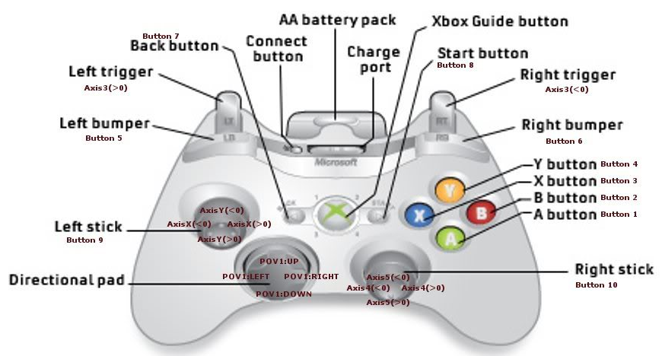
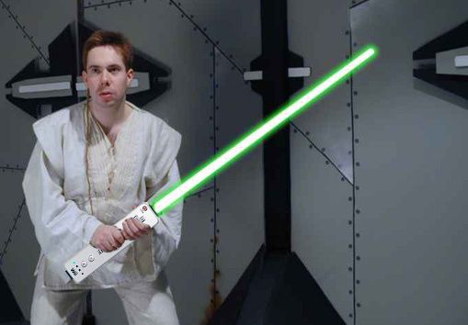

Slide 7
What are we? (cont.)
50/50
Brief Story: Spend 50% of your “axe sharpening” time on UI/UX design
We’re carb heavy
‘Don’t segregate soldiers and scholars’ (devs & designers/directors)

Slide 8
What’s next?
Today & Tomorrow
We’ll talk about some technology, discuss some initiatives, and make some plans
The CDB has made great strides in the full-source initiative
We need to figure out how we should maximize this opportunity
We need your expertise in work in a successful geographically disbursed, multi developer environment
We will plan to use some tools
RefreshCache <Sample Server /> (more later)
SVN, IRC, the Wiki, and Twitter

Slide 9
Communication is Everything
Or…
Communication isn’t everything it’s the only thing

Slide 10
Communication is Everything
Communicate, communicate, communicate
If people don’t know what you’ve done you may as well not have done it.
Communicating takes real time and effort
But the payoff is huge
IRC – your daily dose of this RefreshCache community and the rest of the community developers
Truly, we are about to see the rediscovery of IRC
Don’t’ believe me?
The Google Wave™ will make it happen

Slide 11
What if?
But what if we’re successful?
(BTW…we will be!)
We really need to think about our software priorities…
We need to think about what is really important to the church

Slide 12
Hold Tight!!!
Don’t stress and don’t give up
What is about to happen to you over the next two days is not meant to overwhelm you…

