Slide 1
jQuery Awesomeness
Using jQuery In Your Arena Modules
Jason Offutt
Software Engineer
Central Christian Church
Email: jason.offutt@cccev.com
Twitter: @yell0wdart
Tweet about us using #RefreshCache!

Slide 2
jQuery Boot Camp
Drilling through the DOM with Selectors
jQuery Selectors are compatible with the CSS 3.0 specification
General: $(“input”);
* Returns an array of ALL <input /> elements on the page
Narrow: $(“div#mainContent input.formItem:text);
* Selects all <input type=“text” class=“formItem” /> inside of the <div id=“mainContent”> element
Specific: $(“#myTextBox:text”);
* Selects only <input type=“text” id=“myTextBox” />

Slide 3
jQuery Boot Camp
this
The “this” keyword retains proper scope within jQuery
Using $(this) within an event handler will select the DOM element currently being interacted with
Traversing the DOM
jQuery’s API offers various helper methods for traversal
Positional methods:
first([selector]), last([selector]), next([selector]), prev([selector])
$(this).next() – selects the next sibling relative to the current element
Relational methods:
parent([selector]), parents([selector]), siblings([selector]), children([selector])
$(this).parent() – selects the immediate parent of the current element

Slide 4
jQuery Boot Camp
DOM Manipulation
CSS
css(“name”, “value”), css({ “name” : “value”}) – manipulates element’s “style” attribute
addClass(“class”) – adds CSS class to the element’s “class” attribute
removeClass(), removeClass(“class”) – removes all CSS classes, or just the specified one from the element’s “class” attribute
Attributes
attr(“name”), attr(“name”, “value”) – returns the string value of the given attribute name, or sets the value of the given attribute name on the selected element
removeAttr(“name”) – removes the given attribute from the selected element
Values, Text, HTML
val(), val(“value”) – returns the value of the selected input element or sets its value to the given string
text(), text(“value”) – returns the text value (no markup) of the selected element, or sets the inner text to the given string
html(), html(“value”) – returns an HTML string of the selected element’s inner HTML, or sets the inner HTML to the given string

Slide 5
jQuery Boot Camp
Branching
jQuery in common JavaScript branching structures
Using is([selector]) in an if block:
if ($(“#myTextbox”).is(“:hidden”)) { }
Using val() in a switch block:
switch ($(“#myHiddenField”).val()) { }
Looping
jQuery makes iteration easy with a “foreach”
Using each() to loop through an array:
$(“input:text”).each(function() { /* code inside the loop goes here */ });
Use $(this) within the loop to reference the current array member

Slide 6
jQuery Boot Camp
jQuery Simple Events
Document Ready
THE jQuery event… Everything else happens inside it
Fired when the page has been loaded
$(document).ready(function() { });
Most encompass traditional JavaScript events
click([event])
focus([event])
blur([event])
mouseover([event])
mouseout([event])
$(document).ready(function() {
$(“#myDeleteButton”).click(function(event) {
if (someConditionIsTrue) {
return true;
}
event.preventDefault();
return false;
});
});

Slide 7
jQuery Boot Camp
jQuery Compound Events
Provide added functionality, more robust features
mouseenter(function([args]) { })
mouseleave(function([args]) { })
hover(function([args]) { }, function([args] { })
$(“div.panel”).hover(
function() { // mouse enter
// mouseenter code goes here
},
function() { // mouse leave
// mouseleave code goes here
});
mouseover/mouseout vs mouseenter/mouseleave
Traditional JavaScript mouseover and mouseout events (and their jQuery counterparts) are fired when the mouse enters or leaves the parent element OR any of its children.
Can cause unexpected results. May fire more than necessary.
jQuery’s mouseenter and mouseleave events are fired independently. A parent’s mouseenter event is completely independent of any child elements that have a mouseenter event bound to them.
Leads to more predictable/reliable behavior.

Slide 8
jQuery Boot Camp
jQuery Live Events
Live Events
live(“event”, function(){ }), die(“event” function(){ })
Used for binding and unbinding events to dynamically created DOM elements
$(“input.formItem:button”).live(“click”, function() {
// event handling code goes here
});
$(“input.formItem:button”).die(“click”, function() {
// event disposal/cleanup code goes here
});

Slide 9
jQuery Boot Camp
jQuery Visual Effects & Transitions
Show/Hide
show([speed], [callback]), hide([speed], [callback]) – Show or hide a DOM element by adjusting it’s visibility and display settings
Fading
fadeIn([speed], [callback]), fadeOut([speed], [callback]) – Smoothly fades in or fades out a DOM element by adjusting it’s opacity
Sliding
slideUp([speed], [callback]), slideDown([speed], [callback]), slideToggle() – Smoothly slides a DOM element up or down by adjusting it’s offset height

Slide 10
jQuery Boot Camp
Resources
jQuery Documentation
jQuery API Browser
jQuery Plugins
jQueryUI

Slide 11
jQuery Deep Dive
Selecting ASP.NET controls with jQuery
Easily done inline with ASP.NET’s data binding tags
$(“#<%= myButton.ClientID %>”)…
While very easy, this technique is ONLY available to JavaScript code written inline in your aspx or ascx page. We can’t utilize a separate code file. This leads to one major problem…

Slide 12
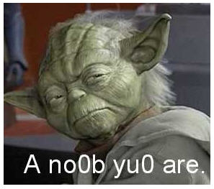
jQuery Deep Dive
Inline JavaScript is for n00bs… Real developers use separate code files!
How do we solve such
a dilemma?

Slide 13
jQuery Deep Dive
How can we select an ASP.NET control based on its client ID?
Advanced jQuery Selector Kung-Fu
Partial attribute value selectors
Attribute Equality “=“
$(“input[id=‘myTextBox’]”)…
Attribute Inequality “!=“
$(“input[id!=‘myTextBox’]”)…
This will select <inputs /> without an id attribute AND <inputs /> with an id attribute that is NOT EQUAL TO “myTextBox”
Attribute Starts With “^=“
$(“input[id^=‘myTextBox’]”)…
Attribute Ends With “$=“
$(“input[id$=‘myTextBox’]”)…
Attribute Contains “*=“
$(“input[id*=‘myTextBox’]”)…

Slide 14

jQuery Deep Dive
jQuery and ASP.NET AJAX
The $(document).ready() by itself works great… if you’re not dealing with a page that contains any Update Panels.
When a partial postback
occurs, all jQuery events
bound to controls INSIDE
an Update Panel get
unbound.
¡Ay Dios mío! (OMG!)

Slide 15
jQuery Deep Dive
PageRequestManager to the rescue!
Singleton implementation, similar to the ScriptManager
Utilizes a page life-cycle, similar to ASP.NET’s server-side page life-cycle
Initialize Request
Begin Request
Page Loading
Page Loaded
End Request
Event handling in traditional .NET style
Optional sender and args parameters for each page event
$(document).ready(initAll);
Sys.WebForms.PageRequestManager.getInstance().add_endRequest(initAll);
function initAll() {
// all jQuery events for your module are bound here
}

Slide 16
jQuery Deep Dive
Maintaining Client “State” Across Server Posts
Problem:
You have a collapsible panel with form controls that generate a server post. You want to keep the panel open after post, but since the web is stateless, your panel is always closed by default (as defined in your CSS) after a postback.
Solution: Abuse hidden fields to keep track of state information
Hidden fields participate in View State, so their value will persist across server posts
Your markup might look like this:
<input type=“hidden” id=“ihPanelOpen” runat=“server” />
<div class=“panel”>HTML text, form stuff, etc</div>
Your JavaScript could do this:
var hiddenField = $(“input[id$=‘ihPanelOpen’]:hidden”);
if (hiddenField.val() == “true”) {
hiddenField.next(“div.panel”).show();
}

Slide 17
jQuery Deep Dive
jQuery vs ASP.NET AJAX element selection
Both perform similar tasks
ASP.NET AJAX’s $get() & $find()
Both return a DOM element
$get() is shorthand for document.getElementById()
$find() is shorthand for Microsoft’s Sys.Application.findComponent()
Both are static method calls

Slide 18
jQuery Deep Dive
jQuery vs ASP.NET AJAX element selection
Both perform similar tasks
jQuery’s $() (or jQuery())
$() returns an array of jQuery objects
jQuery objects wrap DOM element properties within framework method calls
“$” is shorthand for “jQuery”
$ is an object

Slide 19
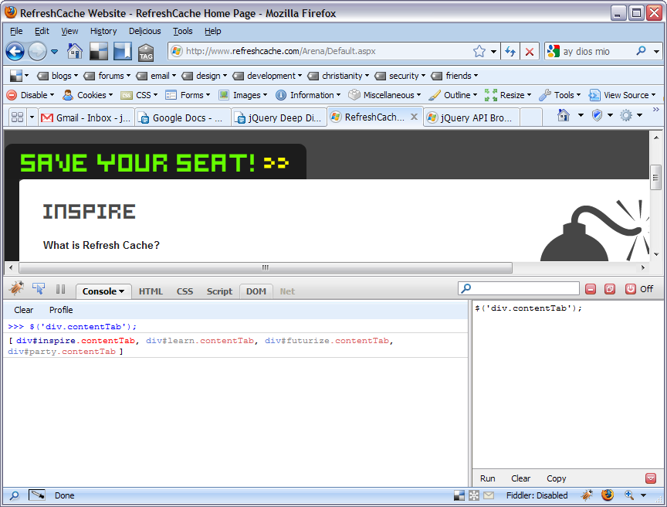
jQuery Deep Dive
Using the FireBug Console to troubleshoot your jQuery Selectors

Slide 20
jQuery Awesomeness
Any Questions?
Email: jason.offutt@cccev.com
Twitter: @yell0wdart
IRC: irc://chat.freenode.net/ArenaChMS
GTalk: jason.offutt@gmail.com
Web: http://jordanrift.com

