Slide 1

Tools of the Trade
using msbuild to automate packaging
Nick Airdo
Software Engineer
Central Christian Church
Email: nick.airdo@cccev.com
Twitter: @airdo
Tweet using #RefreshCache

Slide 2
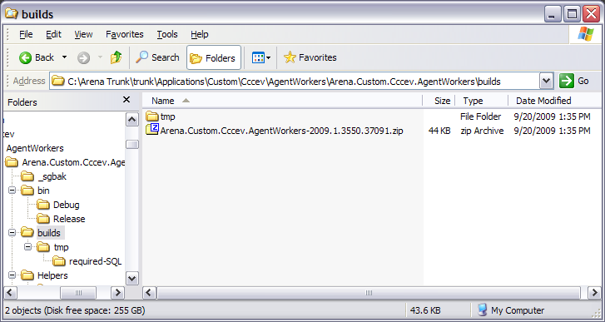
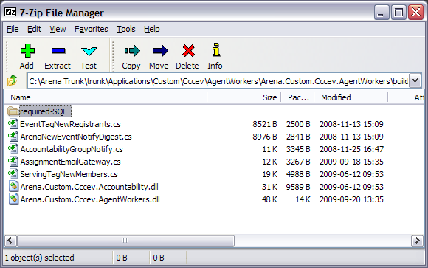

Monkey Tasks
Kill the monkey

Slide 3
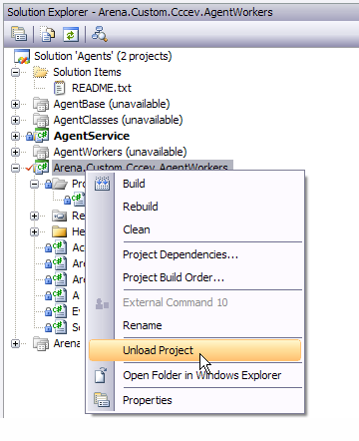
Visual Studio Project
Unload
Edit

Slide 4
the .csproj
Import
Target
Clean
<Project>
.
.
.
<Import Project="$(MSBuildExtensionsPath)\MSBuildCommunityTasks\MSBuild.Community.Tasks.Targets" />
<PropertyGroup>
<BuildDir>builds</BuildDir>
</PropertyGroup>
<Target Name="AfterBuild" DependsOnTargets="BuildPackageZip">
</Target>
<!-- Clean old stuff -->
<Target Name="DeleteFiles">
<ItemGroup>
<OldFiles Include="$(BuildDir)\tmp\**" />
</ItemGroup>
<Delete Files="@(OldFiles)" />
</Target>

Slide 5
Continued…
Copy
…
<!-- Prepare the files to be zipped -->
<Target Name="CopyFiles" DependsOnTargets="DeleteFiles">
<ItemGroup>
<CopyFiles Include="*.cs" Exclude="MetricsByZip.cs;ArenaFamilySplitter.cs" />
<CopyFiles Include="$(OutputPath)Arena.Custom.Cccev.Accountability.dll" />
<CopyFiles Include="$(OutputPath)Arena.Custom.Cccev.AgentWorkers.dll" />
</ItemGroup>
<ItemGroup>
<SqlFiles Include="Helpers\SQL\*“ />
</ItemGroup>
<MakeDir Directories="$(BuildDir)\tmp" Condition="!Exists('$(BuildDir)\tmp')" />
<MakeDir Directories="$(BuildDir)\tmp\required-SQL" Condition="!Exists('$(BuildDir)\tmp\required-SQL')" />
<Copy SourceFiles="@(CopyFiles)" DestinationFolder="$(BuildDir)\tmp" />
<Copy SourceFiles="@(SqlFiles)" DestinationFolder="$(BuildDir)\tmp\required-SQL" />
</Target>
…

Slide 6
Continued…
Condition
Version
Zip
<!-- Create the package zip file -->
<Target Name="BuildPackageZip" DependsOnTargets="CopyFiles“
Condition="'$(Configuration)' == 'Release'">
<ItemGroup>
<ZipFiles Include="$(BuildDir)\tmp\**" />
</ItemGroup>
<Version BuildType="Automatic" RevisionType="Automatic" Major="2009" Minor="1“>
<Output TaskParameter="Major" PropertyName="Major" />
<Output TaskParameter="Minor" PropertyName="Minor" />
<Output TaskParameter="Build" PropertyName="Build" />
<Output TaskParameter="Revision" PropertyName="Revision" />
</Version>
<Zip Files="@(ZipFiles)" WorkingDirectory="$(BuildDir)\tmp\"
ZipFileName="$(BuildDir)\Arena.Custom.Cccev.AgentWorkers-$(Major).$(Minor).$(Build).$(Revision).zip"
ZipLevel="9" />
</Target>
.
.
.
</Project>
Notes:
Note the conditional – only runs if in “Release” configuration.

Slide 7
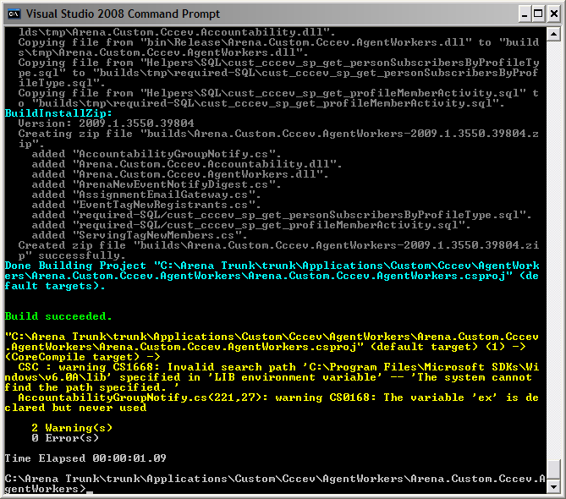
command line
msbuild Arena.Custom.Cccev.AgentWorkers.csproj /property:Configuration=Release

Slide 8
Get Free Tasks
MSBuild.Community.Tasks http://msbuildtasks.tigris.org/
MSBuild Extension Pack http://msbuildextensionpack.codeplex.com/

