Slide 1


M.Tech Program
Advanced Industry Integrated Programs
Jointly offered by University and LTIMindTree
AI-Powered Reverse Logistics for
e-commerce
Pottam Anisha
Knowledge partner | Implementation partner

Slide 2
AI-Powered Reverse Logistics for e-commerce
Introduction
Reverse logistics and returns management are critical for modern e-commerce platform.
Traditional system lacks predictive and prescriptive capabilities.
This project uses AI techniques to make reverse logistic smarter and more sustainable.

Slide 3
AI-Powered Reverse Logistics for e-commerce
Objective
Predict product return likelihood and fraudulent behaviors.
Estimate return cycle and cost per return.
Analyze customer sentiment from textual feedback.
Compute susteainability metrics(CO2 emission).
Provide AI explainability.
Deploy in streamlit.

Slide 4
AI-Powered Reverse Logistics for e-commerce
Scope
Return Prediction
Cycle time Estimation
Cost per return
Disposition Decision(Resell, Refurbish, Scrap)
Fraud Detection
CSAT Score
Sustainability Score(CO2 saved)

Slide 5
AI-Powered Reverse Logistics for e-commerce
e Logistics
Literature Review
[1] Blockchain and AI in Reverse Logistics: A Qualitative Synthesis of Strategic Applications and Challenges, Merium Bouzedif, 2025
[2] Application of AI in reverse logistics, Sudipta Chowdhury, 2024
[3] AI – Driven innovations for Sustainable E-commerce returns management, Bo Chiuan Su, 2025
[4] Return management in e-commerce firms: ML approach to predict product returns, Anurag Mishra, 2024

Slide 6
AI-Powered Reverse Logistics for e-commerce
Logistics
Summary of Literature
Combining blockchain with AI improves efficiency, transparency and fraud prevention.
Research trends show a clear shift towards AI-driven automation and circular supply chain optimization.
AI reduces both costs and environmental impact by optimizing routes and recyclability in returns.
ML driven categorization and handling of returns improve accuracy, lower costs and boost customer satisfaction.

Slide 7
AI-Powered Reverse Logistics for e-commerce
Logistics
Key Differentiators
Proactive Vs Reactive
Integrated KPIs
Fraud + Sustainability Focus
Prescriptive AI

Slide 8
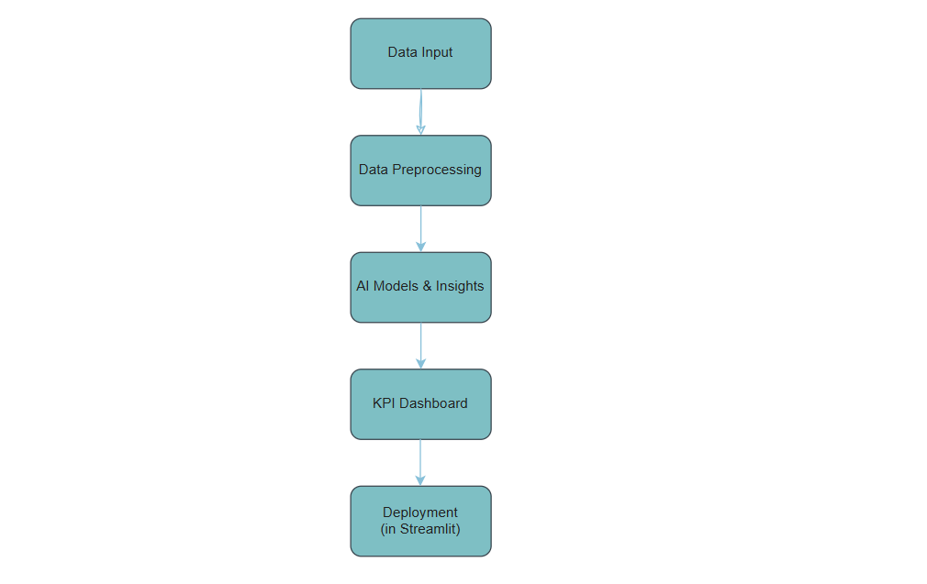
AI-Powered Reverse Logistics for e-commerce
Logistics
Flowchart

Slide 9
AI-Powered Reverse Logistics for e-commerce
Modules to cover
Data Collection and preparation
E-commerce orders, returns, feedback, logistics.
Feature engineering: customer profile, sentiment etc.
Exploratory Data Analysis
Analyse return trends, fraud detection analysis, sentiment distribution, correlation analysis between price and return rate, visualizations.

Slide 10
AI-Powered Reverse Logistics for e-commerce
Modules to cover
3. Baseline Modeling
Return prediction(logistic regression), fraud detection(Isolation forest), linear/XGBoost regression,Sentiment(TF-IDF + Logistic Regression)
4. Advanced Modeling
LSTM, Prophet, OR-Tools, DistilBERT.

Slide 11
AI-Powered Reverse Logistics for e-commerce
Modules to cover
5. Explainability and Insights
Apply SHAP and LIME for model explainability.
Show why an order is flagged.
6. Deployment and Visualization
Build Streamlit Dashboard.
Geospatial Mapping

Slide 12
AI-Powered Reverse Logistics for e-commerce
THANK YOU

