Slide 1


M.Tech/MCA Program
Advanced Industry Integrated Programs
Jointly offered by University and LTIMindTree
Review III
Real time Sign Language to Text Converter
using contextualization
Team Member
Nairit Das
Knowledge partner | Implementation partner

Slide 2
Real time Sign Language to Text Converter
Introduction
Problem: Overcoming the communication gap for the deaf and hard-of-hearing.
Solution: A real-time app to translate ASL alphabet gestures into text via webcam.
Technology: A deep learning model analyzing hand shape and motion for accuracy.
Goal: Using AI to build an accessible tool that fosters greater inclusivity.

Slide 3
Real time Sign Language to Text Converter
Objective
Develop a real-time application to translate ASL alphabet signs into text via a webcam.
Implement a deep learning model (CRNN) to accurately recognize gesture sequences.
Using LLMs to include efficient and simplified contextualization.
Achieve high validation accuracy for reliable performance.

Slide 4
Real time Sign Language to Text Converter
Objective
Design a simple and user-friendly interface for seamless interaction.
Daily Life: Enable direct communication for deaf individuals in everyday settings (e.g., retail, banking).
Inclusivity: Foster greater participation for the deaf community in education and workplaces.

Slide 5
Real time Sign Language to Text Converter
Modules
Data Preparation & Augmentation
Deep Learning Model Architecture
Model Training
Testing With Synthetic test Data
Real-Time Inference Application

Slide 6
Real time Sign Language to Text Converter
Problem Statement
To create a real-time, AI-powered web application that translates American Sign Language finger-symbols into text to bridge the communication gap.

Slide 7
Real time Sign Language to Text Converter
Methodology/Modeling Plan
Data Preparation: Training images were resized to 128x128 and converted to RGB to maximize detail and ensure compatibility.
Model Architecture & Training: Train a powerful EfficientNetV2 + GRU model using a two-stage fine-tuning strategy to achieve the highest possible accuracy in recognizing individual signs.

Slide 8
Real time Sign Language to Text Converter
Methodology/Modeling Plan
Inference Pipeline: Use a "sliding window" technique to apply the trained model across a full video, generating a continuous stream of character predictions that are then decoded into a raw text string.
Final Translation: Send the raw, messy text string from the model to the Gemini API with a simple instruction to correct it into a clean and coherent English sentence.

Slide 9
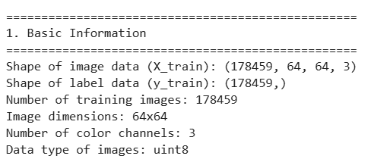
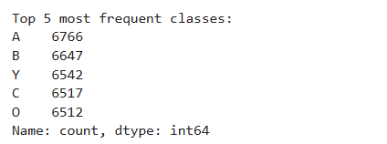
Real time Sign Language to Text Converter
Data Preprocessing
Exploratory Data Analysis

Slide 10
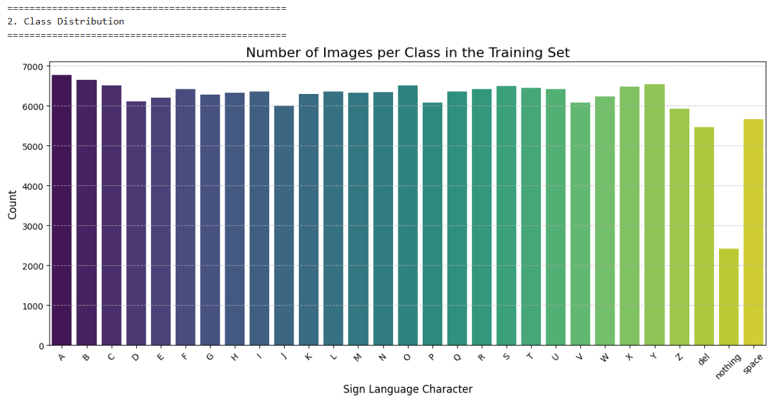
Real time Sign Language to Text Converter
Data Preprocessing
Exploratory Data Analysis

Slide 11
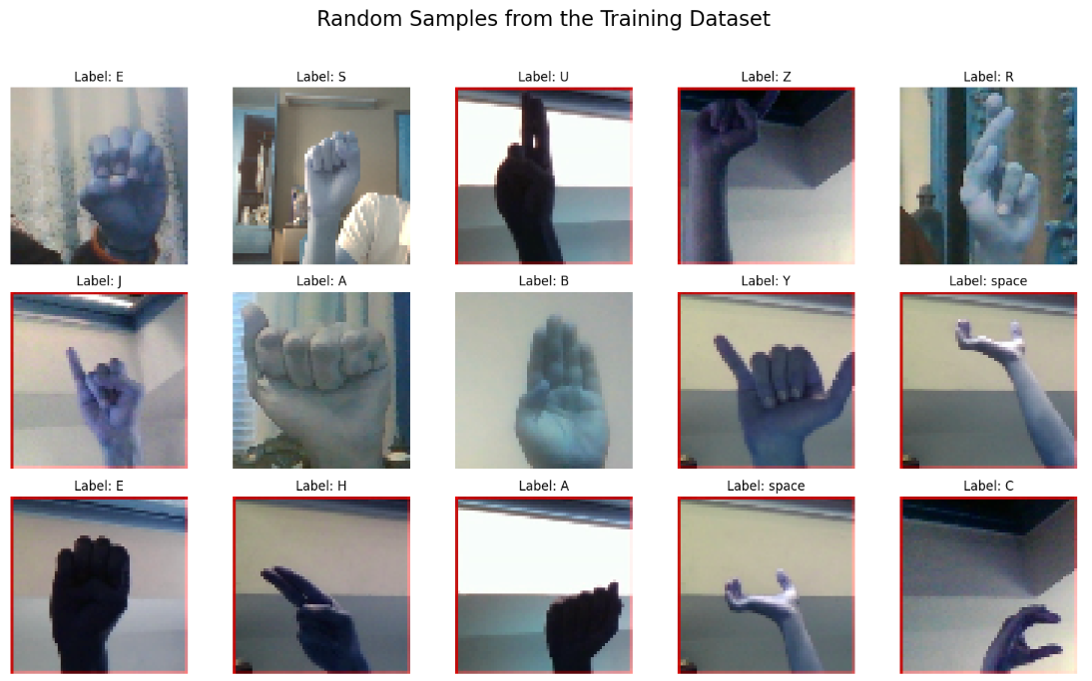
Real time Sign Language to Text Converter
Data Preprocessing
Exploratory Data Analysis

Slide 12
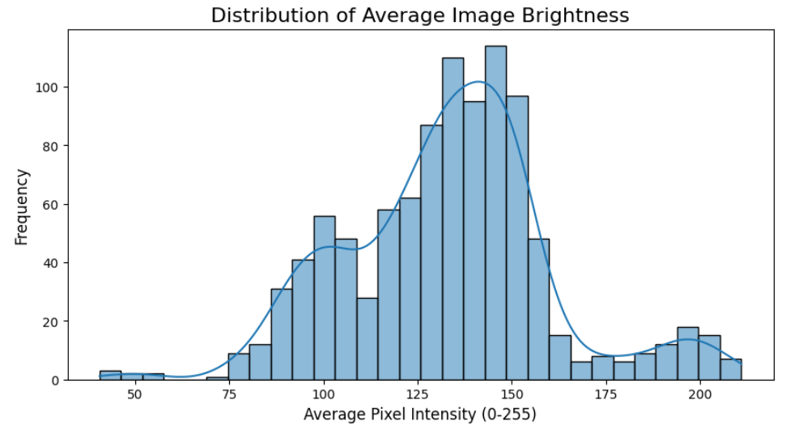
Real time Sign Language to Text Converter
Data Preprocessing
Exploratory Data Analysis

Slide 13
Real time Sign Language to Text Converter
Approach/Algorithms/Tools
EfficientNetV2 - Spatial feature extraction from individual sign language images.
GRU (Gated Recurrent Unit) - Temporal sequence processing of the image features.
Two-Stage Fine-Tuning - Advanced transfer learning strategy to maximize model accuracy.
Sliding Window Algorithm - Inference technique to apply the sequence model to videos of any length.

Slide 14
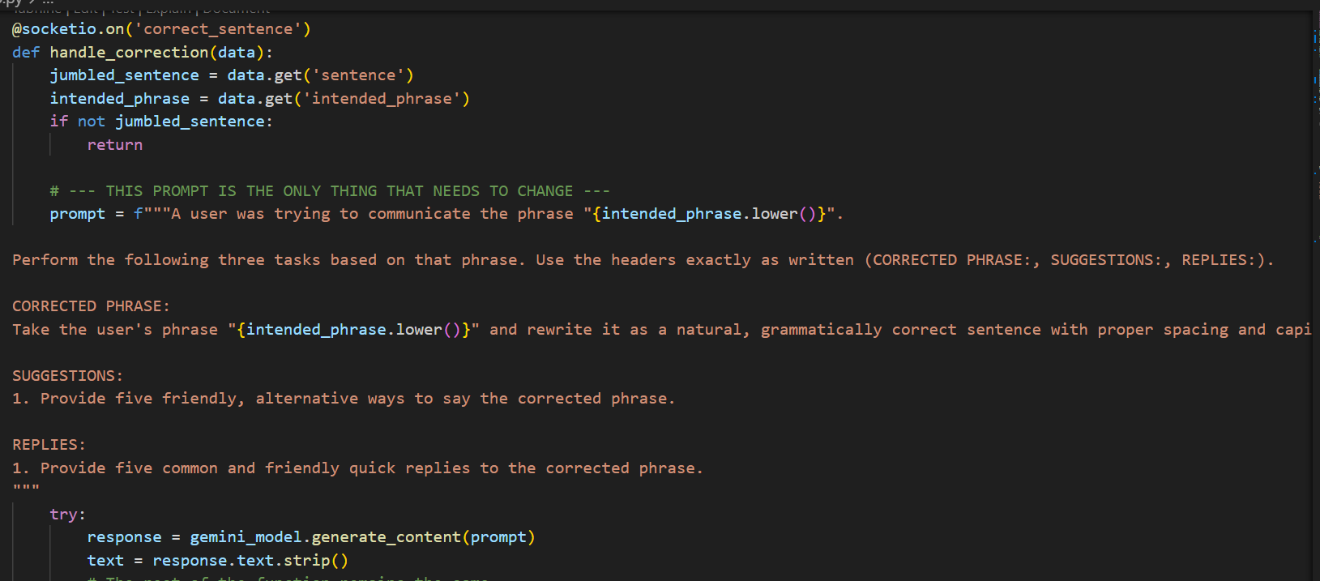
Real time Sign Language to Text Converter
Approach/Algorithms/Tools
Gemini Pro (LLM) - Few-shot text correction and contextualization.
TensorFlow/Keras - Primary deep learning framework for model building and training.
OpenCV - Core tool for all video and image preprocessing tasks.

Slide 15
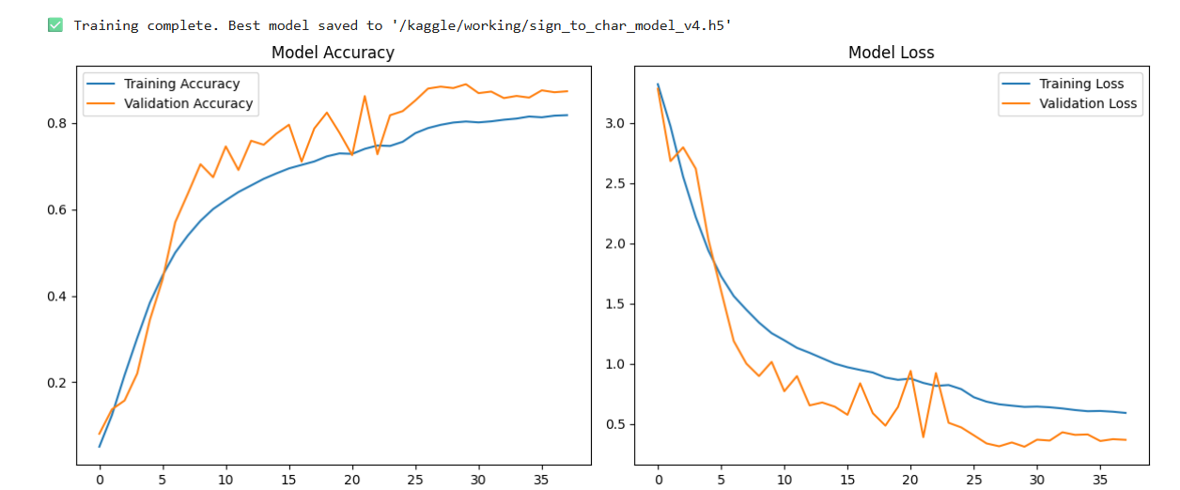
Real time Sign Language to Text Converter
Training
Model Training: The model was fine-tuned in two stages for high accuracy: first the classifier head, then the entire model using a low learning rate.

Slide 16
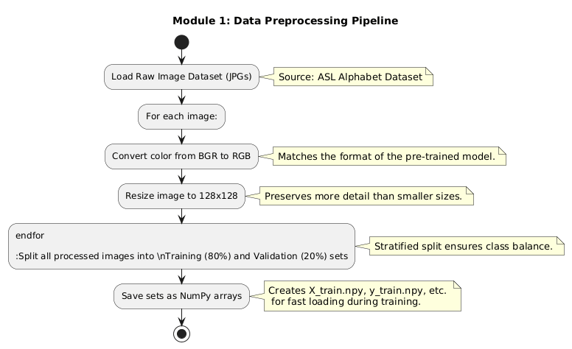
Real time Sign Language to Text Converter
Pipeline structure

Slide 17
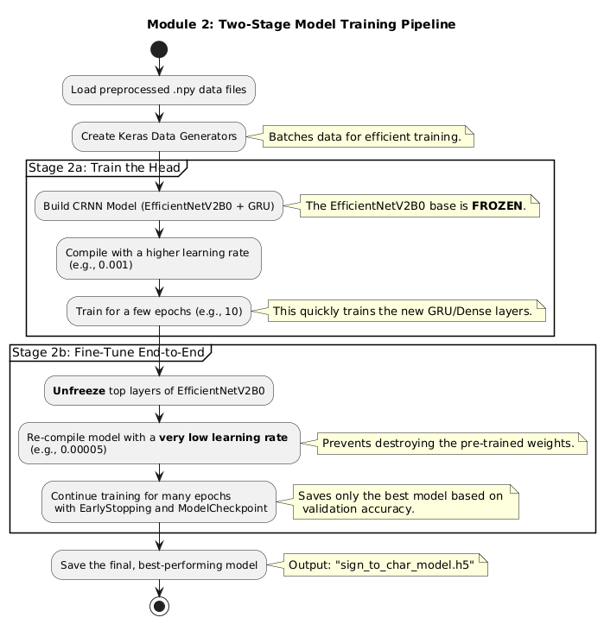
Real time Sign Language to Text Converter
Pipeline structure

Slide 18
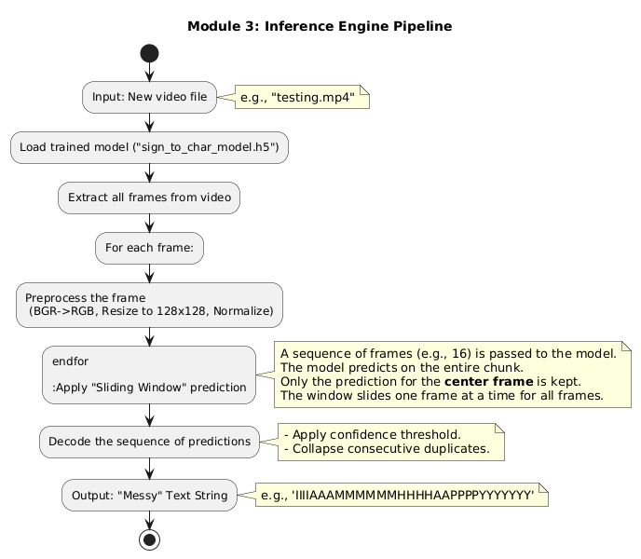
Real time Sign Language to Text Converter
Pipeline structure

Slide 19
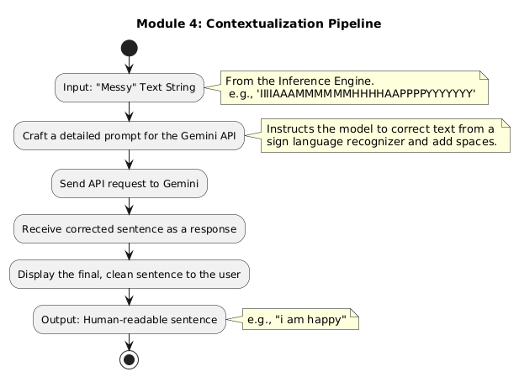
Real time Sign Language to Text Converter
Pipeline structure

Slide 20
Real time Sign Language to Text Converter
Findings and Results
Real-Time Sign Recognition: Successfully developed a computer vision pipeline using a Convolutional Neural Network (CNN) that accurately classifies individual ASL finger-spelling gestures from a live webcam feed, even with intentional "jumbling" and random characters.
AI-Powered Correction & Enhancement: Integrated a Large Language Model (Google's Gemini) to intelligently correct the raw, jumbled text into a coherent sentence, and further enhance the user experience by generating context-aware suggestions and quick replies.

Slide 21
Real time Sign Language to Text Converter
Conclusion
This project successfully developed an intelligent communication aid by synergizing a real-time sign language recognition model with a generative AI for advanced text correction and contextual enhancement.

Slide 22
Real time Sign Language to Text Converter
Acknowledgement
I extend my deepest gratitude to my mentors, for their invaluable mentorship and support throughout this project.
My sincere thanks to my peers and colleagues for their insightful discussions and collaborative spirit.
I also thank LTIMindtree for giving me this opportunity to implement my knowledge

Slide 23
Real time Sign Language to Text Converter
Reference
Sign Language Gloss translation using LLMs and Semantically Aware Label Smoothing
EfficientNet Paper
Github
Ai Studio , Microsoft Copilot

Slide 24
Real time Sign Language to Text Converter
Thank You

