Slide 1


M.Tech Program
Advanced Industry Integrated Programs
Jointly offered by University and LTIMindTree
Real time Sign Language to Text Converter
using contextualization
Team Member
Nairit Das
Knowledge partner | Implementation partner

Slide 2
Real time Sign Language to Text Converter
using contextualization
Introduction
Problem: Overcoming the communication gap for the deaf and hard-of-hearing.
Solution: A real-time app to translate ASL alphabet gestures into text via webcam.
Technology: A deep learning model analyzing hand shape and motion for accuracy.
Goal: Using AI to build an accessible tool that fosters greater inclusivity.

Slide 3
Real time Sign Language to Text Converter
using contextualization
Objective
Develop a real-time application to translate ASL alphabet signs into text via a webcam.
Implement a deep learning model (CRNN) to accurately recognize gesture sequences.
Using GRU to include efficient and simplified contextualization.
Achieve high validation accuracy (over 85%) for reliable performance.

Slide 4
Real time Sign Language to Text Converter
using contextualization
Objective
Design a simple and user-friendly interface for seamless interaction.
Daily Life: Enable direct communication for deaf individuals in everyday settings (e.g., retail, banking).
Inclusivity: Foster greater participation for the deaf community in education and workplaces.

Slide 5
Real time Sign Language to Text Converter
using contextualization
Scope
Recognizes ASL Alphabet (A-Z)
Recognizes Digits (0-9)
Provides real-time translation
Uses a standard webcam for input
Requires single-handed signs
Needs good lighting & a clear background
Built with Python, TensorFlow, & OpenCV
Delivers a final trained model

Slide 6
Real time Sign Language to Text Converter
using contextualization
Literature Review
[1]: Fayyazsanavi, Pooya, et al. “Gloss2Text: Sign Language Gloss Translation Using LLMs and Semantically Aware Label Smoothing.” ArXiv.org, 2024, arxiv.org/abs/2407.01394. Accessed 10 Sept. 2025.
[2]: Pang, Haozhou, et al. LLM Gesticulator: Leveraging Large Language Models for Scalable and Controllable Co-Speech Gesture Synthesis. Apr. 2025, pp. 8–0, https://doi.org/10.1117/12.3060395. Accessed 10 Sept. 2025.

Slide 7
Real time Sign Language to Text Converter
using contextualization
Literature Review
[3]: Tan, Sihan, et al. “Improvement in Sign Language Translation Using Text CTC Alignment.” ArXiv.org, 2024, arxiv.org/abs/2412.09014. Accessed 10 Sept. 2025.
[4]: Liang, Han, et al. “LLaVA-SLT: Visual Language Tuning for Sign Language Translation.” ArXiv.org, 2024, arxiv.org/abs/2412.16524. Accessed 10 Sept. 2025.

Slide 8
Real time Sign Language to Text Converter
using contextualization
Literature Review
Gloss2Text
Contribution: This work improves the translation of sign language glosses (textual representations of signs) into fluent spoken text.
Method & Relevance: It fine-tunes a large multilingual LLM and uses smart data augmentation and a novel loss function to handle translation ambiguities. This shows that leveraging large, pre-trained models and using advanced training techniques are highly effective strategies for improving translation quality.

Slide 9
Real time Sign Language to Text Converter
using contextualization
Literature Review
LLM Gesticulator
Contribution: This paper generates realistic human body movements that accompany speech from an audio input.
Method & Relevance: It treats motion as a language, tokenizing it and using a Large Language Model (LLM) to "translate" audio to gestures. This validates the core concept of using a translation-based AI model for a visual task like sign language recognition.

Slide 10
Real time Sign Language to Text Converter
using contextualization
Literature Review
Text CTC Alignment
Contribution: This research improves sign language translation by using a hybrid model to better handle the different word order between sign videos and spoken text.
Method & Relevance: It uses a Joint CTC/Attention framework with a hierarchical encoder that reorders visual features to match the text structure. This offers a powerful architectural solution to the core challenge of aligning visual sequences with differently structured text output.

Slide 11
Real time Sign Language to Text Converter
using contextualization
Summary of Literature
The Old Problem: Early Sign Language Translation (SLT) models relied on an intermediate "gloss" step, which created an information bottleneck.
The Unexplored Opportunity: Recent "gloss-free" models, while more direct, have largely ignored the powerful reordering capabilities of Connectionist Temporal Classification (CTC).
The Proposed Solution: To fill this gap, this research proposes a hybrid Joint CTC/Attention framework.
Notes:
Add links to research paper, and select dataset

Slide 12
Real time Sign Language to Text Converter
using contextualization
Summary of Literature
The Core Function: This framework uses CTC's reordering ability to manage the complex, different word order between sign language video and spoken text.
Notes:
Add links to research paper, and select dataset

Slide 13
Real time Sign Language to Text Converter
using contextualization
Data Preparation & Augmentation
This initial stage prepares the raw dataset for training. It first augments the limited test set to create more data, then processes all images by standardizing their size and color. The final, clean data is saved into efficient NumPy (.npy) files for fast access during training.
Notes:
Add links to research paper, and select dataset

Slide 14
Real time Sign Language to Text Converter
using contextualization
Modules to cover
Data Preparation & Augmentation: Cleans, standardizes, and artificially expands the raw image dataset into a format ready for training.
Deep Learning Model Architecture: Defines the project's brain, a hybrid CNN-RNN model, to understand both the appearance and sequence of signs.

Slide 15
Real time Sign Language to Text Converter
using contextualization
Modules to cover
Model Training: Teaches the model to recognize signs by feeding it the prepared data over many cycles and saving the most accurate version.
Testing With Synthetic test Data: Evaluates the trained model's performance on the artificially expanded test dataset to measure its accuracy on unseen data.

Slide 16
Real time Sign Language to Text Converter
using contextualization
Modules to cover
Real-Time Inference Application: Integrates the trained model into a live application that translates hand signs from a webcam into text on the screen.

Slide 17
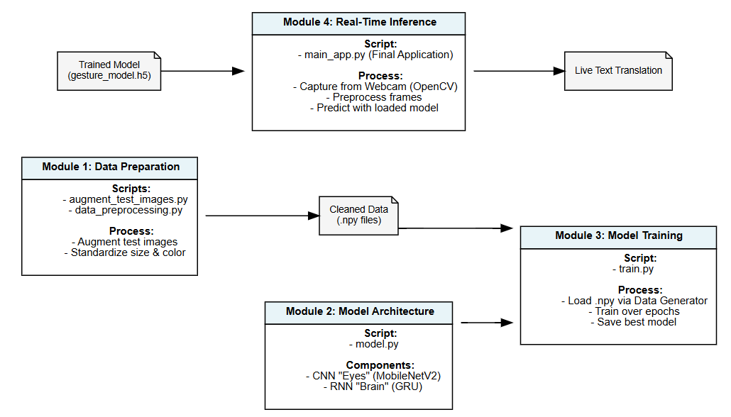
Real time Sign Language to Text Converter
using contextualization
Flowchart

Slide 18

Real time Sign Language to Text Converter
using contextualization
Any Question?

