Slide 1

PROJECT -2
WORLDWIDE-BOX-OFFICE-REVENUE

Slide 2
Introduction
The objective of the project is to predict the worldwide box office revenue based on certain parameters (customer feedbacks)
The input parameters chosen for the prediction of revenue are
Budget
Runtime
Original_language
Popularity
Release date
Status

Slide 3

Approach- Model
After studying the various model’s we concluded to use the following model’s in predicting the revenue
Linear Regression
Random forest Regression
Poly-Regression

Slide 4
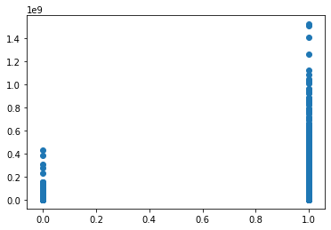
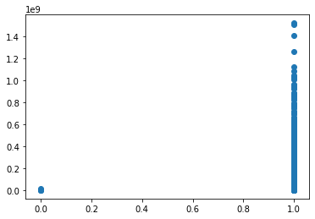
DATA CLEANING
Box-Office Revenue
Box-Office Revenue
Rumored
Movie Status
Released
Others
Movie language
En
Notes:
During data cleaning itself we can see that english language movies have grossed most of the revenue at box office
Also, we see that before the film release rumored movies also grossed some revenue
Rumored revenue = ?

Slide 5
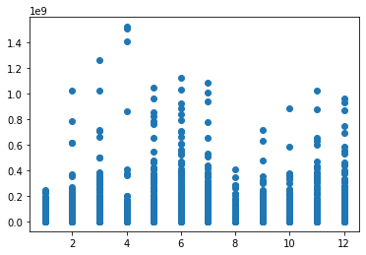
DATA CLEANING
Removed ‘NaN’
Revenue > 100
Budget > 0
Runtime > 0
Total Data : 2947 rows
Box-Office Revenue
Movie release Month

Slide 6
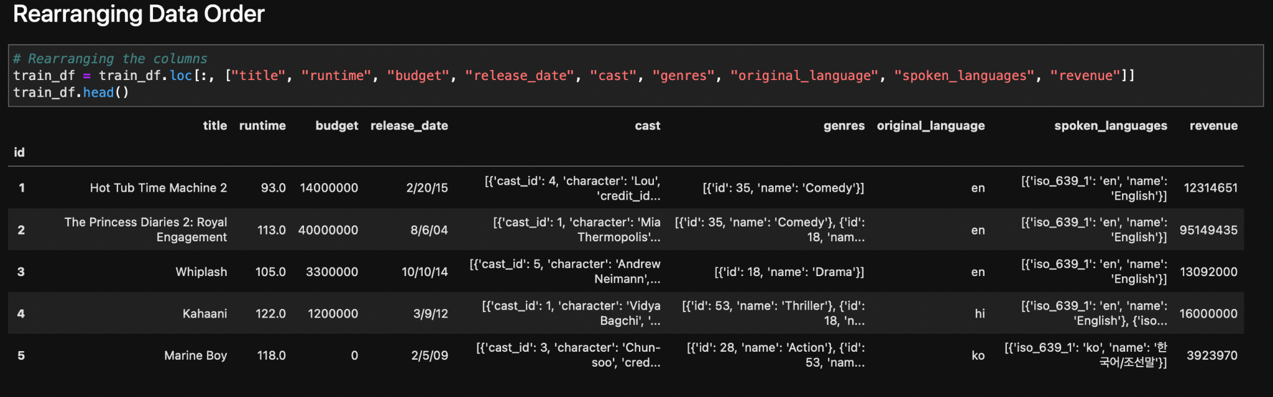
Extra Step in Data Cleaning

Slide 7
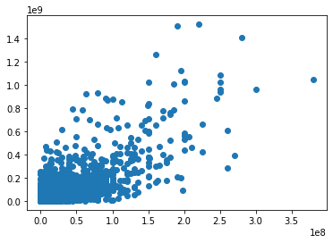
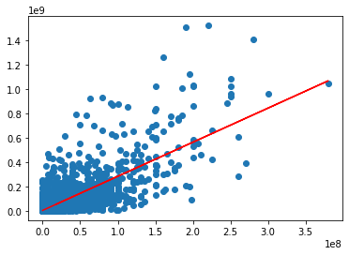
Linear Regression
Slope-
2.79586263
Y-intercept-
3853722.19546928
Box-Office Revenue
Box-Office Revenue
Budget
Budget
Notes:
We see the correlation of linear regression output to the predicted revenue

Slide 8
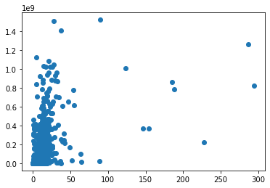
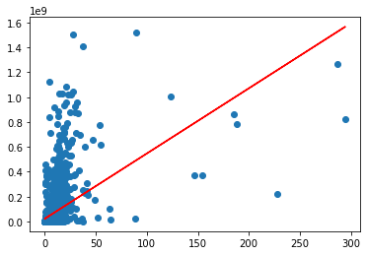
Linear Regression
Slope- 5243366.4052512
Y-intercept-
22349804.271705262
Box-Office Revenue
Box-Office Revenue
Popularity
Popularity
Notes:
Popularity was a float value obtained based on customer voting. The correlation of prediction somewhat matches the actual value where most of the data lies( ie.. between 100 and 50 million)

Slide 9
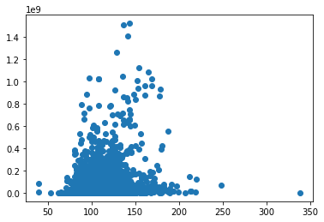
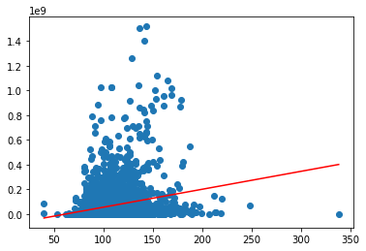
Linear Regression
Slope- 1453446.25672894
Y-intercept-
-89639096.12995665
Box-Office Revenue
Box-Office Revenue
Runtime
Runtime
Notes:
Runtime data is based on the number of days the movie ran and the prediction of revenue based on the number of days. Here we find the correlation of data between the runtime value 50 to 175

Slide 10
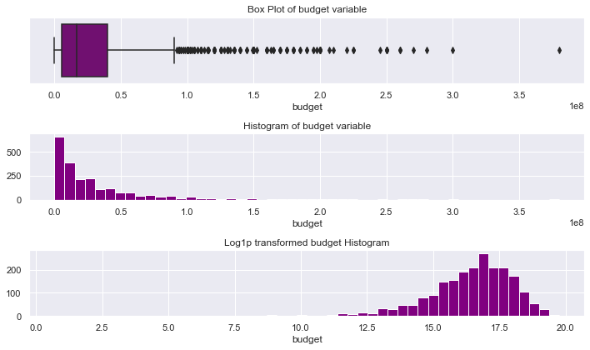
BOX Visualization - Budget Variable
Notes:
Boxplots are a standardized way of displaying the distribution of data based on a five number summary (minimum(Q1-1.5*IQR, Q1(first quartile-25%),Median, third quartile(Q3-75%) and Maximum(Q3+1.5*IQR)
IQR- InterQuartileRange

Slide 11
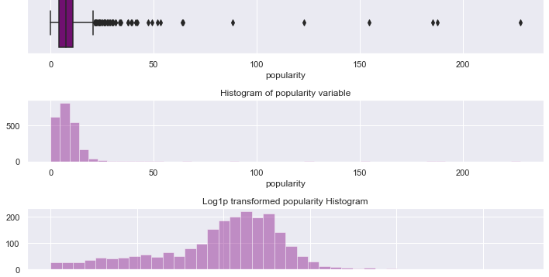
BOX Visualization- Popularity Variable

Slide 12
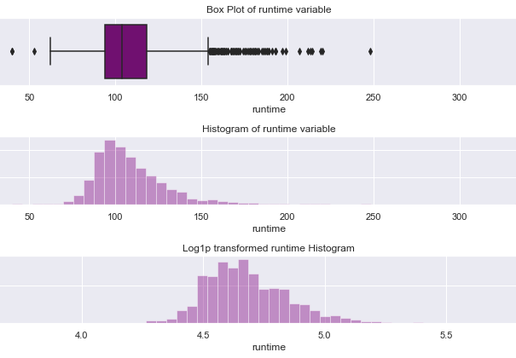
BOX Visualization- Runtime Variable
Notes:
Check the data of runtime?

Slide 13
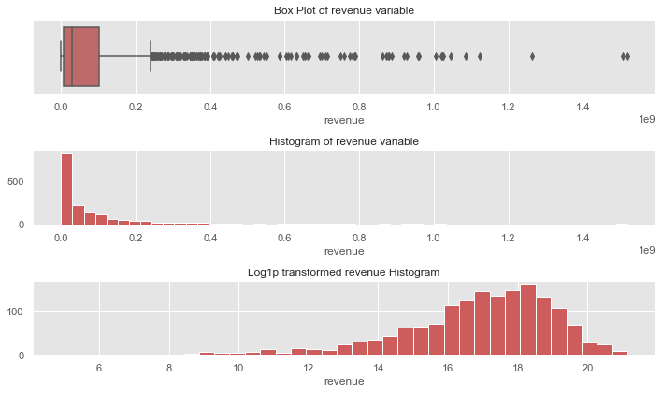
BOX Visualization-
Revenue

Slide 14
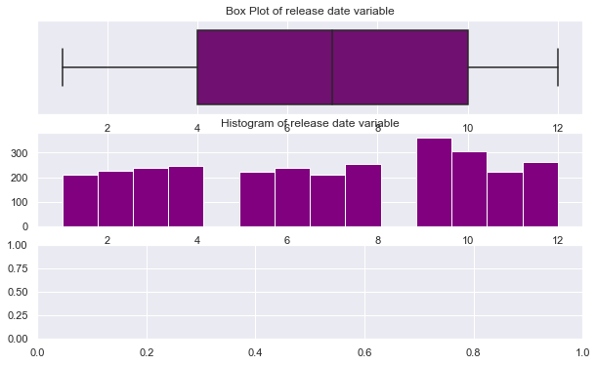
BOX Visualization-
Release date

Slide 15
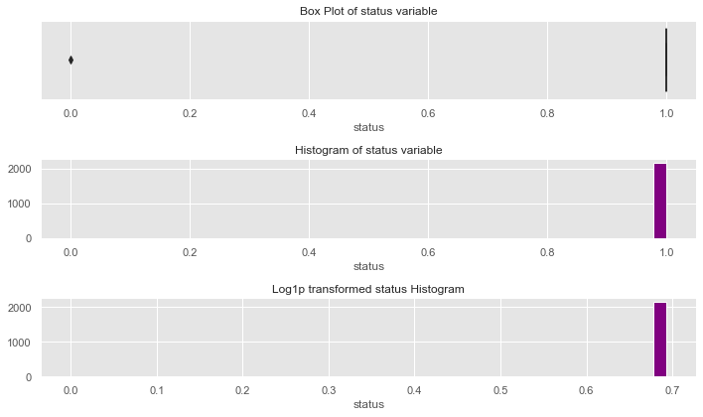
Box Visualization-
Status
Notes:
Rumored data ?

Slide 16
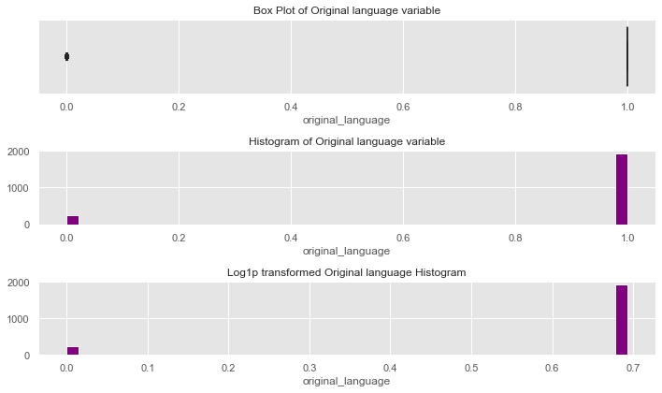
BOX Visualization-
Original language

Slide 17
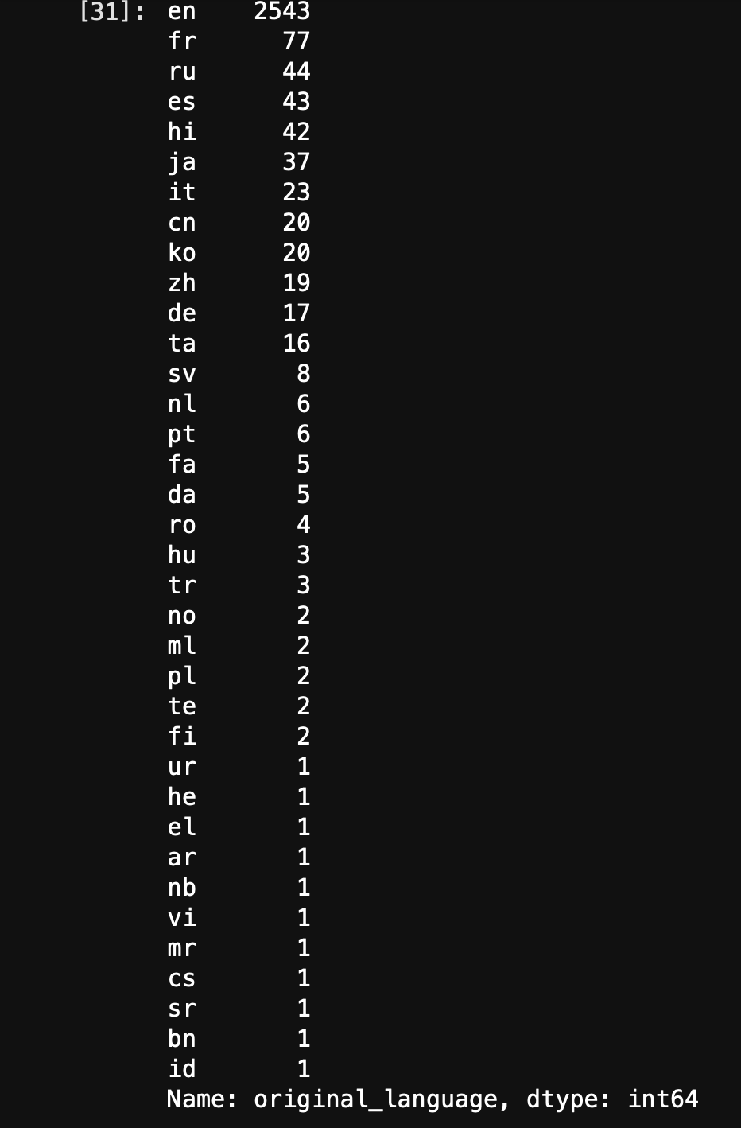
Language Occurrences

Slide 18
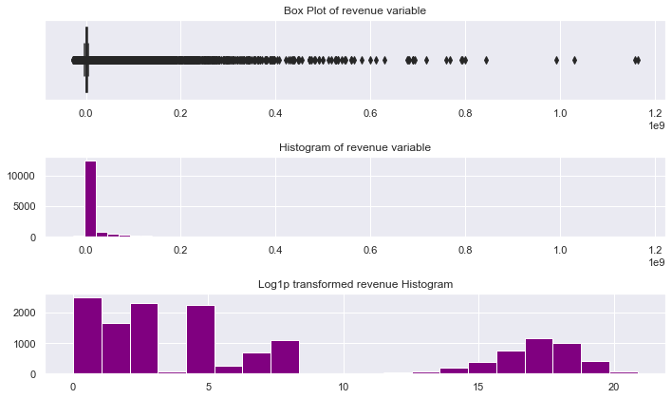
BOX Visualization- Predicted revenue
Notes:
MultiInput/Output Linear Regression Result

Slide 19

Random Forest Regression
Random Forest Regression is a supervised learning algorithm that uses ensemble learning method for regression. ... A Random Forest operates by constructing several decision trees during training time and outputting the mean of the classes as the prediction of all the trees.
A Random Forest's nonlinear nature can give it a leg up over linear algorithms, making it a great option.
Also, since our data has both categorical and continuous, random forest helps in making better decision trees.
The predictive ability achieved using the data is as follows.
Random forest predictive ability (r^2): {rf_model.score(X_test, y_test):.3f}")
Random forest predictive ability (r^2): 0.362

Slide 20
Polynomial Regressions

Slide 21
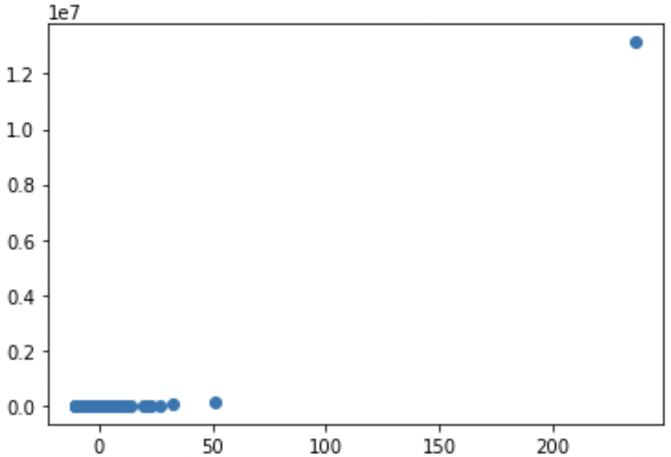
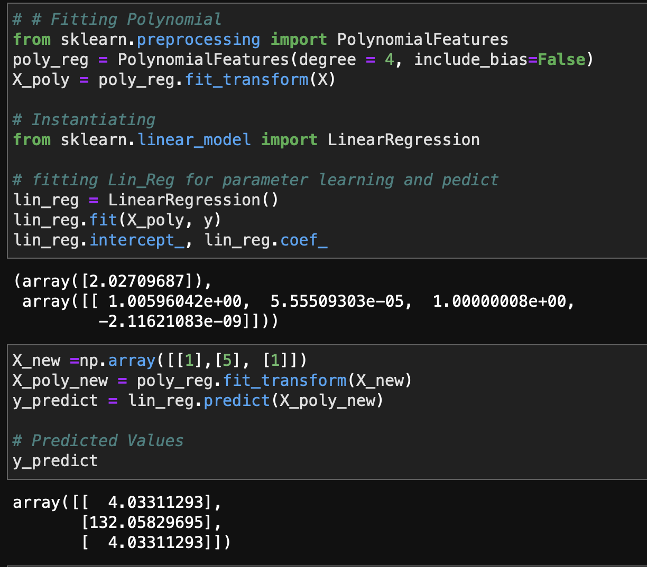
(Popularity & Revenue)

Slide 22
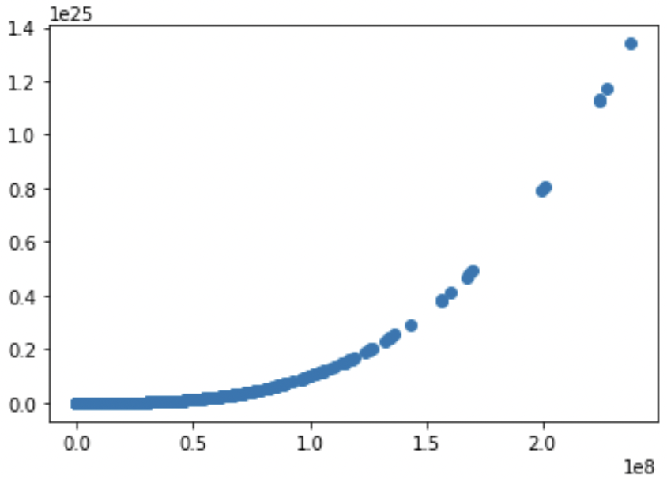
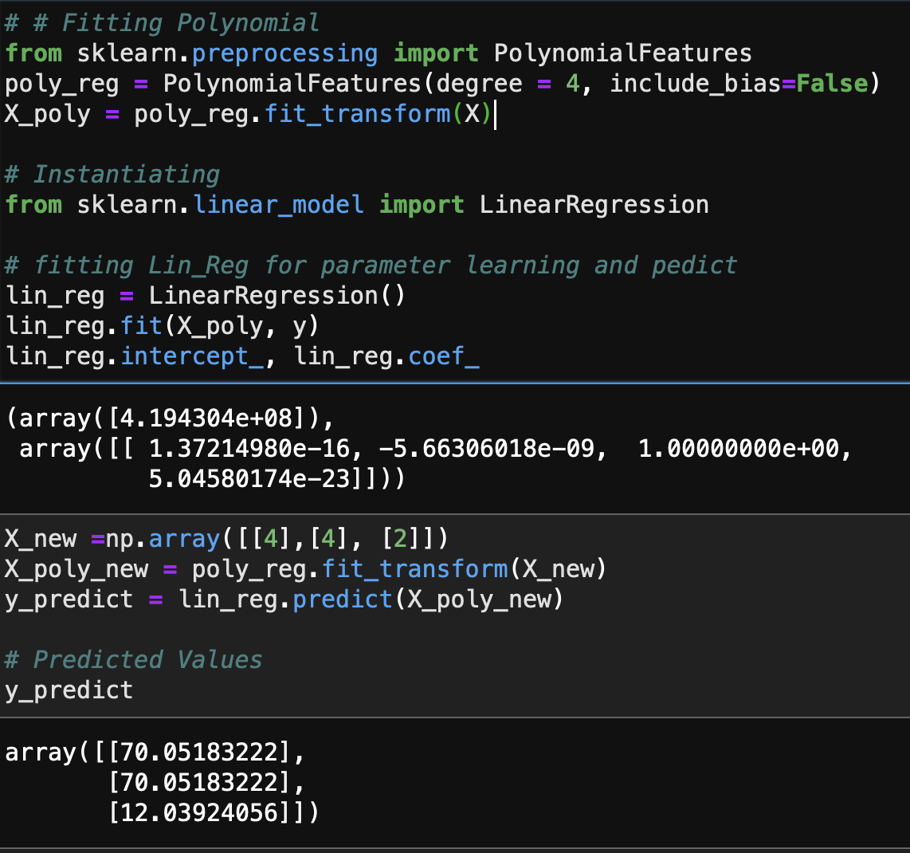
(Budget & Revenue)
Notes:
Consistent correlation =good prediction choice

Slide 23
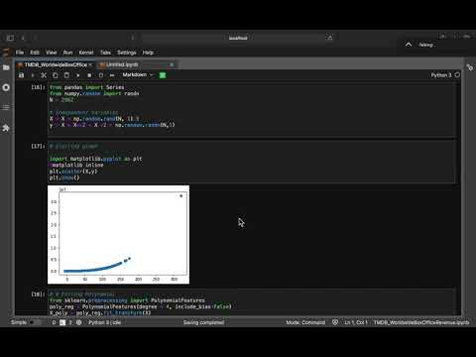
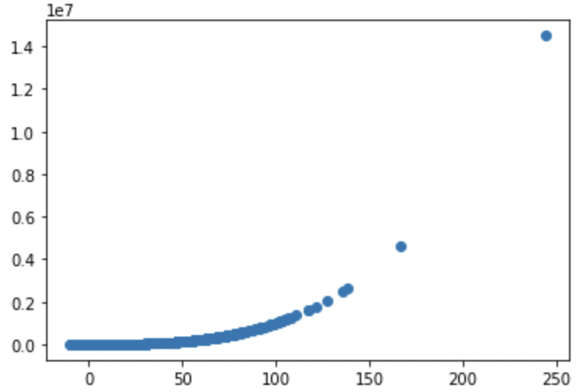
(Runtime & Revenue)
Notes:
Run time and budget = better than pop in predicting over BOM rev

Slide 24
Conclusion
In conclusion it can be seen that the linear regression gave a correlated output in predicting the box office revenue when the input variable are more continuous like budget, popularity & runtime.
The Random Forest Regressor did a much more training & testing of multi input variable to predict the output variable , the box office revenue.
The polynomial was the non-linear model that was used in predicticting the box office revenue similar to the linear regression. The predictions was used to gauge the model accurate predictions in comparison to the real values. The relationship focuses on the applied linear model trying to fit a non-linear model.
However, a con can be due to insufficient amount of data, or noise levels may not help in minimizing potential errors.

Slide 25
Future Enhancements
Predict using categorical values viz.,
Production Companies
Cast
genres
API Data
API Key: 0e2bbdb9b1fd91d87793fa8cd3aa8474
https://api.themoviedb.org/3/movie/550?api_key=0e2bbdb9b1fd91d87793fa8cd3aa8474

