Slide 1


CE142: OBJECT ORIENTED PROGRAMMING WITH C++
December – April 2019
Chapter – 5
Functions
Devang Patel Institute of Advance Technology and Research

Slide 2


Objectives
To be able to recognize when the use of a function would be appropriate in a program.
To know the syntax for declaring and defining a function.
To know how to return a value from a function.
To know how to write and use functions that do not return values (sometimes called procedures).
To know how to use parameters with function calls.
To know under what condition parameters must be passed by reference.
To know under what condition parameters should be passed by constant reference.
To be able to write functions that accept parameters as values, by reference and by constant reference.
Chapter – 5 : Functions

Slide 3
Contents
Return types in main( )
Function Prototyping
Call by Reference & Call by Value
Return by Reference
Inline Functions
Default Arguments
Constant Arguments
Function Overloading
Chapter – 5 : Functions

Slide 4
Introduction
Dividing a program into functions.
  a major principle of top-down, structured programming.
To reduce the size of the program.
Code re-use.
Like C++ operators, a C++ function can be overloaded to make it perform different tasks depending on the arguments passed to it.
Chapter – 5 : Functions

Slide 5
Continue…
void show( ); /* Function declaration */
void main( )
{
----
show( ); /* Function call */
----
}
void show( ) /* Function definition */
{
----
---- /* Function body */
}
Chapter – 5 : Functions

Slide 6
The main( ) Function
The main( ) returns a value of type int to the operating system by default.
The functions that have a return value should use the return statement for termination.
Use void main( ), if the function is not returning any value.
Chapter – 5 : Functions

Slide 7
Function Prototyping
The prototype describes the function interface to the compiler by giving details such as:
  The number and type of arguments
  The type of return values.
It is a template
When the function is called, the compiler uses the template to ensure that proper arguments are passed, and the return value is treated correctly.
Chapter – 5 : Functions

Slide 8
Continue…
Function prototype is a declaration statement in the calling program.
type function-name ( argument-list ) ;
The argument-list contains the types and names of arguments that must be passed to the function.
Chapter – 5 : Functions

Slide 9
Continue…
Each argument variable must be declared independently inside the parentheses.
float avg ( int x, int y) ; // correct
float avg ( int x, y) ; // illegal
In a function declaration, the names of the arguments are dummy variables and therefore they are optional.
Chapter – 5 : Functions

Slide 10
Continue…
float avg ( int , int ) ;
The variable names in the prototype just act as placeholders and, therefore, if names are used, they do not have to match the names used in the function call or function definition.
void display( ); // function with an
void display(void); // empty argument list.
Chapter – 5 : Functions

Slide 11
Call by Value
A function call passes arguments by value.
The called function creates a new set of variables and copies the values of arguments into them.
The function does not have access to the actual variables in the calling program and can only work on the copies of values.
Chapter – 5 : Functions

Slide 12
Call by Value
Example :
using namespace std; // function declaration
void swap(int x, int y);
int main () {
// local variable declaration:
int a = 100;
int b = 200;
cout << "Before swap, value of a :" << a << endl;
Chapter – 5 : Functions

Slide 13
Call by Value
cout << "Before swap, value of b :" << b << endl;
//calling a function to swap the values.
swap(a, b);
cout << "After swap, value of a :" << a << endl;
cout << "After swap, value of b :" << b << endl;
return 0;
}
Chapter – 5 : Functions

Slide 14
Call by Reference
When we pass arguments by reference, the formal arguments in the called function become aliases to the actual arguments in the calling function.
This means that when the function is working with its own arguments, it is actually working on the original data.
Chapter – 5 : Functions

Slide 15
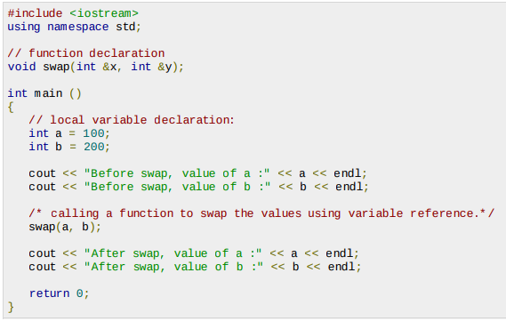
Call by Reference
Example :
Chapter – 5 : Functions

Slide 16

Call by Reference
Output :
Chapter – 5 : Functions

Slide 17
Return by Reference
A function can return a reference.
int & max (int &x, int &y)
{
if (x > y)
return x;
else
return y;
}
Chapter – 5 : Functions

Slide 18
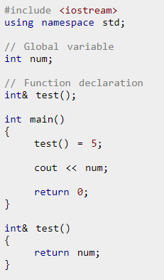
Return by Reference
Example :
Output :
5
In program above, the return type of function test() is int&. Hence, this function returns a reference of the variable num.
Chapter – 5 : Functions

Slide 19
Inline Functions
Inline function is a function which when invoked requests the compiler to replace the calling statement with its body.
A keyword inline is added before the function name to make it inline.
It is an optimization technique used by the compilers as it saves time in switching between the functions otherwise.
Member functions of a class are inline by default even if the keyword inline is not used.
Syntax :
inline return_type function_name ([argument list])
{
body of function
}
Chapter – 5 : Functions

Slide 20
Inline Functions
Example :
#include <iostream>
#include <conio.h>
using namespace std;
inline void print(int x)
{
cout<<x<< " ";
}
int main() {
int i, N;
cout<<"C++ Program to print first N natural numbers"<<endl<<endl;
Chapter – 5 : Functions

Slide 21
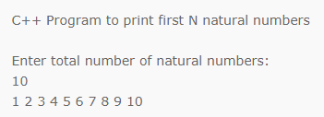
Inline Functions
cout<<"Enter total number of natural numbers:"<<endl; cin>>N;
for(i=1;i<=N;i++)
{
print(i);
}
return 0;
}
Output :
Chapter – 5 : Functions

Slide 22
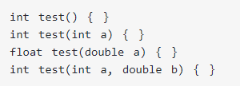
Function Overloading
In C++ programming, two functions can have same name if number and/or type of arguments passed are different.
These functions having different number or type (or both) of parameters are known as overloaded functions.
For example:
Chapter – 5 : Functions

Slide 23

Function Overloading Continue…
Here, all 4 functions are overloaded functions because argument(s) passed to these functions are different.
Notice that, the return type of all these 4 functions are not same. Overloaded functions may or may not have different return type but it should have different argument(s).
The number and type of arguments passed to these two functions are same even though the return type is different. Hence, the compiler will throw error.
Chapter – 5 : Functions

Slide 24
Default Argument
In C++ programming, you can provide default values for function parameters.
The idea behind default argument is simple. If a function is called by passing argument/s, those arguments are used by the function.
But if the argument/s are not passed while invoking a function then, the default values are used.
Default value/s are passed to argument/s in the function prototype.
Chapter – 5 : Functions

Slide 25
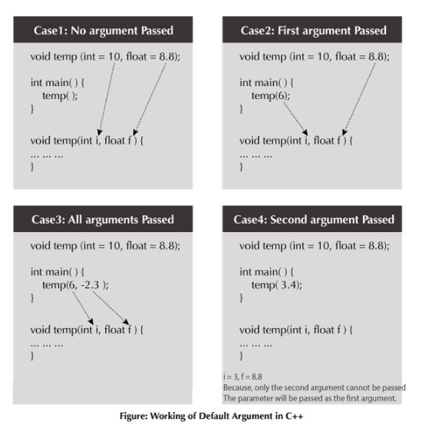
Default Argument Continue…
Chapter – 5 : Functions

Slide 26

Default Argument Continue…
Example :
#include<iostream>
using namespace std;
// A function with default arguments, it can be called with
// 2 arguments or 3 arguments or 4 arguments.
int sum(int x, int y, int z=0, int w=0)
{
return (x + y + z + w);
}
/* Drier program to test above function*/
int main()
{
cout << sum(10, 15) << endl;
cout << sum(10, 15, 25) << endl;
cout << sum(10, 15, 25, 30) << endl;
return 0;
}
Chapter – 5 : Functions

Slide 27
Default Argument Continue…
Common mistakes when using Default argument
1. void add(int a, int b = 3, int c, int d = 4);
The above function will not compile. You cannot miss a default argument in between two arguments. In this case, c should also be assigned a default value.
2. void add(int a, int b = 3, int c, int d);
The above function will not compile as well. You must provide default values for each argument after b. In this case, c and d should also be assigned default values.
If you want a single default argument, make sure the argument is the last one. void
add(int a, int b, int c, int d = 4);
3. No matter how you use default arguments, a function should always be written so that it serves only one purpose.
Chapter – 5 : Functions

Slide 28
Review Questions
Write True or False :
A function can return more than one value. –False
A function needs function definition to perform a specific task. – True
If a function returns no value, the return type must be declared as void. – True
In a function, The return statement is not required if the return type is anything other than void. – False
A local variable declared in a function is not usable out side that function. - True
Chapter – 5 : Functions

Slide 29
Review Questions
Write a function for following Problem statement :
Function to print prime numbers between 100 to 200
Function to print Fibonacci series
Function to print factorial of number
Chapter – 5 : Functions

Slide 30






Presentation Prepared By:
  Contact us:
  dweepnagarg.ce@charusat.ac.in
  parthgoel.ce@charusat.ac.in
  hardikjayswal.it@charusat.ac.in
  dipakramoliya.ce@charusat.ac.in
  krishnapatel.ce@charusat.ac.in
  khushipatel.ce@charusat.ac.in
  Ms. Krishna Patel
Subject Teachers:
  Ms. Dweepna Garg
  Subject Coordinator
  Ms. Khushi Patel
  Mr. Parth Goel
  https://parthgoelblog.wordpress.com
Mr. Hardik Jayswal
Devang Patel Institute of Advance Technology and Research

