Slide 1
INTRODUCTION TO AI
AI in Cyber Security
Intelligent threat detection, anomaly identification
& automated incident response
A practical view of AI/ML applications, industry solutions,
implementation risks and responsible adoption.
Group 09:
Diya Bakraniya
Khushi Shah
Maitri Jani
Mohit Sharma
Naisargi Thakkar
Nishant Purohit

Slide 2
THE THREAT LANDSCAPE
Cybersecurity Threats & Their Impact
Financial institutions are high-value targets because they handle money, sensitive data and are heavily dependent on digital services.
WHY FINANCIAL SERVICES?
Valuable data • Continuous transactions • Connected systems • Third-party dependencies
Phishing & Social Engineering
Ransomware & Malware
Account Takeover
Sending fake messages to manipulate users & employees.
Malicious software to steal data or disrupt operations.
Use of stolen credentials for unauthorized access and transfers.
DDoS Attacks
AI Fraud & Deepfakes
Supply Chain & Insider Threats
Flooding of traffic to make banking and payment services unavailable.
Impersonation through synthetic voice and video messages to trick people.
Misuse of access by vendors and employees to expose internal systems.
BUSINESS IMPACT
Financial loss
Data breaches
Service disruption
Regulatory risk
Loss of trust
Recovery costs
Cybersecurity is a business-continuity and customer-protection priority—not only an IT issue.
AI IN CYBERSECURITY

Slide 3
DETECT
AI in Real-Time Threat Detection
AI/ML evaluates transactions, messages and system activity as they happen.
01 Transaction fraud detection
02 Phishing & social engineering
03 Malware & zero-day threats
USE: Detect suspicious transactions carried out using stolen credentials.
ALGORITHMS
• Random Forest & XGBoost: Learn from historical data and output a fraud probability score.
• Graph Neural Networks (GNNs): Analyse relationships between accounts, IP addresses, devices, and transactions.
USE: Identify malicious emails, spoofed senders and AI-generated phishing
ALGORITHMS
• Decision Tree, Random Forest, SVM: Classify incoming messages as safe, suspicious or fraud.
• NLP & Transformer models (e.g. BERT): Understand the meaning & context of messages.
USE: Detect zero-day attacks & suspicious endpoint/network behaviour
ALGORITHMS
• SVM: Detect network intrusion by classifying data packets as malicious or benign.
• Autoencoders: Help identify previously unseen malware
OUTCOME
Earlier detection • Reduced fraud losses • Faster intervention
AI IN CYBERSECURITY

Slide 4
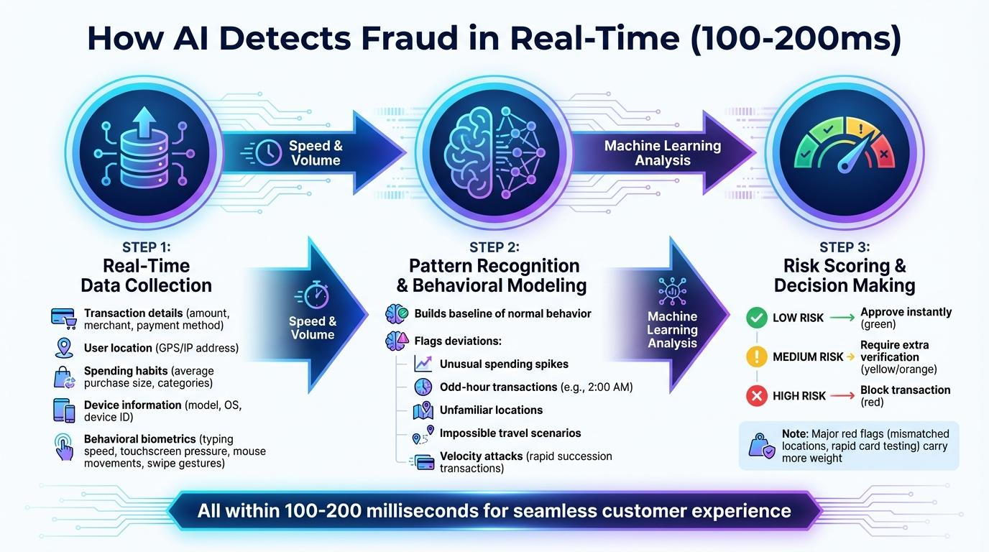
DETECT
How AI Detects Fraud in Real Time
AI IN CYBERSECURITY

Slide 5
IDENTIFY
AI in Anomaly Identification
UEBA learns normal activity for users and devices, then flags meaningful deviations.
1. Behaviour profiling & baseline
UEBA
EXAMPLE: UNUSUAL ACCOUNT ACTIVITY
K-Means clustering groups users with similar roles and activity to define normal patterns.
User & Entity
Behaviour Analytics
NORMAL
Usual device and routine login
Monitors:
• Employees & customers
• Servers & devices
• Login times and locations
• Data access and transfers
2. Sequential behaviour analysis
RNNs / LSTMs detect suspicious sequences—for example, disabling logs before a bulk download.
DEVIATION
New device + unusual time
HIGH RISK
Large confidential-data download
GOAL
Detect compromised accounts, insider threats and data exfiltration.
3. Anomaly detection & risk scoring
PCA reduces complex features; Isolation Forest identifies outliers and supports risk scoring.
AI flags the deviation for investigation; a human analyst validates context and risk.
AI IN CYBERSECURITY

Slide 6
RESPOND
AI-Powered Automated Incident Response
AI helps prioritize incidents; SOAR coordinates security tools and response playbooks.
High-risk
alert
SOAR
ingestion
Context
enrichment
Automated playbook
execution
Human review
& recovery
1
2
3
4
5
ML techniques
Automated containment
Agentic SOAR
Classification
Predictive analytics
Reinforcement learning
Isolate infected endpoints
Block malicious traffic
Temporarily lock compromised accounts
Use of autonomous AI agents that can plan, reason, and adaptively investigate security incidents live at runtime
HUMAN-IN-THE-LOOP
Require expert approval for high-impact actions; verify, recover, document and improve.
AI IN CYBERSECURITY

Slide 7
INDUSTRY APPLICATIONS
AI-Driven Cybersecurity Solutions
Three examples of how vendors apply AI across enterprise security, integrated defence and endpoint protection.
Feature / Focus | Palo Alto Networks | Microsoft | Quick Heal / Seqrite
Primary AI Engine | Precision AI | Security Copilot & Agentic Mesh | GoDeep.AI
Target Environment | Enterprise networks, heavy cloud deployments, and global SOCs. | Global enterprises, hybrid Azure clouds, and Windows ecosystems. | Consumers, SMBs, and distributed enterprise endpoints.
Response Speed & Automation | <30 sec threat closure via Cortex XSIAM | Automatic attack disruption across Windows and cloud layers. | Instant behavioral blocking and dynamic ransomware data rollback.
Generative AI Assistant | Strata Copilot & Cortex Copilot | Microsoft Security Copilot | Security Intelligent Assistant (SIA)
Specialized AI Defence | Prisma AIRS: Protects enterprise-built LLMs from prompt injection. | MDASH Agents: 100+ AI agents hunting for unpatched OS bugs. | AntiFraud.AI: Scans calls, texts, and links to block financial scams.
TAKEAWAY • AI is shifting cybersecurity from reactive monitoring toward proactive, increasingly automated defence.
AI IN CYBERSECURITY

Slide 8
IMPLEMENTATION RISKS
AI Integration Challenges
Effective AI security must balance robustness, ethical safeguards and measurable business value.
01 Adversarial AI
02 Ethical challenges
03 Return on investment
Attackers manipulate AI systems to evade or weaken security.
• Model evasion post deployment
• Data poisoning at training stage
• Prompt injection
• Model extraction
ATTACK PATH
Identify weakness → Manipulate input → Evade detection
• Accountability: responsibility for false negatives
• Data privacy: Excessive collection or monitoring
• Algorithmic Bias: Data inaccuracy & false positives
• Transparency: Limited explainability
• Over-reliance: Blind trust in automated outputs
COST DRIVERS
• AI Software license
• Cloud and data integration
• Skilled staff and employee training
• Model training, deployment and maintenance
MEASUREMENT CHALLENGE
Prevented attacks and avoided losses are difficult to quantify.
KEY CHALLENGE: Balance security gains with cost, ethical responsibility and evolving threats.
AI IN CYBERSECURITY

Slide 9
RESPONSIBLE ADOPTION
Responsible AI Integration & Conclusion
Build AI-enabled cybersecurity solutions that are secure, explainable, accountable and measurable.
SECURE THE AI
GOVERN RESPONSIBLY
PROVE THE VALUE
• Apply NIST AI RMF practices
• Regular audits & use of Explainable AI (XAI)
• Align with applicable RBI, CERT-In and DPDP requirements
• Human In The Loop (HITL)
• Adversarial training and data validation
• Continuous monitoring and rate limiting
• Use MITRE ATLAS to understand AI attack techniques
• Start with high-impact use cases
• Track MTTD and MTTR improvements
• Measure prevented losses, lifecycle costs and false positives
CONCLUSION
AI strengthens threat detection, anomaly identification and incident response — but it must complement, not replace, human judgement.
AI-DRIVEN SPEED + HUMAN EXPERTISE + ACCOUNTABILITY
AI IN CYBERSECURITY

