Slide 1
Paper-9
Title of the Paper : Multistage attention network for image inpainting
Author’s name: Ning Wang , Sihan Ma , Jingyuan Li , Yipeng Zhang a, Lefei Zhang .
Published in : Elsevier
Journal Name: Pattern Recognition
Date of Publication: 24 May,2020.

Slide 2
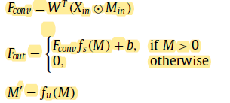

Partial Convulational Strategy
The partial convolution strategy can be described in three parts, namely, mask convolution, feature normalization, and mask updating. In mask convolution, we obtain F conv . After feature normalization, we generate output feature map F out . M is the updated mask feature map. F out and M can serve as the inputs for the next layer.

Slide 3


The SE Module includes three steps: 1) Squeeze, 2) Excitation, and 3) Reweight. In Squeeze part, feature map of input u is compressed to get channel-wise responses z-c , which is actually the global average pooling. Then the weights w c of feature maps in C channels are learned through fully connected layers and non-linear layers in Excitation part. It is the most important segment in SE Module. Finally, channel-wise multiplication is adopt to get the reweighted the feature map u out .
To maintain the channel of outputs and inputs equal to propagate the attention to the next layer. Therefore, they merge all feature maps and shrink the channel numbers to the original channel number using pixelwise convolution f Conv (). The final output of the module can be denoted as:
φout = f Con v (f SE ( φin , φatt ))

Slide 4




Loss Function
Perceptual Loss: To ensure the similarity of high-level structures to maintain the structure information of the global image.
Style Loss: To preserve style consistency, such as color and patterns.
Adversarial Loss: They use a full convolutional network as discriminator D in the proposed method. Different from the existing methods is the outputs of the discriminator no longer represent the entire image but refer to different areas of an image. In this way, each of the discrimination results represents the local features of image. set of local discrimination results covers all regions of the image .
Total Variation Loss: In the proposed model, total variation loss ( L tv ) is introduced to enhance the spatial smoothness of the generated image .

Slide 5


Hole Loss and Valid Loss: L hole and L valid are the L1 regularization between generated image I pred and ground truth I gt of hole (dam- aged) and valid (undamaged) regions.
Overall Loss: The overall loss function of the proposed algo- rithm is expressed as follows:

Slide 6
Paper -4
Title: Facial Inpainting Using Generative Adversarial Network with Feature Reconstruction and Landmark Loss to Preserve Spatial Consistency in Unaligned Face Images
Author’s Name: Avin Maulana, Chastine Fatichah,Nanik Suciati
Published in: INASS (International Journal Of Intelligent Engineering & Systems)
Date of Publication: July 20,2020

Slide 7
Training Strategies:
The first stage of network training uses two types of loss: K-L divergence loss (ℒ𝐾𝐿) and Feature Reconstruction Loss (ℒ𝑓). This stage is carried out at 15000 steps.
In the second stage, the generator is trained with additional losses from the local and global discriminator.

Slide 8
In the last stage, the landmark loss, namely (𝐿ℎ)is incorporated to the total loss. The addition of this loss landmark aims to improve the inpainting result with better perceptual quality so the image produced by the network looks more realistic.

Slide 9
Paper
Title of the paper:PiiGAN: Generative Adversarial Networks for
Pluralistic Image Inpainting
Author’s name:WEIWEI CAI , (Student Member, IEEE), AND ZHANGUO WEI
Date of publication March 9, 2020
Published in: IEEE

Slide 10
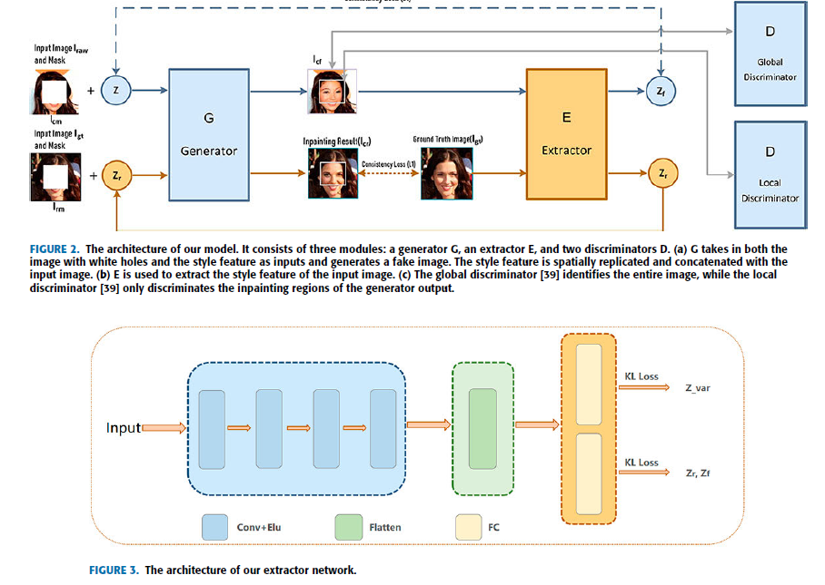
Figure-3 shows the extractor network architecture of our proposed method. It has four convolution layers, one attened layer, and two parallel fully connected layers. Each convolutional layer uses the Elus activation function.
The extractor extracts the style feature of each training sample and outputs its mean and covariance.

Slide 11
EXTRACTOR

Slide 12
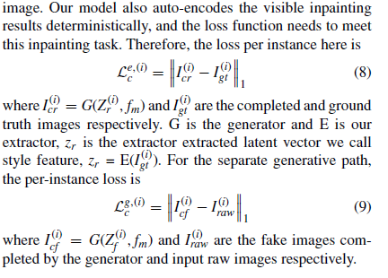
1) CONSISTENCY LOSS:We adjusted the form of perceptual loss and propose the consistency loss to handle this problem.

Slide 13
