Slide 1
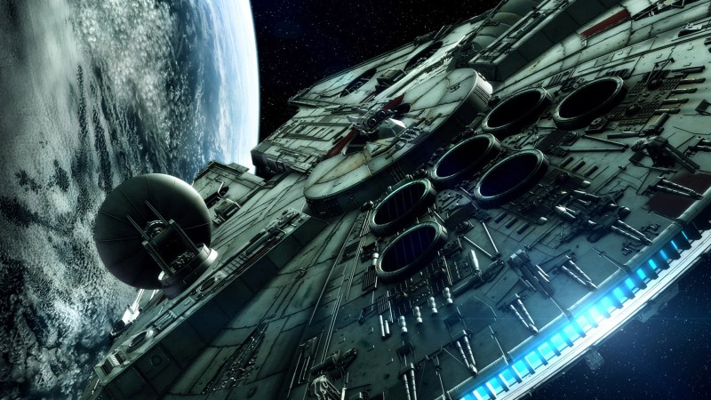

Project Portfolio Star wars Figure Shop
서영석(Young suk, Seo)
2024.04.01~2024.04.

Slide 2
Content
Research
Information
Research
Subject
Logo,Color, Font
Persona
Prototype
prototype
Code
Code
Review
review

Slide 3
Content
Research
Information
Research

