Slide 1


CALIBO AI ACADEMY | MUC01 | 2026
CATEGORY PULSE
Retail Product Performance EDA
From transaction data to supplier-review decisions
Batch-16: Naishadh Vytla · Nakul Sriraj · Sushmitha · Adi Seshu

Slide 2
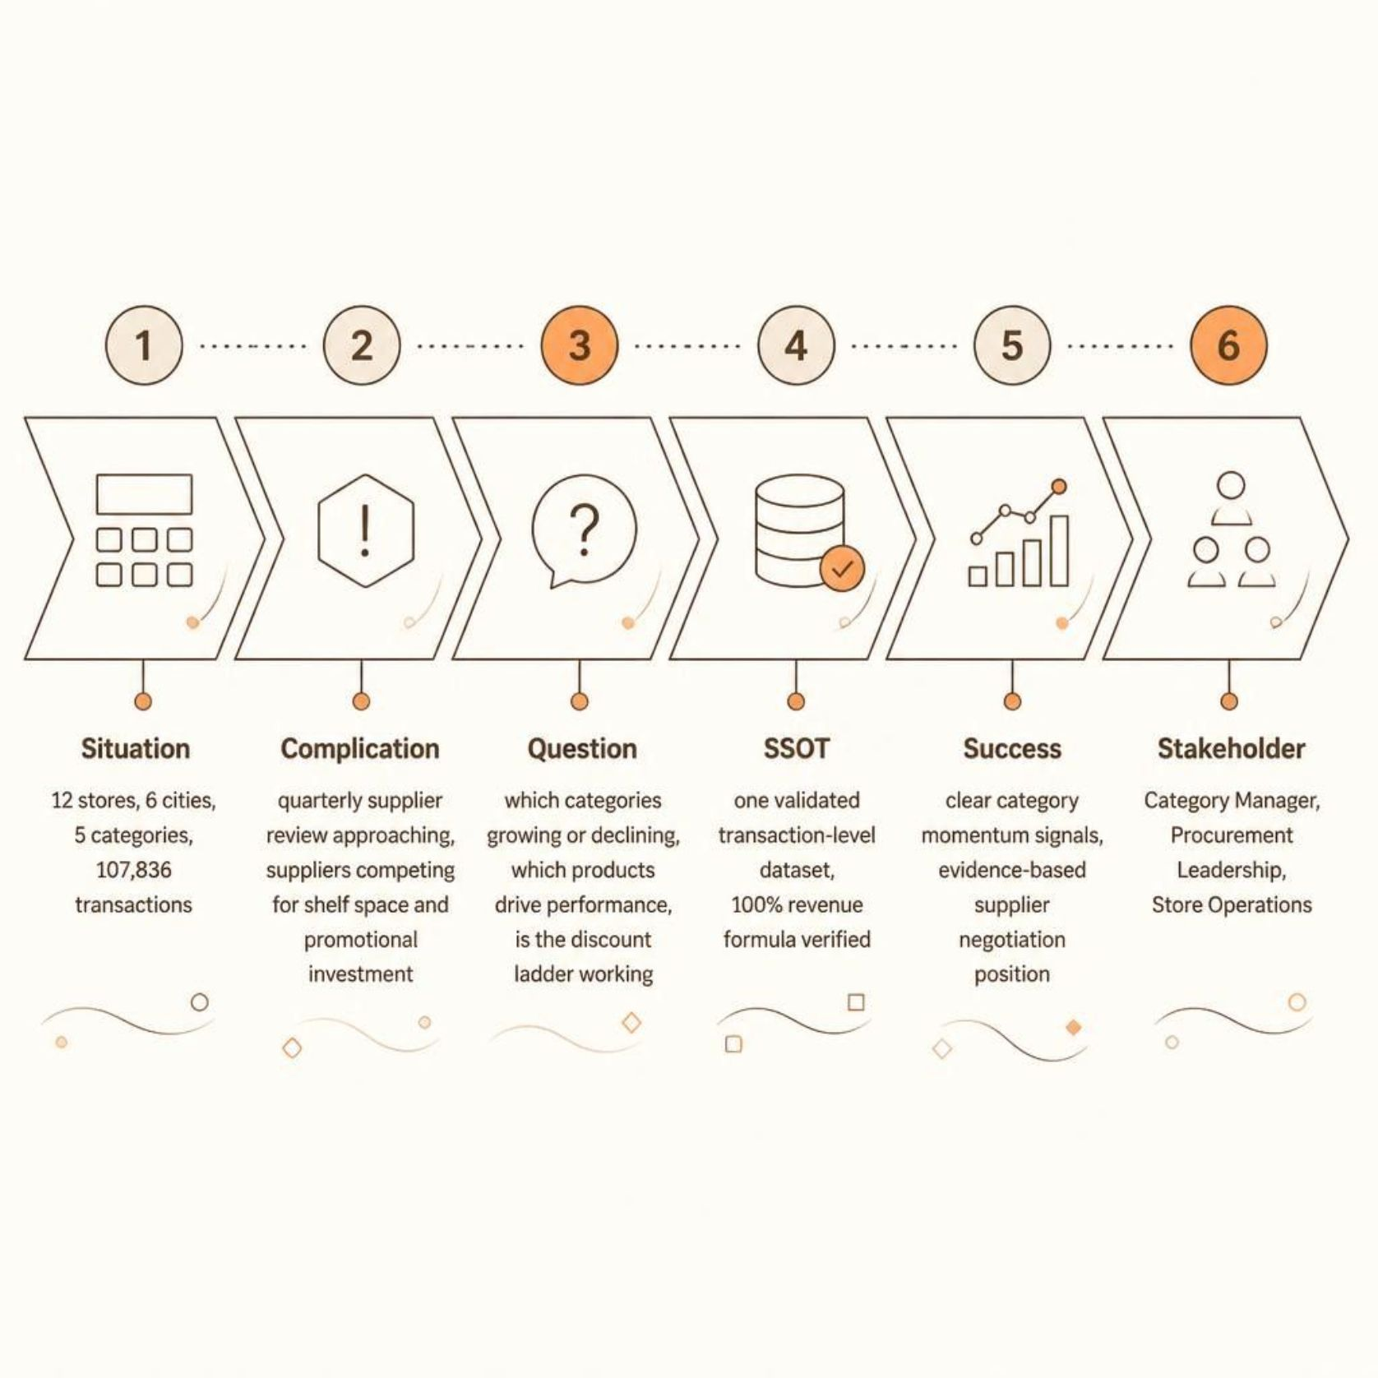
THE BUSINESS QUESTION
THE SUPPLIER-REVIEW PROBLEM
A regional retail chain operates 12 stores across six Andhra Pradesh cities and five product categories. The Category Manager is entering a quarterly supplier review where suppliers will argue for shelf space and promotional investment.
"Which categories are growing or declining, which products drive category performance, and is the discount ladder actually working?"
The CBIM framework anchors every analytical step to a single validated dataset and a clear supplier-review outcome.

Slide 3

DATA & TRUST
SINGLE SOURCE OF TRUTH
107,836
₹459.8M
Transactions
Total Revenue
Jan–Jun 2026
Analyzed
12
5
Stores
Categories
Across 6 cities
25 products
Data Quality Confirmed
Why this matters: Every chart and recommendation traces back to the same validated transaction-level dataset.
No missing values or duplicate transaction IDs
Revenue formula validated for 100% of rows
Continuous date coverage: Jan 1–Jun 30, 2026
One validated DataFrame used for all downstream analysis

Slide 4

EXECUTIVE SNAPSHOT
FIVE NUMBERS TELL THE STORY
₹459.8M
−₹15.5M
−35%
Total Revenue
Monthly Revenue Change
Electronics Momentum
Full six-month period analyzed
Jan ₹84.8M → Jun ₹69.3M
Jan ₹45.7M → Jun ₹29.7M
+34%
2.58
Apparel Momentum
Units Per Transaction
Jan ₹10.0M → Jun ₹13.5M
Flat across 0% → 20% discount range
Revenue pressure is concentrated, not broad-based.
Source: MUC01 Retail Sales Dataset | Jan–Jun 2026

Slide 5
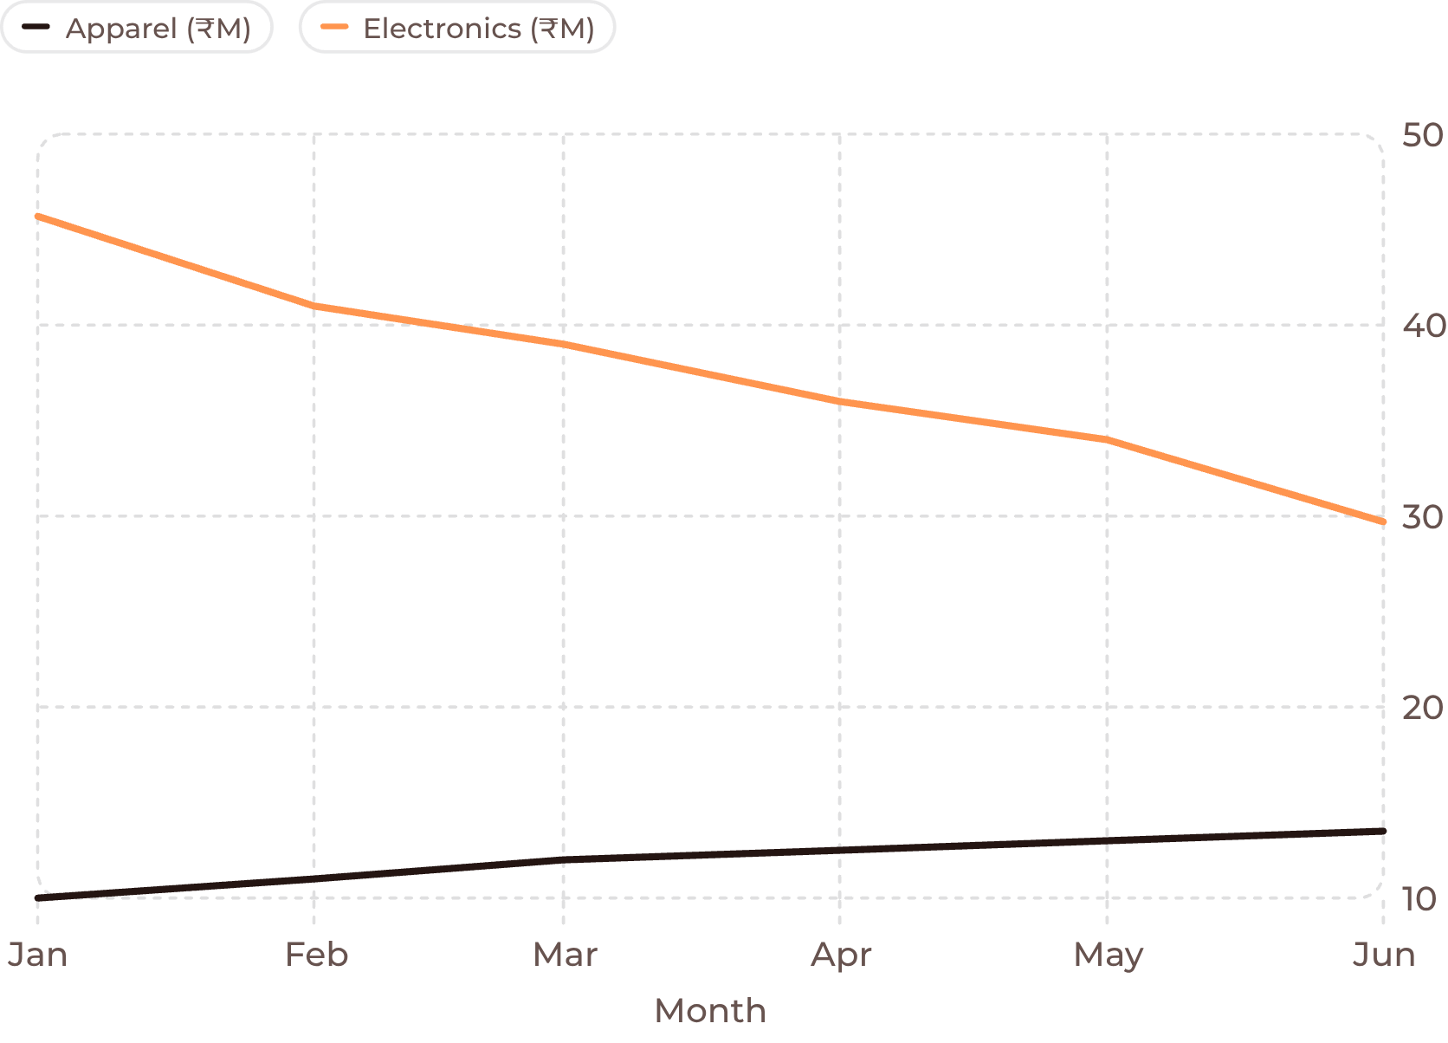
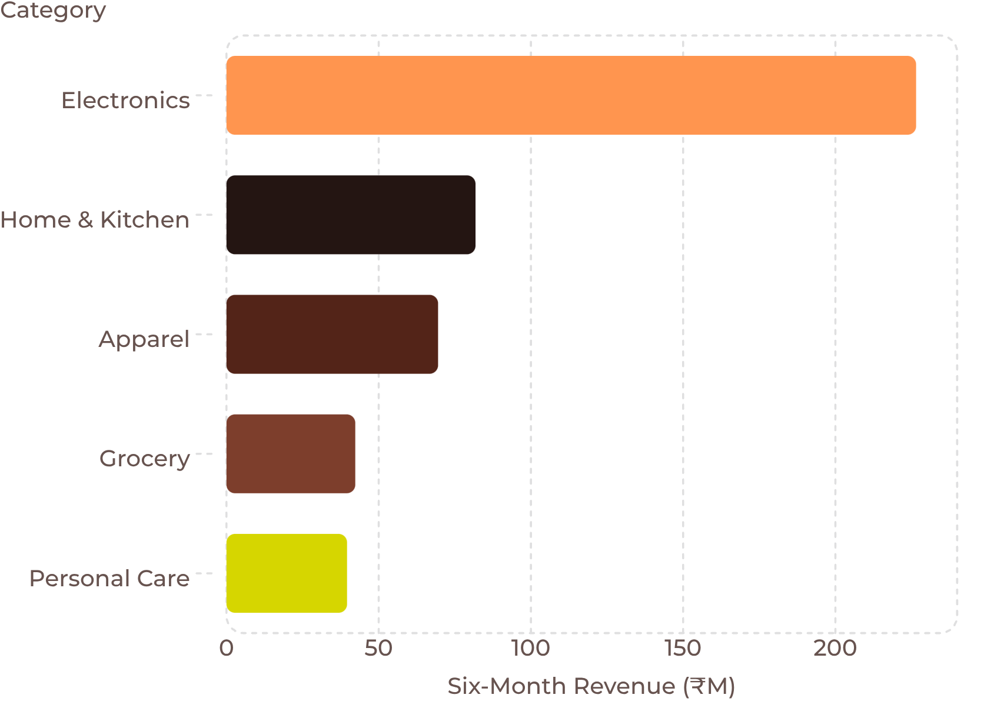
CATEGORY PULSE
ELECTRONICS IS THE REVENUE ENGINE — AND THE MAIN SOURCE OF DECLINE
Monthly Revenue Trend: Electronics vs. Apparel
Electronics declined −35% while Apparel grew +34% over the same period. The divergence is stark and consistent.
Source: MUC01 Retail Sales Dataset | Jan–Jun 2026
Electronics: ₹226.5M — 49.3% of total chain revenue. The largest category is also the steepest decline.

Slide 6
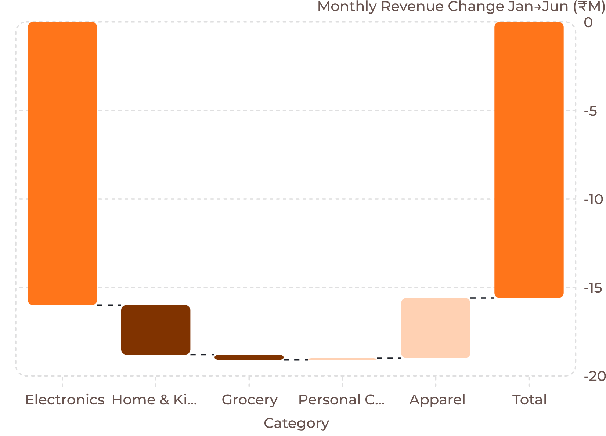
SOURCE OF DECLINE
THE CHAIN DECLINE IS AN ELECTRONICS PROBLEM
Monthly Revenue Contribution Change: Jan → Jun
Electronics alone lost −₹16.0M in monthly revenue contribution — more than the chain's entire net decline of −₹15.5M.
Apparel's +₹3.4M gain and Personal Care's +₹0.1M partially offset the Electronics decline. Home & Kitchen (−₹2.8M) and Grocery (−₹0.3M) contributed minor additional pressure.
Key insight: Other category growth partially offsets the Electronics decline, but not enough to prevent a net chain-wide monthly revenue drop.
Source: MUC01 Retail Sales Dataset | Jan–Jun 2026

Slide 7

PRODUCT INTELLIGENCE
NO DEAD SKU — THE SIGNAL IS AT CATEGORY LEVEL
Category | Top Product | Revenue | Bottom Product | Revenue | Gap
Electronics | Headphones | ₹47.7M | Smart TV | ₹41.9M | 13.9%
Home & Kitchen | Mixer Grinder | ₹16.9M | Water Bottle | ₹15.8M | 6.8%
Apparel | Saree | ₹14.2M | Kurta | ₹13.6M | 4.0%
Grocery | Rice (5kg) | ₹8.6M | Sugar (1kg) | ₹8.4M | 2.2%
Personal Care | Shampoo | ₹8.2M | Sunscreen | ₹7.6M | 7.7%
Key insight: No single product is dragging a category down. The actionable signal sits at category level rather than a single SKU — supplier discussions should focus on category momentum, not individual product cuts.
Source: MUC01 Retail Sales Dataset | Jan–Jun 2026

Slide 8
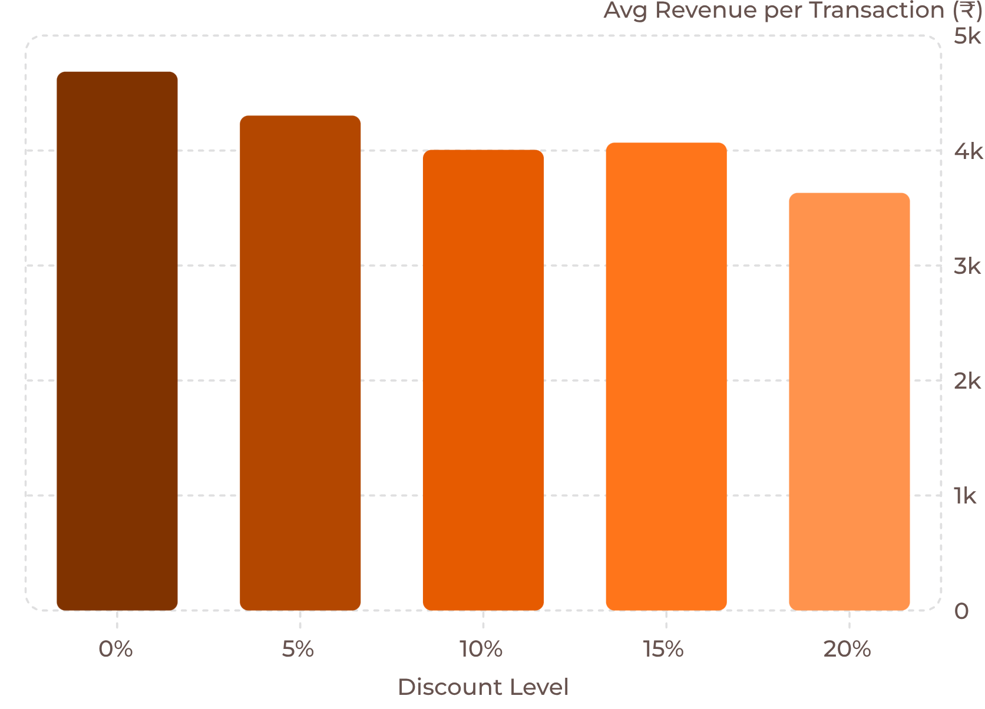
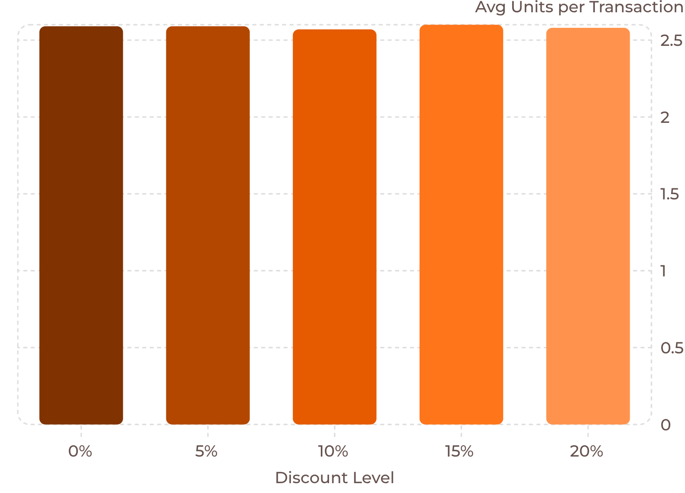

DISCOUNT INTELLIGENCE
DISCOUNTS BUY NO EXTRA VOLUME
Average Revenue per Transaction by Discount Level
Revenue per transaction falls ~22% as discounts deepen — from ₹4,686 at 0% to ₹3,632 at 20%.
Source: MUC01 Retail Sales Dataset | Jan–Jun 2026
Units per transaction remain essentially flat at ~2.58 across all discount levels. The dataset shows no meaningful volume response as discounts deepen.
Caveat: Transaction data shows association, not causation. Profitability cannot be evaluated without cost/margin data.

Slide 9
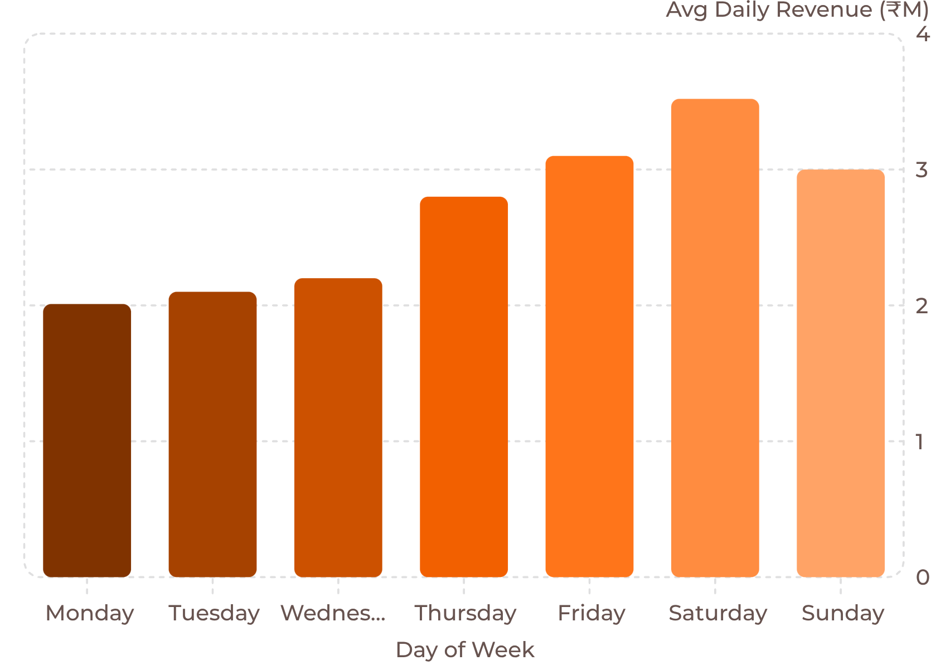
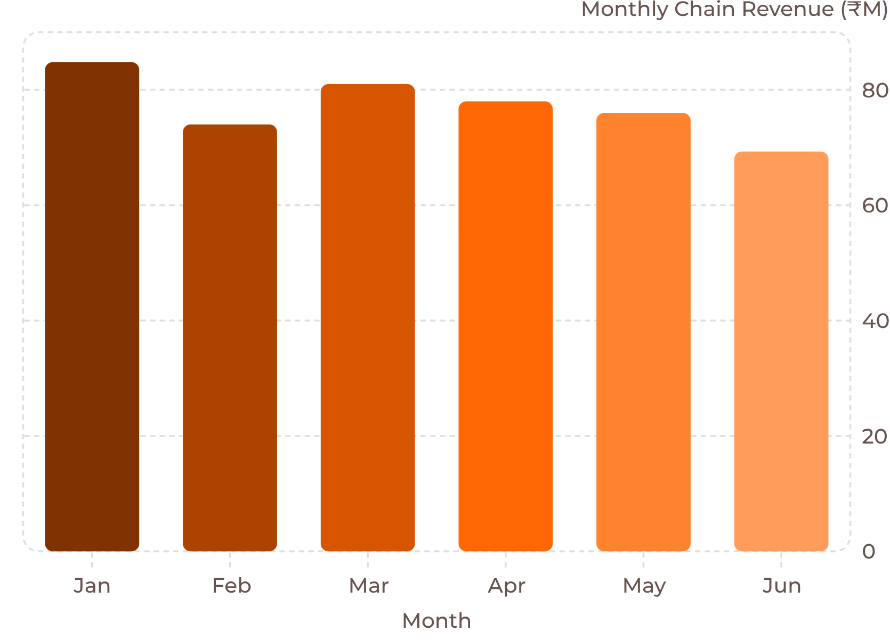
DEMAND TIMING
DEMAND IS WEEKEND-DRIVEN
Day-of-Week Revenue Pattern
Saturday generates ~75% more revenue than Monday (₹3.52M vs. ₹2.01M). Demand builds from Thursday, peaks Saturday, and softens into Sunday. Electronics follows the same weekend-skewed pattern as the chain.
Source: MUC01 Retail Sales Dataset | Jan–Jun 2026
Business implication: Promotional timing should concentrate toward Thu–Sun rather than relying on broad mid-week discounting. The monthly decline trend reinforces the urgency of category-level action.

Slide 10
CATEGORY MANAGER BRIEFING
SUPPLIER REVIEW: WHAT WE WOULD TAKE INTO THE ROOM
1. Back Apparel +34%
2. Challenge Electronics −35%
Only category with sustained momentum. Jan ₹10.0M → Jun ₹13.5M. Prioritize shelf space and promotional investment.
₹45.7M → ₹29.7M. −₹16.0M monthly revenue contribution change. Demand a recovery plan from the supplier.
3. Reconsider Mid-Week Discounting
4. Request Cost Data Before Final Decision
2.59 → 2.58 units per transaction across all discount levels. Discounts do not appear to increase volume.
Revenue-only analysis cannot establish profitability. Request category-level COGS/margin data and ideally footfall data.
"THE DATA DOES NOT POINT TO A SKU-CUTTING PROBLEM. IT POINTS TO A CATEGORY MOMENTUM PROBLEM."
Calibo AI Academy | MUC01 Category Intelligence

