Slide 1
Taking clear-cut declines out of the manual queue
CALIBO AI ACADEMY · PATH 2 · KLU BATCH 10 · MUC02
A credit pre-screening engine for personal loans, and the threshold the bank can defend
Naishadh · Raghunandan · Saketh · Pradeepthi
For the Credit Policy Analyst
Notes:
Presenter: Naishadh Vytla. We are Batch 10. Our use case: a bank reads every one of its 3,000 personal loan applications a month by hand. We built a model that takes the clear-cut declines out of that queue, and we will show you exactly how far it can be trusted.

Slide 2
Every application gets 25 minutes, even the obvious ones
THE PROBLEM
3,000
25 min
1,250 hrs
personal loan applications a month
of manual credit review for each one
of analyst time a month, and nearly half end in a decline
Our question: which applications can be auto-declined, and at what confidence, while keeping wrongly declined good customers at 5% or less?
CBIM canvas · Situation, Complication, Question · Batch 10 · MUC02
Notes:
Presenter: Naishadh Vytla. Situation: 3,000 applications a month, 25 minutes each, which is about 1,250 analyst hours. Complication: many declines are obvious in the first minute, yet each still costs 25 minutes, and good applicants wait longer. Our question is not "build a model". It is which applications can safely leave manual review, at what threshold, within the bank's 5% risk limit.

Slide 3

Three data issues, three decisions, no rows dropped
DATA · 12,000 APPLICATIONS · APR–SEP 2026
1,039
441
12
Blank credit scores
Missing incomes
Incomes above ₹6 lakh
All have zero months of credit history. They are new-to-credit applicants, not errors. Kept and flagged.
Mostly business owners and self-employed (11–13%). Filled with the median for that job type.
All salaried: annual salary typed as monthly. Divided by 12.
The SSOT caveat: the decision column is past analyst judgement, not whether customers repaid. The model can only copy it.
Step 5.1 · Naishadh Vytla
Notes:
Presenter: Naishadh Vytla. Dropping blank scores would have removed 8.7% of applicants, mostly young first-time borrowers, and hidden the group the model handles worst. Every fix leaves a flag, so later steps can see what was filled. The caveat matters most: we are predicting what analysts decided, not who repaid.

Slide 4
Below a score of 650, the bank almost never approves
FINDING 1 · CREDIT SCORE
85.2%
77.2%
54.4%
53.9%
Approval jumps tenfold across 650: from 3.2% to 32.5%.
32.5%
New-to-credit applicants are approved 53.9% of the time: analysts use judgement there.
2.0%
3.2%
<600
600–649
650–699
700–749
750–799
800+
No score
Approval rate by credit score band, 12,000 applications · Step 5.2 · Raghunandan
Notes:
Presenter: Raghunandan. Lower scores get fewer approvals, but the real finding is the cliff: below 650 analysts approve about 3 in 100. That is an unwritten rule, and exactly the kind of decision a pre-screener can apply with confidence. The grey bar, new to credit, sits in the middle, which warns us the model will struggle there.

Slide 5
Once EMIs take more than half of income, approvals collapse
FINDING 2 · AFFORDABILITY (FOIR)
FOIR = (existing EMIs + new EMI) ÷ monthly income.
65.5%
59.0%
47.8%
Proposed policy: a 50% FOIR limit, with 50–55% as an exception band that needs sign-off.
32.4%
15.6%
1,715 applicants (14%) are already above 55%.
Under 30%
30–40%
40–50%
50–55%
Over 55%
Approval rate by FOIR band · Step 5.3 · Raghunandan
Notes:
Presenter: Raghunandan. We built FOIR ourselves from existing EMIs, the proposed EMI and monthly income. Approval holds up to about 50% and then falls off a cliff. It later turned out to be the single strongest input in the model.

Slide 6
79% accurate, but accuracy is not the number the bank cares about
THE MODEL · LOGISTIC REGRESSION · TEST SET OF 2,400
What pushes an application towards decline
225
FOIR
+1.22
Late payments (24m)
+0.98
good customers the bank approved would be declined at the default 0.5 cut-off
Gig / Contract job
+0.62
Salaried job
−0.44
Credit score
−1.01
About 280 a month. One in five automatic declines would be wrong. ROC-AUC 0.867.
Orange (+) pushes towards decline; teal (−) pulls towards approval. The model learned the same two rules analysts follow.
Scaled features · gender, city, ID and date excluded · Step 5.4 · Pradeepthi
Notes:
Presenter: Pradeepthi. Accuracy is 79.1%, but the number that matters is 225: creditworthy applicants who would be turned away at the default cut-off. The coefficients reassure us: affordability, late payments and credit score drive the model, the same policy we found by hand.

Slide 7
0.90 is the lowest threshold inside the 5% limit
THE THRESHOLD · THE BANK'S 5% RULE DECIDES
Threshold | Auto-declined | Wrongly declined | 5% rule
0.50 | 44.9% | 20.9% | Breaks
0.60 | 37.6% | 16.8% | Breaks
0.70 | 30.8% | 12.1% | Breaks
0.80 | 23.5% | 7.1% | Breaks
0.85 | 19.7% | 5.9% | Breaks
0.90 | 15.2% | 4.7% | Meets
0.95 | 10.0% | 2.1% | Meets
AT 0.90, EVERY MONTH
~456 apps
~190 hours
leave the manual queue, with 4.7% of them good customers the bank would have approved.
Test set, all applicants · scaled to 3,000 applications × 25 minutes · Step 5.5 · Pradeepthi
Notes:
Presenter: Pradeepthi. The bank sets the risk limit; the model only shows where it falls. At 0.5, one auto-decline in five would be a good customer. 0.85 still breaks the rule at 5.9%. 0.90 is the lowest threshold that meets it, auto-declining 15.2% of applications: about 456 a month, or 190 analyst hours.

Slide 8
New-to-credit applicants always go to an analyst
WHO THE MODEL MUST NOT DECIDE FOR
56.7%
6 of 12
4.7 → 3.1%
model accuracy for applicants with no credit score, against 81.2% for scored applicants
new-to-credit applicants the model would auto-decline at 0.90 were approved by the bank
wrong declines once they are routed to analysts, for half a point of volume
With them excluded, 0.85 also passes the rule (4.8%), but a 0.2-point margin on 2,400 applications is too thin for a first launch. We keep 0.90.
Test set · 203 new-to-credit applicants · Steps 5.4–5.5 · Pradeepthi
Notes:
Presenter: Pradeepthi. 8.7% of applicants have no bureau score. Analysts approve about half of them on judgement, and the model is barely better than a coin toss for them. Sending all of them to analysts makes the auto-decline lane safer at almost no cost. We considered 0.85 and chose not to take it yet.

Slide 9
The gender gap comes mostly from income and job mix
FAIRNESS CHECK
Approval rate | Women | Men | Gap
All applicants | 50.4% | 54.1% | 3.7 pts
Gig / Contract | 34.6% | 35.2% | 0.5 pts
Business Owner | 51.6% | 51.1% | −0.6 pts
Salaried | 56.8% | 59.1% | 2.3 pts
Self-Employed | 47.6% | 52.0% | 4.3 pts
Model auto-declines at 0.90 | 15.1% | 14.5% | 0.6 pts
Women earn less (₹45K vs ₹55K median) and are almost twice as likely to be gig workers (21% vs 12%).
The model does not widen the gap. Leaving gender out is necessary, not sufficient: income and job type can act as proxies, so report outcomes by gender every month.
Gender is never a model input · auto-decline rates with new-to-credit routed to analysts · Step 5.6 · Saketh
Notes:
Presenter: Saketh. "We did not use gender, so it is fair" is the trap answer. We measured outcomes: a 3.7-point gap overall that almost disappears within gig and business-owner applicants. The model's auto-decline rates are within a point. Gaps remain inside salaried and self-employed, which is why we ask for monthly monitoring.

Slide 10
Auto-decline at 90% confidence, and only for applicants with a credit score
RECOMMENDATION TO THE CREDIT POLICY ANALYST
14.7%
~441
~184 hrs
3.1%
of applications leave the queue
applications a month
of analyst time freed a month
wrongly declined, inside the 5% limit
Also write the 650 score floor and a 50% FOIR limit into policy, and report outcomes by gender every month.
Step 5.7 · Credit Policy Briefing · Saketh
Notes:
Presenter: Saketh. We recommend the model auto-declines only when it is at least 90% confident and the applicant has a credit score. That takes about 441 applications and 184 analyst hours a month out of the queue, with 3.1% wrongly declined. The decisions rest on the same two rules analysts already follow: affordability and credit score. New-to-credit applicants stay with humans. And before going live we need repayment data, because today the model copies analyst decisions, not repayment outcomes.

Slide 11
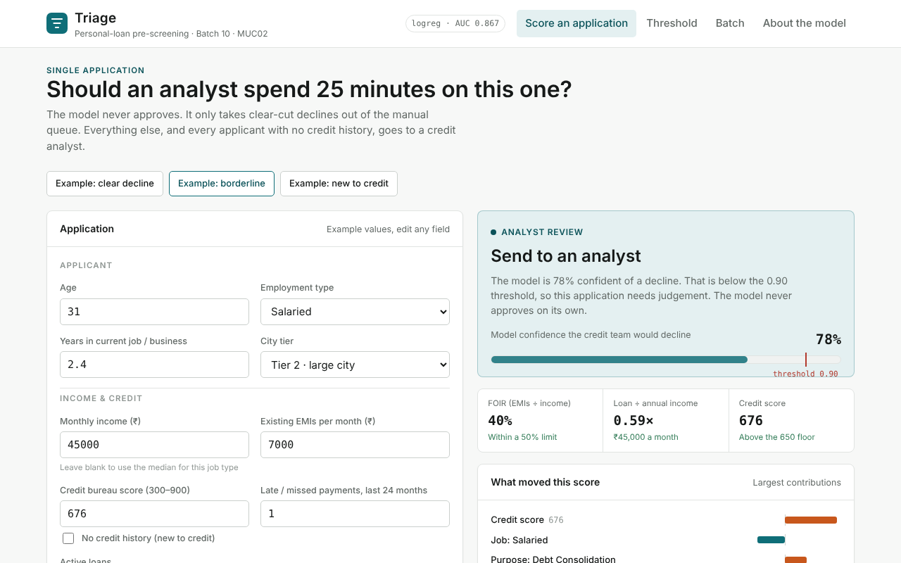
Triage: the model, deployed
BEYOND THE BRIEF
The trained model runs in the browser. The analyst can score an application, move the threshold against the 5% rule, and triage a whole intake file.
Static site on Netlify, no server, data never leaves the browser. Matches scikit-learn to within 1e-10 on all 2,400 test applications.
app/index.html · model/train_export.py · Naishadh Vytla
Notes:
Presenter: Naishadh Vytla. We exported the model to JSON and rebuilt the scoring in JavaScript, so the Credit Policy Analyst can use it without opening a notebook. Here a borderline application scores 78%, below 0.90, so it goes to an analyst. The threshold view shows the same trade-off you just saw, live.

Slide 12

Notes:
Presenter: Naishadh Vytla. Click the video to play (2 minutes). This is Triage live at triagecreditscreener.netlify.app: the landing page scores an example in place, an analyst signs in, scores an application into one of three lanes, sets the bank's 5% policy at 0.90, triages a whole intake CSV and gets a report. Under the hood the model is trained once in Python and shipped as JSON, Supabase row-level security guards every user's data, and the browser scorer matches scikit-learn on 300 of 300 test rows.

Slide 13
Before going live, the bank needs repayment data
LIMITATIONS AND NEXT STEPS
Link decisions to repayment
Run in shadow mode
Monitor by gender
Today the model copies analyst judgement, including any bias. Train on 12-month repayment outcomes instead.
Score live applications for a month without declining any. If wrong declines stay well under 5%, test 0.85.
Report approval and auto-decline rates by gender every month, and investigate if the gap grows.
Batch 10 | Sections | Cross-cutting
Naishadh Vytla | CBIM canvas (led), 5.1 cleaning | Notebook assembly, Triage web app
Raghunandan | 5.2 approval drivers, 5.3 FOIR | Chart consistency, team documentation
Pradeepthi | 5.4 model, 5.5 threshold | Presentation deck
Saketh | 5.6 fairness, 5.7 briefing | QA, 1-page summary, checklist
Calibo AI Academy · Path 2 · KLU Batch 10 · MUC02 · Six months of simulated data, April–September 2026
Notes:
Presenter: Saketh. Our biggest limitation is the target: past decisions, not repayment. We would add repayment data, run the lane in shadow mode for a month before it declines anyone, and monitor outcomes by gender. Thank you; questions welcome.

