Slide 1
POWER BI TRAINING ASSIGNMENT
Sales Business Intelligence
& Analytics Dashboard
From transaction data to decision-ready business insights
STUDENT
Sales | Profitability
Products | Customers | Budget
Naishadh Vytla
ID • 2300040035

Slide 2
01 | WHAT THE DASHBOARD SAYS
Executive Snapshot
TOTAL SALES
GROSS PROFIT
GROSS MARGIN
~40M
~13M
32.51%
Analyzed period
Sales less cost
Reported overall margin
ORDERS
UNITS SOLD
AVG. ORDER VALUE
~11K
~33K
~3.64K
Approximate orders
Approximate units
Revenue per order
DECISION SIGNAL
Strong headline totals are paired with a sharp post-2022 decline, uneven monthly performance, concentration in key products/customers, and a budget KPI that requires validation.
Power BI Sales Intelligence & Analytics
2

Slide 3
02 | WHY THIS DASHBOARD EXISTS
Business Problem & Analysis Scope
DATA SCOPE
BUSINESS QUESTIONS
DECISION USE
Sales transactions for 2021–2023 with product, customer, salesperson, location and date details, plus budget data.
How are we performing against last year and budget? Which products, customers, people and regions matter most?
Identify performance shifts, concentration risks, weak periods and areas requiring targeted follow-up.
ANALYSIS LENS
Performance → Drivers → Risks → Actions
Power BI Sales Intelligence & Analytics
3

Slide 4
03 | FROM RAW DATASETS TO AN ANALYSIS-READY MODEL
Data Preparation & Star Schema
1
2
3
4
5
6
7
Import datasets
Inspect columns & types
Remove unnecessary data
Append 2021–2023 sales
Create Fact_Sales
Handle data-quality issues
Prepare model
STAR SCHEMA
Dim_Product
Dim_Date
Dim_Customer
Fact_Sales
Dim_Location
Dim_Salesperson
One-to-many relationships
Filters flow from dimensions to facts.
Power BI Sales Intelligence & Analytics
4

Slide 5
04 | MEASURES POWERING THE REPORT
KPI & DAX Framework
Total Sales
Gross Profit
SUMX(Fact_Sales, Price × Quantity)
Total Sales − Total Cost
Gross Margin %
YTD Sales
Gross Profit ÷ Total Sales
TOTALYTD(Total Sales, Date)
Budget
Business KPIs
SUM(Monthly Allocation2)
Orders • Units • AOV • YoY • Budget Achievement
PURPOSE
Standardized measures turn transaction-level data into comparable business KPIs and time-intelligence views.
Power BI Sales Intelligence & Analytics
5

Slide 6
05 | SEVEN REPORT PAGES
Dashboard Architecture
01
02
03
04
Executive Overview
Sales Trend Analysis
Product Performance
Customer Analysis
05
06
07
Salesperson Performance
Geographic Analysis
Budget vs Actual
DESIGN LOGIC
Start with the executive picture, drill into time, products, customers, people and geography, then close the loop with budget validation.
Power BI Sales Intelligence & Analytics
6

Slide 7
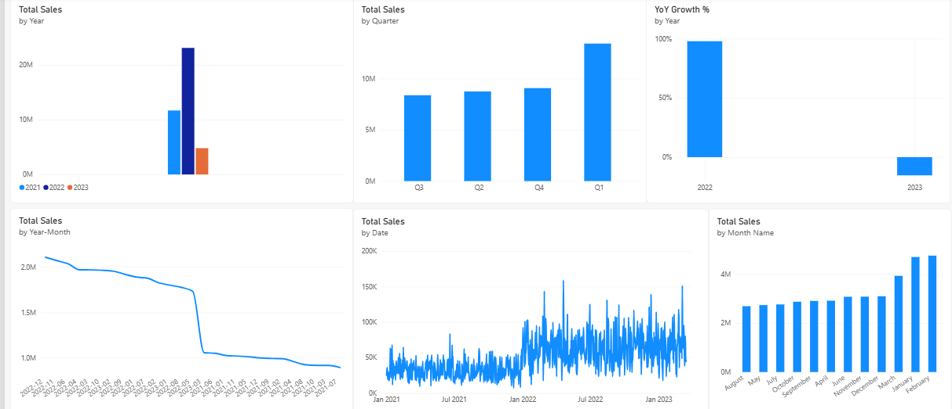
06 | TIME-BASED PERFORMANCE
Sales & Trend Analysis
WHAT THE TREND SHOWS
2022
Peak sales year
YoY growth
~−72.32%
Monthly
Noticeable ups & downs
Daily
Drill down for unusual days
Planning
Use seasonal patterns for promotions & stock
Source dashboard visual: sales trend analysis
Power BI Sales Intelligence & Analytics
7

Slide 8
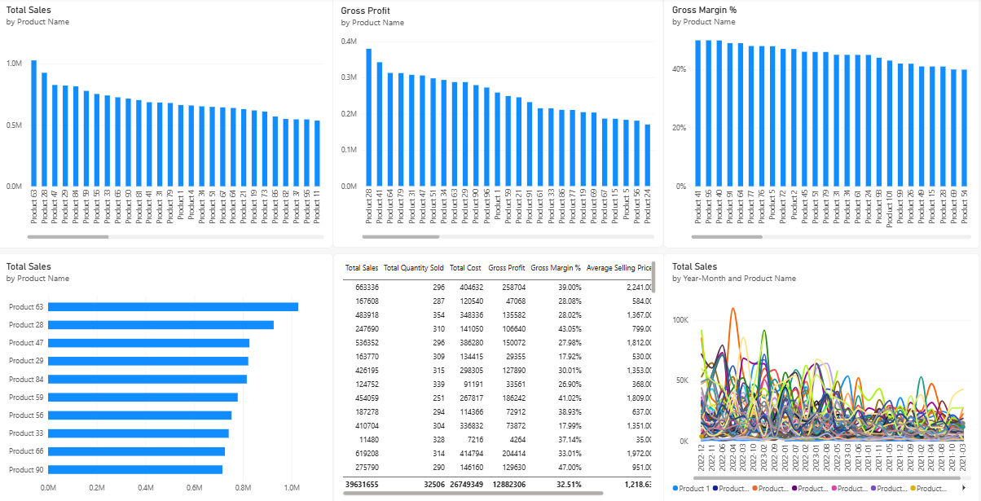
07 | REVENUE DEPENDENCY
Product & Customer Concentration
BUSINESS READING
• A limited group of products contributes a large share of sales.
• Top products should be protected through availability and focused marketing.
• Weaker products need review for improvement or replacement.
• Customer concentration increases retention risk if major accounts are lost.
Source dashboard visual: product performance
Power BI Sales Intelligence & Analytics
8

Slide 9
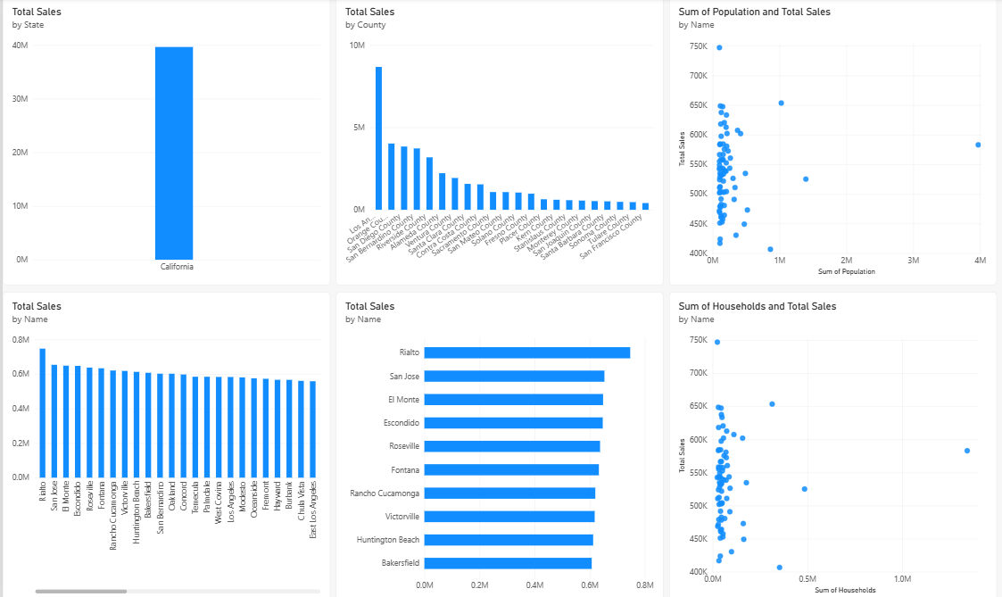
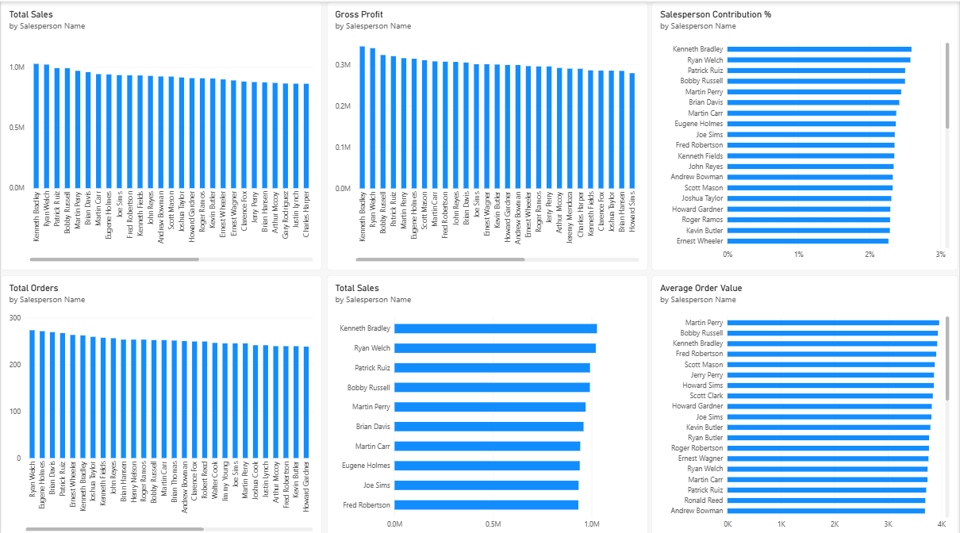
08 | FINDING WHERE PERFORMANCE VARIES
Geographic & Salesperson Performance
Geographic analysis
Salesperson performance
Use these views to locate strong and weak regions and identify salesperson performance differences before assigning targeted actions.
Power BI Sales Intelligence & Analytics
9

Slide 10
09 | DATA-QUALITY CHECKPOINT
Budget vs Actual: Validation Required
1
Check budget table
2
Check relationships
CURRENT BUDGET ACHIEVEMENT
Review monthly allocations.
Verify filter paths.
3963.17%
Treat as untrusted until validated.
3
Check DAX
4
Re-test KPI
Reconcile the calculation.
Validate monthly/yearly totals.
WHY THIS MATTERS
The source submission explicitly flags the 3963.17% figure as a validation issue. It should not be used to judge budget performance until the data, relationships and calculation are reconciled.
Power BI Sales Intelligence & Analytics
10

Slide 11
10 | WHAT MANAGEMENT SHOULD NOTICE
Key Business Findings
01
Sales decline
YoY growth is reported at approximately −72.32%; the change needs root-cause analysis.
02
2022 benchmark
2022 is identified as the strongest sales year in the analyzed period.
03
Concentration
A small set of products and customers drives a large share of revenue.
04
Volatility
Monthly sales show noticeable swings, making planning less consistent.
05
Budget KPI
Budget Achievement is currently 3963.17% and requires validation before decision use.
Power BI Sales Intelligence & Analytics
11

Slide 12
11 | TURNING INSIGHTS INTO NEXT STEPS
Recommendations & Action Plan
01
Diagnose the decline
Break the sales drop down by year, month, product, customer, salesperson and location.
02
Fix the budget KPI
Validate budget values, relationships and DAX before using budget achievement.
03
Protect high performers
Keep top products available and supported; review weaker products.
04
Strengthen retention
Prioritize high-value customers with personalized offers and repeat-purchase initiatives.
05
Plan around seasonality
Align promotions, inventory and sales activity with monthly/quarterly patterns.
Outcome: better sales planning • stronger retention • smarter product decisions • more reliable financial analysis
Power BI Sales Intelligence & Analytics
12

Slide 13
12 | FINAL TAKEAWAY
Closing Summary
The dashboard connects sales, profitability, products, customers, people, locations and budget performance into one analytical view.
PERFORMANCE
MOMENTUM
RISK
CONTROL
~40M sales
~13M gross profit
2022 peak
~−72.32% YoY
Product + customer concentration
Monthly volatility
Budget KPI requires
validation
Naishadh Vytla | 2300040035
Power BI Sales Intelligence & Analytics
Power BI Sales Intelligence & Analytics
13

