Slide 1
FraudGuard
KLU + Path-3 · ML-02 · Real-time UPI / digital payment fraud detection
Group 8 · Matrix Mechanics
31 October 2026
N. Varshitha · M. Kumara Swamy · V. Naishadh · M. Suman Srinivas
Every payment gets a fraud score; the score becomes approve, step-up OTP or block, with the two cut-offs set by rupee cost
78%
lower expected fraud cost on unseen data
0.33%
of customers see any friction
60 / 74
test frauds stopped or challenged
Notes:
Open with the decision problem: every payment needs a decision in a fraction of a second. FraudGuard scores it and turns the score into approve, step-up OTP or block, with thresholds set by rupee cost. Headline: on the held-out test period, expected cost fell 78% against approving everything, and only 0.33% of customers felt any friction.

Slide 2
Group 8 · Matrix Mechanics: who owns what
Member | Problem statements owned | Presents | Time
N. Varshitha | PS1 Data quality & reliability PS2 Fraud lens & the accuracy trap | Slides 3–8: the problem, the accuracy trap, datasets, cleaning, UPI signal check | ≈ 2½ min
M. Kumara Swamy | PS3 Fraud patterns (EDA) PS4 Supervised learning | Slides 9–15: where fraud lives, the pipeline, 22 models, weights vs SMOTE | ≈ 2½ min
V. Naishadh | PS5 Anomaly detection PS6 Cost-based threshold | Slides 16–19: label-free detectors, the ₹ threshold, cost sensitivity | ≈ 2 min
M. Suman Srinivas | PS7 Risk-score decision rule PS8 Selection, explanation & actions | Slides 20–27: three bands, ₹ saved, SHAP, three actions, live demo | ≈ 3 min
Live app calibofraudguard.netlify.app Code github.com/naishadhvytla/hackathon01calibo
Notes:
Introduce the team in one breath. Each member owns two problem statements end to end and presents them; the presenter's name is at the bottom right of every slide. About 10 minutes in total.

Slide 3
Each payment needs a decision in milliseconds, and both mistakes cost money
₹5,000
Fraud approved
Loss, chargeback, investigation
₹300
Genuine payment blocked
Friction, support call, churn risk
₹15
Step-up OTP challenge
Mostly genuine drop-off (≈5% × ₹300); SMS < ₹1
What is step-up OTP? Extra proof of identity asked only when a payment looks risky. The real owner types the one-time password and the payment goes through; a fraudster with stolen details usually cannot, because they don't have the phone. It does not stop scams where the victim is talked into typing the OTP, so we assume it stops 70% of fraud.
Expected cost = missed fraud × ₹X + genuine blocked × ₹Y + OTP challenges × ₹Z + fraud that passes OTP × ₹X
No official ₹ figures were published, so these are stated assumptions. The notebook and the app's Policy page recompute every threshold for any values.
PS2 · N. Varshitha
Notes:
Frame fraud loss against customer friction. We put a rupee price on each outcome: ₹5,000 for missed fraud, ₹300 for a wrongly blocked customer, ₹15 for an OTP challenge. The ₹15 is mostly genuine customers who abandon the payment (about 5% × ₹300), not the SMS. No official costs were given, so these are stated assumptions; slide 19 shows the decision barely moves when they change.

Slide 4
The accuracy trap: 99.87% accurate, zero fraud caught
99.87%
accuracy of a model that approves everything
0 of 74
frauds it catches; ₹3.70 L lost
₹6,100
saved by the cost threshold, which is less accurate
So we select on PR-AUC and rupee cost; accuracy appears only to make this point.
PS2 · N. Varshitha
Notes:
The wow-factor slide. Fraud is 0.13% of the test period, so labelling everything genuine is 99.87% accurate and catches nothing. Accuracy can't even rank our own two settings: the cost threshold is less accurate than 0.5 but ₹6,100 cheaper. Hence recall, precision, PR-AUC and rupees.

Slide 5
Can the data be trusted?
Two datasets, one pipeline: one carries signal, one does not
Presented by N. Varshitha (PS1–2) and M. Kumara Swamy (PS3)

Slide 6
Two datasets, run through the identical pipeline
ULB Credit Card Fraud
Worldline + Machine Learning Group, ULB · Kaggle (mlg-ulb/creditcardfraud)
UPI Transactions 2024
Organiser-supplied, simulated UPI-style file
Scope European cardholders, September 2013, 2 days
Size 284,807 payments · 492 frauds (0.172%)
Columns Time, Amount (currency not stated), V1–V28, Class
Confidential V1–V28 are PCA components; original features withheld
Cleaned 1,081 duplicates dropped → 283,726 rows, 473 frauds
Role Primary: model, thresholds, actions
Scope 1 Jan – 30 Dec 2024
Size 250,000 payments · 480 frauds (0.192%)
Columns Type, merchant, amount ₹, ages, state, banks, device, network, status, hour, weekday
Missing No sender, receiver or device IDs
Leakage transaction_status is known only after the decision → excluded
Role Negative control: same code, tests for signal
PS1 · N. Varshitha
Notes:
The brief told us to inspect the UPI file before choosing it, so we ran both datasets through the same code. Credit card: the Kaggle ULB benchmark with anonymised PCA features. UPI: the organiser's simulated file, which turns out to have no learnable signal.

Slide 7
Data quality audit: what we kept, dropped and excluded
Check | Credit card | UPI 2024
Missing values | None | None
Duplicates | 1,081 exact duplicates (19 fraud) → dropped | None
Impossible amounts | None negative; 1,808 zero amounts (25 fraud) → kept, flagged (card testing) | None; ₹10–₹42,099 → log-transformed
Timestamps | Seconds since start → hour of day; raw Time dropped | All valid; hour and weekday consistent
Inconsistent categories | None (PCA) | All 112,445 P2P rows have a merchant category; amounts identical across types
Leakage columns | Only Class excluded | transaction_status (post-decision), transaction id excluded
Split | Time-ordered 60 / 20 / 20, before any resampling | Same
PS1 · N. Varshitha
Notes:
Every check the brief lists, for both datasets, with the treatment. Two things to stress: zero amounts are kept because they're a card-testing signal, not an error; and UPI's status column is excluded because a blocked fraud would show up as FAILED, so it leaks the outcome.

Slide 8
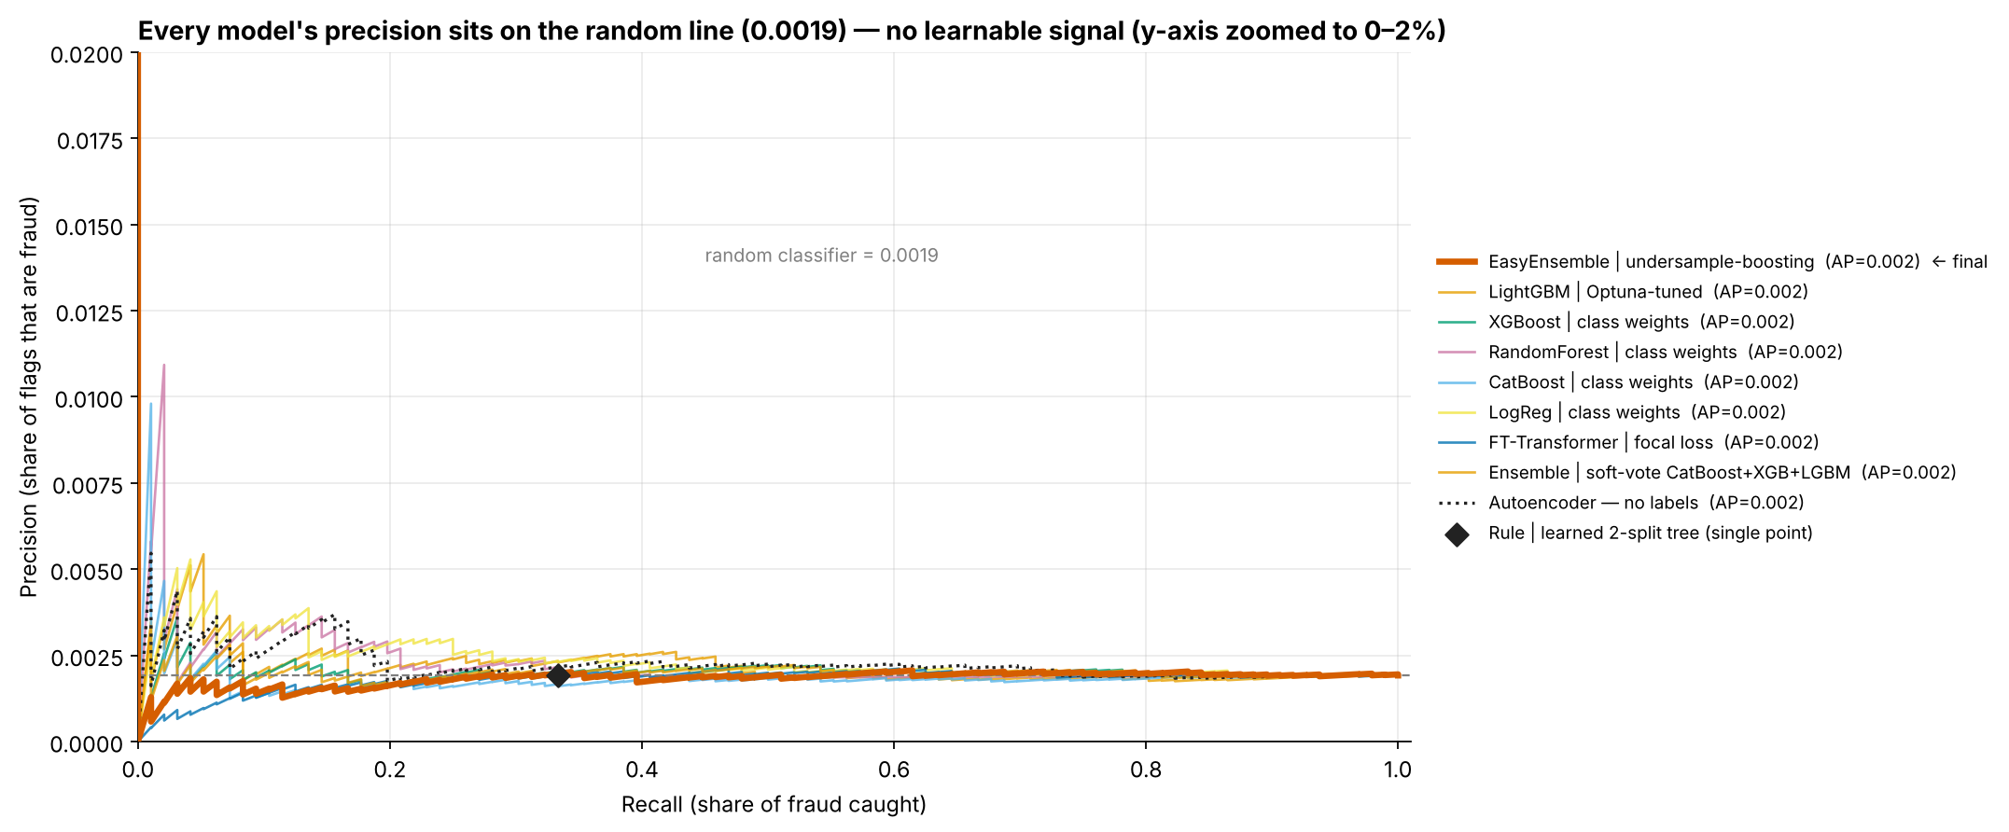
The UPI fraud label carries no learnable signal
13
χ² tests; none survives multiple-testing correction
0.47–0.54
test ROC-AUC across all 22 models
p = 0.78
the validation 'winner' on test (p = 0.016 on validation)
Approve all
is the cost-optimal UPI policy: ₹4.80 L vs ₹4.85 L for any rule
PS1 · N. Varshitha
Notes:
Every test came back at chance. The interesting one: the model that won on validation had p = 0.016, but on test p = 0.78. That's what picking the best of 22 models on noise looks like. So no UPI model is deployable; our recommendation 2 is about fixing UPI data capture.

Slide 9
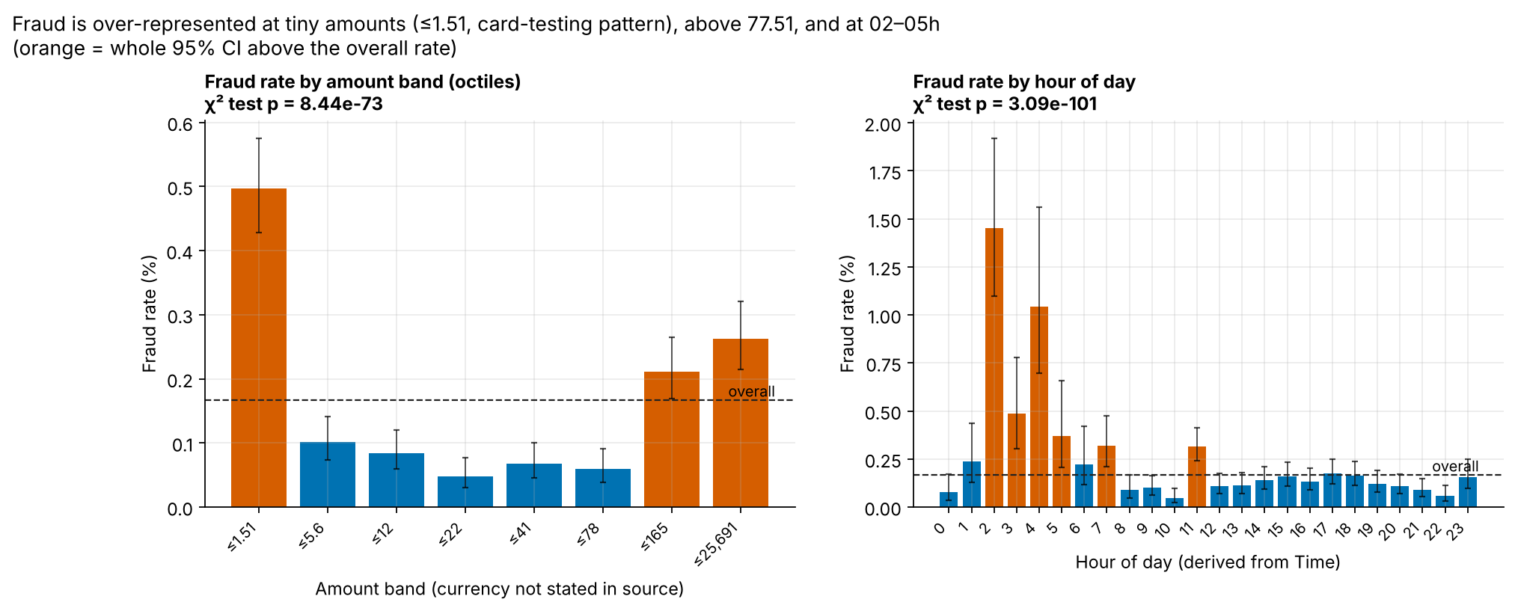
On card data, fraud clusters in micro-amounts, the night and bursts
3× · 8×
fraud rate at amounts ≤ 1.51 and at zero (card testing)
23% in 5.7%
of fraud in the 01–05h window, which carries 5.7% of traffic
43 in 1 hour
frauds arriving together: campaigns, not noise
PS3 · M. Kumara Swamy
Notes:
Three patterns with 95% confidence intervals: card testing at tiny and zero amounts, a night window, and bursts. These are associations, not causes; say that explicitly. They feed recommendation 3.

Slide 10
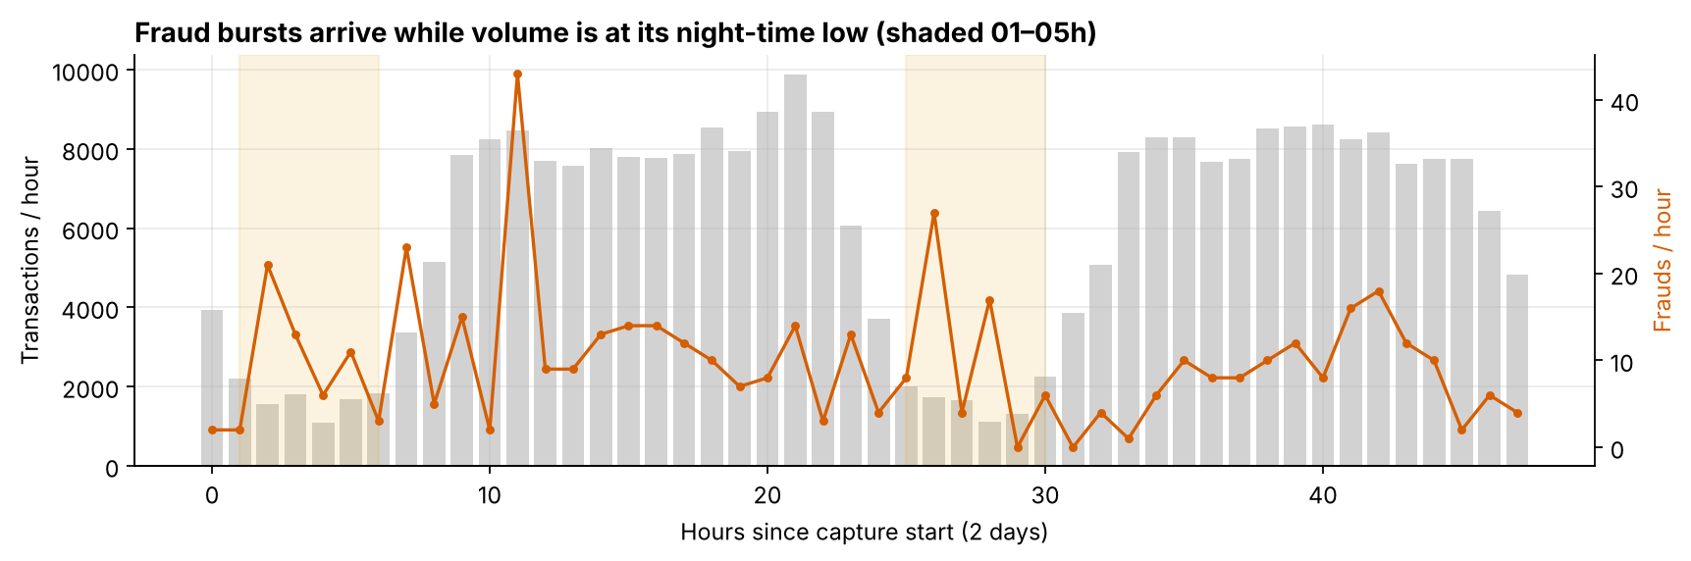
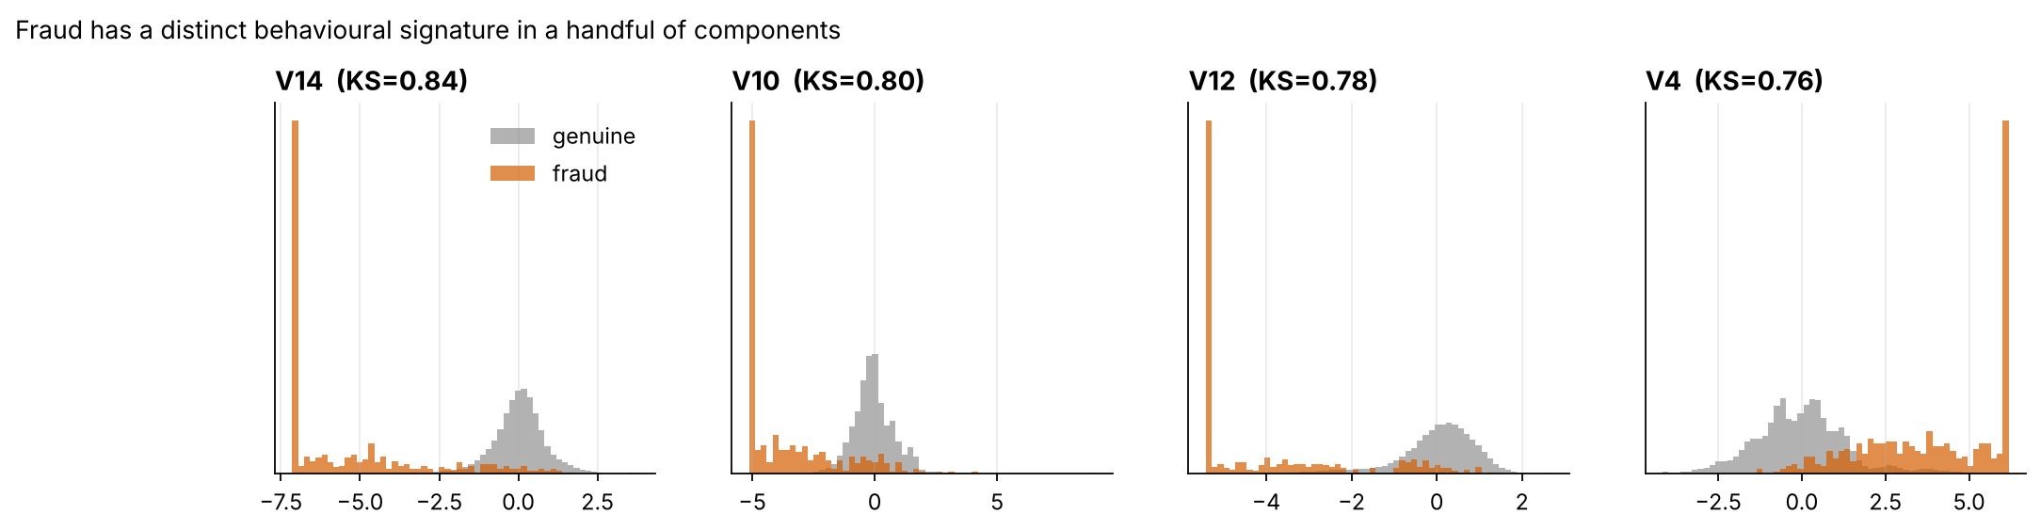
Fraud arrives in night-time bursts with a distinct behaviour signature
PS3 · M. Kumara Swamy
Notes:
Top: payments per hour in grey, frauds in orange, night window shaded. Bottom: four anonymised components separate fraud almost on their own (KS statistic up to 0.84); the model uses exactly these.

Slide 11
How the system decides
22 supervised models, 6 label-free detectors, one cost-set rule
Presented by M. Kumara Swamy (PS4) and V. Naishadh (PS5)

Slide 12
One pipeline: labelled and label-free scores feed a cost-set rule
Audit & split
dedupe · leakage out · time split 60/20/20
Supervised model
CatBoost + class weights
Calibrate
isotonic → risk 0–100
₹ threshold search
2 cut-offs on validation
Decide
approve · OTP · block
Label-free watch-list
COPOD, no labels
Guard-rails enforced in code: SMOTE only inside the training pipeline · Optuna tunes on time-series folds inside train · deep-model early stopping on the last 15% of train · model choice, calibration and thresholds on validation · test scored once · seed 42
PS4 · M. Kumara Swamy
Notes:
Walk left to right. Judges look for leakage, so stress the guard-rails: no resampling before the split, nothing tuned on test, a time-aware split. The label-free detector runs alongside as a watch-list.

Slide 13
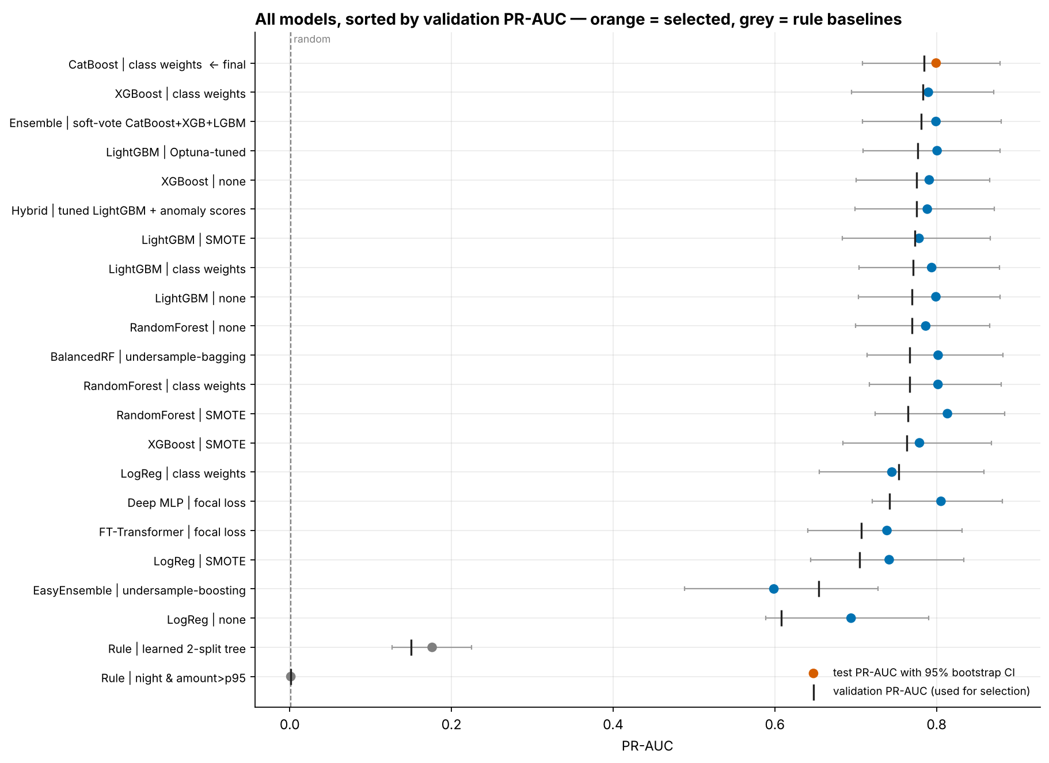
22 models compared; CatBoost wins on validation PR-AUC and cost
Selection rule, fixed before test
Within 0.01 of best validation PR-AUC (6 models)
Lowest validation ₹ cost: CatBoost ₹66,300
Single model over ensemble (latency, exact SHAP)
Permutation test p < 0.002
0.80
test PR-AUC (95% CI 0.71–0.88) vs 0.0013 random
< 1 µs
per payment on a laptop CPU
PS4 · M. Kumara Swamy
Notes:
Dots are test PR-AUC with 95% bootstrap intervals; bars are validation, which drove the choice. The top models overlap on test, so the choice rests on cost and operability. The ensemble's members were fixed in advance to avoid selection bias.

Slide 14
Class weights beat SMOTE; imbalance handling matters most for linear models
LogReg: weights 0.753 · SMOTE 0.705 · none 0.608
A linear model needs imbalance handling; class weights do it best.
Trees: all three regimes within ±0.02
Well inside the ±0.08 bootstrap interval, so the difference is noise.
Decision: class weights
No synthetic transactions, no extra training time, probabilities closer to calibrated. SMOTE always ran inside the training fold only.
PS4 · M. Kumara Swamy
Notes:
This answers 'does SMOTE beat class weights?' from the brief. Not here. For logistic regression class weights win clearly; for tree ensembles the three are within noise.

Slide 15
We tried research-grade models; tuned trees still won
Model | What it adds | Val PR-AUC | Test PR-AUC | Verdict
FT-Transformer (Gorishniy et al., 2021) | Attention over feature tokens; focal loss | 0.707 | 0.739 | Below every GBDT
Deep MLP, focal loss (Lin et al., 2017) | Loss-level imbalance handling | 0.742 | 0.806 | Weaker on validation
LightGBM + Optuna (30 TPE trials) | Tuned on time-series folds in train | 0.777 | 0.801 | No gain over defaults
Hybrid: LightGBM + anomaly scores | Label-free scores as features | 0.775 | 0.789 | Adds nothing
Soft-vote ensemble (fixed members) | CatBoost + XGBoost + LightGBM | 0.781 | 0.799 | No gain over CatBoost
CatBoost, class weights (selected) | Ordered boosting, √-balanced weights | 0.784 | 0.799 | Best val PR-AUC and cost
Consistent with Grinsztajn et al. (2022): tree ensembles still lead on mid-sized tabular data. The brief rewards business value, not complexity, so complexity had to earn its place.
PS4 · M. Kumara Swamy
Notes:
We went beyond the brief's LR, RF, XGBoost: transformers, focal loss, Bayesian tuning, a hybrid and an ensemble. None beat CatBoost on validation, which matches the literature, so the simple model wins and we can say why.

Slide 16
Without any labels, COPOD finds 59% of fraud in its top 1%
44 of 74
test frauds in COPOD's top 1%; precision there is 60× random
43 overlap
with the supervised top 1%: it mostly re-finds known fraud
Watch-list
its job: surface new fraud patterns that have no labels yet, for analysts, not for blocking
PS5 · V. Naishadh
Notes:
This answers PS5. Detectors fit on training features only; labels used afterwards. Also tested: ECOD, Isolation Forest, autoencoder, LOF and DBSCAN, which flags 0.6% as noise and catches 6 of 12 frauds in its sample.

Slide 17
From score to rupees
A cost-based threshold, then three bands
Presented by V. Naishadh (PS6) and M. Suman Srinivas (PS7)

Slide 18
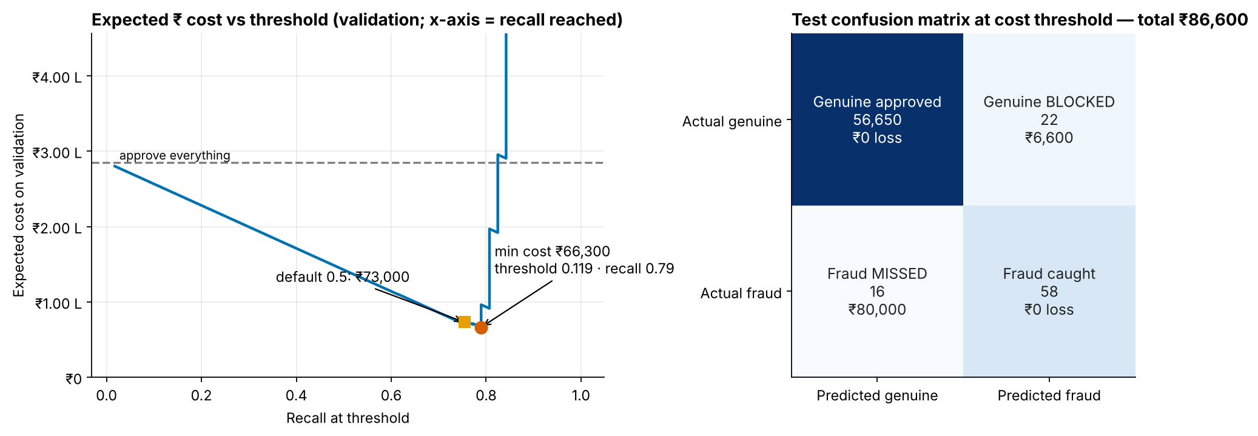
The cheapest cut-off is 0.119, not 0.5
58 of 74
frauds caught on test at 0.119
22
genuine payments blocked
₹86,600
test cost vs ₹92,700 at 0.5
₹54,500–₹1.27 L
bootstrap 95% CI of that cost
PS6 · V. Naishadh
Notes:
Left: expected cost on validation at every threshold; the minimum is 0.119, the square is the 0.5 default. Right: the test confusion matrix in rupees. We chose on validation and scored test once.

Slide 19
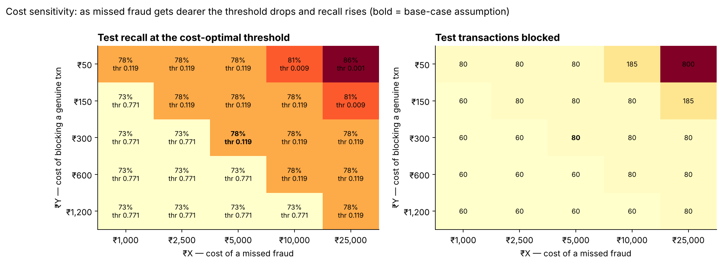
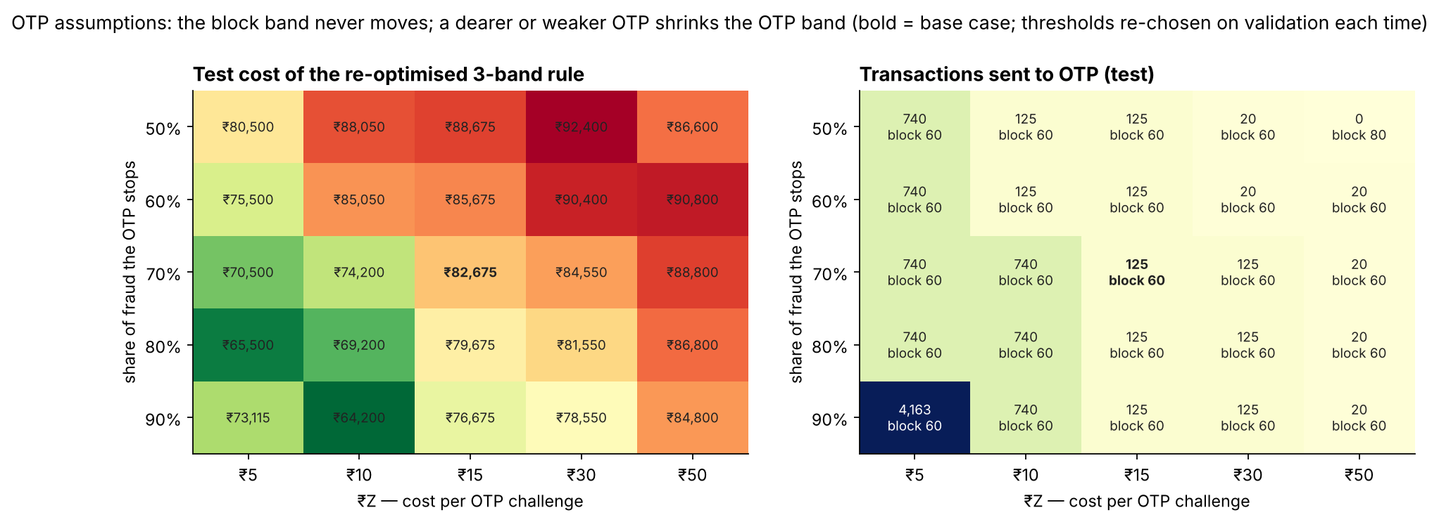
Wrong cost guesses barely move the decision
₹X × ₹Y: 25 scenarios
Only four distinct thresholds appear; recall stays between 73% and 86%.
₹Z × OTP stop rate
The block band stays at 60 payments in every case. A dearer or weaker OTP only shrinks the OTP band.
Official costs on the day?
Type them into the app's Policy page: thresholds re-optimise in under a second.
PS6 · V. Naishadh
Notes:
This defends the assumed costs. Top: missed-fraud cost against block cost. Bottom: OTP cost against how much fraud OTP stops. The block decision never moves, and the app recomputes everything live for any official numbers.

Slide 20
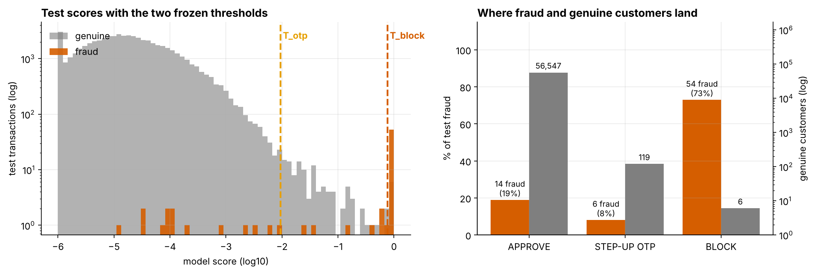
Three bands: block 60, challenge 125, approve the rest
Band | Rule (model score) | Payments | Fraud | Genuine customers | Expected cost
APPROVE | < 0.0095 | 56,561 | 14 missed | pass | ₹70,000
STEP-UP OTP | 0.0095 – 0.771 | 125 | 6 challenged | 119 challenged | ₹10,875
BLOCK | ≥ 0.771 | 60 | 54 stopped (73%) | 6 blocked | ₹1,800
90%
of blocked payments are fraud
81%
of fraud stopped or challenged
0.33%
of customers see any friction
1.0 / 88.9
calibrated risk (0–100) where OTP / block start
PS7 · M. Suman Srinivas
Notes:
This is PS7. Two thresholds found by an exact search over validation scores, minimising approve + OTP + block cost, then frozen. Read the table: 60 blocks, 54 of them fraud; 125 OTPs, 119 genuine customers challenged; 14 frauds slip through.

Slide 21
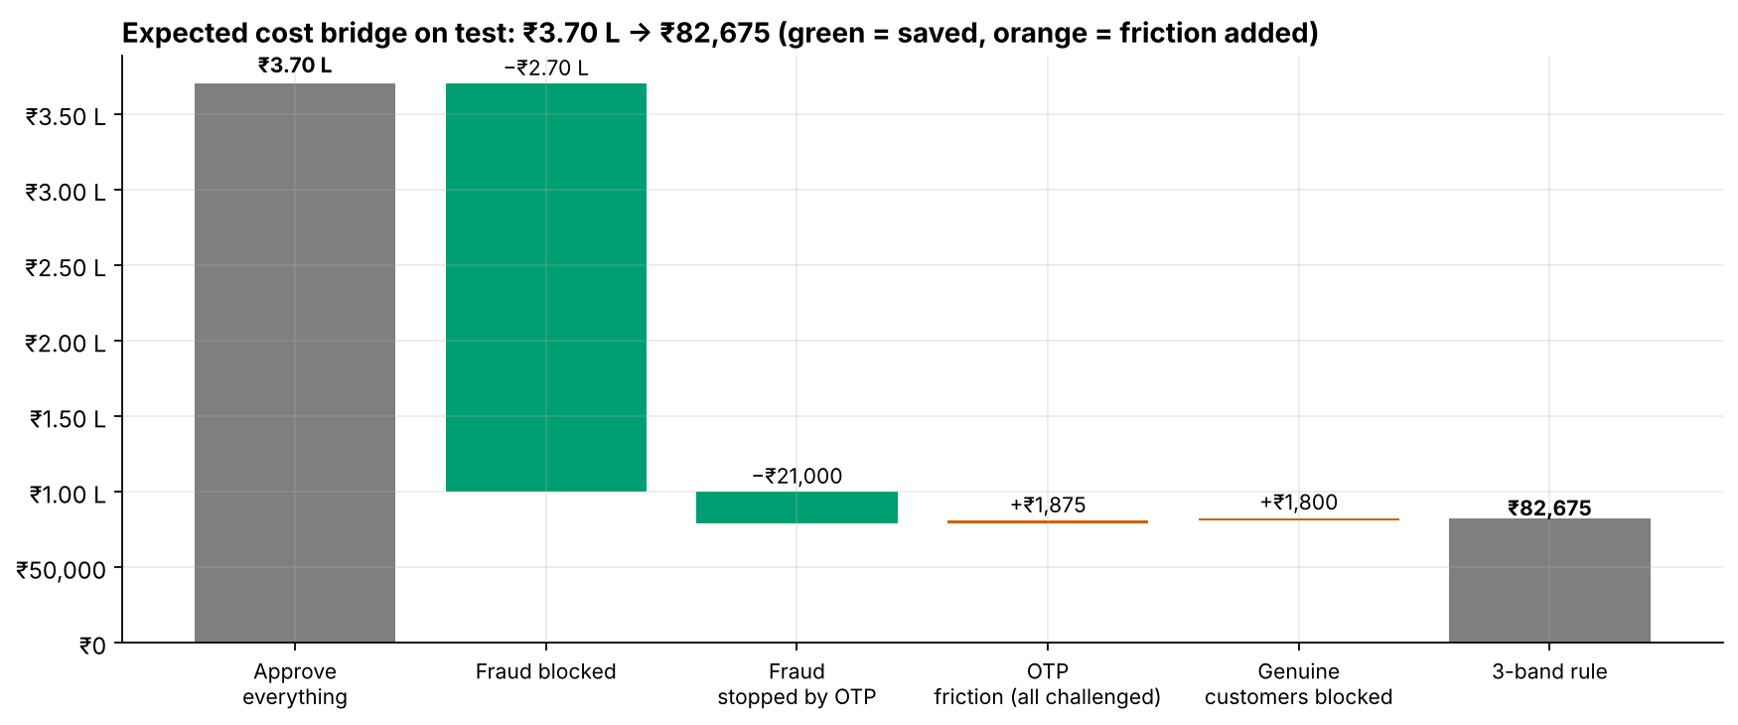
Expected cost falls from ₹3.70 L to ₹82,675 on unseen data
Projected (scenario estimate)
≈ ₹50.63 L saved per million payments
if future traffic looks like the test period and the assumed costs hold. Everything else on this slide is observed on held-out data.
PS7 · M. Suman Srinivas
Notes:
Left: four policies on the same test period. Right: the bridge from approve-everything, where blocking does most of the work. The per-million figure is a projection and is labelled as one, as the brief requires.

Slide 22
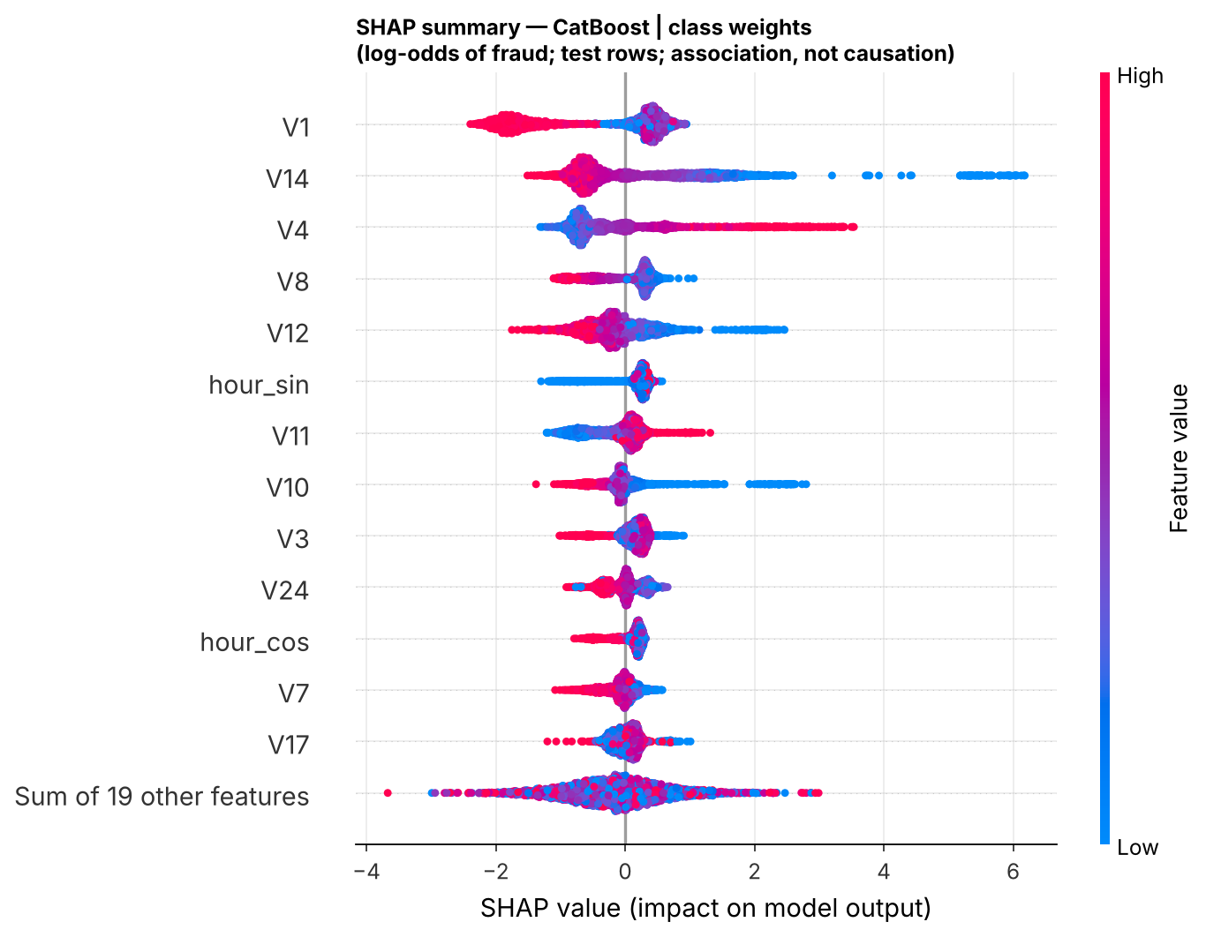
The model relies on the same behaviour signals the data showed
Low V14 → up to +6 log-odds of fraud
the strongest single signal
High V4, low V12 and V10 push towards fraud
the same components that separated fraud in the EDA
Hour of day ranks 6th
matching the night window
Every payment explained live
The web app computes exact TreeSHAP in the browser. Associations, not causes.
PS8 · M. Suman Srinivas
Notes:
SHAP agrees with the EDA, so the model learned real behaviour, not an artefact. Be upfront that V1–V28 are anonymised by the bank, so we can't name them in business terms.

Slide 23
Three findings, three actions
Each tied to observed evidence; projections labelled
Presented by M. Suman Srinivas (PS8)

Slide 24
Three actions, each tied to observed evidence
1 · This quarter
Retire 0.5; deploy the three-band rule
Evidence (observed)
₹82,675 vs ₹92,700 on test; blocks are 90% fraud
Action
Shadow-run 2–4 weeks, then go live; re-fit thresholds monthly from the cost curve
2 · Before any UPI model
Fix UPI data, then model it
Evidence (observed)
22 models at chance; no IDs; a leakage field
Action
Log account and device IDs and dated labels; COPOD watch-list meanwhile; random holdout
3 · Next sprint
Target card testing and bursts
Evidence (observed)
≤ 1.51 amounts hold 37% of fraud; 01–05h = 23% of fraud in 5.7% of traffic
Action
Velocity limits on micro-authorisations; burst alerts; night staffing; A/B test first
PS8 · M. Suman Srinivas
Notes:
Exactly three, each linked to evidence. One has the largest observed value. Two unlocks UPI at all. Three is operational and must be A/B tested, because the patterns are associations.

Slide 25
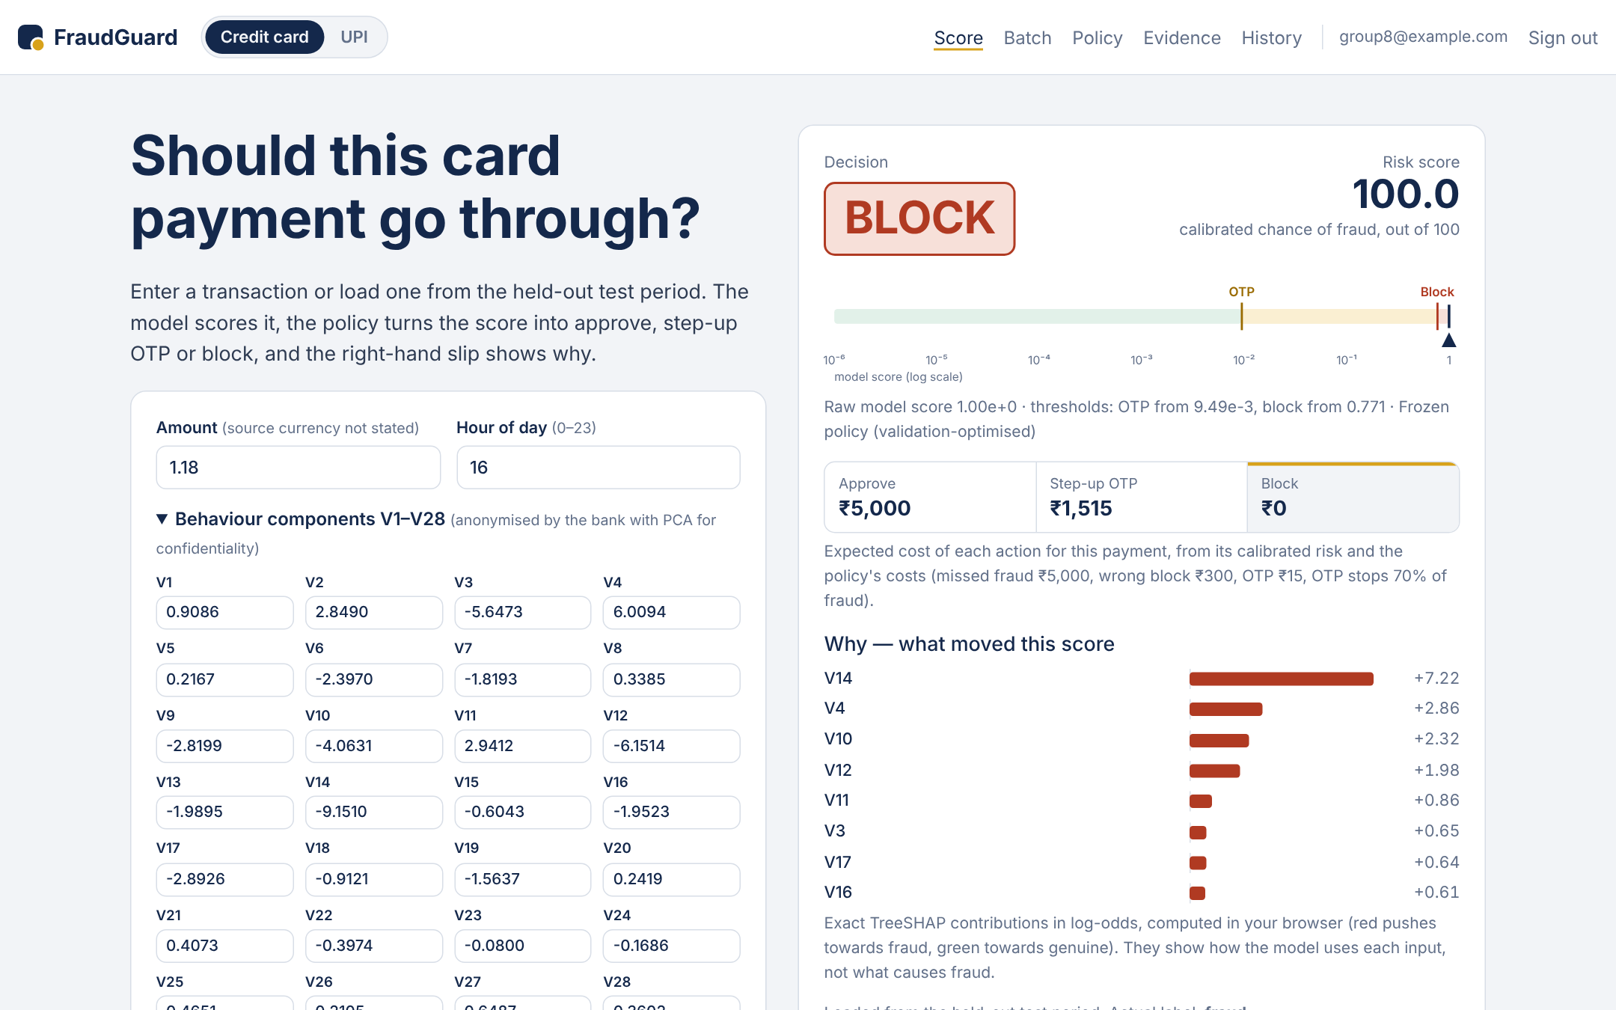
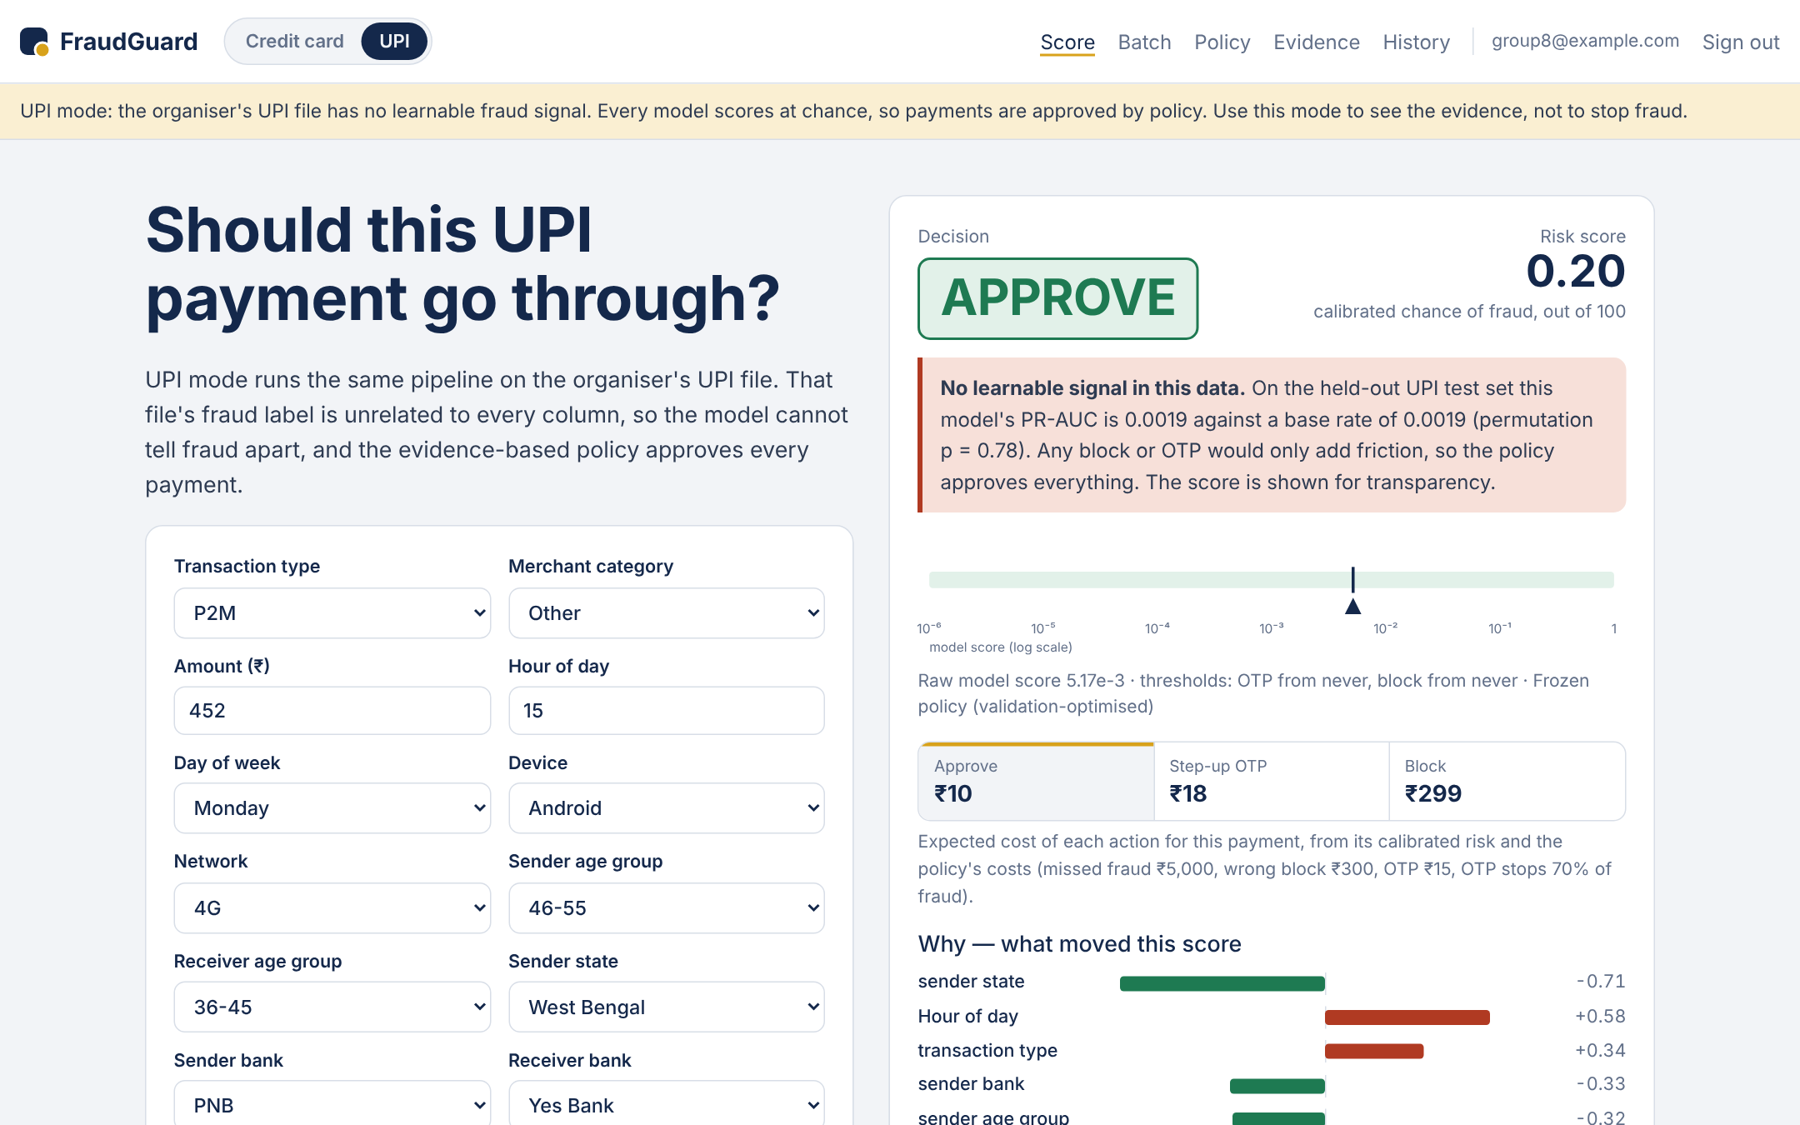
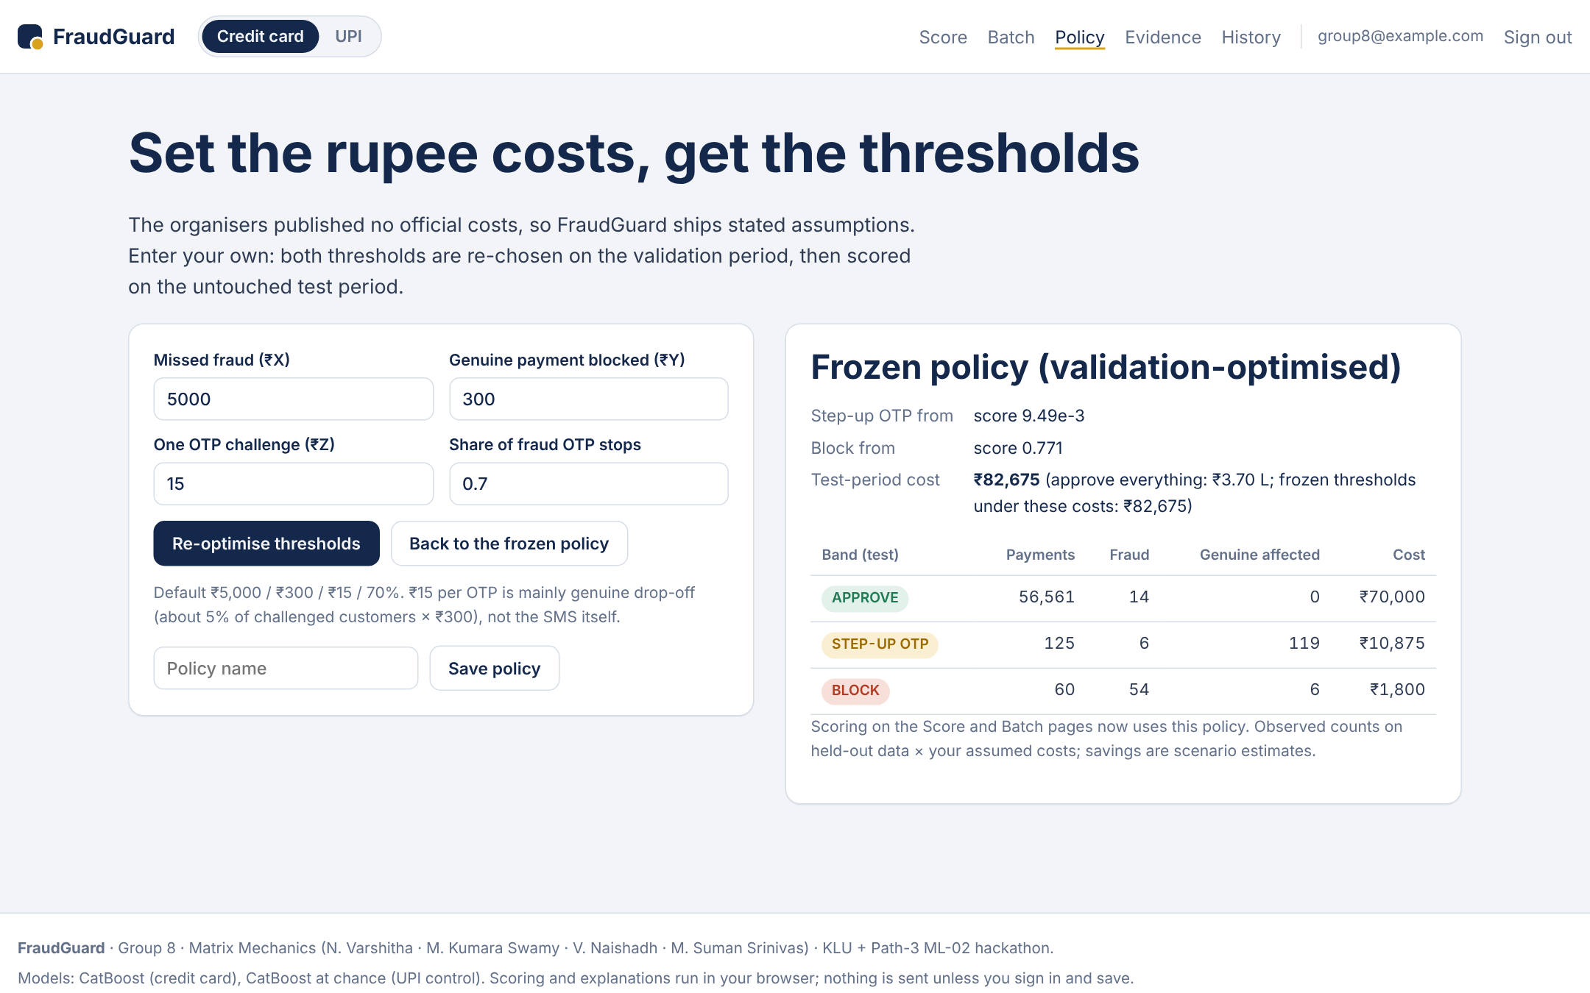
Live demo: FraudGuard on the web, in both modes
calibofraudguard.netlify.app · sign in · Score · Batch CSV · Policy (official ₹ costs) · Evidence · History and audit log
Demo · M. Suman Srinivas
Notes:
Switch to the live app at calibofraudguard.netlify.app (sign in first). Load a test fraud: BLOCK with the reasons. Load a genuine: APPROVE. Edit V14 down and watch the risk climb. Open Policy and type a different missed-fraud cost to show the thresholds re-optimise. Switch to UPI mode to show the no-signal banner.

Slide 26
Special points and limitations
Confidentiality
Card features are PCA-anonymised by the data owner
UPI file has no personal identifiers
App scores in the browser; saves are row-level-secured per user
Compliance for rollout
DPDP Act 2023: consent, purpose, retention
RBI fraud-reporting and customer-liability rules
An appeal path for blocked customers
Limitations
~2 days of 2013 card data; 74 test frauds → wide CIs
Amount currency not stated; costs per event
Assumed ₹ costs → savings are scenarios
Blocked fraud is never confirmed → keep a random holdout
PS8 · M. Suman Srinivas
Notes:
Close the analysis on honesty: what the data can and can't support, and what a real rollout would need.

Slide 27
From 99.87% accuracy to rupees saved
Recall, precision and PR-AUC instead of accuracy · a cost-based threshold instead of 0.5 · three bands instead of one score · a label-free watch-list for unseen fraud · a fair comparison of 22 models · three prioritised actions
Group 8 · Matrix Mechanics
N. Varshitha · M. Kumara Swamy · V. Naishadh · M. Suman Srinivas
calibofraudguard.netlify.app
Questions?
Notes:
Recap the brief's 'from → to' table in one line and open for questions. Likely questions: why not UPI (slide 8), what if costs are wrong (slide 19), does SMOTE help (slide 14), how was leakage prevented (slide 12).

