Slide 1
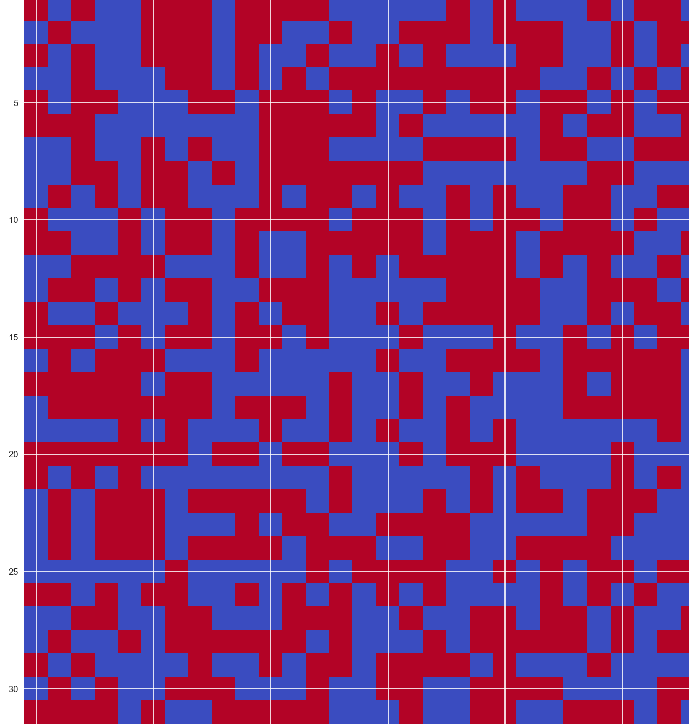
Critical Phenomena and Cluster Algorithms: A Comparative Analysis of the 2D Ising Model
PHYS 514 - Computational Physics
Naishal Patel, Fall 2024

Slide 2
Motivation - Importance and Challenges
Importance of studying phase transitions and critical phenomena
Significance of the 2D Ising model
Challenges in computational studies: critical slowing down

Slide 3
Motivation - Cluster Algorithms and Project Objectives
Role of cluster algorithms (Wolff and Swendsen-Wang) in overcoming critical slowing down
Project objectives:
comparative analysis
Efficiency
critical exponents

Slide 4
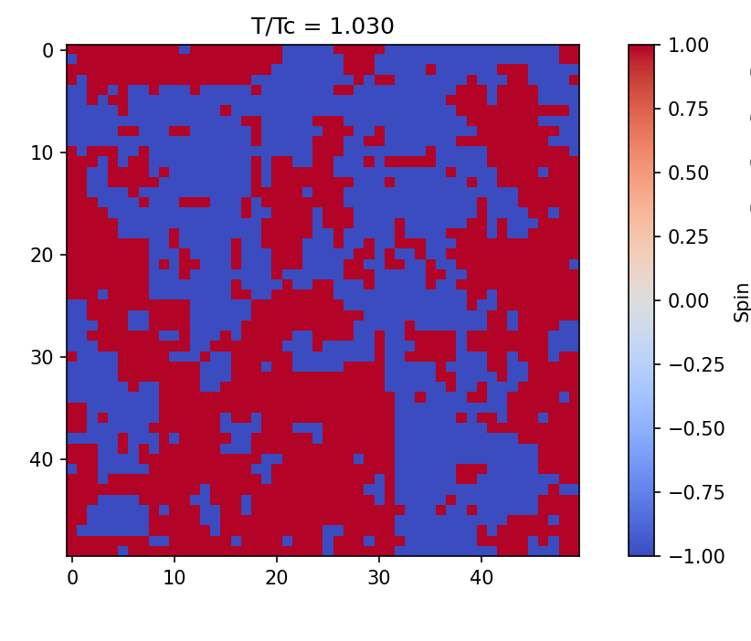


Methods - 2D Ising Model
Brief overview of the 2D Ising model
Hamiltonian and order parameter
Exact solution by Onsager

Slide 5
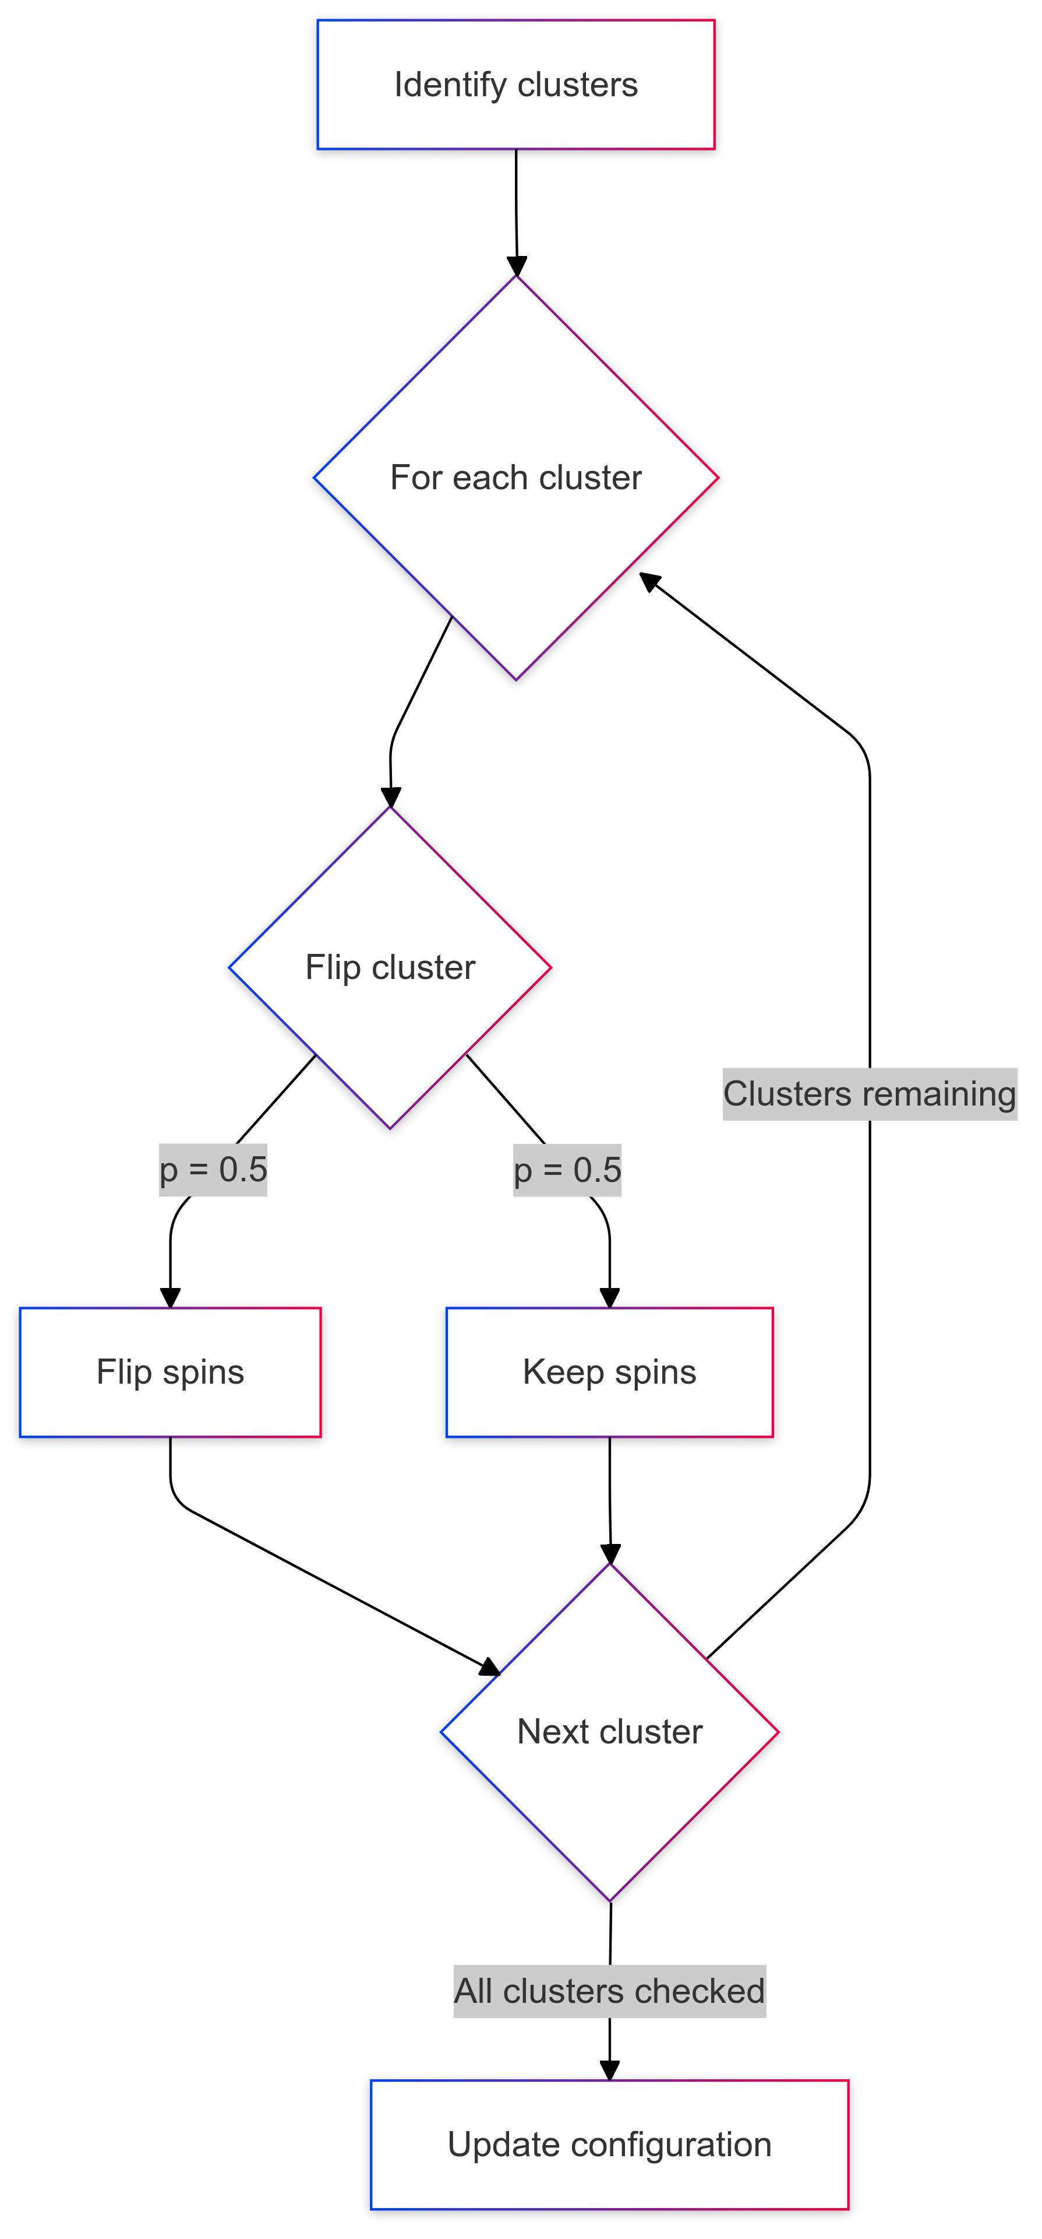
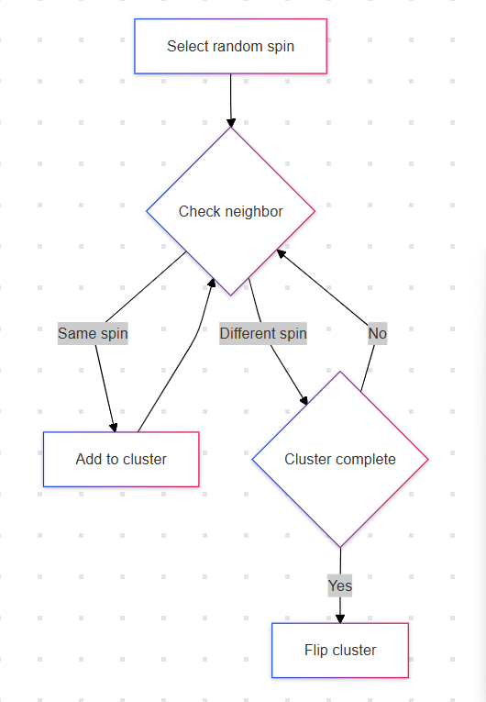
Methods - Cluster Algorithms
Swendsen-Wang
Wolff
Explanation of the Wolff single-cluster algorithm
Explanation of the Swendsen-Wang multi-cluster algorithm

Slide 6
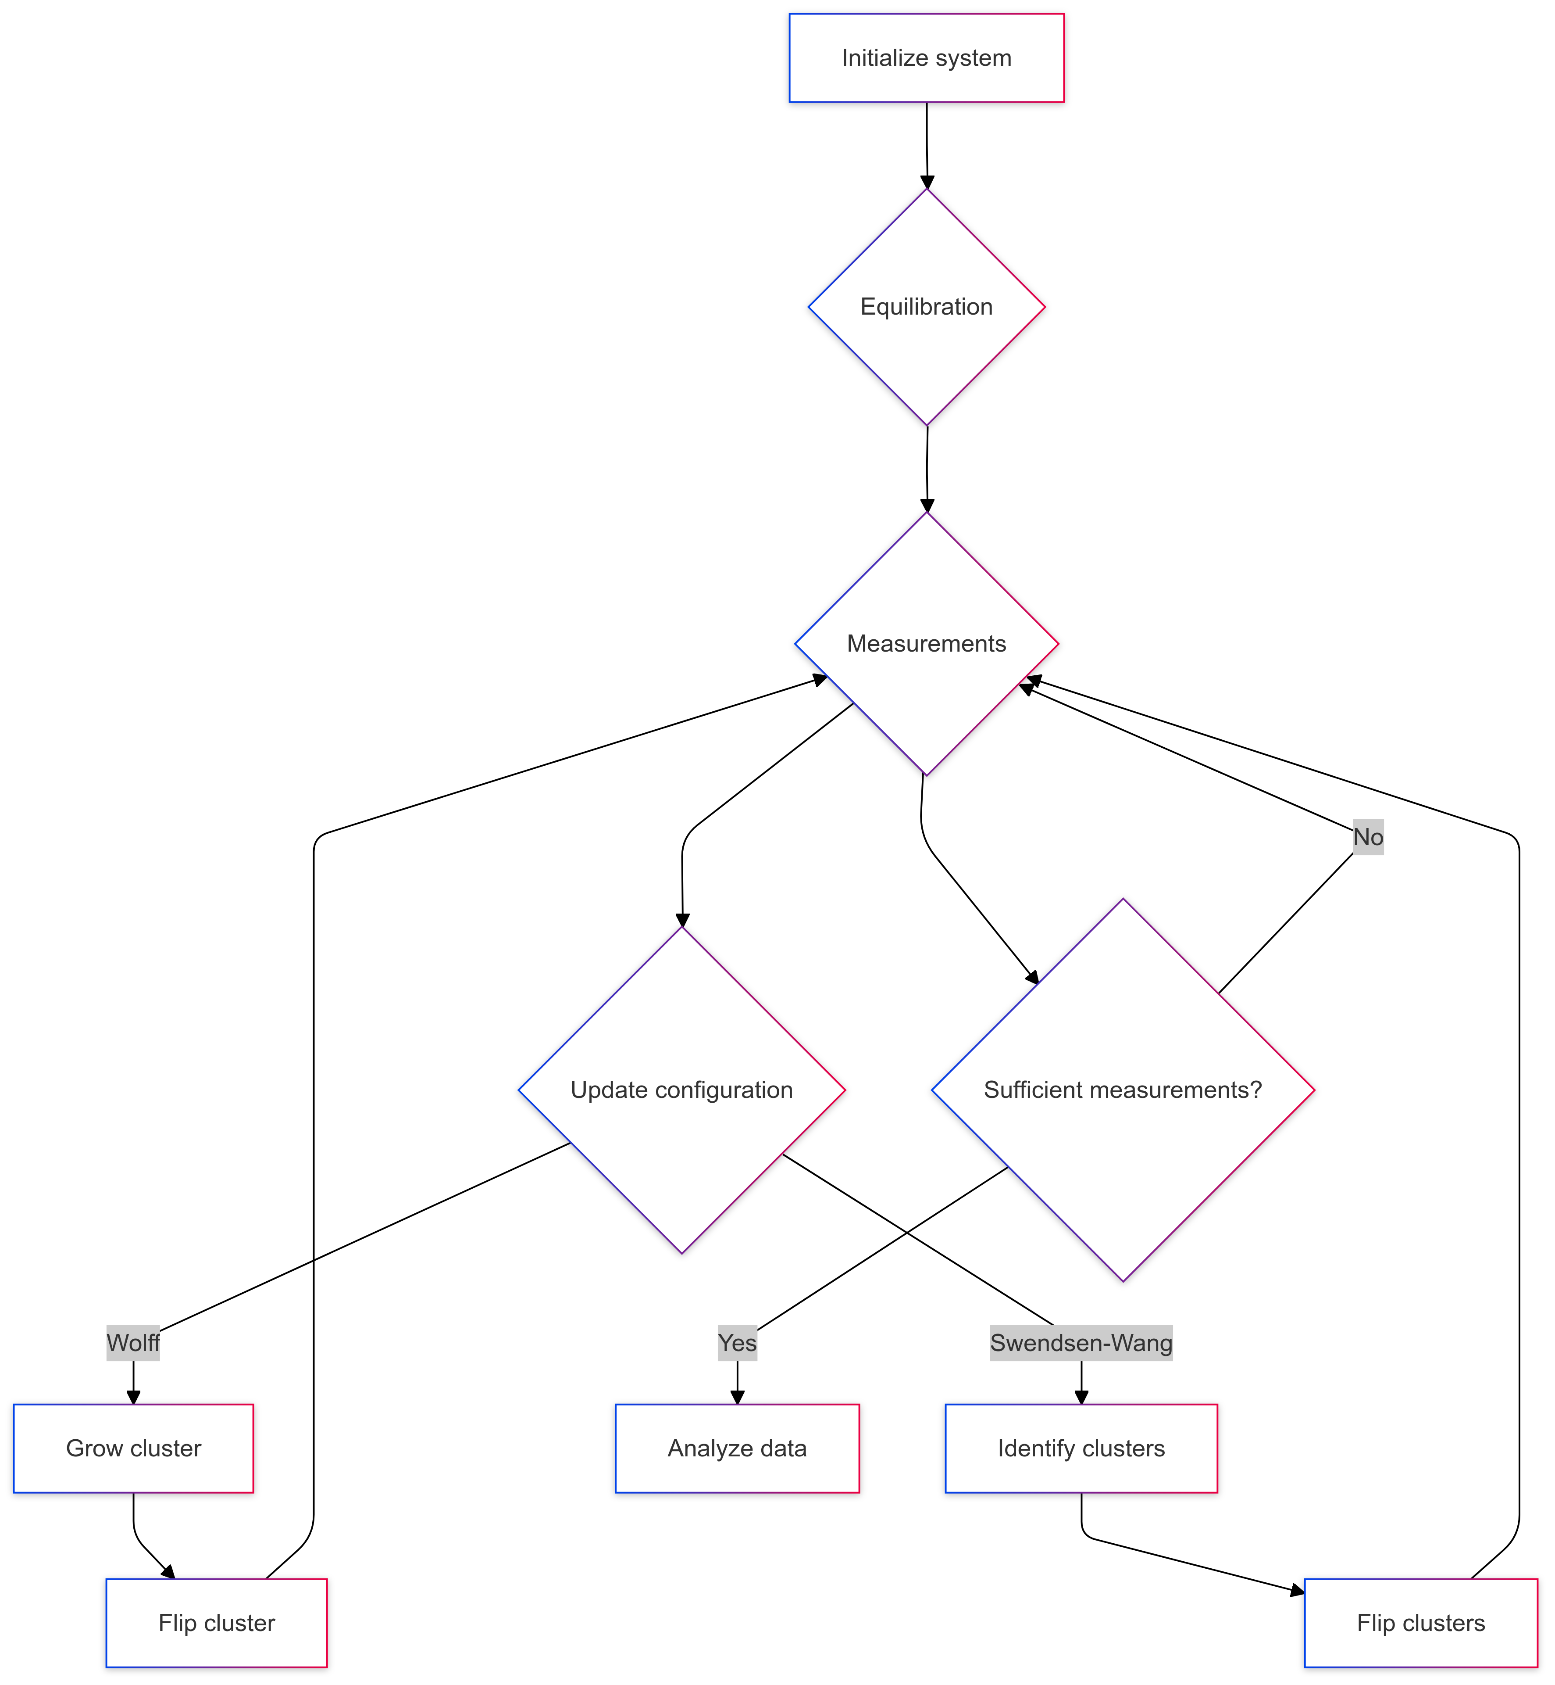
Methods - Implementation and Analysis
Implementation details and optimization techniques
Measurement and analysis techniques (observables, error analysis)
Flow chart describing code flow

Slide 7

Methods - Finite-Size Scaling and Setup Verification
Brief explanation of finite-size scaling techniques:
Scaling of observables with system size
Extraction of critical exponents
Setup verification
Initial spin configuration
Local energy distribution

Slide 8
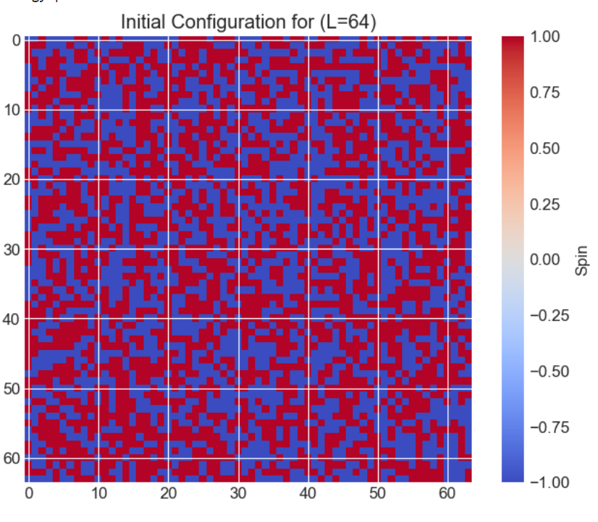
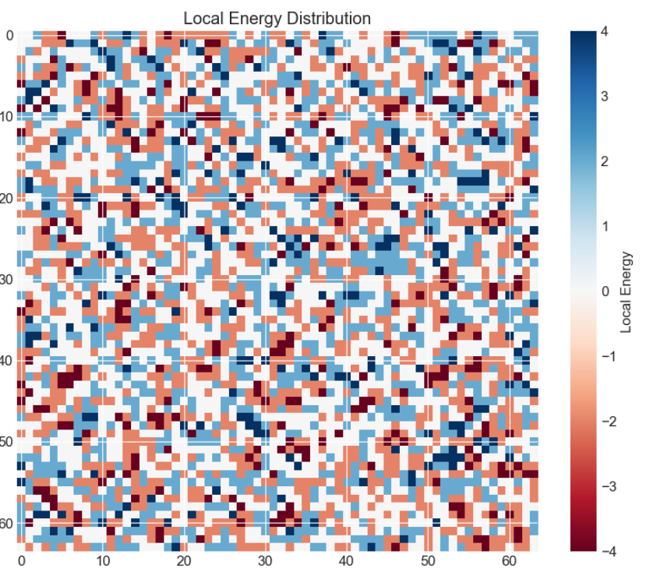
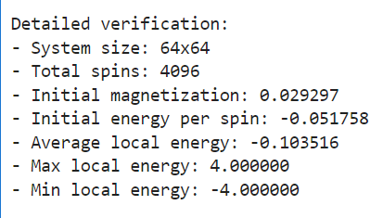

Slide 9
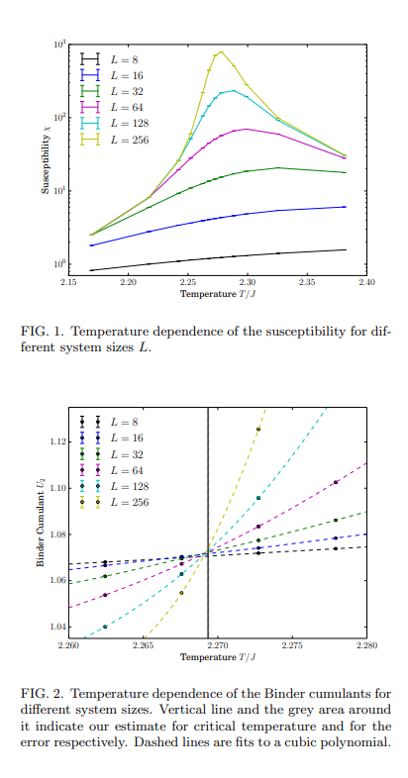
Replication of Paper Results
The Magnetization and Binning Cummulant plots from the paper
Key differences in system sizes and measurement protocols:
Paper: L up to 256, 1,280,000 measurements per point
Our work: L ≤ 64; 10,000 measurements per point

Slide 10
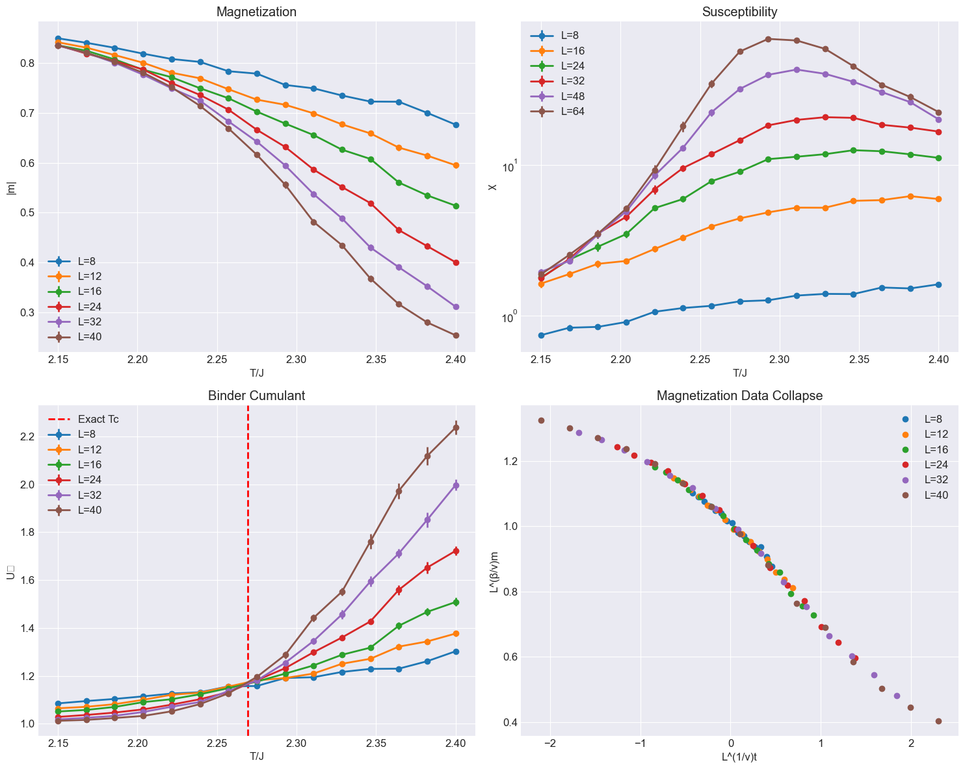
Our Results
Our full figure with magnetization, susceptibility, Binder cumulant, and data collapse plots
Emphasize the achievement of similar results with smaller system sizes and fewer measurements
Highlight the consistency between our results and the paper, validating our implementation

Slide 11
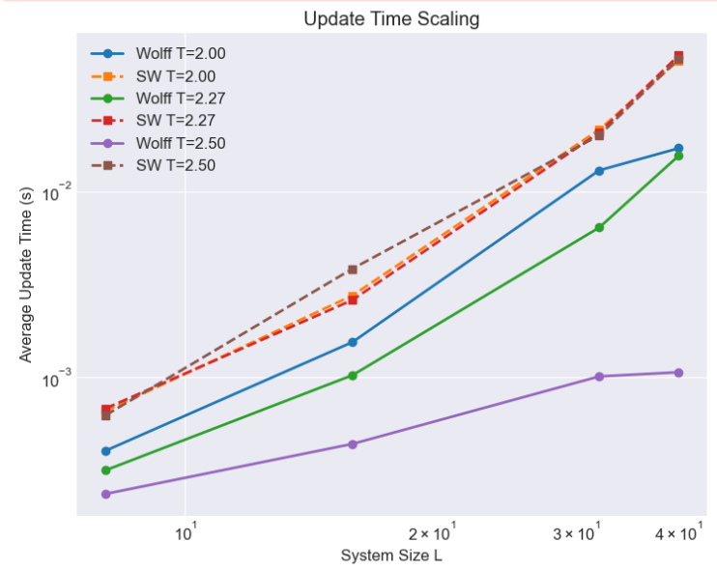
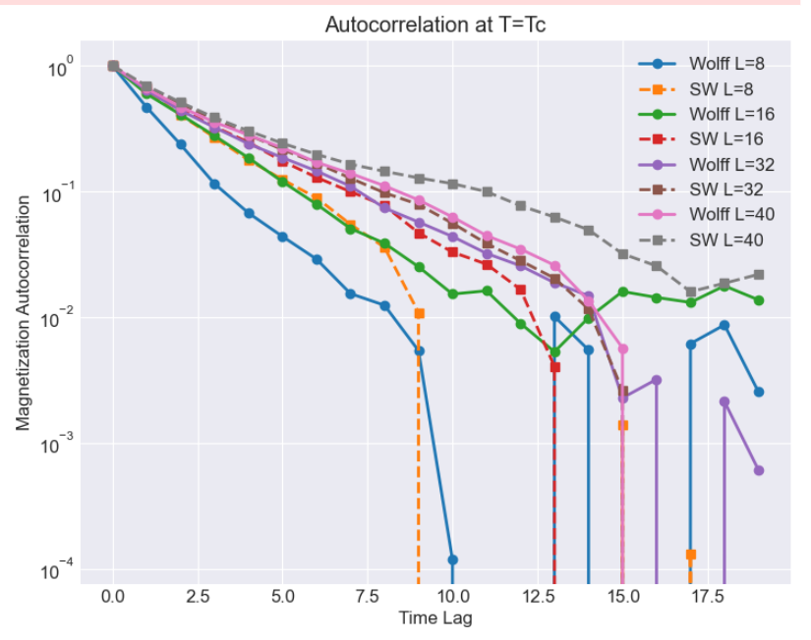
Results - Performance Analysis (1)
Update time scaling and autocorrelation analysis
Autocorrelation function plot for magnetization at the critical temperature

Slide 12
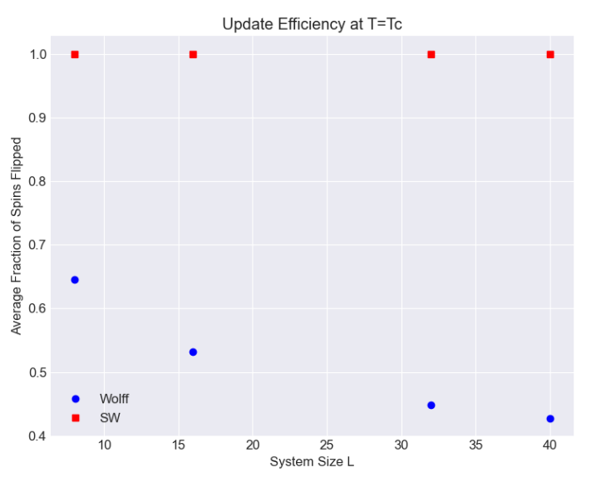
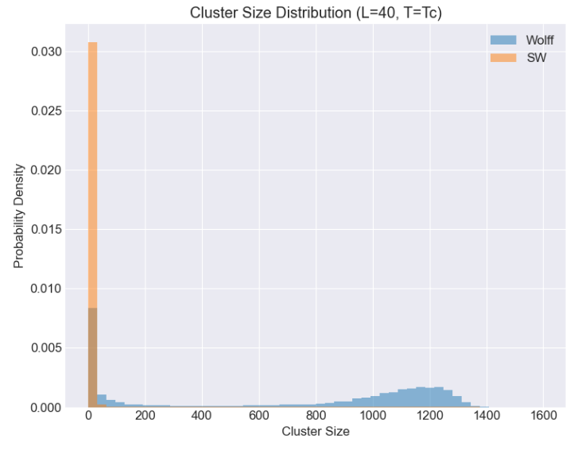
Results - Performance Analysis (2)
Cluster properties and update efficiency
Comparative advantages of Wolff and Swendsen-Wang algorithms

Slide 13
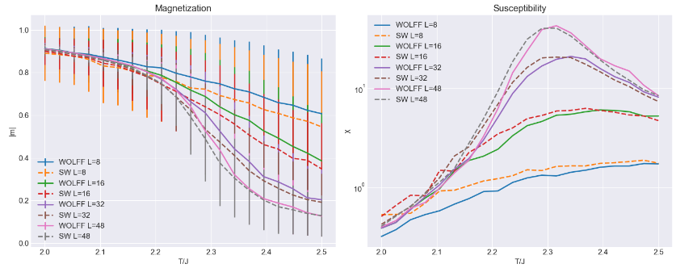
Results - Physical Observables (1)
Magnetization and susceptibility
Susceptibility versus temperature plot, showing the divergence at the critical point

Slide 14
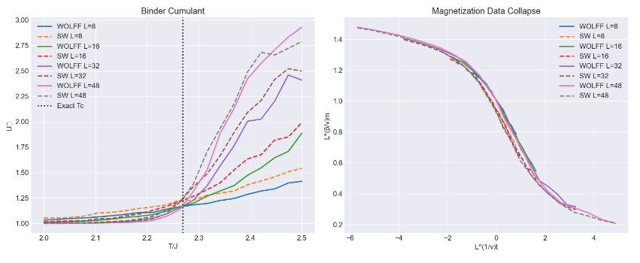
Results - Physical Observables (2)
Binder cumulant and data collapse
Data collapse plot, validating the finite-size scaling hypothesis.
Consistency between algorithms and agreement with theoretical predictions

Slide 15
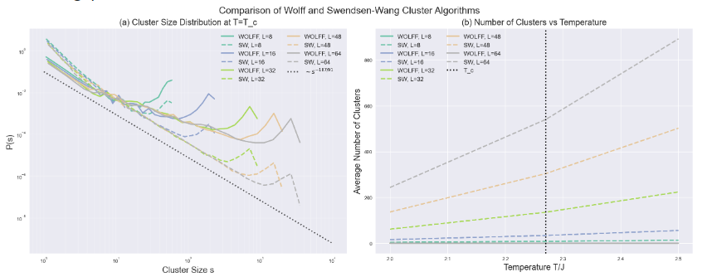
Results - Cluster Geometry Analysis (1)
Cluster size distribution and scaling
Cluster formation dynamics

Slide 16
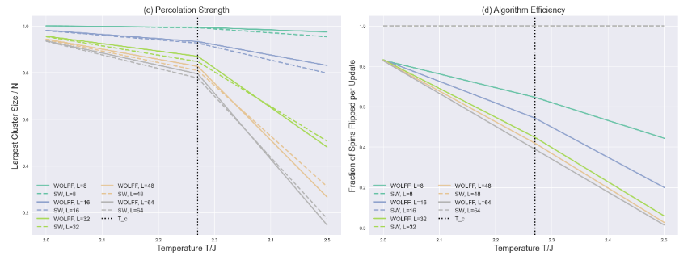
Results - Cluster Geometry Analysis (2)
Percolation strength plot, illustrating the critical behavior and finite-size effects
Algorithm efficiency plot, comparing the fraction of spins flipped per update as a function of temperature
Critical behavior and algorithm efficiency
Differences between Wolff and Swendsen-Wang algorithms in cluster properties

Slide 17
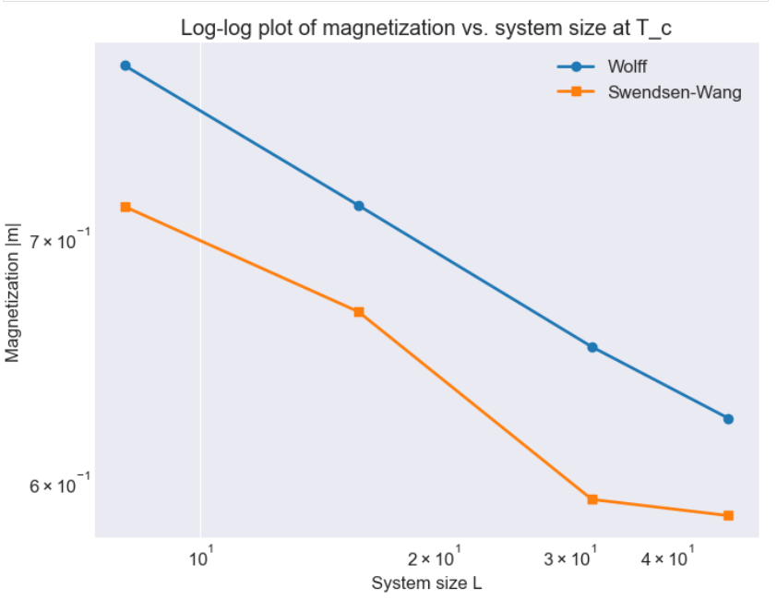
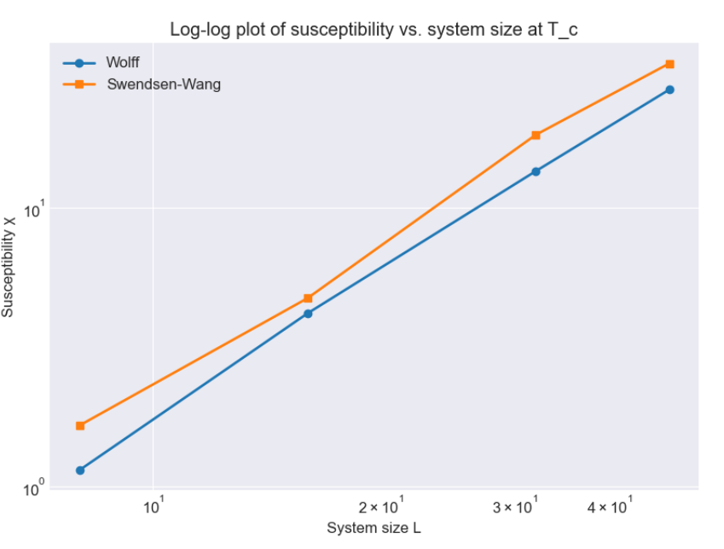
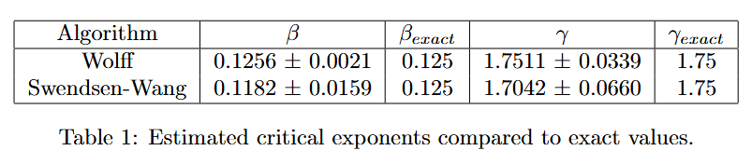
Critical Exponents Analysis
Estimation of magnetization exponent β and susceptibility exponent γ using finite-size scaling
Comparison with exact values and discussion of algorithm performance

Slide 18
Conclusions (1)
Summary of the main findings and insights
Strengths and limitations of the Wolff and Swendsen-Wang algorithms

Slide 19
Conclusions (2)
Implications for the study of critical phenomena in more complex systems
Future directions and potential extensions

Slide 20
Acknowledgments and References
Acknowledge any support, funding, or collaborations
List key references

Slide 21

Thank You and Q&A
"Thank you for your attention!"
"Questions?"

Slide 22
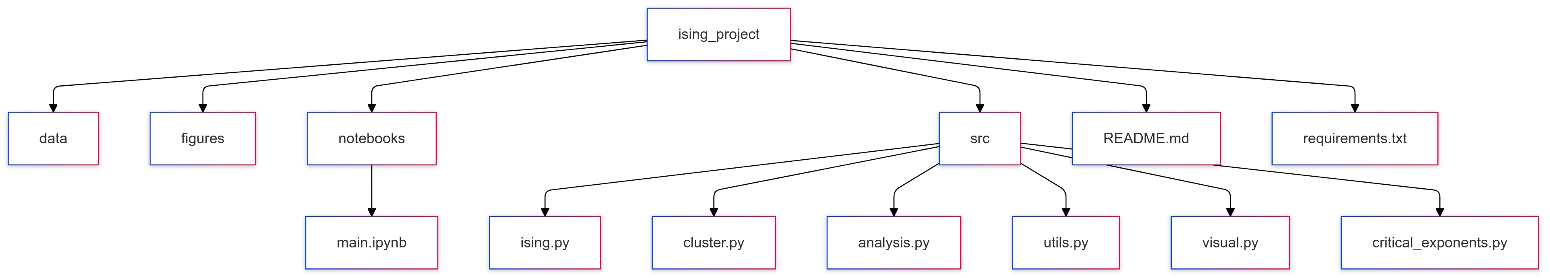
Project Directory

