Slide 1

指導教授：黃三益 教授
學生：M954020031 陳聖現
M954020033 王啟樵
M954020042 呂佳如

Slide 2


Slide 3
Background & Motivation (1/2)
We all like cars
Cars sell
  515000 cars are sold in Taiwan, 2005 (IEK-ITIS)
  Highest in 10 years
Promotions
New models / Renews
Favorable loan / divided payment
Presents

Slide 4
Background & Motivation (2/2)
Price of daily goods
Price of gasoline
Greenhouse Effect
How a selling car is?

Slide 5
Dataset and Data mining techniques
Car Evaluation Database
  UCI Machine learning repository
  http://www.ailab.si/blaz/hint/car_dataset.htm
Classification
ID3 Learning algorithm

Slide 6


Slide 7
Step One：Translate the Business Problem into a Data Mining Problem
Business problem:
What kind of cars can get good evaluation?
Evaluation as the target attribute
Data mining problem:
Find out the rules from other attributes

Slide 8
Step Two：Select Appropriate Data(1/4)
What Is Available?
  The dataset is from the UCI Machine Learning Repository, which comes from University of California at Irvine, Donald Bren School of Information and Computer Science.
  This dataset is presented by Marko Bohanec and Blaz Zupan.

Slide 9
Step Two：Select Appropriate Data(2/4)
How Much Data Is Enough?
  Data mining techniques are used to discover useful knowledge from volumes of data, that is to say, the larger data we use, the better result we can get.
  But there are also some scholars think that a great deal of data don’t guarantee better result than little of data.
  Due to the resource is limited, the larger sample will result in much load and contain lots of exceptional cases when doing data mining tasks.
  The dataset our team choose has 1728 instances.

Slide 10
Step Two：Select Appropriate Data(3/4)
How Many Variables?
  The dataset consists of 1728 instances and each record contains seven attributes which are: buying price, maintenance price, number of doors, capacity in terms of persons to carry, the size of luggage boot, estimated safety of the car, and car acceptability.
  The attribute of car acceptability is a class label which used to classify the degree of the car that customers accept, the other attributes are viewed as predictive variables.

Slide 11
Step Two：Select Appropriate Data(4/4)
What Must the Data Contain?
Attribute name | Description | Domain
b_price | Buy Price | v-high / high / med / low
m_price | Repair price | v-high / high / med / low
door | The number of the door | 2 / 3 / 4 / 5-more
person | The number of passenger | 2 / 4 / more
size | Suitcase capacity | Small / med / big
safety | Safety evalution | Low / med / high
class | level of customer acceptance | Unacc / acc / good / vgood

Slide 12
Step Three：Get to Know the Data(1/4)
Examine Distributions
Examine Distributions
Examine Distributions
b_price
Price
m_price
door
Car
Comfortable
person
size
Safety
safety

Slide 13
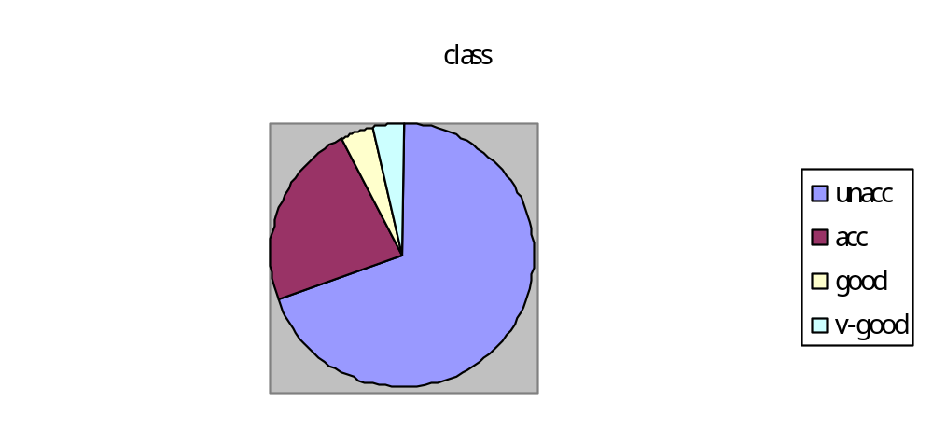
Step Three：Get to Know the Data(1/4)
Compare Values with Descriptions

Slide 14
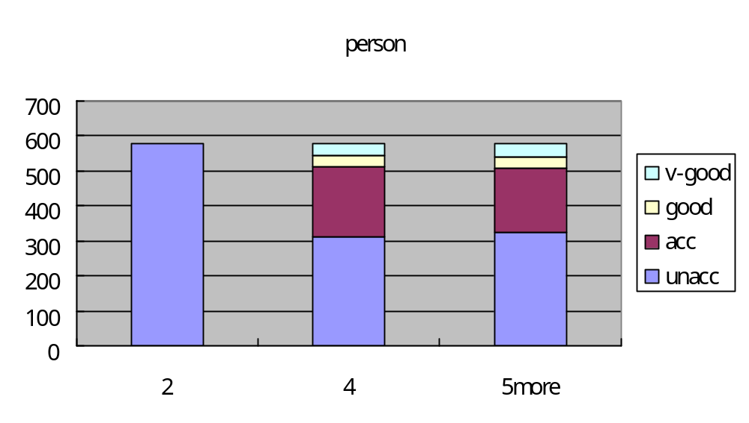
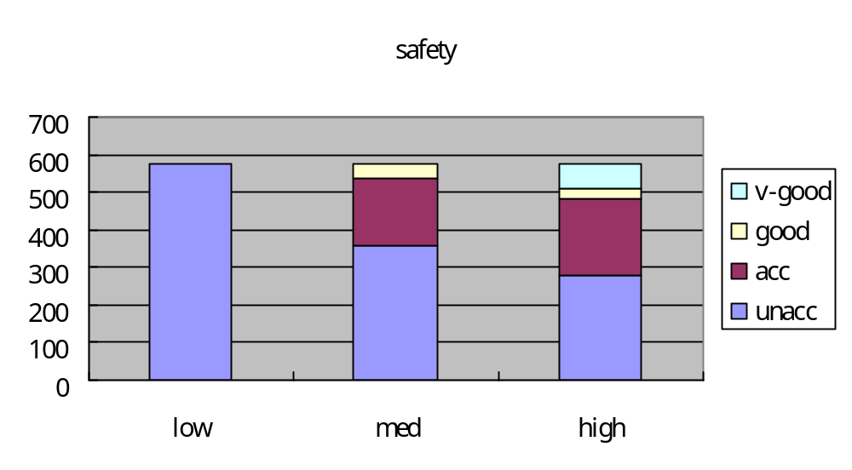

Slide 15
Step Three：Get to Know the Data(3/4)
Validate Assumptions
  In this six attributes, even if is the worst category, also have some customers can accept, for example suitcase capacity (size) even if is small, still could classify to “good”.
  But there has two attributes quite are special, respectively is person as well as safety.
  In the “person ”, the value is 2, the class all are unacc.
  In the safety attribute value is low, the class all are unacc.
  Therefore we may supposition this two attributes is very important for customer when they chose the car.

Slide 16
Step Three：Get to Know the Data(4/4)
Ask Lots of Questions
  From above, we know these two attributes is important to customers.
  They do not compromise on these two attributes.
  The reason might be that customers think a car have only two seats is not so functional to them, and they pay much attention to the safety of cars.
  After all, the value of life is beyond the value of money.

Slide 17
Step Four：Create a Model Set
Creating a Model Set for Prediction
  We separated the data set into two parts, one part is used as training data set to produce the prediction model, and the other part is used as test data set to test the accuracy of our model.
  We used cross-validation method, which means all data from the data set might be selected into training data set and test data set.

Slide 18
Step Five：Fix Problems with the Data
Categorical Variables with Too Many Values
Numeric Variables with Skewed Distributions and Outliers
Missing Values
Values with Meanings That Change over Time
Inconsistent Data Encoding

Slide 19
Step Six：Transform Data to Bring Information to the Surface
Capture Trends
Create Ratios and Other Combinations of Variables
Convert Counts to Proportions

Slide 20
Step Seven：Build Models
The data mining method we used to build the model is classification.
We chose the weka.Classifiers.tree.Id3 our classify method, since it shows the better result.
10-fold cross-validation

Slide 21
Step Eight：Assess Models(1/3)
  === Summary ===
  Correctly Classified Instances 1544 89.3519 %
  Incorrectly Classified Instances 61 3.5301 %
  Kappa statistic 0.9071
  Mean absolute error 0.0177
  Root mean squared error 0.1329
  Relative absolute error 8.8179 %
  Root relative squared error 43.4172 %
  UnClassified Instances 123 7.1181 %
  Total Number of Instances 1728

Slide 22
Step Eight：Assess Models(2/3)
  === Detailed Accuracy By Class ===
  TP Rate FP Rate Precision Recall F-Measure Class
  0.974 0.017 0.994 0.974 0.984 unacc
  0.936 0.026 0.898 0.936 0.917 acc
  1 0.006 0.83 1 0.907 vgood
  0.787 0.008 0.755 0.787 0.771 good

Slide 23
Step Eight：Assess Models(3/3)
  === Confusion Matrix ===
  a b c d <-- classified as
  1171 28 0 3 | a = unacc
  7 292 4 9 | b = acc
  0 0 44 0 | c = vgood
  0 5 5 37 | d = good

Slide 24
Step Nine：Deploy Models
Because we don’t have the scoring set to test the model, we skip this step.

Slide 25
Step Ten：Assess Results
Although, there are 61 entries have been wrongly classified, we can tell, from confusion Matrix, that even they are in a wrong class, most of them are led to a class near by their actual classes.
There are 44 entries were in the next class to their actual classes.
Overall, the model performs quite well, from all evaluating values followed with the less serious mis-classification.
We believe the result is reliable.

Slide 26


Slide 27
Conclusions (1/2)
There are many rules concluded from the decision tree, so we chose some of them to discuss.
As mentioned above, “Safety” is very important.
Thus, if the value of “safety” is low, the result will directly fall into unacceptable (unacc).
And whatever the value of safety is, if “person”’s value is 2, the entry will also fall directly into unacceptable.

Slide 28
Conclusions (2/2)
Among the six attributes, customers care less about “door”, as in most of the case this attribute affect the customers’ acceptance less.
Maybe because cars are high price product, customers won’t easily give a good or v-good evaluation to ones with just a single outstanding attribute.
Because of that, restrictions lead to good and v-good evaluation is plenty – not so easily met. Following are the rules customers would give good or v-good evaluations.

