Slide 1
Instructor :- Prof. Bakul Gohel
Classification using EEG data
Looking through the brain

Slide 2
Introduction
Recognizing objects from different categories is of fundamental importance for survival.
Electroencephalography , or EEG, records the electrical activity of brain.
EEG signals - good temporal resolution, but a low spatial one.
EEG scope in human computer interaction, psychology, and neurological sciences.

Slide 3

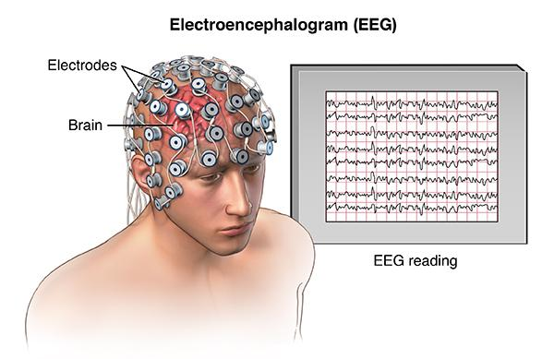
Dataset
10 - Subjects
5185 to 5188 - Trials per subject
124 - Electrodes or Channels
32 - Time Sample per trial
6 - Classes

Slide 4

Objective
Classification using linear discriminant analysis.
To study the linear separability
Brain analysis with following binary classes
Human Face
Inanimate objects
Effects of data augmentation on linear separability.
Spatial and Temporal analysis of brain.

Slide 5
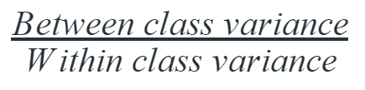
LDA
Bayesian classifier
Linear decision boundary
Maximizes :
Gaussian density to each class
Optimization technique : Eigen solver
Shrinkage: Estimation of Covariance matrices

Slide 6
Data Augmentation
K-fold Cross Validation
New data points by averaging n number of data points, belonging to same class, randomly :-
With Replacement - Same number of samples
Without Replacement
n = [2, 4, 6, 8]
K -> 5 , N -> 8

Slide 7
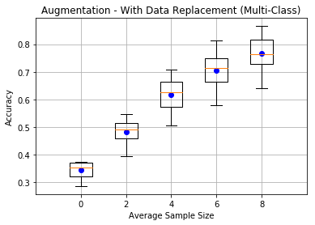
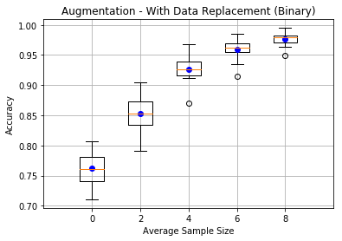
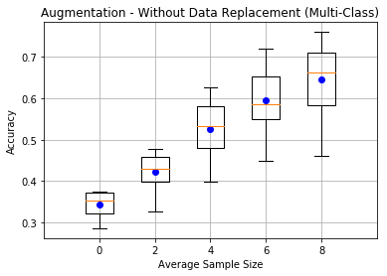
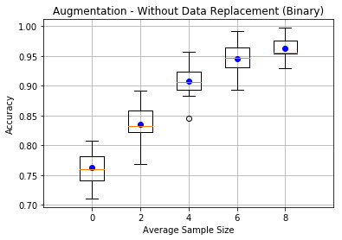
Result

Slide 8
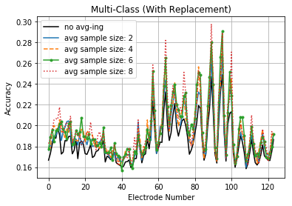
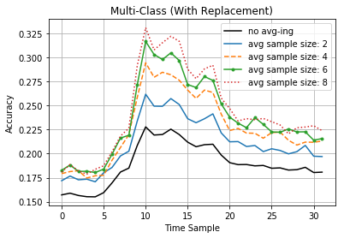
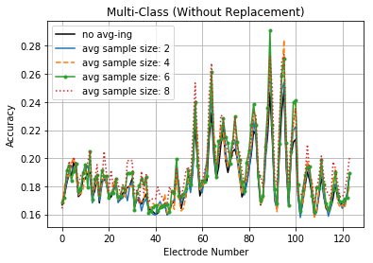
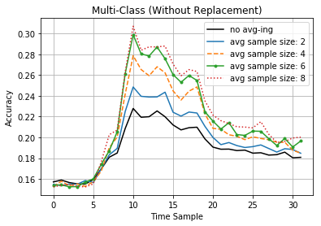

Slide 9
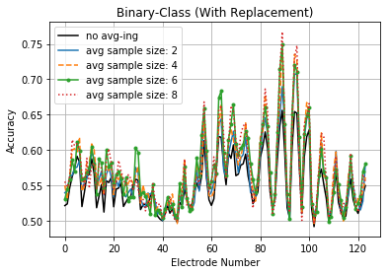
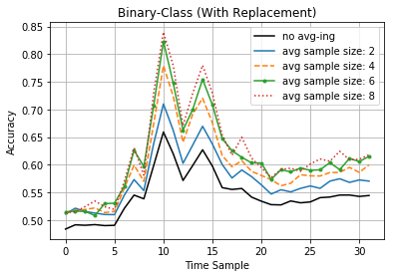
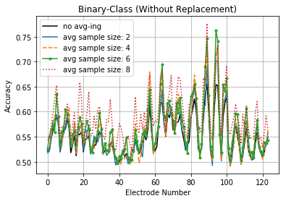
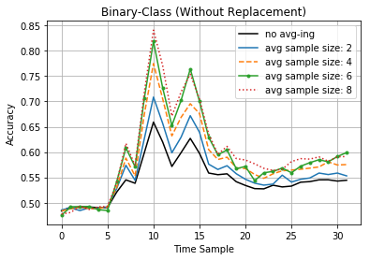

Slide 10
Conclusion
Thank you
Brain differentiates human face and inanimate objects very distinctively.
Specific region of visual recognition
Specific time of brain response
Augmentation effects
decreased SNR - more linear separability
Increased accuracy
Stability of machine learning model is important

