Slide 1





pizza sales
analysis
Insights and Trends
Md. Rehaan

Slide 2
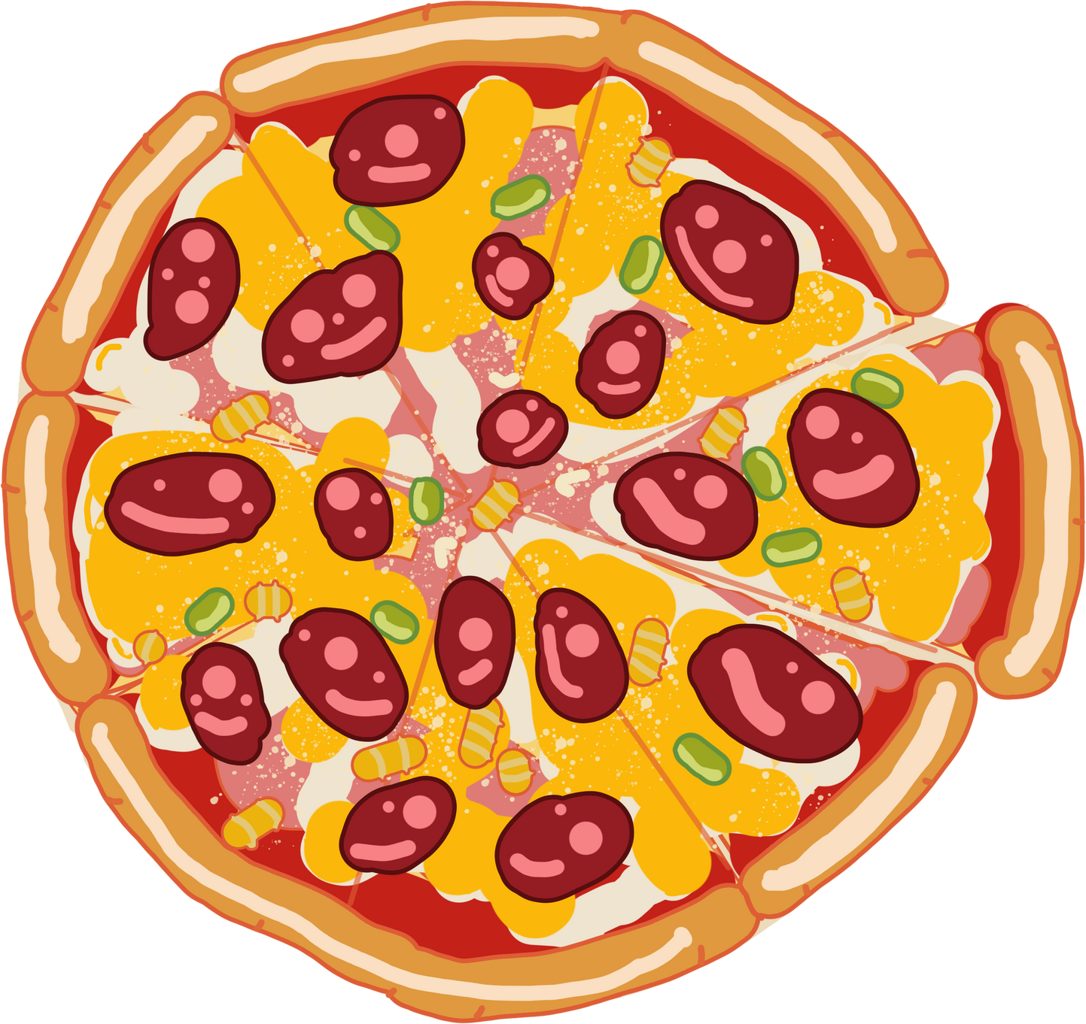

Introduction
The primary goal of this analysis is to uncover key insights and trends in pizza sales. By examining various aspects of the sales data, aim to identify top- selling products, understand customer preferences, and provide actionable recommendations for optimizing sales and inventory management

Slide 3

DATA BASE SCHEMA
-pizzahut
Data base contains four tables contains annual data of Pizza Sales
Orders:- contains (order id, order date, order time)
Order details:- contains (order details id, order id, quantity, pizza id)
Pizza type:- contains (pizza type id, category, ingredients, name )
pizzas:- contains(pizza id, pizza type id, price, size)

Slide 4

in this presentation, we will cover
Retrieve the total number of orders placed.
Calculate the total revenue generated from pizza sales.
Identify the highest-priced pizza.
Identify the most common pizza size ordered.
List the top 5 most ordered pizza types along with their quantities.
Join the necessary tables to find the total quantity of each pizza category ordered.
Determine the distribution of orders by hour of the day.
Join relevant tables to find the category-wise distribution of pizzas.
Group the orders by date and calculate the average number of pizzas ordered per day.
Determine the top 3 most ordered pizza types based on revenue.
Calculate the percentage contribution of each pizza type to total revenue.
Analyze the cumulative revenue generated over time.
Determine the top 3 most ordered pizza types based on revenue for each pizza category.

Slide 5


Sales Trends
Total number of Order placed
There are total of 21350 Pizzas order placed
Total Revenue Generated from pizza sales
Total Revenue of Rupees, Eight Lakhs
Seventeen Thousands Eight Hundred Sixty

Slide 6




Highest Priced Pizza
Data told us that The Greek Pizza is highest priced one, with a price of 35.95
Most Common size of Pizza ordered
Large size Pizza ordered by the most, with the quantity of 18k

Slide 7
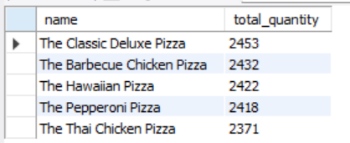
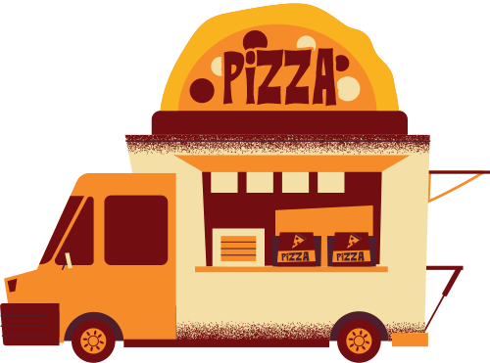
Top Five Pizza, Ordered Pizzas
These are the Top Five Pizzas:
The Classic Deluxe Pizza
The Barbecue Chicken Pizza
The Hawaiian Pizza
The Pepperoni Pizza
The Thai Chicken Pizza

Slide 8
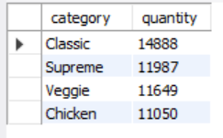
Category wise Pizzas, Ordered Pizzas
quantity
Classic - 14888
Supreme - 11987
Veggie - 11649
Chicken - 11050

Slide 9

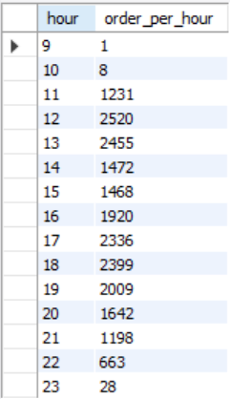

Distribution Of Orders by Hours Of the day
The table shows that people likes to eat pizza
in evening time

Slide 10

Average Number of Pizzas order per day
On an average the total of 138 pizzas are orderd per day

Slide 11
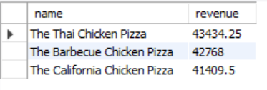
Top Three Pizza, according to Revenue
These are the Top Three According to Revenue:
The Thai Chicken Pizza
The Barbecue Chicken Pizza
The California Chicken Pizza

Slide 12
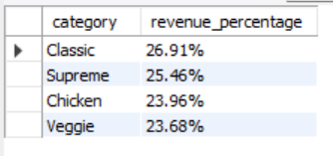
Contribution of each Type of Pizza, According to percentage of Revenue
Results shows that Classic category pizzas generates Highest revenue

Slide 13
REcommedations
Promote Top-Selling Pizzas During Peak Hours:
Insight: The analysis shows that certain pizzas, such as The Classic Deluxe Pizza and The Barbecue Chicken Pizza, are consistently top sellers.
Recommendation: Implement targeted promotions and discounts for these top-selling pizzas during peak ordering times, especially in evenings, to boost sales further

Slide 14
REcommedations
2. Increase Inventory for Large-Sized Pizzas:
Insight: Large-sized pizzas are the most commonly ordered size, with a significant quantity of 18,000 orders.
Recommendation: Ensure adequate inventory levels of ingredients for large-sized pizzas to meet the high demand and avoid stockouts.

Slide 15
REcommedations
3. Consider Special Offers for Evening Orders:
Insight:The distribution of orders by the hour indicates a higher number of pizza orders in the evening.
Recommendation: Introduce special evening deals or discounts to capitalize on the higher demand during this time and attract more customers.

Slide 16
REcommedations
4. Focus Marketing on Classic Category Pizzas to Maximize Revenue:
Insight: Classic category pizzas generate the highest revenue among all categories.
Recommendation: Design marketing campaigns that highlight the Classic pizzas, showcasing their popularity and unique flavors to drive more sales and revenue.

Slide 17
Thankyou

