Slide 1
Tailored Reviews
Team of
Vignesh Srinivasan
Shobhit Jaipurkar
Naitik Shukla
Navneet Goswami
Optimizing Website Reviews to produce the most fruitful insights.

Slide 2
Contents
Business Goals
Gathering Data
Schema Design
Demo

Slide 3
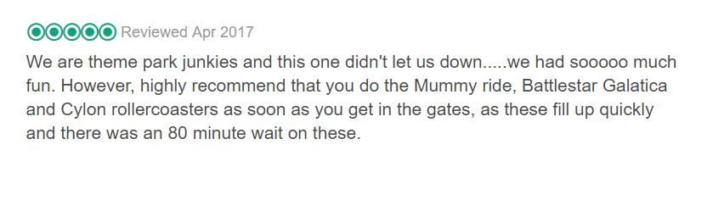
The Problem Statement
Overall Rating of a place doesn’t count for much as it can be easily manipulated with dummy votes. Hence, Customer Reviews are the truest form of reccomendations.
However, reviews are not a one-size-fits-all reflection of a place. They are highly subjective.
Many important factors such as Recency, Profile Similarity and Credibility are often ignored.

Slide 4





Basic Flowchart
Information
Database
I want to go to X
Selection Algorithm
User Information
Similar-User Suggested Attractions
Similar-User Suggested Restaurant
3 Most Credible Reviews For X

Slide 5
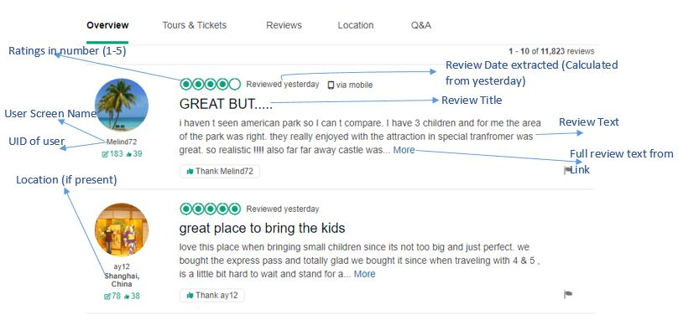
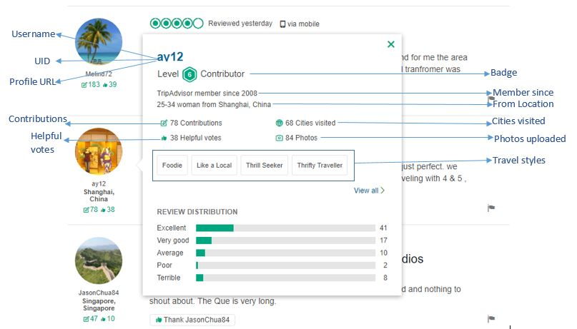
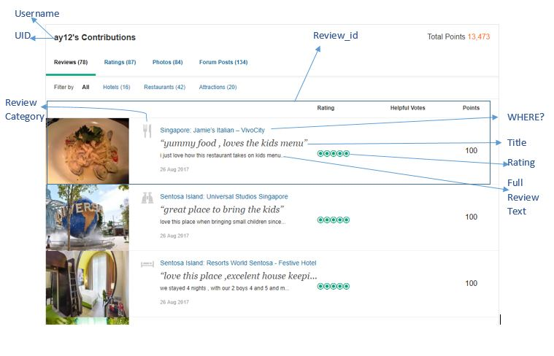
Gathering the Data
Review and Customer Data is gathering by scraping TripAdvisor.com
Data considered as relevant fields are shown below

Slide 6

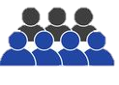


Web-Scraping
~1,100 Pages Scraped with close to 1000 profiles
Over 30,000 Reviews
5-6 hours to scrape

Slide 7
Data Description
The Web Scraping program would create 3 different txt files with all the data necessary.
In addition to the several columns shown earlier, we derived two new variables necessary for optimizing the reviews.
The Credibility Score assesses and quantizes the level of the reviewer’s credibility based on Contributor Level, Date of Joining, No. of Helpful reviews, Cities Visited and Total No. of Reviews.
The Similarity Quotient assesses the degree upto which the reviewer shares a similarity with the end-user. This is based on the Reviewers’ From Location, Travel Style and Places Visited.
CS = 0.4(CL) + 0.175(Contributions) + 0.25(Helpful) + 0.125(Cities Visited) + 0.05(Date of Joining)
SQ = 0.2(From Location) + 0.5(Travel Style) + 0.3(Cities Visited)

Slide 8
Schema Design
Used MongoDB to arrange the messy data into an easily consumable form
Relationships between data vary from table to table. It is a hybrid between Embedded Relationships and Referential Relationships.

Slide 9
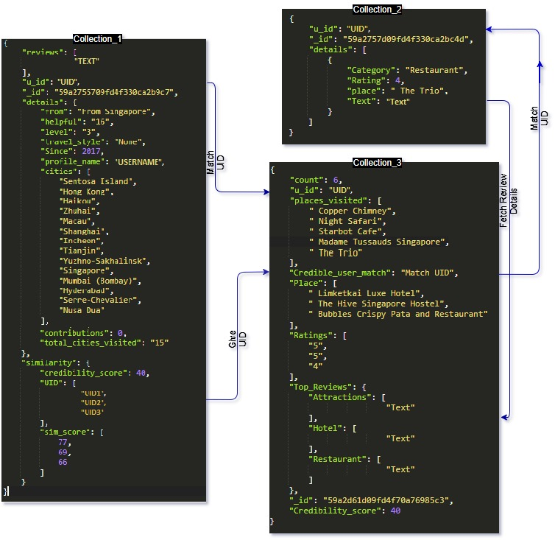
Schema Overview

Slide 10
Limitations & Assumptions
Assumed that our end-user is already a member of TripAdvisor.com with an updated profile.
Scope of the Tailored Reviews currently covers only Universal Studios, Singapore.
Sentiment of Review is ignored and reviews are judged based solely on Credibility and Similarity.
Normalized values for calculation of CS and SQ incorporate a top limit for the data categories, which may exceed for some users.

Slide 11
Benefits
Unlocks the true potential of peer-to-peer suggestions.
Credibility Score and Similarity Quotient will match you with better suggestions, and will get better as system scales.
Businesses are able to predict visiting trends and reward diligent reviewers/influencers with elusive offers.
Cons: Increase in amount of website loading time

Slide 12
Demo
A low-level implementation of our proposed system.

Slide 13
Questions?

