Slide 1

Amazon ML Hiring Challenge
Predict Customer Category

Slide 2
Problem Statement
Customer – Wants to see products that matches his needs
Business – Needs to show product that are more likely to buy
Solution – Categorize customers that are more likely to click on the displayed product search result.
A machine learning model that accurately predicts the customer category based on features sampled from various criteria depicting the usage of the app by the customer.
Notebook available here.

Slide 3


Basic Data Analysis

Slide 4
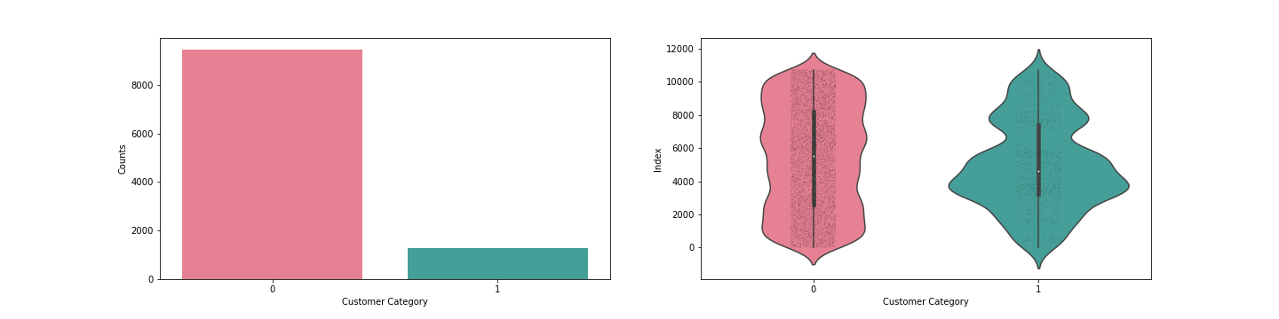
Customer Category
This is our target variable. We have to classify each customer into two categories.
It can be inferred from the results that the data is heavily imbalanced.
This means that we are very selective of the customers to whom we show our product suggestions.

Slide 5
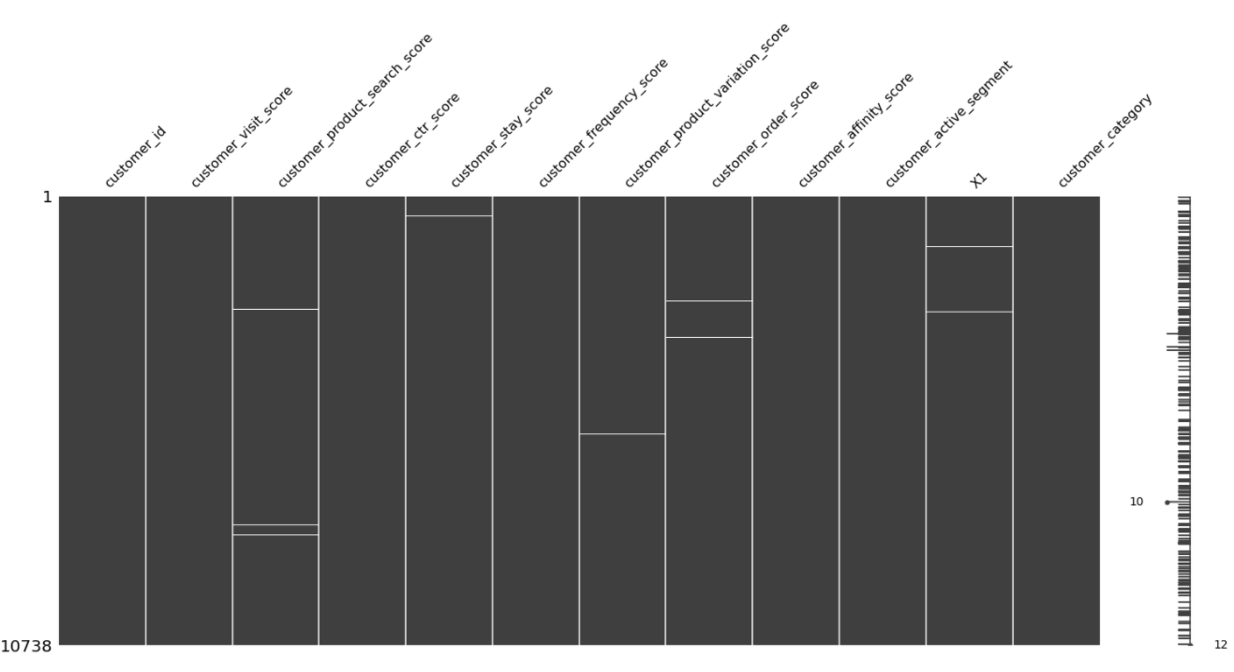
Missing values
Distribution of missing values in the given dataset.

Slide 6
Basic Data Analysis
The data is heavily imbalanced.
There are numerical features as well as categorical features in our dataset.
Some of the features have missing values.
Let’s analyze each feature independently and fix above problems.

Slide 7
Feature Analysis and Cleaning

Slide 8
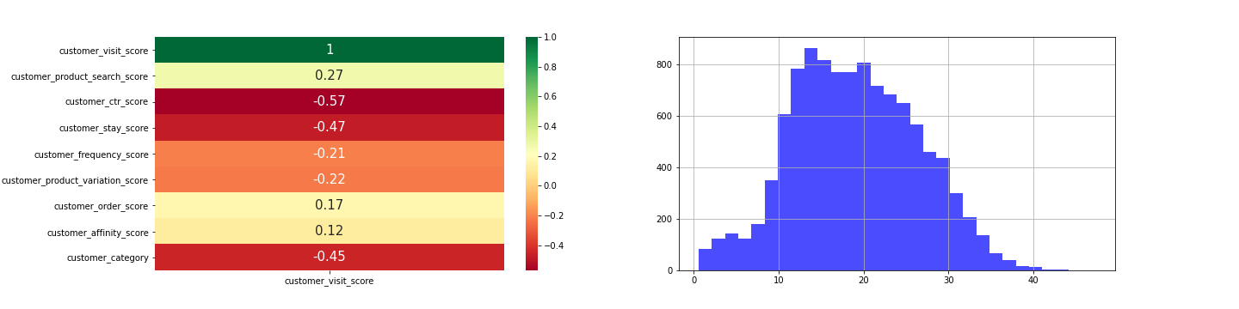
Visit Score
A score based on how regularly the customer visits the website.
Uniform Distribution
Data is noisy – Clean the data by categorizing the data into 10 classes

Slide 9
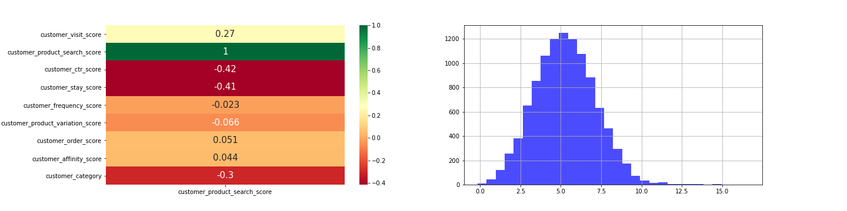
Product Search Score
Quality or price range of product that the customer searches for.
Normal Distribution – Missing values are filled from values randomly sampled from the distribution.

Slide 10
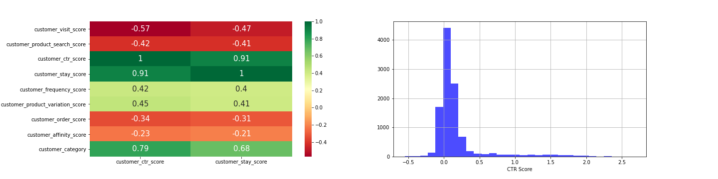
CTR & Stay Scores
Ctr Score : How many of the searched links does the customer click.
Stay Score: A score based on the time spent on an avg. by the customer.
We can observe that these two scores are heavily correlated which says that the more the person stays, the more likely he is to click on the link.

Slide 11
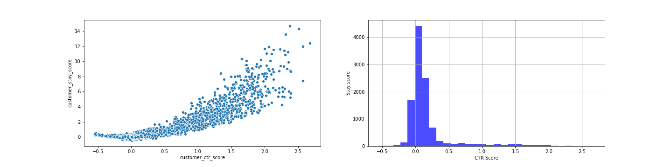
CTR & Stay Scores
It can be inferred from the scatter plot that most of the data is concentrated towards the lower end.
This explains the positive correlation of these factors with target customer category and much of target belonging to category 0.
Missing values in Stay Score are imputed using KNN Imputer modelled on CTR score.

Slide 12
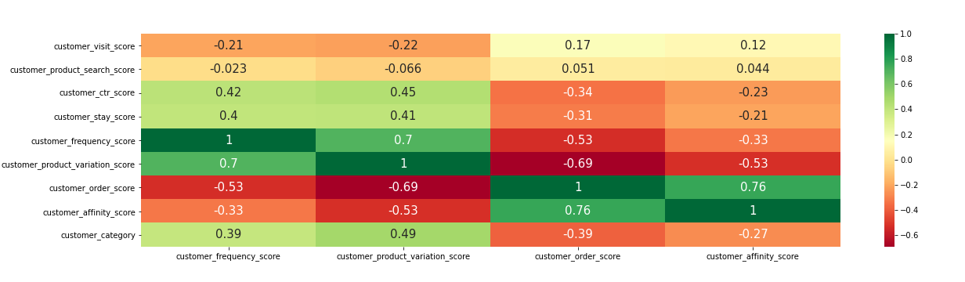
Other Features
Frequency Score – Frequency of customers visit to the website
Product variation score – Score based on the variety of products seen by customer.
Order score – Reliability of customer in not returning the order.
Affinity Score – Customers affinity to the website.

Slide 13
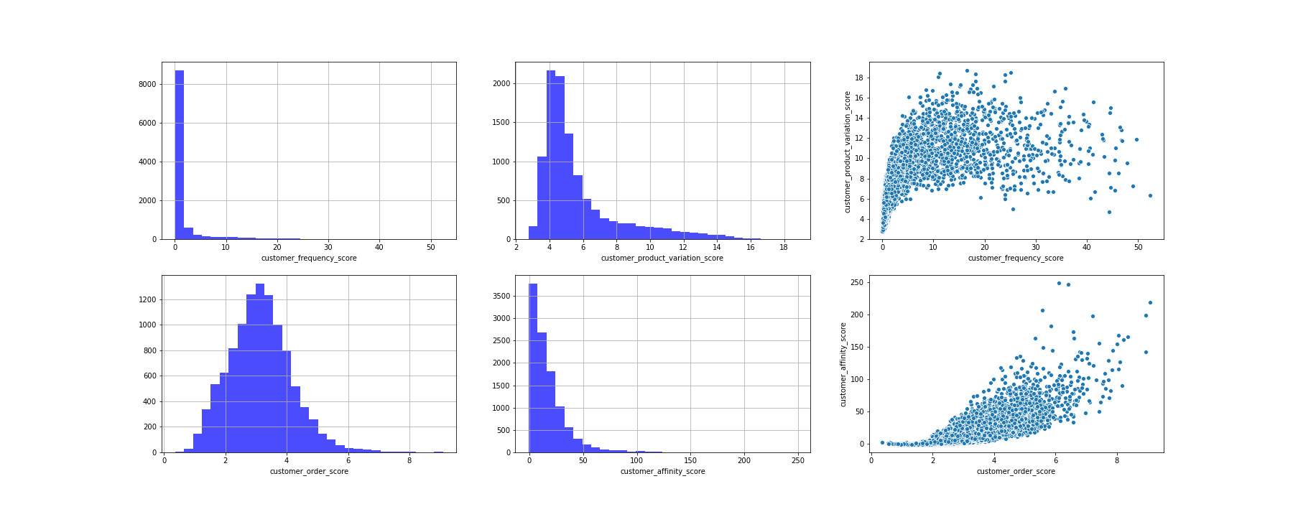
Distribution Plots for remaining features

Slide 14
Feature Inference
Frequency and Product Variation scores, Order and Affinity scores are positively correlated.
From the scatter plots, for frequency and product variation score, we can infer that the scores are densely packed to the lower end because they have a positive correlation in predicting the customer category.
As expected, order score has a negative correlation with our customer category, because we don’t want to show our products to customers that are more likely to return it back.
For handling missing values in Order score, random scores are sampled from its distribution. In product variation score, an iterative imputer called Mice Imputer is used that fills the missing values by modelling the current feature on rest of the features iteratively.

Slide 15
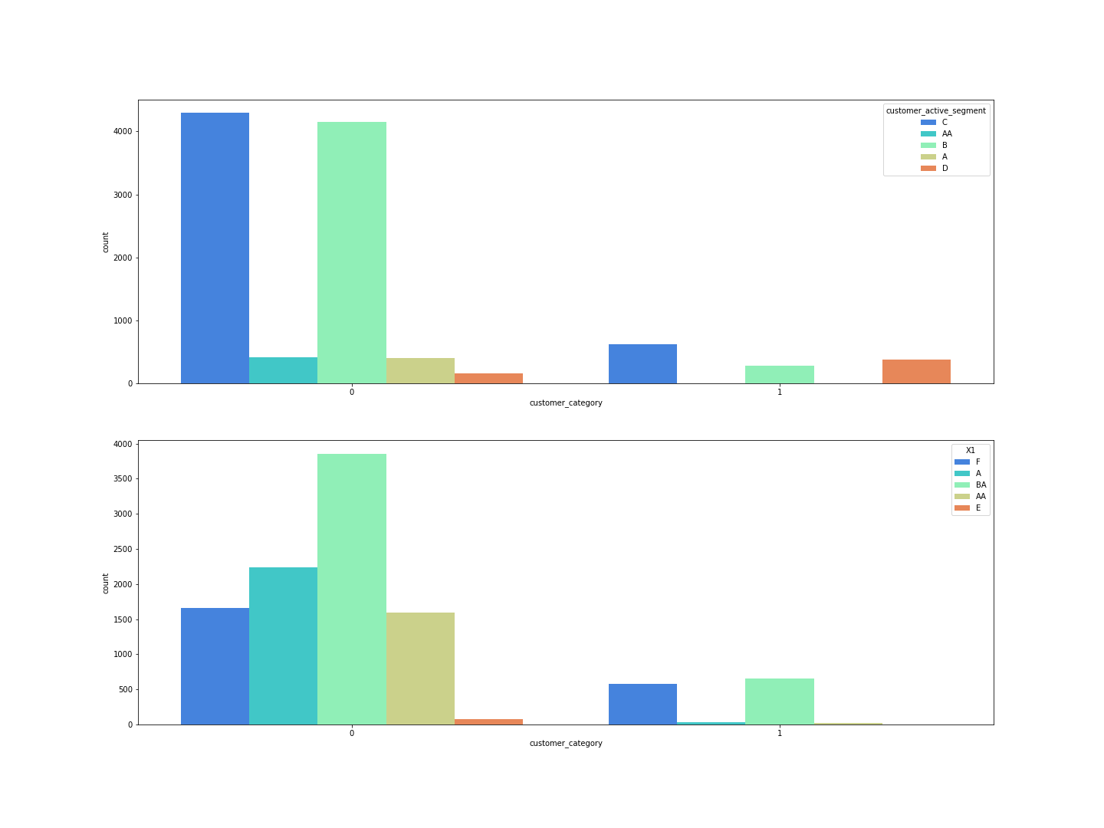

Categorical Features Distribution

Slide 16
Categorical Features
Two categorical features, Active Segment and X1
Not much information about how they are calculated or what each of the category signifies.
But it can be inferred that some categories are more likely to be classified as Type 1 customer than other.
Also, it was found that all the rows with missing values correspond to Type 0 customer.
So, filled all the missing values in these features with a dummy variable.

Slide 17
Handle Missing Values
For normally distributed features like Product Search and Order scores, missing values are filled with values randomly sampled by their distribution.
For Stay Score, it is highly correlated with CTR score. So, A KNN imputer is used to fill the missing values.
For product variation score, multivariate imputation is used which fills in missing values by modelling current feature on remaining features.
And finally, for imputing categorical features, I treated all missing values to be a separate category.

Slide 18
Data cleaning and Encoding
Visit score - Uniformly distributed but also noisy. So, categorically divided the data into 10 bins and labelled them from range 1 to 10.
Categorical features – Affinity score and X1 score are also to be labelled.
One hot encoding , Label encoding are available methods.
By label encoding we are assigning some prior into the distribution. So, used one hot encoding.

Slide 19
ML Model Training

Slide 20
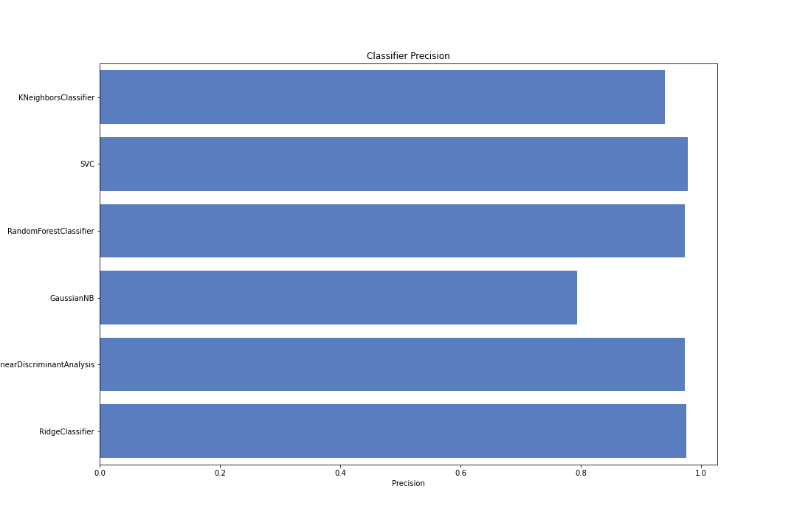
The available data is split into training and validation modules for an initial understanding of which models performed the best. Later parameters are hypertuned to fine tune the models. We can see that linear models are generally performing better from the above precision scores obtained from various models.

Slide 21
Model Training
The available data is split into training and validation modules and trained on various models.
Linear models are found to be performing better than ensemble methods.
Later parameters are hypertuned for each models to fine tune these models.

Slide 22
Training and Hyperparameter Tuning
As can be seen from the results, Ridge and Linear Discriminant analyzer are performing better than other models.
Ensemble methods - As our data is heavily imbalanced, they suffer from having less data to classify the minority customer category of 1.
Best Random Forest Classifier - n_estimators – 150, max_depth =2, max_column_split=0.6 - 95 accuracy
SGD Classifier and SVM produced results that are heavily based on random state variable which is not a good sign.
Finally zeroed upon Ridge Classifier and Linear Discriminant classifier
Linear Discriminant Analyser doesn't have significant hyperparameters to tune.
Linear Discriminant Analyser – 97 accuracy
With Ridge Classifier, after careful parameter tuning, observed best results with the following combination.
Ridge Classifier + Normalize data + "saga" solver + alpha =2.5 – Achieved 98.65 accuracy on test dataset

Slide 23

Pros & Cons
Pros
Customer Experience will be enhanced because customer gets to see what he wanted instead of random irrelevant suggestions.
Business will benefit because we can show our product to those customers who are more likely to buy.
Cons
Our product may not reach all types of customers.
For a product that was just launched, this might not be the ideal approach.

Slide 24
Thanks

