Slide 1
“NOTEPAD APP”
Sr. No. | NAME | ROLL NO.
1 | Vedant Narawadkar | 32151
2 | Aarya Sonawane | 32171
GUIDE
Mr. Nilesh S. Shirude
DEPARTMENT OF
ELECTRONICS AND TELECOMMUNICATION ENGINEERING
PUNE INSTITUTE OF COMPUTER TECHNOLOGY
PUNE – 43

Slide 2
Introduction
The notepad application project focuses on developing a lightweight, efficient, and user-friendly tool for creating and managing plain text documents. Text editors like this have been fundamental to computing since its early days, serving as essential utilities for programmers, writers, and everyday users. The concept of a simple text editor traces back to the 1960s and 1970s, with tools like ed and later Notepad on Windows, which provided a no-frills platform for text manipulation. Over time, these tools have evolved to meet the growing demands of users, balancing simplicity with functionality, and remain relevant in a world of complex software suites.

Slide 3
Proposed System
The Notepad Application is a straightforward Java Swing-based text editor designed to provide users with a simple yet effective tool for creating, editing, and managing plain text documents. Below are the key details and features:
The application features a central text area where users can input and modify text.
It includes a menu bar with options for file operations, editing functions, and help.
Users can create new documents, open existing text files, save changes, and print content.
Basic editing tools like copy, paste, cut, and select all are supported with keyboard shortcuts.
An "About" window provides information about the application, including its purpose and version.

Slide 4
Algorithm / flowchart
Init: Create JFrame, JMenuBar (File, Edit, Help), JTextArea; add shortcuts.
Input: Handle menu/shortcut events.
File: New (clear), Open (read .txt), Save (write .txt), Print, Exit.
Edit: Copy (store), Paste (insert), Cut (store/remove), Select All.
Help: Show About window; close on OK.
Update: Show edits live; stay responsive.
End: Close on Exit/window shut.
This is a highly concise version focusing on key actions.

Slide 5
Source code explanation
Notepad.java
Class Setup: Notepad extends JFrame and implements ActionListener to create the main window and handle events.
UI Components:
JMenuBar with "File," "Edit," and "Help" menus, each containing JMenuItems (e.g., "New," "Copy," "About Notepad").
JTextArea (wrapped in JScrollPane) for text input, with word wrap and a 20-point San Serif font.
Functionality:
File Menu:
"New": Clears the text area.
"Open": Uses JFileChooser to load a .txt file into the text area via FileReader and BufferedReader.
"Save": Saves text to a .txt file using JFileChooser and BufferedWriter.
"Print": Calls JTextArea.print().
"Exit": Closes the app with System.exit(0).
Edit Menu:
"Copy": Stores selected text in a String.
"Paste": Inserts stored text at the cursor.
"Cut": Stores and removes selected text.
"Select All": Highlights all text.
Help Menu:
"About Notepad": Opens the About window.
Event Handling: actionPerformed method processes all menu actions based on their command strings.
Main Method: Launches the app with new Notepad().

Slide 6
About.java
Class Setup: About extends JFrame and implements ActionListener for a pop-up info window.
UI Components:
Displays a Windows logo (ImageIcon) and a notepad icon, scaled to fit.
JLabel with HTML-formatted text describing the app (e.g., version, purpose).
"OK" JButton to close the window.
Functionality:
Sets window size (700x600) and position (600, 200).
actionPerformed: Hides the window when "OK" is clicked.
Main Method: Tests the About window independently.
The code uses Java Swing for a GUI-based notepad with basic text editing and file operations. Notepad.java handles the core app logic, while About.java provides a simple info dialog. Keyboard shortcuts and event listeners enhance usability, making it a lightweight, functional text editor.

Slide 7
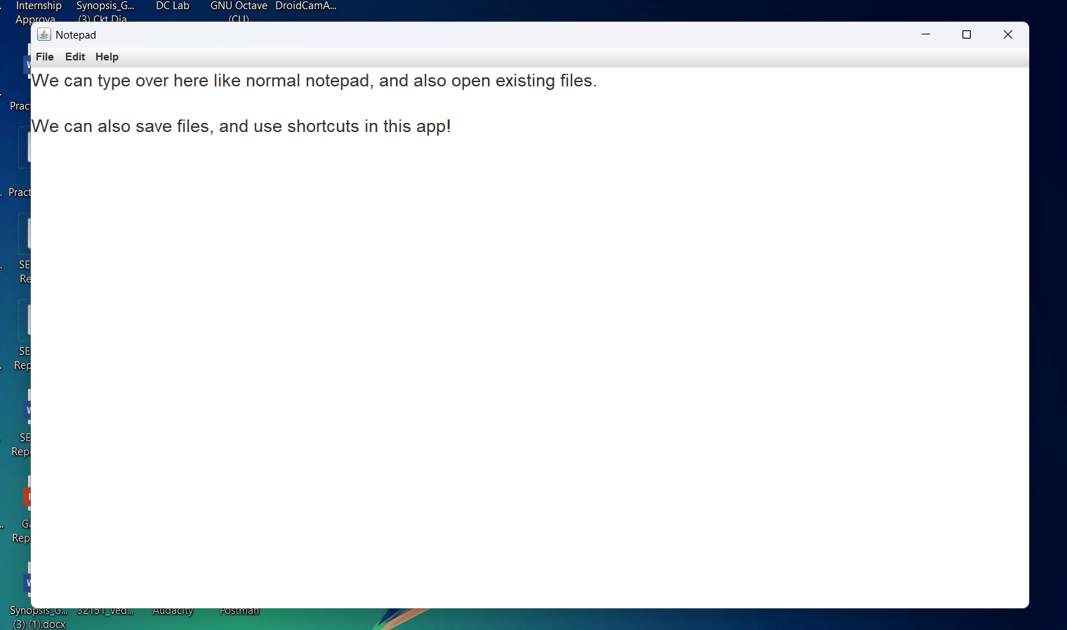
Result:

Slide 8
Conclusion:
The Notepad Application successfully demonstrates the implementation of a simple yet functional text-editing tool using Java Swing. The application effectively enables users to create, edit, and manage plain text documents with ease, incorporating essential features like file operations and basic editing tools. The intuitive menu-based interface, combined with keyboard shortcuts, enhances user productivity and accessibility. The project highlights efficient event handling, graphical user interface design, and file management capabilities, making it a practical exercise in software development and user experience design. This notepad serves as a solid foundation for future enhancements, such as advanced text formatting, cloud integration, or support for additional file types.

Slide 9
Application:
· Skill Development & Training: Enhances text-editing efficiency, familiarity with keyboard shortcuts, and basic software navigation, making it useful for beginner-level computer literacy training.
· Software Development Industry: Provides a foundational example of a lightweight utility application, which can be expanded into more complex text editors or integrated into larger software suites.
· User Interaction Research: Supports studies in human-computer interaction, usability testing, and GUI design by offering a simple platform for analyzing user behavior with text-based tools.
· Productivity Tools: Can be adapted for quick note-taking, drafting, or editing tasks, aiding professionals, students, and casual users in managing text efficiently.
· Education & Learning Tools: Serves as an engaging way to introduce programming concepts like event-driven programming, file I/O operations, and Swing-based UI development to students.
· Programming Practice: Offers a practical project for developers to hone skills in Java, object-oriented design, and application optimization for real-world use cases.
· Everyday Utility & Casual Use: Provides a simple, reliable text-editing solution for personal use, suitable for users of all skill levels seeking a no-frills notepad experience.

Slide 10
Future Scope
· Multi-Document Support: The application can be enhanced to support multiple open documents simultaneously, allowing users to switch between tabs or windows for improved multitasking.
· Mobile Version: The notepad could be adapted into a mobile app for Android and iOS, broadening its accessibility and leveraging touch-based text input.
· Advanced Text Formatting: Features like font selection, text size adjustment, or basic formatting (bold, italic) could be added to increase functionality while maintaining simplicity.
· Cloud Integration: The application could incorporate cloud storage options (e.g., Google Drive, Dropbox) to enable seamless saving, syncing, and accessing of files across devices.
· Customization Options: Users could customize the interface, such as themes, font styles, or window layouts, to enhance the visual and functional experience.
· Search and Replace Functionality: Adding a search-and-replace feature would improve text editing efficiency, making it more competitive.

Slide 11
THANK YOU!!

