Slide 1

Policy background
Economic efficiency
Distributional equity
Fiscal sustainability
Tax incentives: higher marginal take-home pay
Before 6 Jan 2024: NICs 12% → retain 68p per extra £1
From 6 Jan 2024: NICs 10% → retain 70p per extra £1
From 6 Apr 2024: NICs 8% → retain 72p per extra £1
Combined increase in marginal take-home pay: 5.9%
Source: Author’s calculations using HMRC (2024) rates. Income tax fixed at 20%; main NICs band; other deductions excluded.
Notes:
MEMBER C — SLIDE 1
Target: 35 seconds.
My part explains how the National Insurance cuts affect economic efficiency. First, they increase the reward from additional work. With income tax fixed at twenty per cent, employees retain sixty-eight, seventy and then seventy-two pence from each extra pound earned. The combined increase is about five point nine per cent. This calculation applies to earnings within the main National Insurance band. It shows how the policy strengthens financial incentives.
REFERENCES
HM Revenue & Customs (2024) Reduction to the main rates of primary Class 1 and Class 4 National Insurance contributions. https://www.gov.uk/government/publications/changes-to-national-insurance-contributions-from-6-april-2024/reduction-to-the-main-rates-of-primary-class-1-and-class-4-national-insurance-contributions
Meghir, C. and Phillips, D. (2010) ‘Labour supply and taxes’, in Mirrlees, J. et al. (eds.) Dimensions of Tax Design: The Mirrlees Review. Oxford: Oxford University Press, pp. 202–274. https://ifs.org.uk/books/labour-supply-and-taxes-0
Hemming, R. and Kay, J.A. (1980) ‘The Laffer curve’, Fiscal Studies, 1(2), pp. 83–90. https://doi.org/10.1111/j.1475-5890.1980.tb00554.x
Office for Budget Responsibility (2024) Economic and fiscal outlook – March 2024. CP 1027. https://obr.uk/efo/economic-and-fiscal-outlook-march-2024/ (paras. 3.9–3.10).

Slide 2
Policy background
Economic efficiency
Distributional equity
Fiscal sustainability
Labour supply: substitution and income effects
Substitution effect
Income effect
Net response
Higher net wage
↓
Leisure becomes more costly
↓
Incentive to work more
Higher disposable income
↓
Greater demand for leisure
↓
Incentive to work less
Depends on the relative strength of both effects.
Two margins:
• Entering employment
• Adjusting working hours
Source: Meghir and Phillips (2010). The extensive margin concerns participation; the intensive margin concerns hours worked.
Notes:
MEMBER C — SLIDE 2
Target: 35 seconds.
However, two effects influence working hours. The substitution effect makes leisure more expensive because an hour away from work now sacrifices more income. This encourages additional work. The income effect operates in the opposite direction: higher disposable income allows people to enjoy more leisure. The final response depends on their relative strength. We should also distinguish entering employment from changing hours among existing workers.
REFERENCES
HM Revenue & Customs (2024) Reduction to the main rates of primary Class 1 and Class 4 National Insurance contributions. https://www.gov.uk/government/publications/changes-to-national-insurance-contributions-from-6-april-2024/reduction-to-the-main-rates-of-primary-class-1-and-class-4-national-insurance-contributions
Meghir, C. and Phillips, D. (2010) ‘Labour supply and taxes’, in Mirrlees, J. et al. (eds.) Dimensions of Tax Design: The Mirrlees Review. Oxford: Oxford University Press, pp. 202–274. https://ifs.org.uk/books/labour-supply-and-taxes-0
Hemming, R. and Kay, J.A. (1980) ‘The Laffer curve’, Fiscal Studies, 1(2), pp. 83–90. https://doi.org/10.1111/j.1475-5890.1980.tb00554.x
Office for Budget Responsibility (2024) Economic and fiscal outlook – March 2024. CP 1027. https://obr.uk/efo/economic-and-fiscal-outlook-march-2024/ (paras. 3.9–3.10).

Slide 3
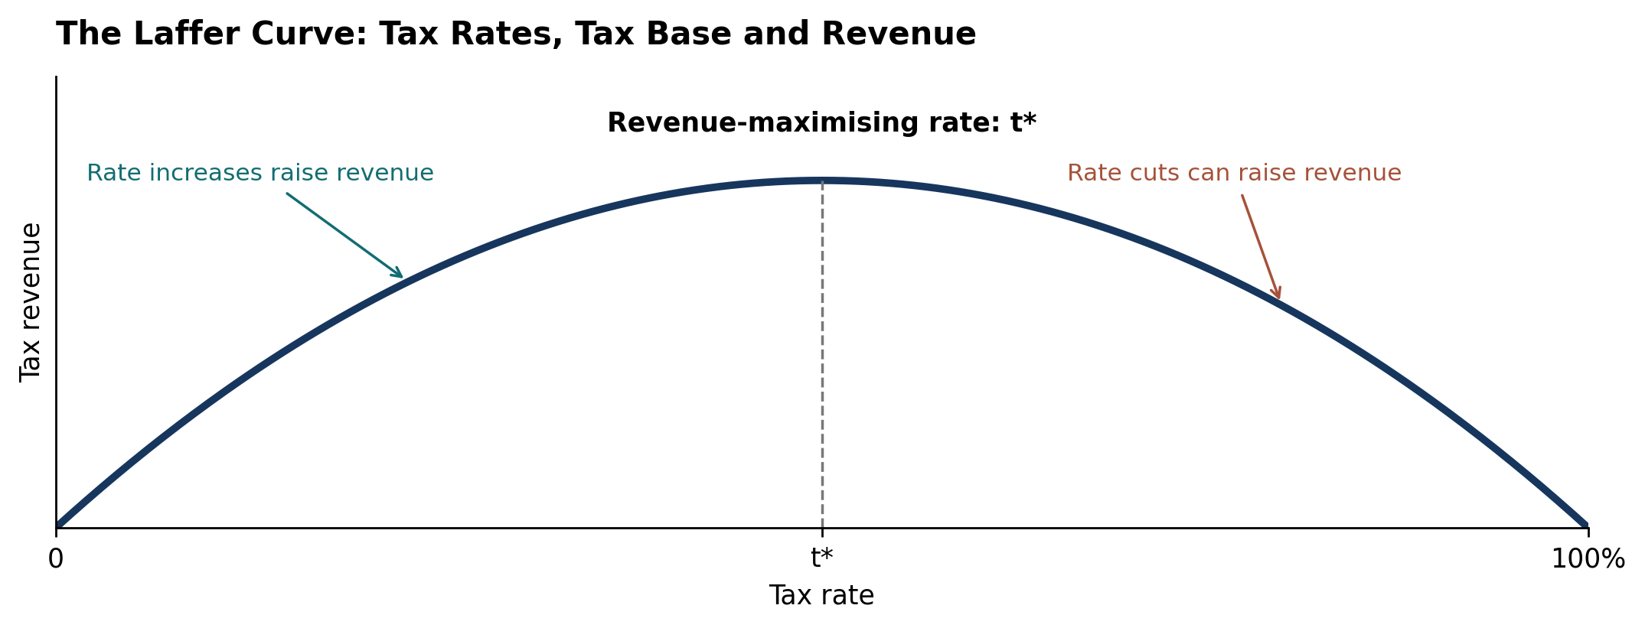
Policy background
Economic efficiency
Distributional equity
Fiscal sustainability
Laffer curve: behavioural gains and fiscal effects
Tax rate × taxable base
OBR forecast: March 2024
98,000 FTEs
Additional labour supply
≈20% of static fiscal cost
recovered through behaviour
Work incentives can expand the taxable base.
Sources: Hemming and Kay (1980); OBR (2024), paras. 3.9–3.10. Laffer curve: theoretical illustration; OBR figures: projections.
Notes:
MEMBER C — SLIDE 3
Target: 35 seconds.
Finally, the Laffer curve links tax rates with the taxable base. Stronger work incentives can expand that base and recover some lost revenue. The OBR projected a labour-supply increase equivalent to ninety-eight thousand full-time workers and approximately twenty per cent recovery of the March measures’ static fiscal cost. My conclusion is that the cuts have a credible incentive rationale, while their overall value also depends on sustainable financing.
REFERENCES
HM Revenue & Customs (2024) Reduction to the main rates of primary Class 1 and Class 4 National Insurance contributions. https://www.gov.uk/government/publications/changes-to-national-insurance-contributions-from-6-april-2024/reduction-to-the-main-rates-of-primary-class-1-and-class-4-national-insurance-contributions
Meghir, C. and Phillips, D. (2010) ‘Labour supply and taxes’, in Mirrlees, J. et al. (eds.) Dimensions of Tax Design: The Mirrlees Review. Oxford: Oxford University Press, pp. 202–274. https://ifs.org.uk/books/labour-supply-and-taxes-0
Hemming, R. and Kay, J.A. (1980) ‘The Laffer curve’, Fiscal Studies, 1(2), pp. 83–90. https://doi.org/10.1111/j.1475-5890.1980.tb00554.x
Office for Budget Responsibility (2024) Economic and fiscal outlook – March 2024. CP 1027. https://obr.uk/efo/economic-and-fiscal-outlook-march-2024/ (paras. 3.9–3.10).

