Slide 1

Policy background
Economic efficiency
Distributional equity
Fiscal sustainability
Tax incentives: a higher return from additional work
Marginal take-home pay per additional £1 earned
COMBINED NICs CUTS
+5.9%
Higher marginal
take-home pay
(72 − 68) ÷ 68 × 100
NICs main rate: 12% → 10% → 8%
Source: Author’s calculations using HMRC (2024) rates. Assumes 20% income tax, main NICs band and no other deductions.
Notes:
MEMBER C — SLIDE 1
Target: 35 seconds.
My part explains how the National Insurance cuts affect economic efficiency. First, they increase the reward from additional work. With income tax fixed at twenty per cent, employees retain sixty-eight, seventy and then seventy-two pence from each extra pound earned. The combined increase is about five point nine per cent. This calculation applies to earnings within the main National Insurance band. It shows how the policy strengthens financial incentives.
REFERENCES
HM Revenue & Customs (2024) Reduction to the main rates of primary Class 1 and Class 4 National Insurance contributions. https://www.gov.uk/government/publications/changes-to-national-insurance-contributions-from-6-april-2024/reduction-to-the-main-rates-of-primary-class-1-and-class-4-national-insurance-contributions
Meghir, C. and Phillips, D. (2010) ‘Labour supply and taxes’, in Mirrlees, J. et al. (eds.) Dimensions of Tax Design: The Mirrlees Review. Oxford: Oxford University Press, pp. 202–274. https://ifs.org.uk/books/labour-supply-and-taxes-0
Hemming, R. and Kay, J.A. (1980) ‘The Laffer curve’, Fiscal Studies, 1(2), pp. 83–90. https://doi.org/10.1111/j.1475-5890.1980.tb00554.x
Office for Budget Responsibility (2024) Economic and fiscal outlook – March 2024. CP 1027. https://obr.uk/efo/economic-and-fiscal-outlook-march-2024/ (paras. 3.9–3.10).

Slide 2
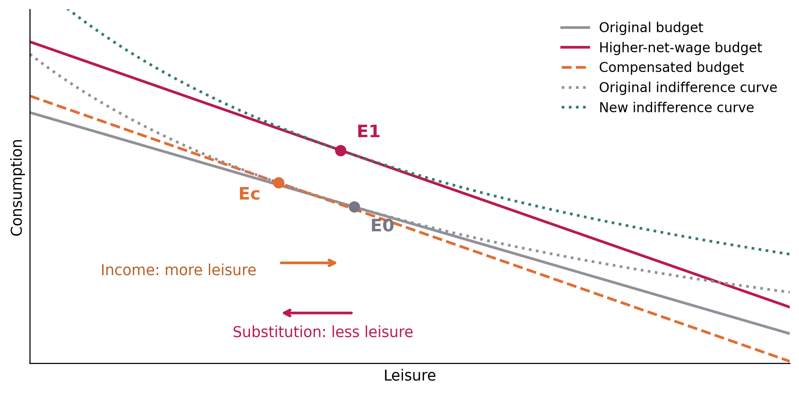
Policy background
Economic efficiency
Distributional equity
Fiscal sustainability
Labour supply: substitution and income effects
How a higher net wage changes work–leisure choices
01 / SUBSTITUTION
Higher reward
from extra work
Less leisure → more work
02 / INCOME
More leisure
Higher income → less work
Participation in employment ≠ hours worked by existing employees
Source: Author’s theoretical illustration based on Meghir and Phillips (2010).
Notes:
MEMBER C — SLIDE 2
Target: 35 seconds.
However, two effects influence working hours. The substitution effect makes leisure more expensive because an hour away from work now sacrifices more income. This encourages additional work. The income effect operates in the opposite direction: higher disposable income allows people to enjoy more leisure. The final response depends on their relative strength. We should also distinguish entering employment from changing hours among existing workers.
REFERENCES
HM Revenue & Customs (2024) Reduction to the main rates of primary Class 1 and Class 4 National Insurance contributions. https://www.gov.uk/government/publications/changes-to-national-insurance-contributions-from-6-april-2024/reduction-to-the-main-rates-of-primary-class-1-and-class-4-national-insurance-contributions
Meghir, C. and Phillips, D. (2010) ‘Labour supply and taxes’, in Mirrlees, J. et al. (eds.) Dimensions of Tax Design: The Mirrlees Review. Oxford: Oxford University Press, pp. 202–274. https://ifs.org.uk/books/labour-supply-and-taxes-0
Hemming, R. and Kay, J.A. (1980) ‘The Laffer curve’, Fiscal Studies, 1(2), pp. 83–90. https://doi.org/10.1111/j.1475-5890.1980.tb00554.x
Office for Budget Responsibility (2024) Economic and fiscal outlook – March 2024. CP 1027. https://obr.uk/efo/economic-and-fiscal-outlook-march-2024/ (paras. 3.9–3.10).

Slide 3
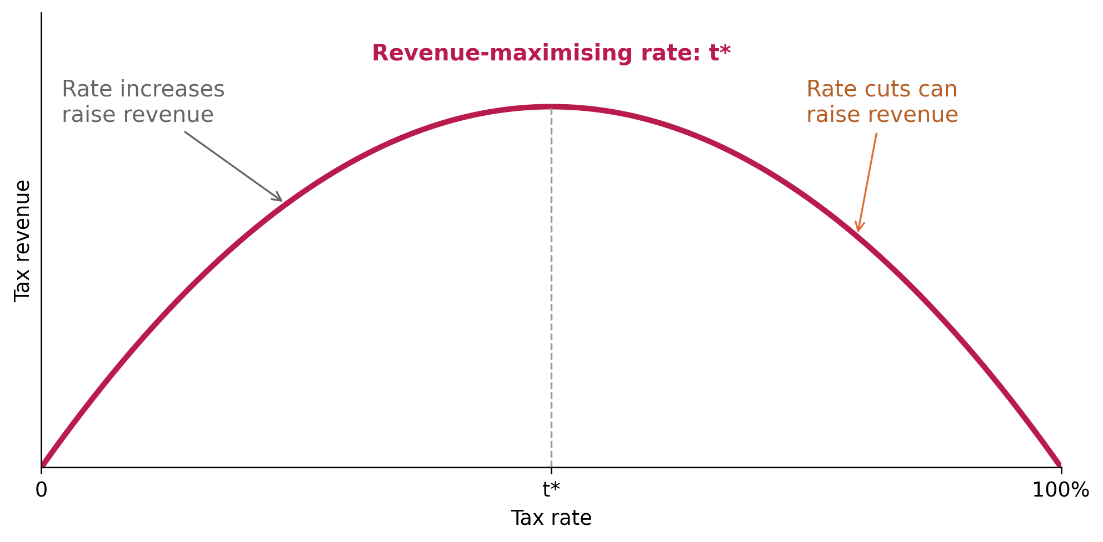
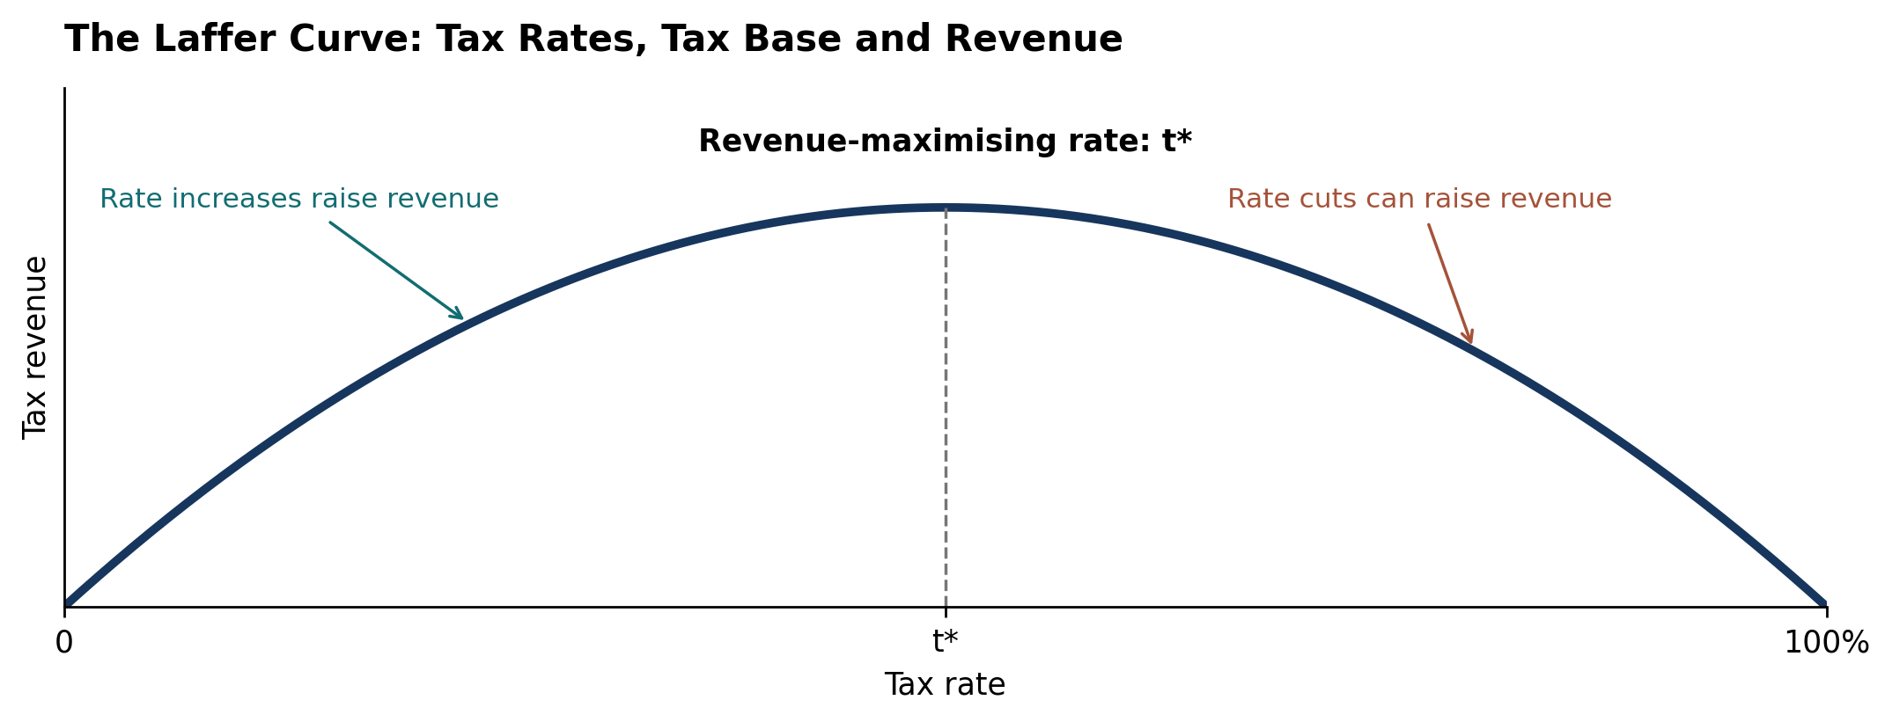
Policy background
Economic efficiency
Distributional equity
Fiscal sustainability
Laffer curve: behavioural gains and fiscal effects
Tax revenue = tax rate × taxable base
OBR / MARCH 2024
98,000
full-time equivalents
Additional labour supply
≈20%
of static fiscal cost recovered
Stronger work incentives, supported by sustainable financing
Sources: Hemming and Kay (1980); OBR (2024), paras. 3.9–3.10. Diagram: theoretical illustration; OBR figures: forecasts.
Notes:
MEMBER C — SLIDE 3
Target: 35 seconds.
Finally, the Laffer curve links tax rates with the taxable base. Stronger work incentives can expand that base and recover some lost revenue. The OBR projected a labour-supply increase equivalent to ninety-eight thousand full-time workers and approximately twenty per cent recovery of the March measures’ static fiscal cost. My conclusion is that the cuts have a credible incentive rationale, while their overall value also depends on sustainable financing.
REFERENCES
HM Revenue & Customs (2024) Reduction to the main rates of primary Class 1 and Class 4 National Insurance contributions. https://www.gov.uk/government/publications/changes-to-national-insurance-contributions-from-6-april-2024/reduction-to-the-main-rates-of-primary-class-1-and-class-4-national-insurance-contributions
Meghir, C. and Phillips, D. (2010) ‘Labour supply and taxes’, in Mirrlees, J. et al. (eds.) Dimensions of Tax Design: The Mirrlees Review. Oxford: Oxford University Press, pp. 202–274. https://ifs.org.uk/books/labour-supply-and-taxes-0
Hemming, R. and Kay, J.A. (1980) ‘The Laffer curve’, Fiscal Studies, 1(2), pp. 83–90. https://doi.org/10.1111/j.1475-5890.1980.tb00554.x
Office for Budget Responsibility (2024) Economic and fiscal outlook – March 2024. CP 1027. https://obr.uk/efo/economic-and-fiscal-outlook-march-2024/ (paras. 3.9–3.10).

