Slide 1

ECONOMIC EFFICIENCY | MEMBER C
01 WORK INCENTIVES
Lower NICs increase the reward from extra work
Take-home pay from each additional £1 earned
+5.9%
Higher marginal
take-home pay
(72 − 68) ÷ 68 × 100
NICs main rate: 12% → 10% → 8%
Source: Author’s calculations using HMRC (2024) rates. Income tax held at 20%; main NICs band; other deductions excluded.
1
Notes:
MEMBER C — SLIDE 1
Target: 35 seconds.
My part explains how the National Insurance cuts affect economic efficiency. First, they increase the reward from additional work. With income tax fixed at twenty per cent, employees retain sixty-eight, seventy and then seventy-two pence from each extra pound earned. The combined increase is about five point nine per cent. This calculation applies to earnings within the main National Insurance band. It shows how the policy strengthens financial incentives.
REFERENCES
HM Revenue & Customs (2024) Reduction to the main rates of primary Class 1 and Class 4 National Insurance contributions. https://www.gov.uk/government/publications/changes-to-national-insurance-contributions-from-6-april-2024/reduction-to-the-main-rates-of-primary-class-1-and-class-4-national-insurance-contributions
Meghir, C. and Phillips, D. (2010) ‘Labour supply and taxes’, in Mirrlees, J. et al. (eds.) Dimensions of Tax Design: The Mirrlees Review. Oxford: Oxford University Press, pp. 202–274. https://ifs.org.uk/books/labour-supply-and-taxes-0
Hemming, R. and Kay, J.A. (1980) ‘The Laffer curve’, Fiscal Studies, 1(2), pp. 83–90. https://doi.org/10.1111/j.1475-5890.1980.tb00554.x
Office for Budget Responsibility (2024) Economic and fiscal outlook – March 2024. CP 1027. https://obr.uk/efo/economic-and-fiscal-outlook-march-2024/ (paras. 3.9–3.10).

Slide 2
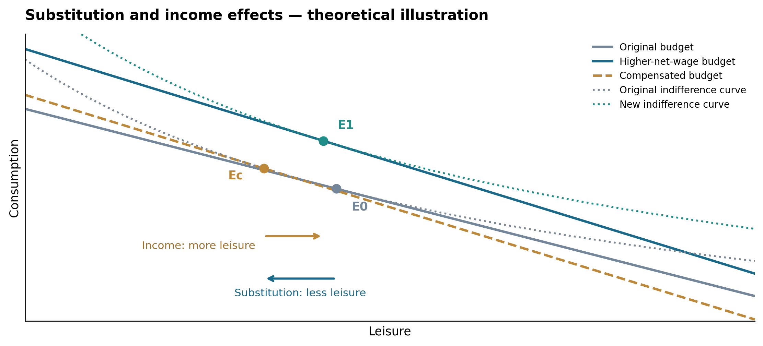
ECONOMIC EFFICIENCY | MEMBER C
02 LABOUR SUPPLY
Two effects shape the labour-supply response
SUBSTITUTION EFFECT
Higher net wage
→ more work
INCOME EFFECT
Higher income
→ more leisure
Two margins: entering employment | adjusting working hours
Source: Meghir and Phillips (2010). Author’s theoretical illustration.
2
Notes:
MEMBER C — SLIDE 2
Target: 35 seconds.
However, two effects influence working hours. The substitution effect makes leisure more expensive because an hour away from work now sacrifices more income. This encourages additional work. The income effect operates in the opposite direction: higher disposable income allows people to enjoy more leisure. The final response depends on their relative strength. We should also distinguish entering employment from changing hours among existing workers.
REFERENCES
HM Revenue & Customs (2024) Reduction to the main rates of primary Class 1 and Class 4 National Insurance contributions. https://www.gov.uk/government/publications/changes-to-national-insurance-contributions-from-6-april-2024/reduction-to-the-main-rates-of-primary-class-1-and-class-4-national-insurance-contributions
Meghir, C. and Phillips, D. (2010) ‘Labour supply and taxes’, in Mirrlees, J. et al. (eds.) Dimensions of Tax Design: The Mirrlees Review. Oxford: Oxford University Press, pp. 202–274. https://ifs.org.uk/books/labour-supply-and-taxes-0
Hemming, R. and Kay, J.A. (1980) ‘The Laffer curve’, Fiscal Studies, 1(2), pp. 83–90. https://doi.org/10.1111/j.1475-5890.1980.tb00554.x
Office for Budget Responsibility (2024) Economic and fiscal outlook – March 2024. CP 1027. https://obr.uk/efo/economic-and-fiscal-outlook-march-2024/ (paras. 3.9–3.10).

Slide 3
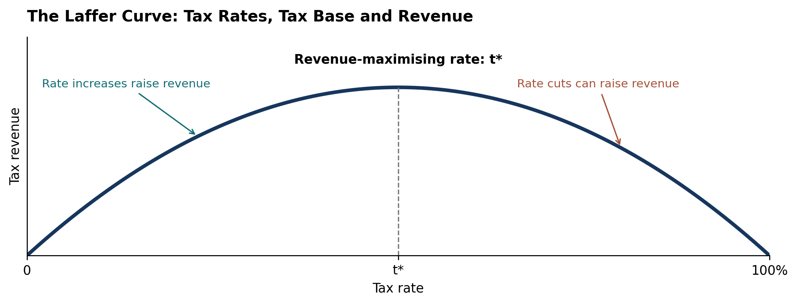
ECONOMIC EFFICIENCY | MEMBER C
03 REVENUE & EFFICIENCY
Behavioural gains can partly recover the fiscal cost
OBR FORECAST
98,000 FTEs
Additional labour supply
≈20%
of static fiscal cost recovered
Revenue = tax rate × taxable base
Stronger work incentives + sustainable financing
Sources: Hemming and Kay (1980); OBR (2024), paras. 3.9–3.10. March 2024 measures; projected effects.
3
Notes:
MEMBER C — SLIDE 3
Target: 35 seconds.
Finally, the Laffer curve links tax rates with the taxable base. Stronger work incentives can expand that base and recover some lost revenue. The OBR projected a labour-supply increase equivalent to ninety-eight thousand full-time workers and approximately twenty per cent recovery of the March measures’ static fiscal cost. My conclusion is that the cuts have a credible incentive rationale, while their overall value also depends on sustainable financing.
REFERENCES
HM Revenue & Customs (2024) Reduction to the main rates of primary Class 1 and Class 4 National Insurance contributions. https://www.gov.uk/government/publications/changes-to-national-insurance-contributions-from-6-april-2024/reduction-to-the-main-rates-of-primary-class-1-and-class-4-national-insurance-contributions
Meghir, C. and Phillips, D. (2010) ‘Labour supply and taxes’, in Mirrlees, J. et al. (eds.) Dimensions of Tax Design: The Mirrlees Review. Oxford: Oxford University Press, pp. 202–274. https://ifs.org.uk/books/labour-supply-and-taxes-0
Hemming, R. and Kay, J.A. (1980) ‘The Laffer curve’, Fiscal Studies, 1(2), pp. 83–90. https://doi.org/10.1111/j.1475-5890.1980.tb00554.x
Office for Budget Responsibility (2024) Economic and fiscal outlook – March 2024. CP 1027. https://obr.uk/efo/economic-and-fiscal-outlook-march-2024/ (paras. 3.9–3.10).

