Slide 1
Lenovo restricted presentation template
Speaker name | Date

Slide 2
Section header
Subhead here

Slide 3
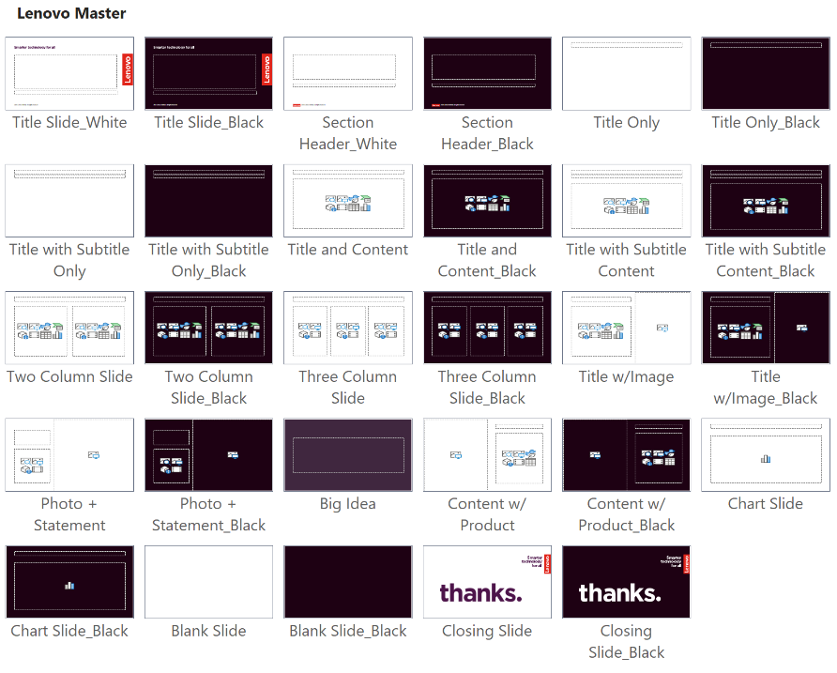
Slide master layouts
Discover all available slide layouts by following these instructions:
In the slide panel on the left, right-click on a thumbnail and select “Layout” to choose an option based on your content needs OR
From the “Home” tab, choose the “Slide Layout” dropdown
Layout options between “Title Slide_White” and “Closing Slide_Black” are considered part of the current template

Slide 4
Template best practices
For every slide layout option, there is an alternative dark option:
For slides that will be printed, use white slide layouts to conserve toner
Dark slides are a dramatic alternative for formal presentations that will be projected on screen
Bold color is your highlight text, text, text, text, text, text
Try not to exceed six bullet points per slide
Tips for transferring content from other templates:
Paste the slide in the desired location and then from "Paste Options" box, choose "Use Destination Theme“
You may still have to copy-paste or cut-paste content into the correct content placeholder on the slide, depending on how the source file was created
Copy-paste the content within the slide instead of copying and pasting entire slides from the side pane
Delete any layout options that appear after "Closing Slide_Black"; these are legacy artifacts from older templates and should not be used

Slide 5
Installing theme files
1
Go to the Brand World Templates page
2
Download the Lenovo theme file (.thmx) and the Lenovo starter template/slide library (.potx) using the instructions near the top of the page
3
Open “File Explorer” and click “View” > “Show” > “Hidden items”
4
Navigate to: “C:\Users\<YourUsername>\AppData\Roaming\Microsoft\Templates”
5
Copy your .potx file (Lenovo Starter Template or Lenovo Slide Library) into the Templates folder
6
Open the “Document Themes” subfolder inside Templates, then copy your .thmx file (Lenovo Theme) into this folder.

Slide 6
Titles are Arial, bold, 32 pt, sentence case
Subtitles are Arial, regular, 22 pt, sentence case
Level one bullet style is Arial, regular, 20 pt
Level two style is Arial, regular, 18 pt
Level three style is Arial, regular, 18 pt
Bulleted copy has initial cap on first word only with no period at the end
If bulleted copy is more than one sentence, use a period at the end
Use periods for all bulleted copy in the list if one requires a period

Slide 7
Two column layout
Two-column level one bullet style is Arial, regular, 20 pt
Level two style is Arial, regular, 18 pt
Level three style is Arial, regular, 18 pt
Level one style
Level one style
Level one style
Two-column level one bullets are Arial, regular, 20 pt
Level two style is Arial, regular, 18 pt
Level three style is Arial, regular, 18 pt
Level one style
Level one style
Level one style

Slide 8
Color scheme
Red
225.37.27
#E1251B
Deep Red 1
100.19.30
#64131E
Deep Purple 1
77.20.74
#4D144A
Deep Blue 1
17.24.79
#11184F
Black
30.01.19
#1E0013
Mid Red 1
184.37.46
#B8252E
Deep Purple 2
122.18.107
#7A126B
Deep Blue 2
41.78.149
#294E95
Deep Gray
78.68.78
#4E444E
Lenovo signature red should be used to elevate the brand but should not be overused. Always use the signature red for the Lenovo logo.
Mid Red 2
242.106.82
#F26A52
Mid Gray
171.168.177
#ABA8B1
Colors built into the template (theme colors)
Pale Red 1
240.199.191
#F0C7BF
Pale Purple 1
217.193. 216
#D9C1D8
Pale Blue 1
201.208.240
#C9D0F0
Pale Gray
230.226.228
#E6E2E4
SMARTER
Passion
Ambition
Knowledge
Curious
Wonder
Creative
SMARTER & LINEAR
GRADIENTS:
LINEAR

Slide 9

Colors for light slides
Use deep and bold colors that contrast with the white background
Theme colors
Avoid the paler tones that do not allow enough contrast with the white background

Slide 10

Colors for dark slides
Use light and bold colors that contrast with the dark background
Theme colors
Avoid the darker tones that do not allow enough contrast with the dark background

Slide 11
Thanks

