Slide 1







Stack Overflow Developer Survey
By: Najaa Bazilah
Date: 01-31-2024

Slide 2



OUTLINE
Executive Summary
Introduction
Methodology
Results
Visualization – Charts
Dashboard
Discussion
Findings & Implications
Conclusion
Appendix

Slide 3

EXECUTIVE SUMMARY
The StackOverflow Developer Survey is a survey that seeks to understand the trends, preferences and behaviors of developers worldwide.
Over 90,000 developer responses collected
Data analysis goal to find what are the trends in programming language, database, platforms and web frame that are currently used and desire by developers.
All the goals are answered through the findings that visualized through data visualization.
Lastly, the conclusion from all the findings during the data analysis is stated at the end.

Slide 4

INTRODUCTION
About the dataset used for analysis
Dataset is from the online survey of software professional across the world done by Stack Overflow.
Approximately 90,000 developers/professional responses available in actual dataset.
The data set used in this analysis is a subset of the original data. Hence, conclusion deduce may not reflect the real-world scenario.
Objective of analysis:
To identify what is the top programming language used currently, and what is the demand in the next year ?
To identify what is the top database skills used currently, and what is the demand in the next year ?
What is the distribution of operating system developers are using?
What is the IDE that are popular among the developers ?

Slide 5

METHODOLOGY
Data Collection - Collect survey data from sources
APIs
Web Scraping
Data Wrangling
To prepare data for analysis by finding missing and duplicated values, then clean and normalized data.
Data Exploratory
Finding the distribution and trend of the data.
Identifying the outliers and correlation of each data sets
Data Visualization
Visualizing the data that to shows the distribution, relationship, and composition.
Comparison of data by category

Slide 6

RESULTS

Slide 7
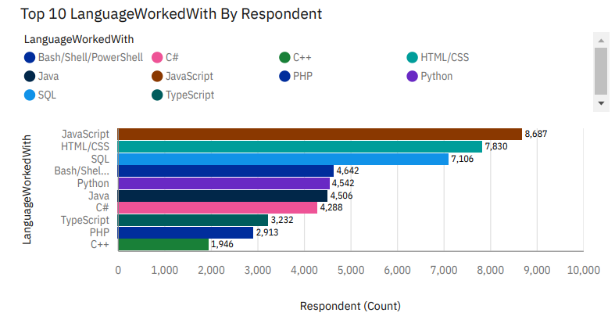
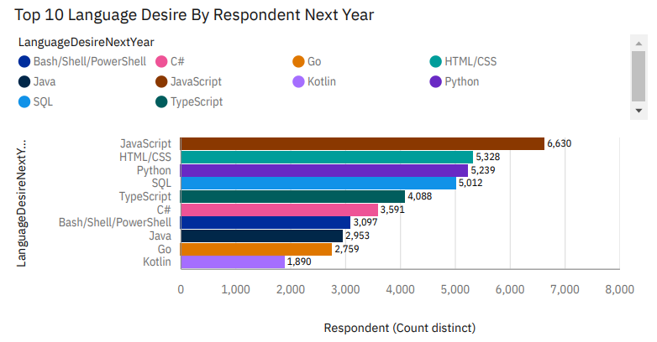
PROGRAMMING LANGUAGE TRENDS
Current Year
Next Year

Slide 8
PROGRAMMING LANGUAGE TRENDS - FINDINGS & IMPLICATIONS
Findings
Javascript is the most used language by respondents in current year, with over 8,000 respondents using it.
Python and TypeScript are the most desired language for the next year, with over 6,000 respondents desiring to work with it.
Respondent more inclined towards language that are versatile and can be used for multiple purposes, such as JavaScript and Python.
Respondent less inclined towards language that are specific to certain tasks such as Bash/Shell/PowerShell.
Implications
Python becomes the fastest growing language.
Possible language migration from Javascript to Typescript

Slide 9
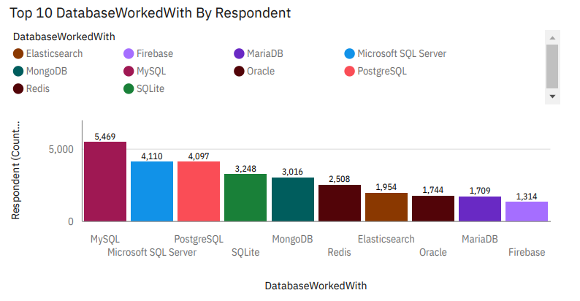
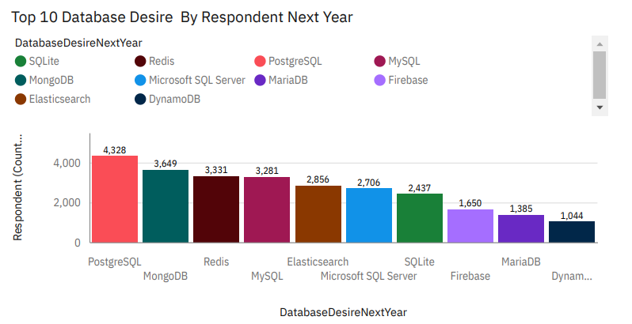
DATABASE TRENDS
Current Year
Next Year

Slide 10
DATABASE TRENDS - FINDINGS & IMPLICATIONS
Findings
MySQL is the most used database by the developers at the current moment.
PostgreSQL is the most desired database by respondent for the next year.
Next year, respondent are more inclined towards open-source database such as PostgreSQL, MongoDB, Redis and Elasticsearch.
Implications
Since PostgreSQL is the most desirable database to be learn by developers, there is a possibility that the used of MySQL will be declined in next year.

Slide 11
DASHBOARD
Github link: https://github.com/najaabzlh/IBM_DataAnalyst_CapStone/blob/e7f6d8fadebd973fd9e2c0cb6a54ee2659f15ab0/W5_IBMCognosDashboard.pdf

Slide 12
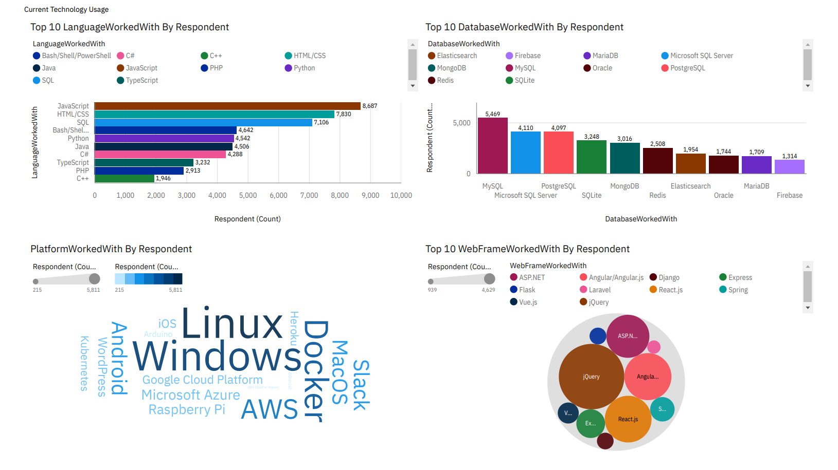
DASHBOARD 1- Current Technology Usage

Slide 13
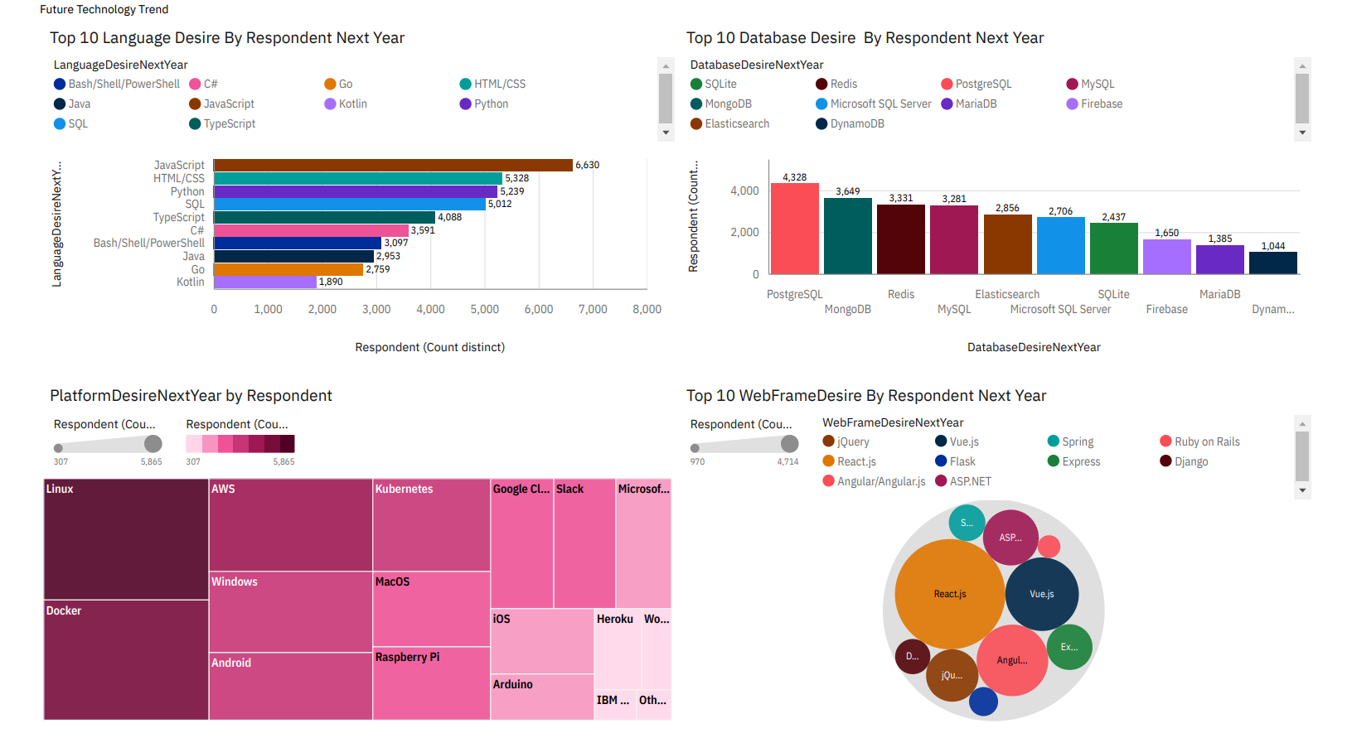
DASHBOARD 2 – Future Technology Trend

Slide 14
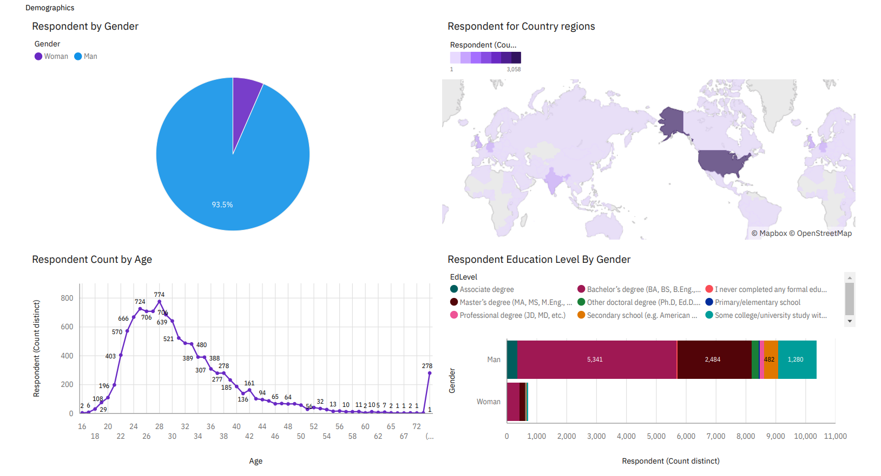
DASHBOARD 3 - Demographics

Slide 15
DISCUSSION

Slide 16
OVERALL FINDINGS & IMPLICATIONS
Findings
Programming Language: JavaScript is the most used language and desired language, followed by HTML/CSS and SQL. Python has become the top new language is that is most desired by the developers in the next year.
Databases: MySQL leads the most database used by developers followed by Microsoft SQL Server and PostgreSQL. PostgreSQL remain top 3 database desire to learn by developers but MySQL showing down trend. This show a shift of database technology desire by developers.
Platform: Linux remained as the top used and desired platform by developers and Windows showing down trend desired of developers which replaced by Docker as the second platform desired by the developers.
Web Frameworks: jQuery is the most used and is still in demand, but React.js and Angular.js are close contenders.
Diversity: Over 90% developers are young male.
Implications
Developers should focus on learning open-source and cross-platform technologies to stay relevant in the industry.
We should have more women to join as the software professional. Industry can hire more underrepresented group like women.

Slide 17

CONCLUSION
From the survey, we able to deduce what are the popular trends of programming language, database, platform and the IDE among the developers.
The developers need to upskills them with cross platform technology to stay relevant and update to the industry.

Slide 18

APPENDIX

Slide 19
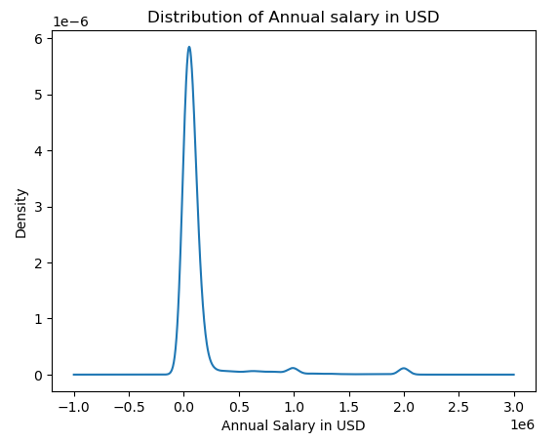
ANNUAL SALARY DISTRIBUTION

Slide 20
JOB POSTINGS

Slide 21
POPULAR LANGUAGES

