Slide 1

Marvel vs dc project 3: WEB APIS & nlpS
General Assembly
Najaf Shaikh

Slide 2
Problem Statement Marvel and DC have been competing for decades and are strong rivals. Over the years, there have been many accusations of writers copying from one another; stealing ideas and characters. This projects aims to understand how similar they are.

Slide 3
Data Collection Subreddits r/Dccomics: 12,500 posts; 20,000 comments r/Marvel: 12,500 posts; 20,000 comments Posts: subreddit title selftext Comments: subreddit body

Slide 4
Data Cleaning 1. Drop unnamed: 0 2. Drop duplicates 3. Selftext NaN values replaced with ‘-’ 4. Lowercase 5. New column for posts : alltext 6. “Removed” and “Deleted” text removed 7. Website text removed

Slide 5
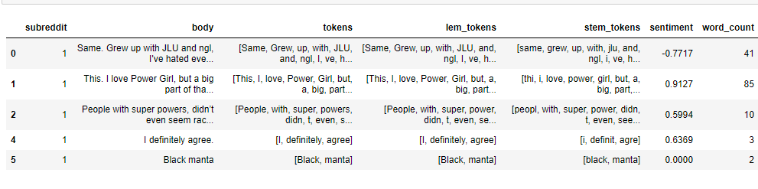
Additional Steps 1. Mapping: DC= 1 Marvel = 0 2. Tokenizing 3. Lemmatizing 4. Stemming 5. Sentiment Analysis 6. Number of words

Slide 6
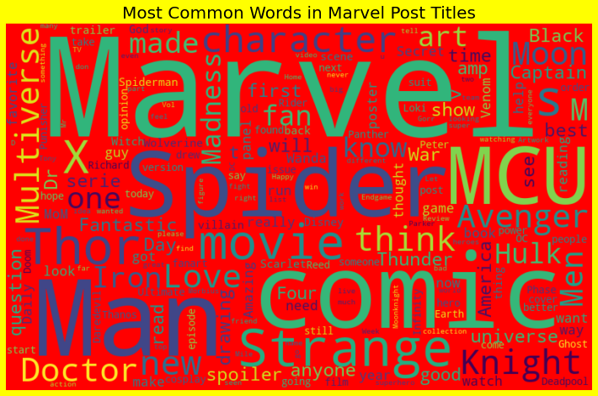
Word_Cloud Marvel
Most Common words
Marvel
Spider
MCU
Thor
Man
Comic
Strange
movie

Slide 7
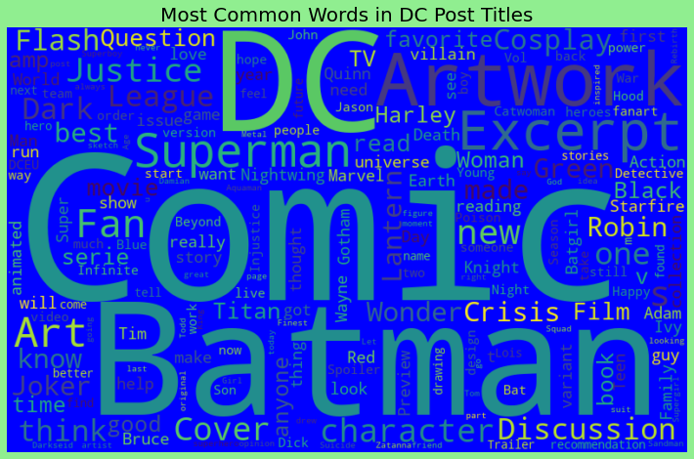
Word Cloud DC
Most common words:
DC
Comic
Batman
Artwork
Superman
Artwork & Art

Slide 8
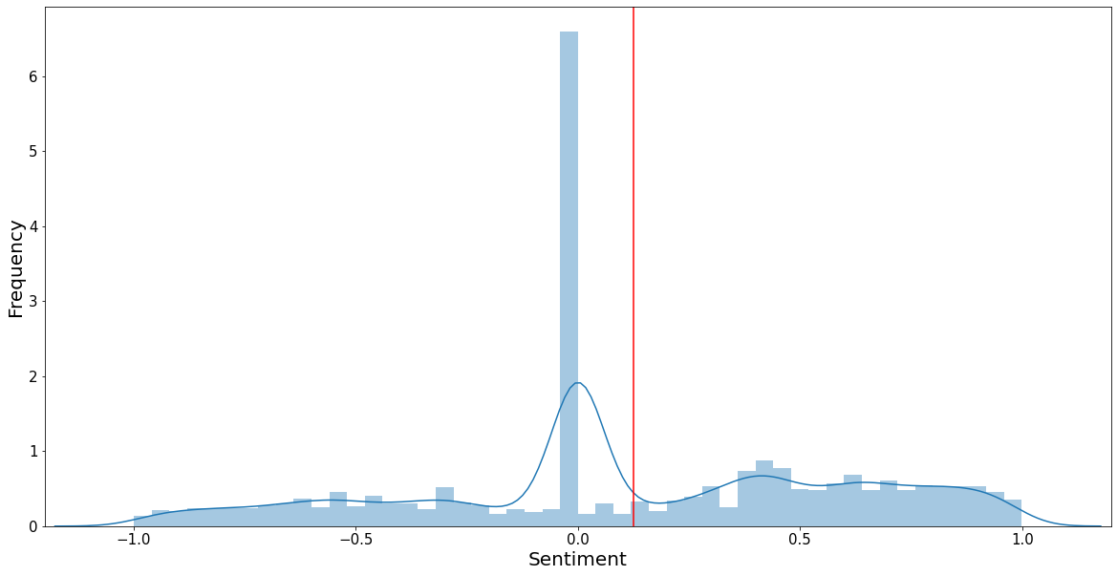
Sentiment Analysis

Slide 9
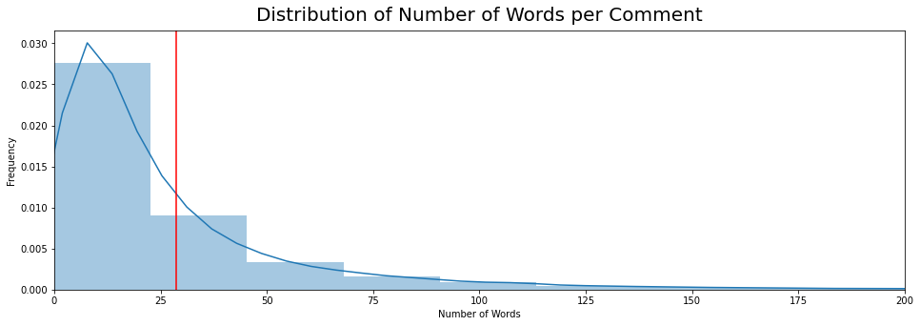
Words per Comment

Slide 10
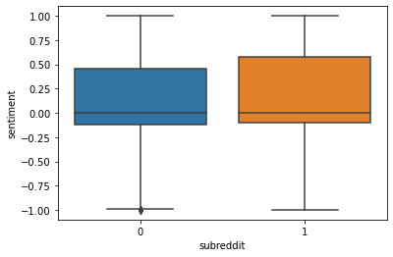
Sentiment Analysis: Boxplot
1: DC
2: Marvel

Slide 11
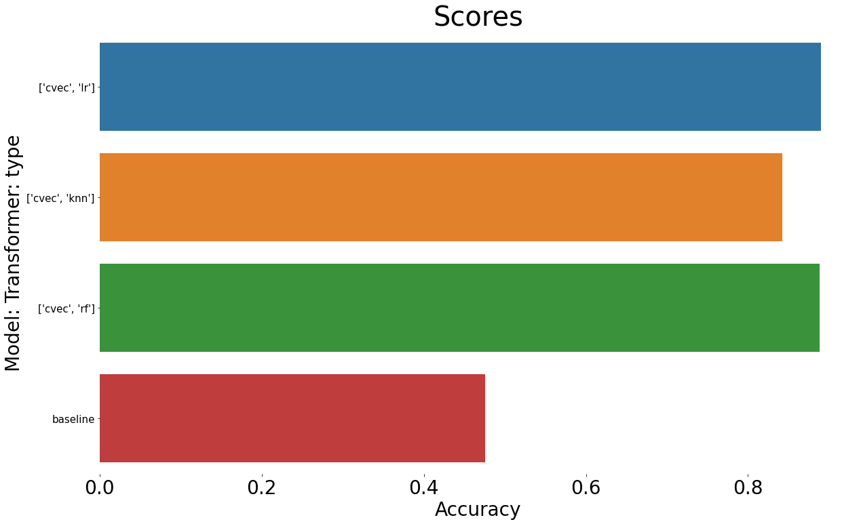
Final Scores
Model | Scores
LogReg | Best: 0.889626 Tr: 0.9044 Test: 0.8834
KNN | Best:0.842105 Tr: 0.8465 Test: 0.8259
Random Forest | Best:0.8879 Tr: 0.9370 Test: 0.8823
Baseline | 0.524106

