Slide 1
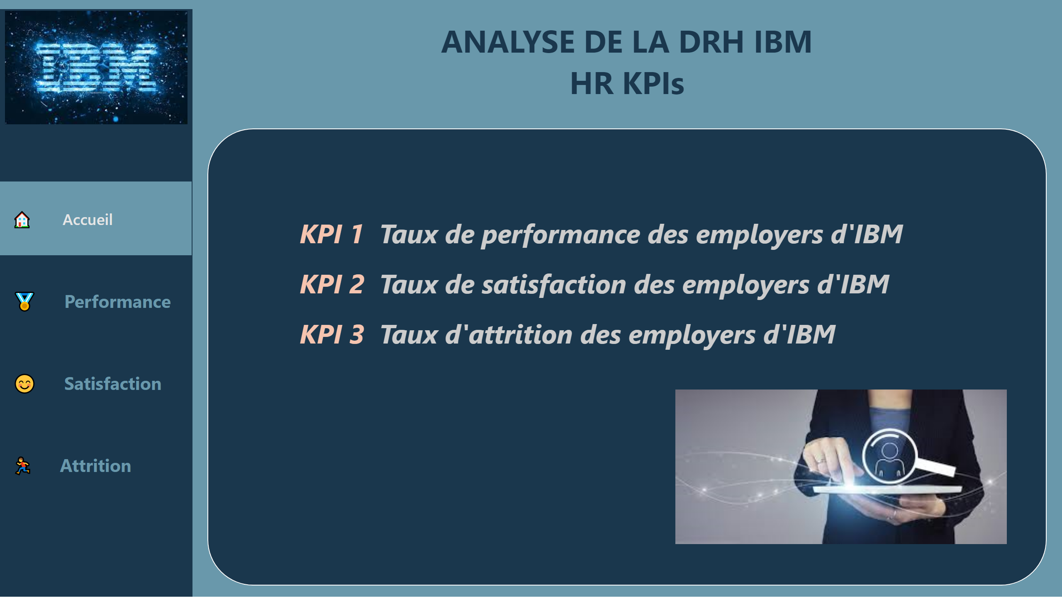
🏠 Accueil
Notes:
Menu Buttons
No alt text provided
shape
No alt text provided
Zone de texte
No alt text provided
Menu BG
No alt text provided
IBM_logo
No alt text provided
image
No alt text provided
textbox
No alt text provided

Slide 2
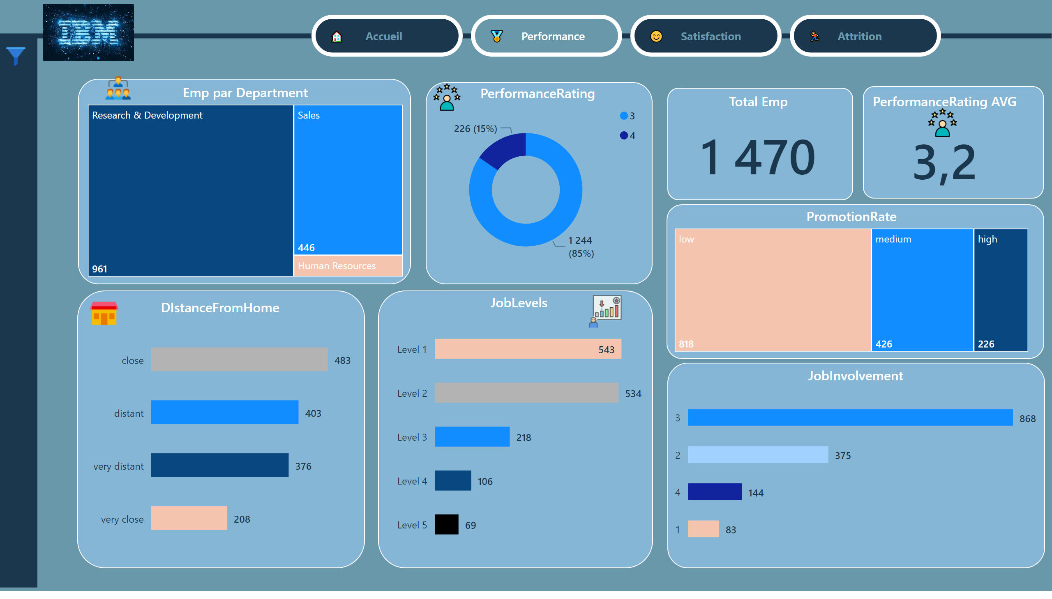
🏅 Performance
Notes:
Menu Buttons
No alt text provided
Menu BG
No alt text provided
IBM_logo
No alt text provided
JobLevels
No alt text provided
JobInvolvement
No alt text provided
PerformanceRating
No alt text provided
PerformanceRating AVG
No alt text provided
Total Emp
No alt text provided
shape
No alt text provided
shape
No alt text provided
shape
No alt text provided
shape
No alt text provided
shape
No alt text provided
shape
No alt text provided
Emp par Department
No alt text provided
shape
No alt text provided
DIstanceFromHome
No alt text provided
PerformanceRating IMG
No alt text provided
shape
No alt text provided
PromotionRate
No alt text provided
actionButton
No alt text provided
shape
No alt text provided
slicer
No alt text provided
slicer
No alt text provided
slicer
No alt text provided
slicer
No alt text provided
slicer
No alt text provided
slicer
No alt text provided
actionButton
No alt text provided
Slicer Pane Buttom
No alt text provided
Info IMG
No alt text provided
Info Pane Buttom
No alt text provided
image
No alt text provided
PerformanceRating IMG
No alt text provided
image
No alt text provided
image
No alt text provided

Slide 3
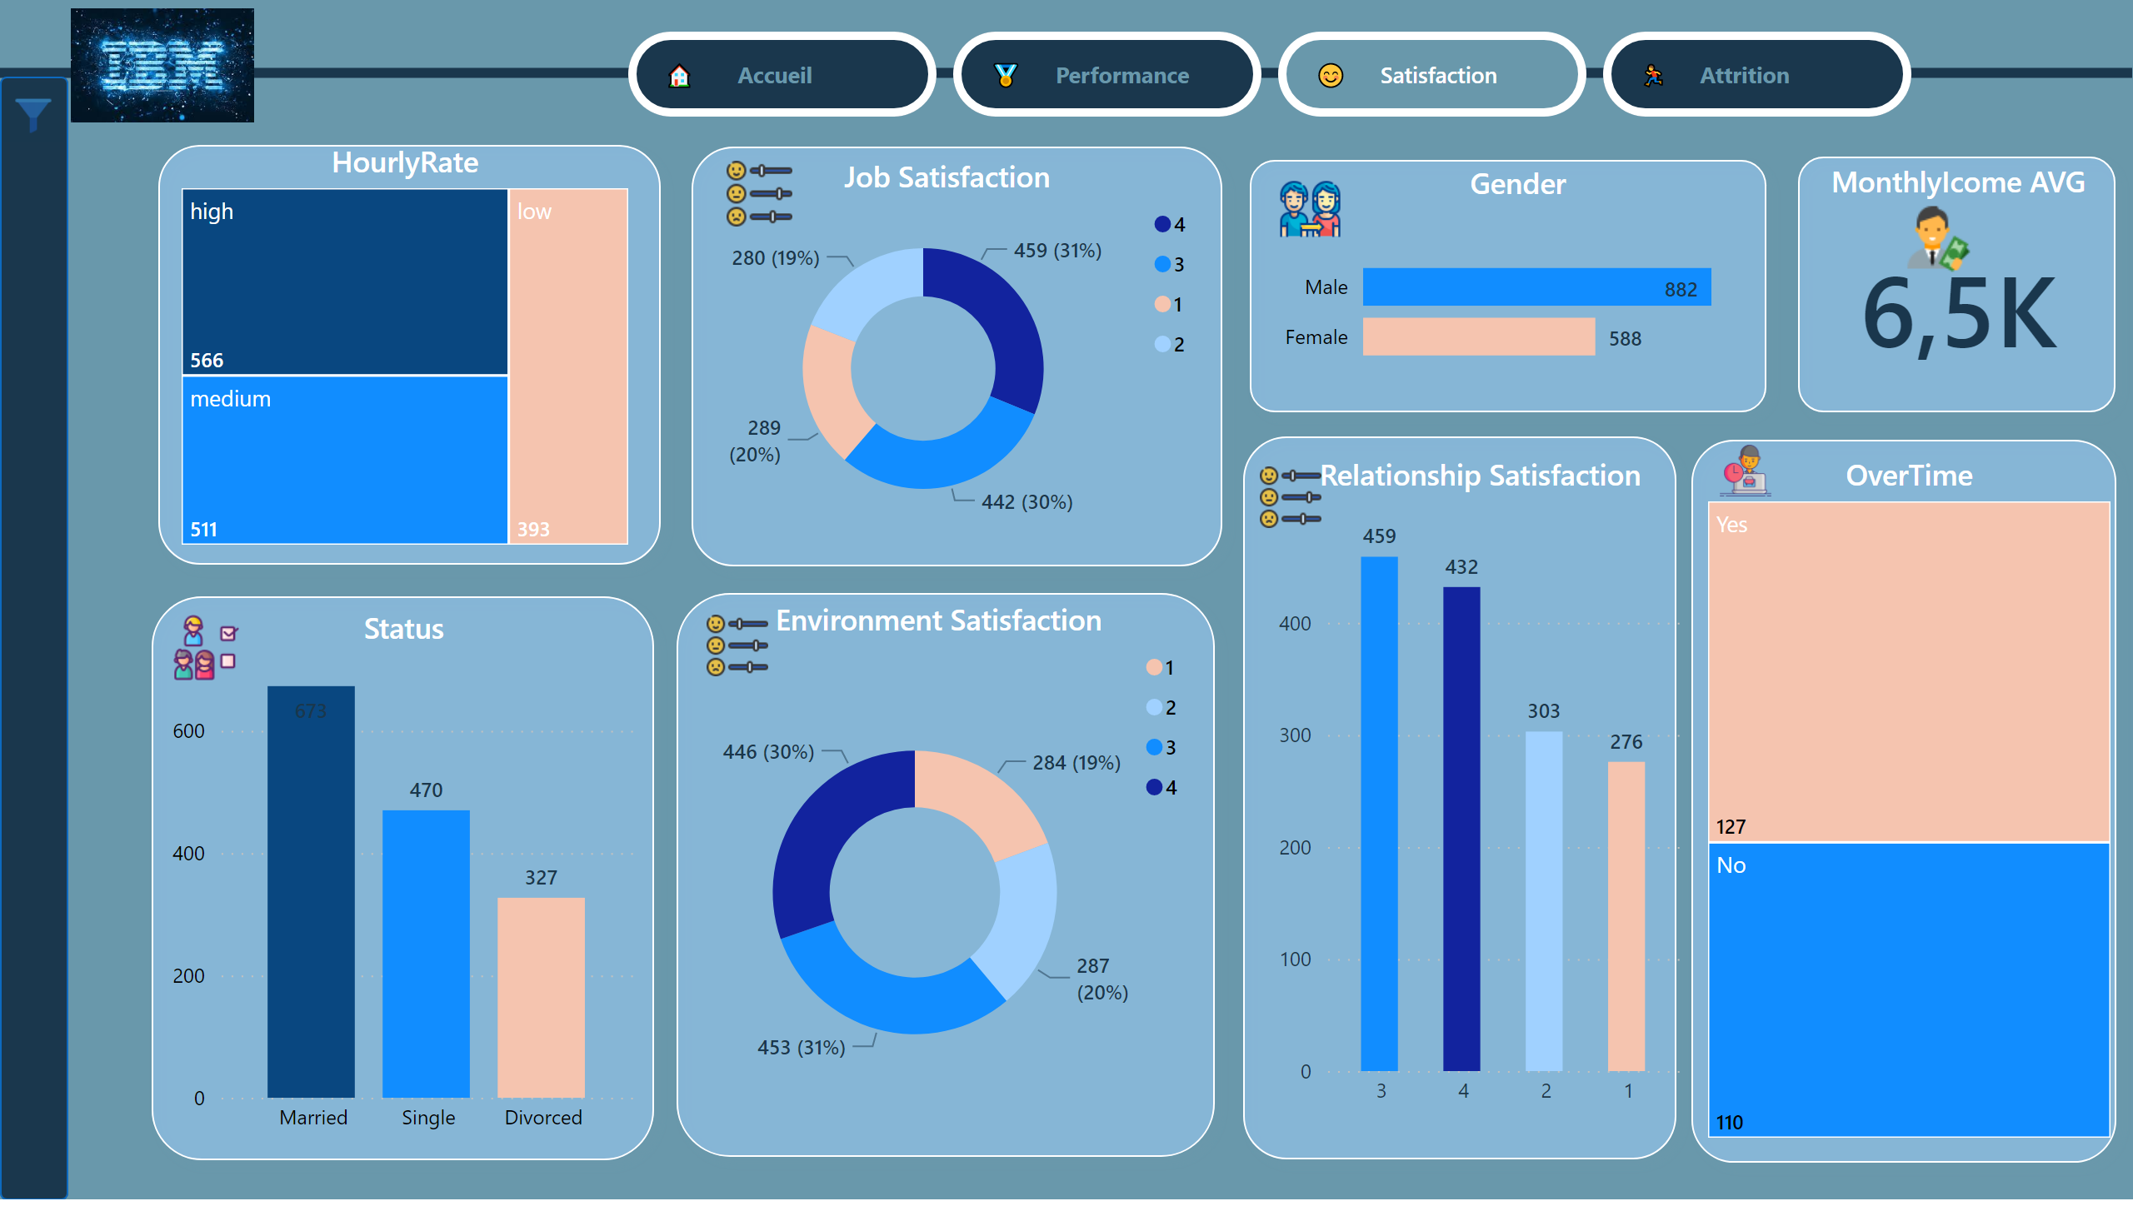
😊 Satisfaction
Notes:
Menu Buttons
No alt text provided
IBM_logo
No alt text provided
Job Satisfaction
No alt text provided
Relationship Satisfaction
No alt text provided
Environment Satisfaction
No alt text provided
MonthlyIcome AVG
No alt text provided
shape
No alt text provided
shape
No alt text provided
shape
No alt text provided
shape
No alt text provided
Slicer Pane Buttom
No alt text provided
shape
No alt text provided
shape
No alt text provided
MonthlyINcome IMG
No alt text provided
HourlyRate
No alt text provided
Status
No alt text provided
shape
No alt text provided
shape
No alt text provided
OverTime
No alt text provided
Gender IMG
No alt text provided
Status IMG
No alt text provided
Overtime IMG
No alt text provided
Gender
No alt text provided
Menu BG
No alt text provided
image
No alt text provided
image
No alt text provided
image
No alt text provided
Info IMG
No alt text provided
actionButton
No alt text provided
shape
No alt text provided
slicer
No alt text provided
slicer
No alt text provided
slicer
No alt text provided
slicer
No alt text provided
slicer
No alt text provided
slicer
No alt text provided
slicer
No alt text provided
slicer
No alt text provided
actionButton
No alt text provided
Info Panel Buttom
No alt text provided

Slide 4
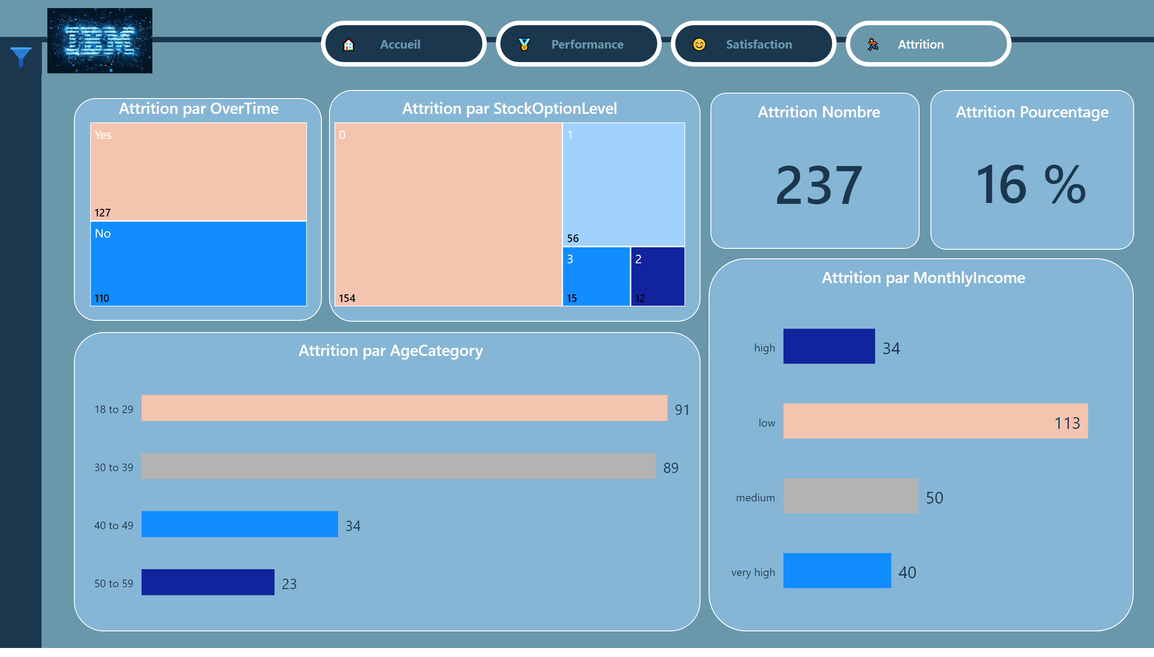
🏃‍♂️ Attrition
Notes:
Menu BG
No alt text provided
Menu Buttons
No alt text provided
IBM_logo
No alt text provided
shape
No alt text provided
shape
No alt text provided
shape
No alt text provided
Attrition Nombre
No alt text provided
Attrition Pourcentage
No alt text provided
shape
No alt text provided
shape
No alt text provided
Attrition par AgeCategory
No alt text provided
Attrition par MonthlyIncome
No alt text provided
Slicer Pane Buttom
No alt text provided
Attrition par StockOptionLevel
No alt text provided
actionButton
No alt text provided
slicer
No alt text provided
slicer
No alt text provided
slicer
No alt text provided
slicer
No alt text provided
slicer
No alt text provided
slicer
No alt text provided
slicer
No alt text provided
shape
No alt text provided
actionButton
No alt text provided
shape
No alt text provided
Attrition par OverTime
No alt text provided
Info Panel Buttom
No alt text provided
Info IMG
No alt text provided

