Slide 1

CAPSTONE PROJECT
CYBERSECURITY FUNDAMENTALS
KEYLOGGERS
Presented by
N.NAJEEBULLAH
110121104070
Aalim Muhammed Salegh College of Engineering

Slide 2
Problem Statement
1
Data Breaches
2
Privacy Concerns
3
Legal Implications
Keyloggers can be used by malicious actors to steal sensitive data, including passwords and financial information.
Users might unknowingly have keyloggers installed, compromising their privacy and personal information.
Usage of keyloggers without consent raises ethical and legal questions regarding individual privacy rights.

Slide 3
Proposed Solution
Encryption
Security Training
Vigilant Monitoring
Implement robust encryption methods to safeguard sensitive keystroke data and prevent unauthorized access.
Education programs to raise awareness about keyloggers and ways to detect and counteract them effectively.
Develop and implement systems to monitor and detect keylogger activities proactively in various environments.

Slide 4
System Approach
Research
Understand the latest keylogger technologies and their implications.
Design
Create a comprehensive framework for identifying, preventing, and countering keyloggers.
Testing
Thoroughly evaluate the developed system's efficacy and its ability to counteract keyloggers.

Slide 5



Algorithm and Deployment
Secure Algorithm
Efficient Deployment
Testing and Validation
Develop robust algorithms to safeguard keystroke inputs from keylogger threats.
Deploy keylogger detection and prevention systems seamlessly across various platforms and devices.
Conduct thorough testing and validation processes to ensure the effectiveness of the developed algorithms.

Slide 6
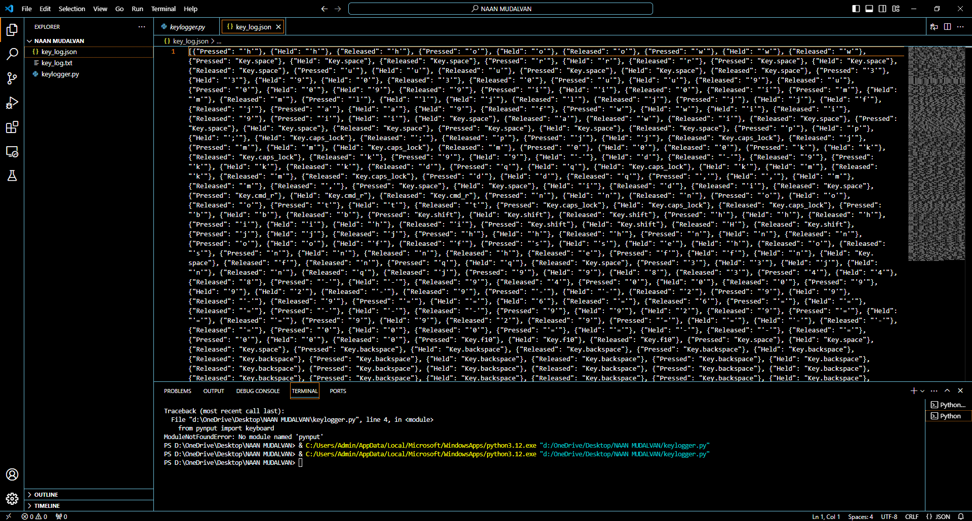
Output Of Keylogger In The JSON File

Slide 7

Output Of Keylogger In The Text File

Slide 8



Conclusion
Deep Understanding
Comprehensive Solution
Future Ready
Developed a deeper understanding of the challenges and opportunities in the realm of keylogger prevention.
Prepared the ground for future advancements in developing sophisticated keylogger prevention techniques.
Proposed a comprehensive solution aiming to tackle the evolving landscape of keylogger threats effectively.

Slide 9
Future Scopes
1
Advanced Technologies
Staying updated with technological advancements to improve keylogger detection and prevention methods.
2
User-friendly Solutions
Developing more user-friendly interfaces to enhance user experiences when safeguarding against keyloggers.
3
Collaborative Approaches
Seeking collaborative initiatives to address keylogger threats and promote cybersecurity awareness globally.

Slide 10
THANK YOU

