Slide 1

PRACTICAL TRAINING FINAL PRESENTATION
The Cohort Flow Simulator
Explaining student delay in Qatar University's CS curriculum, one bottleneck signal at a time
Najeeb Barkhad | Student ID 202307172
Host Organization: Scale AI • Academic Sponsor: Qatar University, CSE
Supervisors: Dr Saleh Al Hazbi • Mr Ayman Adil
15-minute presentation + 5-minute Q&A
Notes:
0:00-0:30. Introduce yourself, the program (Scale x QU Practical Training), and the one-line hook: this simulator explains WHY students get delayed, not just how many do. Keep it brief -- the clock is strict.

Slide 2
ROADMAP
What I'll cover in 15 minutes
01
The Problem
Why a single graduation number can't say what's actually delaying students
02
The System
A discrete-term, multi-cohort simulation engine + full-stack decision-support tool
03
Live Look
Bottlenecks, Advisor, and Analytics as they actually run
04
The Findings
What an 8-cohort steady-state QU CS department reveals at 66% graduation
05
Lessons + Next Steps
What I'd build next, and what I learned cutting scope twice
Cohort Flow Simulator | Scale x Qatar University Practical Training
2
Notes:
0:30-1:00. One breath per line -- don't over-explain the agenda, just orient them.

Slide 3
01 · THE PROBLEM
Delay looks the same in a transcript -- it isn't the same in cause
A student who takes 9 semesters instead of 8 could be delayed for four completely different reasons:
Failed
Blocked by capacity
Blocked by offering
Blocked by prerequisites
a hard gateway course and had to retake it
seats ran out in a required course
the course simply wasn't taught that term
still waiting on an earlier course to clear
These four causes demand four different fixes -- more sections, more seats, a different offering schedule, or a redesigned prerequisite chain. A single graduation-rate number cannot tell a department which one it's looking at. This is the gap the simulator is built to close.
Cohort Flow Simulator | Scale x Qatar University Practical Training
3
Notes:
1:00-2:15. This is the hook -- linger here. Give one concrete example if asked in Q&A: MATH courses failing vs CSEL electives being full look identical in a transcript but need opposite fixes.

Slide 4
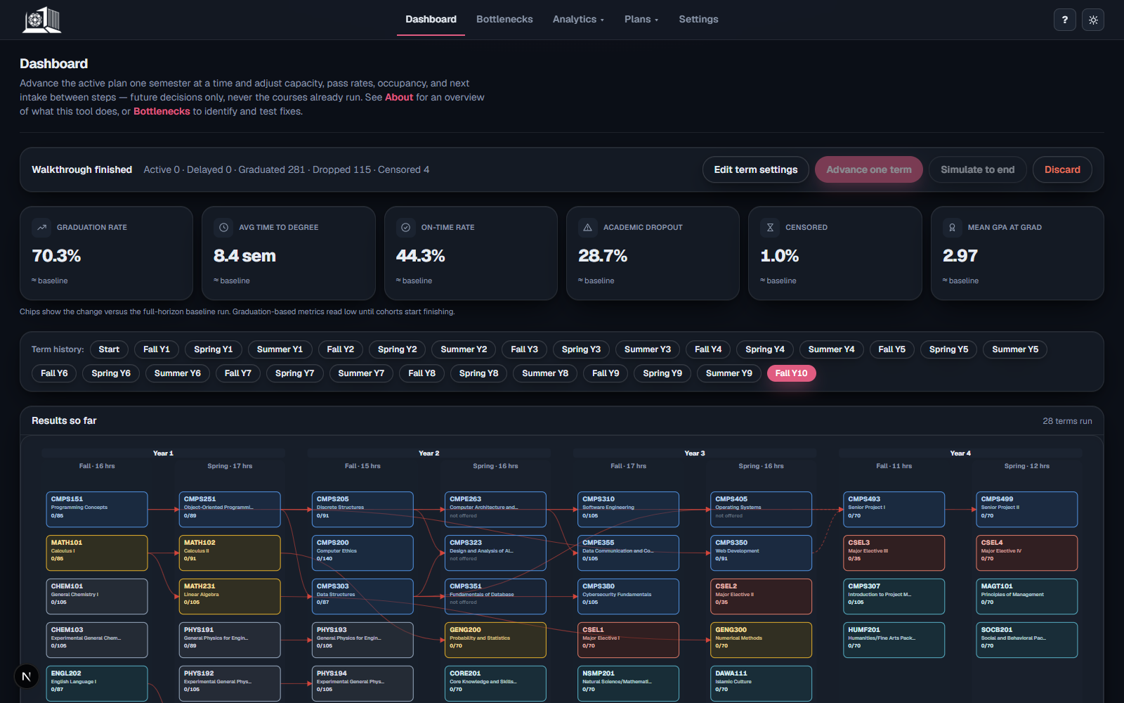
02 · THE SYSTEM
What I built: a multi-cohort curriculum simulator
• Agent-based, discrete-term engine. Each student is simulated individually -- their own GPA, completed credits, probation status, and history -- across up to 12 semesters.
• Real QU CS curriculum. The actual 2024 study plan: 41 courses, 120 credit hours, real prerequisite chains and offering patterns.
• Steady-state, not one class. 8 overlapping cohorts are admitted every year and all compete for the same shared pool of course seats -- just like a real department.
• Four separated bottleneck signals. Failure, capacity, offering, and prerequisite blocks are tracked independently, never merged into one score.
The dashboard: checkpoint-driven, term-by-term walkthrough
Cohort Flow Simulator | Scale x Qatar University Practical Training
4
Notes:
2:15-3:30. Emphasize 'steady-state' -- it's the difference between modeling one class and modeling how a department actually runs year after year, with freshmen and seniors sharing seats.

Slide 5
02 · THE SYSTEM
A layered, full-stack architecture
Simulation Engine
Python discrete-term loop: admits cohorts, runs the 3-phase term cycle, tracks every block signal
src/simulator.py
Service Layer
run_simulation() -- no file I/O, the seam every caller (script, API, checkpoint) shares
src/service.py
API + Database
FastAPI endpoints over a SQLAlchemy/SQLite model: plans, courses, config, scenarios, runs
src/api.py, db.py
Web Dashboard
Interactive roadmap, Bottlenecks, Advisor, and checkpoint-mode walkthrough
web/ (Next.js/React)
One engine, reused unchanged by a CLI script, an HTTP API, and a resumable checkpoint session.
Cohort Flow Simulator | Scale x Qatar University Practical Training
5
Notes:
3:30-4:15. Point out this separation is WHY the same engine could later support a checkpoint/rewind feature without rewriting the core simulation logic.

Slide 6
02 · THE SYSTEM
Every term: a 3-phase loop, per student
1
2
3
Desired Enrollment
Seat Allocation
Course Outcomes
Each student builds a priority list: retakes first, then core/college-requirement courses, electives once they've earned enough credit, then remaining requirements -- capped by their course-load limit.
Requesters are ranked by class standing + a random tiebreak; seats are granted until capacity runs out. Seniors from older cohorts automatically outrank freshmen -- no special-case code needed.
Each granted enrollment resolves to pass/fail via a seeded random draw; GPA, completed credit hours, probation, and graduation status update accordingly.
Students are simulated individually, not as one averaged cohort -- prerequisite eligibility depends on each student's own history.
Cohort Flow Simulator | Scale x Qatar University Practical Training
6
Notes:
4:15-5:15. Keep this fast and visual -- 3 quick beats, don't read every word on the slide.

Slide 7
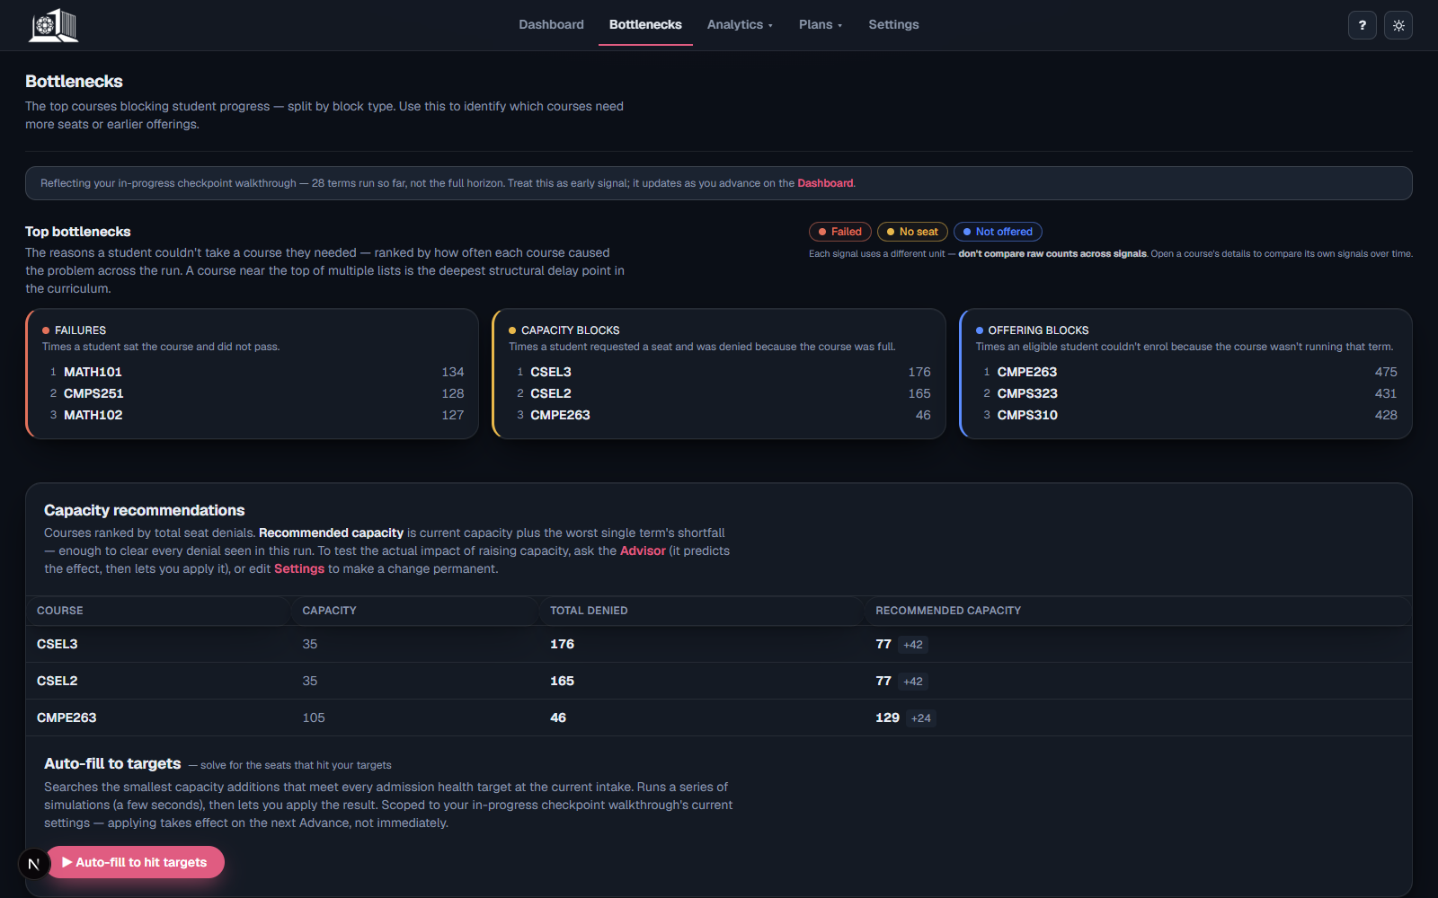
03 · LIVE LOOK
The core innovation: four bottleneck signals, never merged
• Failure -- the course was genuinely hard and students failed it.
• Capacity -- an eligible student requested a seat and lost the allocation.
• Offering -- the course simply wasn't taught that term.
• Prerequisite -- still waiting on an upstream course to clear.
• Why it matters: each signal points to a different fix -- more capacity, a different schedule, or curriculum redesign -- so a claim about "why students are delayed" is backed by specific, checkable evidence.
Ranked live from the four block-signal counters (fail/capacity/offering/prereq)
Cohort Flow Simulator | Scale x Qatar University Practical Training
7
Notes:
5:15-6:45. This is the centerpiece of the whole project -- slow down here. If you only have time to sell one idea, sell this one: four causes, tracked separately, each demanding a different response.

Slide 8
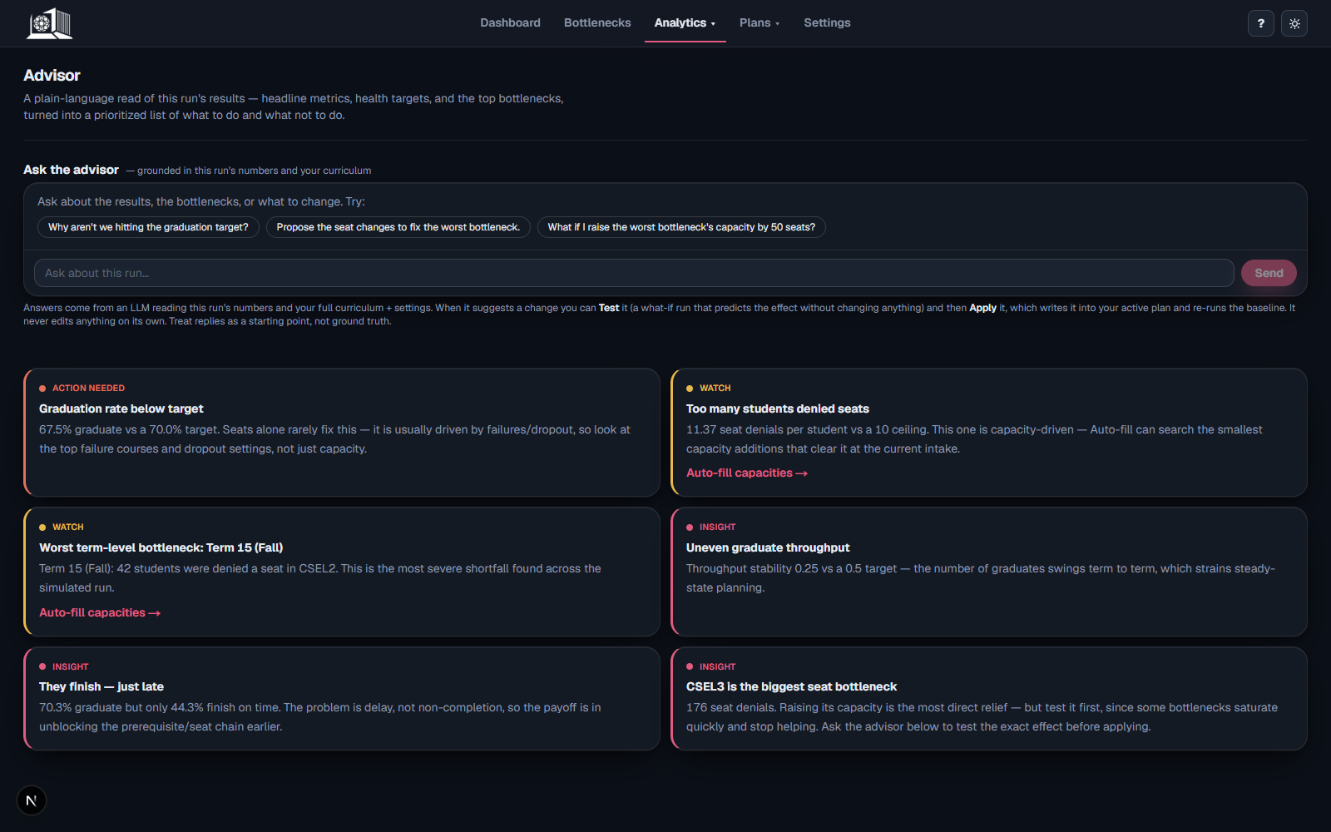
03 · LIVE LOOK
From diagnosis to action: Advisor + Auto-fill
• Rules-based Advisor. Reads the run's health criteria and top bottlenecks into a prioritized, plain-language list -- no LLM, no API key needed.
• Grounded LLM chat. Optional chat grounded in the run's real numbers and the full active curriculum -- answers course-level questions, never invents figures.
• Test, then Apply. Any proposed change (capacity, pass rate, offering, cohort size) can be tested in a sandboxed simulation before it ever touches the live plan.
• Auto-fill solver. Each iteration re-simulates once, bumps the course with the worst single-term shortfall, capped at 20 runs.
Rules-based recommendations, grounded LLM proposals, sandbox-tested before any write
Cohort Flow Simulator | Scale x Qatar University Practical Training
8
Notes:
6:45-8:00. Emphasize the human-in-the-loop design: the model proposes, a human tests and applies. Nothing is written automatically.

Slide 9
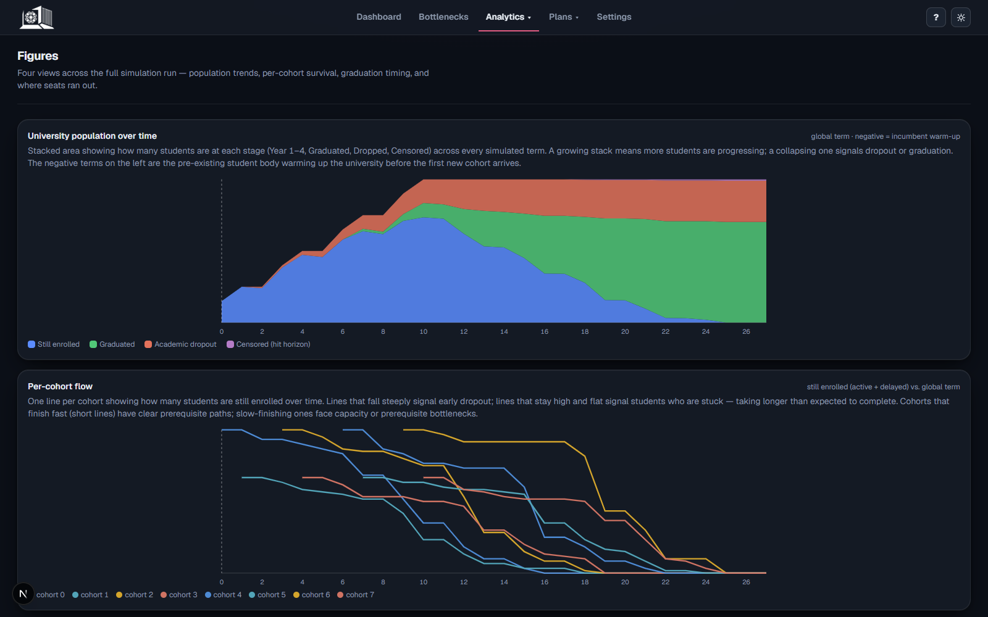
03 · LIVE LOOK
Watching the steady state: multi-cohort analytics
• Population view. One timeline frame per term, aggregated from every active student across all 8 overlapping cohorts.
• Per-cohort flow. A cohort ledger row recorded every term tracks who's stuck, progressing, or dropped out, per entering class.
• Only meaningful once realistic. These charts only became a real signal after the offering schedule and admissions model matched QU's actual pattern -- not a blanket Fall+Spring assumption.
Rendered from the same per-term History ledger every other page reads
Cohort Flow Simulator | Scale x Qatar University Practical Training
9
Notes:
8:00-8:45. Keep this brief -- it's supporting evidence for the steady-state claim, not a new idea.

Slide 10
04 · THE FINDINGS
Baseline results: 8 cohorts, 100 students/year, 12-semester horizon
Metric
Single run
Monte Carlo mean (95% CI)
Graduation rate
66.1%
65.8% (65.4-66.2%)
Academic dropout rate
30.5%
30.9% (30.4-31.3%)
Censored (hits 12-sem horizon)
3.4%
3.4% (3.0-3.7%)
Average time to graduate
8.8 semesters
8.8 semesters (8.73-8.77)
On-time rate (within 8 semesters)
33.5%
33.5% (32.9-34.0%)
Probation rate
14.2%
13.7% (13.4-14.0%)
Two-thirds of students graduate within 12 semesters -- but only a third graduate on the nominal 8-semester schedule. The single run and 30-seed Monte Carlo average agree closely: a useful check that these figures aren't one lucky or unlucky seed.
Cohort Flow Simulator | Scale x Qatar University Practical Training
10
Notes:
8:45-10:00. Lead with the headline: 66% graduate, but only 33% on time. That gap is the whole story the next slide explains.

Slide 11
04 · THE FINDINGS
Reading the four signals separately: three distinct causes
Failure is concentrated in the math gateway.
MATH102, MATH101, and MATH231 are the three most-failed courses -- each with 200+ failed attempts. These early courses gate a large share of the downstream curriculum, so one failure has an outsized effect on a student's whole trajectory.
Capacity pressure is concentrated in electives -- by design.
CSEL2 and CSEL3 account for by far the most capacity-blocked requests (907 and 880). This is the intended effect of the sizing policy: electives are deliberately squeezed since 4 interchangeable slots and no prerequisite chain make contention there the least costly place to feel it.
Prerequisite waiting peaks right before the senior project.
CMPS499 and CMPS493 show the largest prerequisite-block counts -- consistent with sitting at the end of a long compound chain, not being bottlenecks themselves.
Cohort Flow Simulator | Scale x Qatar University Practical Training
11
Notes:
10:00-11:15. The punchline: a single graduation-rate number would only say 'a third are delayed' -- separating the signals says WHY, and each cause needs a different fix (math support/gateway redesign vs. elective capacity vs. nothing -- the senior-project one is a downstream artifact).

Slide 12
05 · LESSONS + NEXT STEPS
Three challenges that shaped the design
Optional terms almost broke the academic clock.
Summer/Winter terms shouldn't cost a student one of their limited semesters. Fix: split global calendar time from each student's personal semester counter.
Determinism had to be designed in from day one.
Every student uses a seeded random stream (seed + student ID), so scenario comparisons reflect the change being tested -- not a different random draw.
More features didn't always mean a better system.
Two features I built and that worked correctly -- the original Live Simulation mode, and a Per-Student Trace -- were still removed once they stopped earning their place against the core research question.
Cohort Flow Simulator | Scale x Qatar University Practical Training
12
Notes:
11:15-12:30. The scope-discipline point is the most 'professional maturity' one -- worth a sentence of reflection if Q&A asks what you'd do differently.

Slide 13
05 · LESSONS + NEXT STEPS
Where this goes next
• Calibrate against real historical data. Replace assumed pass rates/capacities with actual QU enrollment and graduation records.
• Immediate, model-suggested next step. Raise CSEL2/CSEL3 capacity toward the peak-demand standard (or run Auto-fill against a seat-denial target) and check how much of the 66%-to-33% gap closes -- before touching intake size.
• Richer scenario comparison. Compare capacity, offering, and prerequisite-sequencing interventions side by side, beyond a single baseline.
• Deeper advisor guidance. Expand the proposal-and-test workflow into more guided academic-planning suggestions.
Cohort Flow Simulator | Scale x Qatar University Practical Training
13
Notes:
12:30-13:15. Keep to 3-4 items, don't read the whole list verbatim -- point at the first one (real data calibration) as the most important.

Slide 14
CONCLUSION
A graduation number alone can't say why students are delayed.
The Cohort Flow Simulator answers that question with structured, checkable evidence: a steady-state graduation rate of roughly two-thirds, driven primarily by failure risk in a few math gateway courses and by a deliberately scarce elective seat pool -- each pointing to a different, concrete intervention.
Built end-to-end: simulation engine, FastAPI backend, SQLite persistence, and a Next.js dashboard -- a full-stack decision-support tool for real institutional planning, not just a research script.
Notes:
13:15-14:00. Land the plane -- restate the one-line hook from the title slide, now backed by the 66%/33% numbers. Don't introduce new information here.

Slide 15
Thank you.
Questions & Discussion
github.com/najeeb101/Single-Cohort-Flow-Simulator
Najeeb Barkhad • 202307172 • Scale AI x Qatar University Practical Training
Anticipate: Why 8 cohorts / 100 students? How is pass/fail decided? What would you calibrate first against real data? Why keep the prerequisite signal off the Bottlenecks card?
Notes:
14:00-15:00. Buffer slide -- if you're running early, invite one question here before the formal 5-minute Q&A block starts. Likely questions noted below in gray are from your own report's depth, not guaranteed -- use them only if there's silence.

