Slide 1
Airline Delay Prediction
Najeebuddin Ahmed and Khanjan Dabhi

Slide 2
Overview
Introduction
Dataset(s)
Block Diagram
Data Cleansing & Preprocessing
Cleaned Dataset(s)
Correlation Heatmap
Linear Regression
Ridge Regression
Lasso Regression
Logistic Regression
SVM Classifier
Random Forest Classifier
Problems + Conclusion
<number>

Slide 3
Introduction
Airline companies lose $22billion/year[1]
Pay fees:
Delay ≥ 3hrs for Domestic Flights
Delay ≥ 4hrs for International Flights
Passengers miss:
Meetings
Appointments
[1]Rapajic, Jasenka. Beyond Airline Disruptions; Page16
<number>

Slide 4
Dataset(s)
Contains 28 Attributes:
Times- CRS_DEP_TIME and DEP_TIME
Delays- DEP_Delay and ARR_Delay
Destinations- ORIGIN and DEST
Dataset Source:
Courtesy of Yuanyu ‘Wendy’ Mu
https://www.kaggle.com/yuanyuwendymu/airline-delay-and-cancellation-data-2009-2018?select=2015.csv
<number>

Slide 5
Dataset(s) Cont.
1 year:
Year 2015 ≅ 6,000,000 entries
2 years:
Years 2015 to 2016 ≅ 12,000,000 entries
Acknowledgement: United States Department of Transportation
https://www.transtats.bts.gov/DL_SelectFields.asp?Table_ID=236&DB_Short_Name=On-Time
<number>

Slide 6
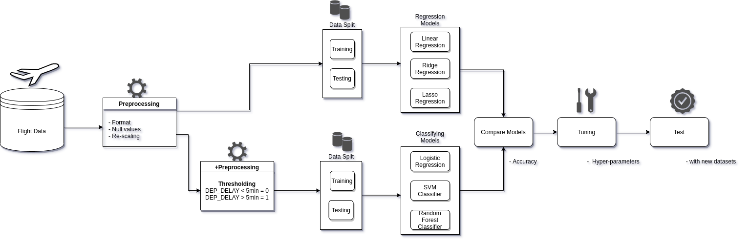
Block Diagram
<number>

Slide 7
Data Cleansing & Preprocessing
Making sure the attributes are the correct format and scale
Finding null values
Delete columns with more that 80% null values
CARRIER_DELAY
LATE_AIRCRAFT_DELAY
Missing values were removed(0.000103% to 1.8%)
<number>

Slide 8
Data Cleansing & Preprocessing Cont.
Delete unwanted columns which were irrelevant to our project
CRS_DEP_TIME
DEP_TIME
Threshold of 5 minutes was added for Departure Delay
Departure Delay > 5 minutes: Departure Delay = 1
Departure Delay<= 5 minutes: Departure Delay = 0
<number>

Slide 9
Cleaned Dataset(s)
Formatted
0 null values
1 year:
Year 2015 ≅ 6,000,000 entries
2 years:
Years 2015 to 2016 ≅ 12,000,000 entries
Predict: DEP_DELAY
<number>

Slide 10
Cleaned Dataset(s) Cont.
Features:
SCHEDULED_ELAPSED_TIME
ACTUAL_ELAPSED_TIME
ARR_DELAY
DISTANCE
TAXI_OUT
TAXI_IN
<number>

Slide 11
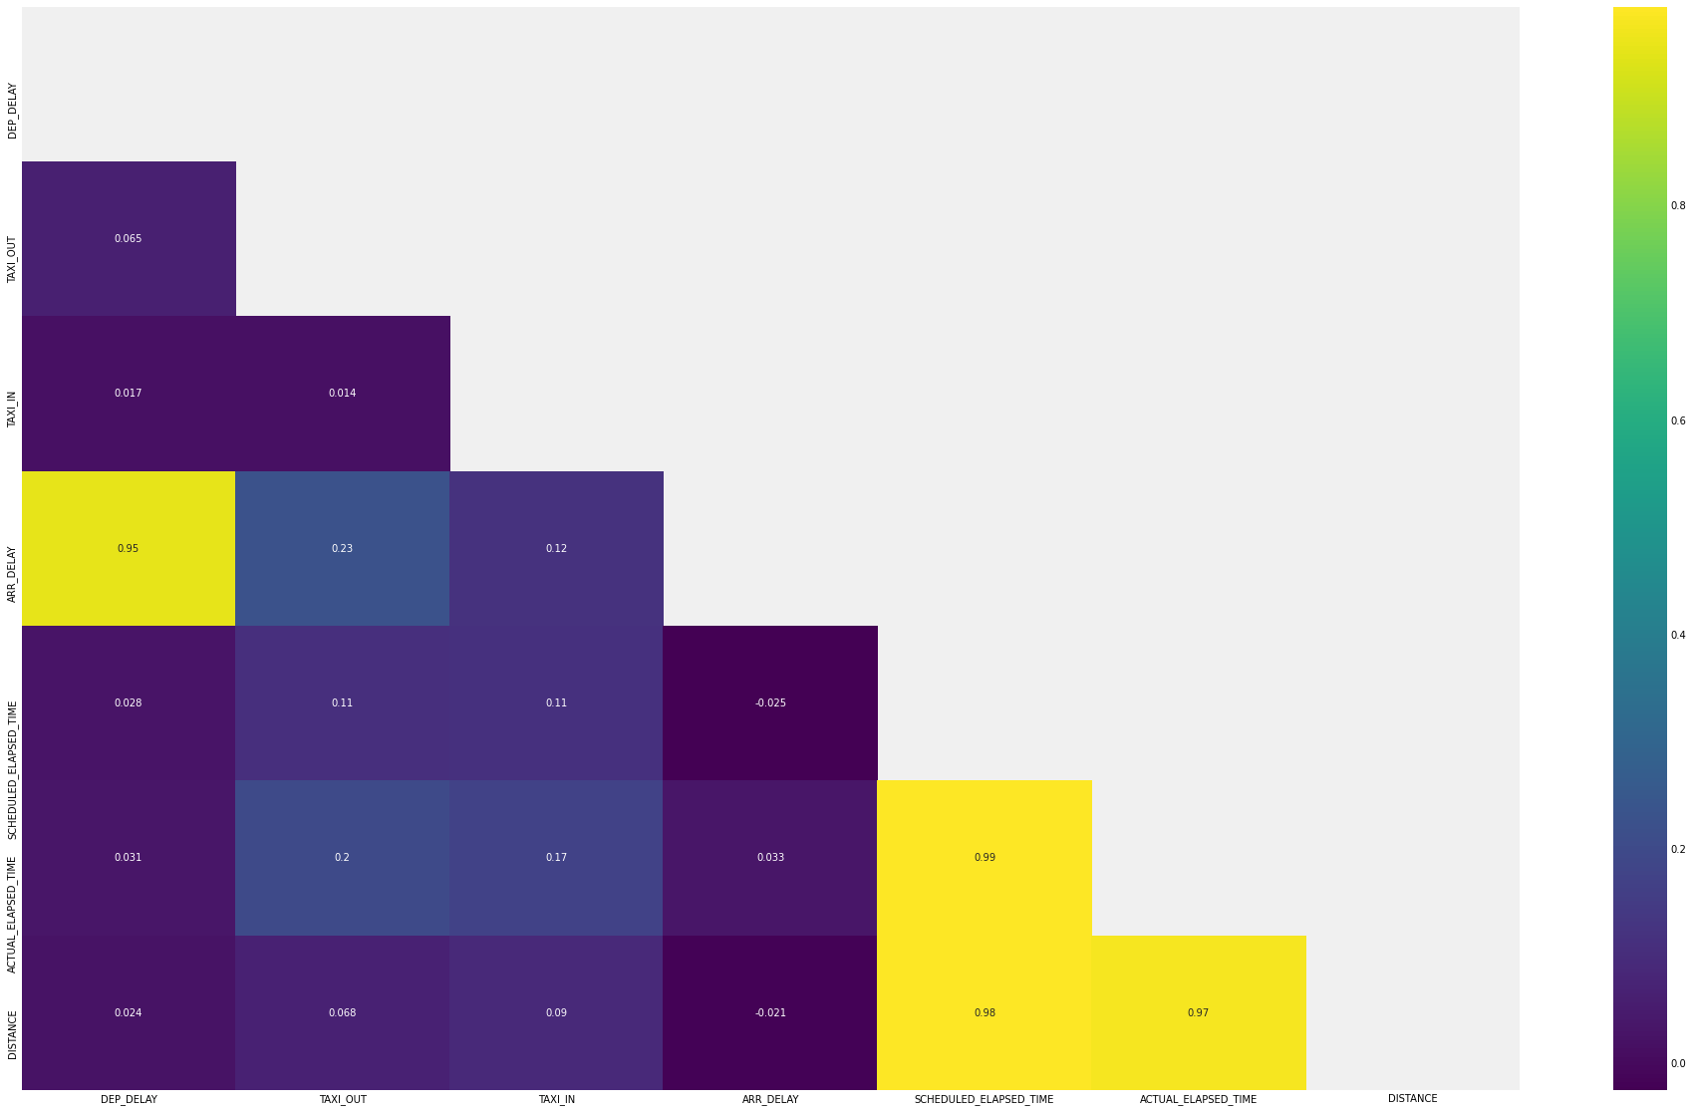
Correlation Heatmap
<number>

Slide 12
Linear Regression
Results with 2015 Dataset:
Testing Score: 0.222
MAE: 4.420
RMSE: 6.186
Results with the Combined Dataset 2015-2016:
Testing Score: 0.499
MAE: 0.207
RMSE: 0.313
<number>

Slide 13
Ridge Regression
Results with 2015 Dataset:
Testing Score: 0.157
MAE: 4.489
RMSE: 6.439
Results with the Combined Dataset 2015-2016:
Testing Score: 0.323
MAE: 0.307
RMSE: 0.364
<number>

Slide 14
Lasso Regression
Results with 2015 Dataset:
Testing Score: -2.960
MAE: 4.759
RMSE: 7.014
Results with the Combined Dataset 2015-2016:
Testing Score: -2.67
MAE: 0.391
RMSE: 0.442
<number>

Slide 15
Logistic Regression
Results with 2015 Dataset:
Accuracy: 69%
Sensitivity: 53.1%
Specificity: 85.7%
Results with the Combined Dataset 2015-2016:
Accuracy: 85.72%
Sensitivity: 75.40%
Specificity: 88.90%
<number>

Slide 16
SVM Classifier
Results with 2015 Dataset:
Accuracy: 48%
Sensitivity: 65.7%
Specificity: 29.9%
Results with the Combined Dataset 2015-2016:
Accuracy: 71.77%
Sensitivity: 7.90%
Specificity: 93.10%
<number>

Slide 17
Random Forest Classifier
Results with 2015 Dataset:
Accuracy: 69%
Sensitivity: 68.5%
Specificity: 69.8%
Results with the Combined Dataset 2015-2016:
Accuracy: 87.72%
Sensitivity: 75.80%
Specificity: 86.50%
<number>

Slide 18
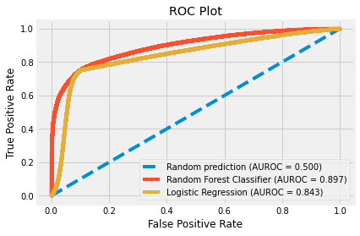
ROC Curve
<number>

Slide 19
Testing
The Random Forest Classifier
Dataset: Year 2018
Entries ≅ 6,000,000
Accuracy: 86.23%
<number>

Slide 20
Problems
Conversion of string attributes to date-time format :
“2245” -> 22:45
Skewed Data :
0 9172336
1 3325077
Higher training time for models and hyperparameter tunings
Time-constraints
<number>

Slide 21
Conclusion
The best model:
Random Forest Classifier with an accuracy of 87%
Year 2018 Accuracy: 86.23%
Accuracy improved by:
adding more data
adding new features
hyperparameter tuning
<number>

Slide 22
Thank you!
<number>

