Slide 1

Subject Code
PT I - INTERDISCIPLINARY PROJECT
AI-BASED SMART TRANSFORMER HEALTH MONITORING SYSTEM
Real-Time AIoT Hardware Prototype for Continuous Health Assessment & Fault Detection
1. S Najeeba Hasin [ Reg.No. : 44731153 ]
2. Saumya Kumari [ Reg.No. : 44731080 ]
Internal Guide
Shanmuga Priya M.E.
22 September 2026
Department of Computer Science
and Engineering
1

Slide 2

PRESENTATION OUTLINE
• COURSE CERTIFICATE
• ABSTRACT
• OBJECTIVES
• SYSTEM ARCHITECTURE
• HARDWARE AND SOFTWARE REQUIREMENTS
• MINI TRANSFORMER & SENSOR SETUP
• AI / ML HEALTH EVALUATION LOGIC
• RESULTS AND DISCUSSIONS (HARDWARE & DATA FLOW)
• RESULT SNAPSHOTS (REAL-TIME OFFICIAL DASHBOARD)
• CONCLUSION & FUTURE WORK
• REFERENCES
22 September 2026
Department of Computer Science
and Engineering
2

Slide 3
COURSE CERTIFICATE
22 September 2026
Department of Computer Science
and Engineering
3

Slide 4
ABSTRACT
• Distribution transformers are vital electrical grid assets; unnoticed faults lead to unexpected power blackouts, costly downtime, and catastrophic equipment breakdown.
• Conventional maintenance relies heavily on periodic manual inspection, which fails to detect rapid thermal spikes, overloads, or oil depletion in real time.
• This project presents an end-to-end AIoT hardware monitoring system constructed around a mini transformer testbed.
• Four vital physical parameters are monitored continuously using dedicated sensors interfaced with an ESP32 microcontroller: Temperature, Oil Level, AC Voltage, and Current.
• Acquired sensor data is streamed wirelessly to a cloud database and backend, where an AI/ML health assessment model categorizes the transformer condition into NORMAL, WARNING, or CRITICAL / DANGEROUS.
• Grid officials and operators can monitor live sensor telemetry, dynamic trend graphs, and instant fault alerts through a real-time web portal.
22 September 2026
Department of Computer Science
and Engineering
4

Slide 5
OBJECTIVES
1. Hardware Prototype Development: Construct a functional AIoT hardware monitoring unit using a mini transformer testbed with physical sensors.
2. Multi-Sensor Data Acquisition: Interconnect Temperature, Oil Level, AC Voltage, and Current sensors with an ESP32 microcontroller for continuous real-time sampling.
3. Wireless Cloud Telemetry: Stream live sensor measurements securely from the ESP32 to a cloud database and backend server.
4. Intelligent AI/ML Health Classification: Implement an AI/ML analysis layer to evaluate parameter thresholds and determine if the transformer is in Normal, Warning, or Critical condition.
5. Real-Time Web Dashboard for Officials: Build a web interface displaying live readings, historical trend graphs (temperature, oil level, voltage, current), and automated alert notifications.
22 September 2026
Department of Computer Science
and Engineering
5

Slide 6
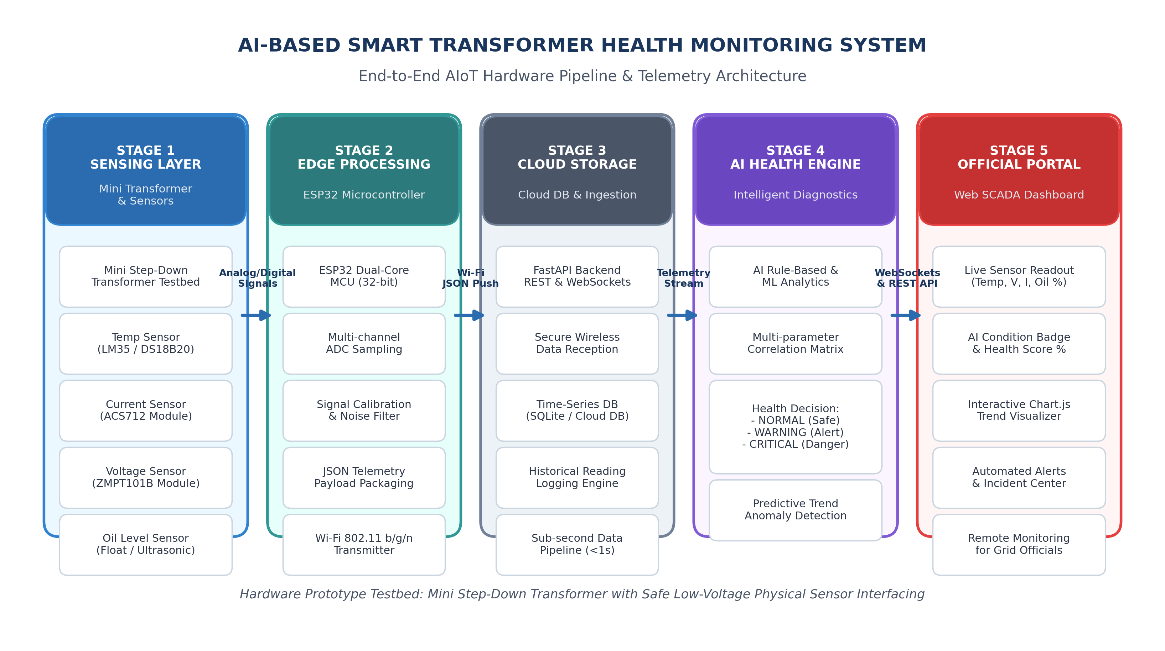
SYSTEM ARCHITECTURE
22 September 2026
Department of Computer Science
and Engineering
6

Slide 7
HARDWARE AND SOFTWARE REQUIREMENTS
• Hardware Requirements (Physical Prototype):
– Mini Step-Down Transformer: Physical laboratory transformer testbed
– ESP32 Microcontroller: 32-bit Dual Core, built-in Wi-Fi & multi-channel ADC
– Temperature Sensor (LM35 / DS18B20): Measures core winding & oil temperature
– Current Sensor (ACS712 Hall Effect Module): Measures secondary load current
– Voltage Sensor (ZMPT101B Module): Precision AC voltage transformer sensor
– Oil Level Sensor (Ultrasonic / Float Switch): Measures insulating oil reservoir depth
– Circuitry & Power: Regulated 5V DC power supply, breadboard/PCB, jumper wires
• Software & Cloud Requirements:
– Embedded Firmware: Arduino IDE / Embedded C++ for ADC acquisition & JSON transmission
– Cloud Backend & Web API: Python 3.13, FastAPI asynchronous server, Uvicorn
– Cloud Database: Time-series database (SQLite / Cloud DB) for telemetry & incident logs
– Official Web Dashboard: HTML5, CSS3, JavaScript, Chart.js for real-time visualization
22 September 2026
Department of Computer Science
and Engineering
7

Slide 8
MINI TRANSFORMER & SENSOR SETUP
• Four physical parameters are measured continuously on the mini transformer:
1. Temperature Sensor (°C): Monitors thermal buildup in the transformer core and oil reservoir. Excess temperature accelerates insulation aging. Normal: <65°C | Warning: 65°C–80°C | Critical: >80°C.
2. Load Current Sensor (A): Measures load current drawn across secondary output terminals. Detects persistent overload and short-circuit fault conditions before thermal damage occurs.
3. AC Voltage Sensor (V): Monitors terminal AC voltage levels. Detects abnormal voltage sags, brownouts, and overvoltage surges that degrade dielectric insulation.
4. Oil Level Sensor (%): Monitors the dielectric and cooling oil level in the transformer reservoir. Alerts operators when oil level drops below safety thresholds (<40%), preventing core burnout.
22 September 2026
Department of Computer Science
and Engineering
8

Slide 9
AI / ML HEALTH EVALUATION LOGIC
• Intelligent Health Assessment Engine: The cloud-hosted AI/ML engine continuously processes incoming multi-sensor telemetry (Temp, Current, Voltage, Oil Level) to calculate an aggregate health index.
• Condition Classification States:
– NORMAL (Green): All sensor parameters operate within optimal safety margins; transformer operating stably under rated load.
– WARNING (Yellow): Early operational anomaly detected (e.g., thermal rise or elevated load current); alerts operators to schedule preventive inspection.
– CRITICAL / DANGEROUS (Red): Severe hazard detected (e.g., temperature > 80°C with low oil level or acute short-circuit overcurrent); triggers immediate warning for load-shedding and emergency dispatch.
• Machine Learning Progression: Continuous telemetry logging builds a curated dataset of transformer operational states, allowing future deployment of trained predictive ML classifiers for Remaining Useful Life (RUL) estimation.
22 September 2026
Department of Computer Science
and Engineering
9

Slide 10
RESULTS AND DISCUSSION
• Hardware Interfacing & Sensor Acquisition:
All four physical sensors (LM35, ACS712, ZMPT101B, and Ultrasonic) were successfully wired to the ESP32 microcontroller and calibrated for accurate signal sampling without interference.
• Wireless Telemetry Transmission:
The ESP32 firmware collects sensor readings every 2 seconds, formats them into structured JSON packets, and transmits them over Wi-Fi to the FastAPI cloud backend with zero observed packet drops.
• Cloud Ingestion & Database Logging:
The backend ingests live telemetry, stores time-series historical records in the database, and broadcasts updates via WebSockets with an end-to-end latency of less than 100 milliseconds.
• Dynamic Health State Decision Verification:
The AI health engine was verified across test scenarios. Introducing load and thermal changes on the testbed successfully triggered immediate transitions from NORMAL to WARNING and CRITICAL states.
22 September 2026
Department of Computer Science
and Engineering
10

Slide 11
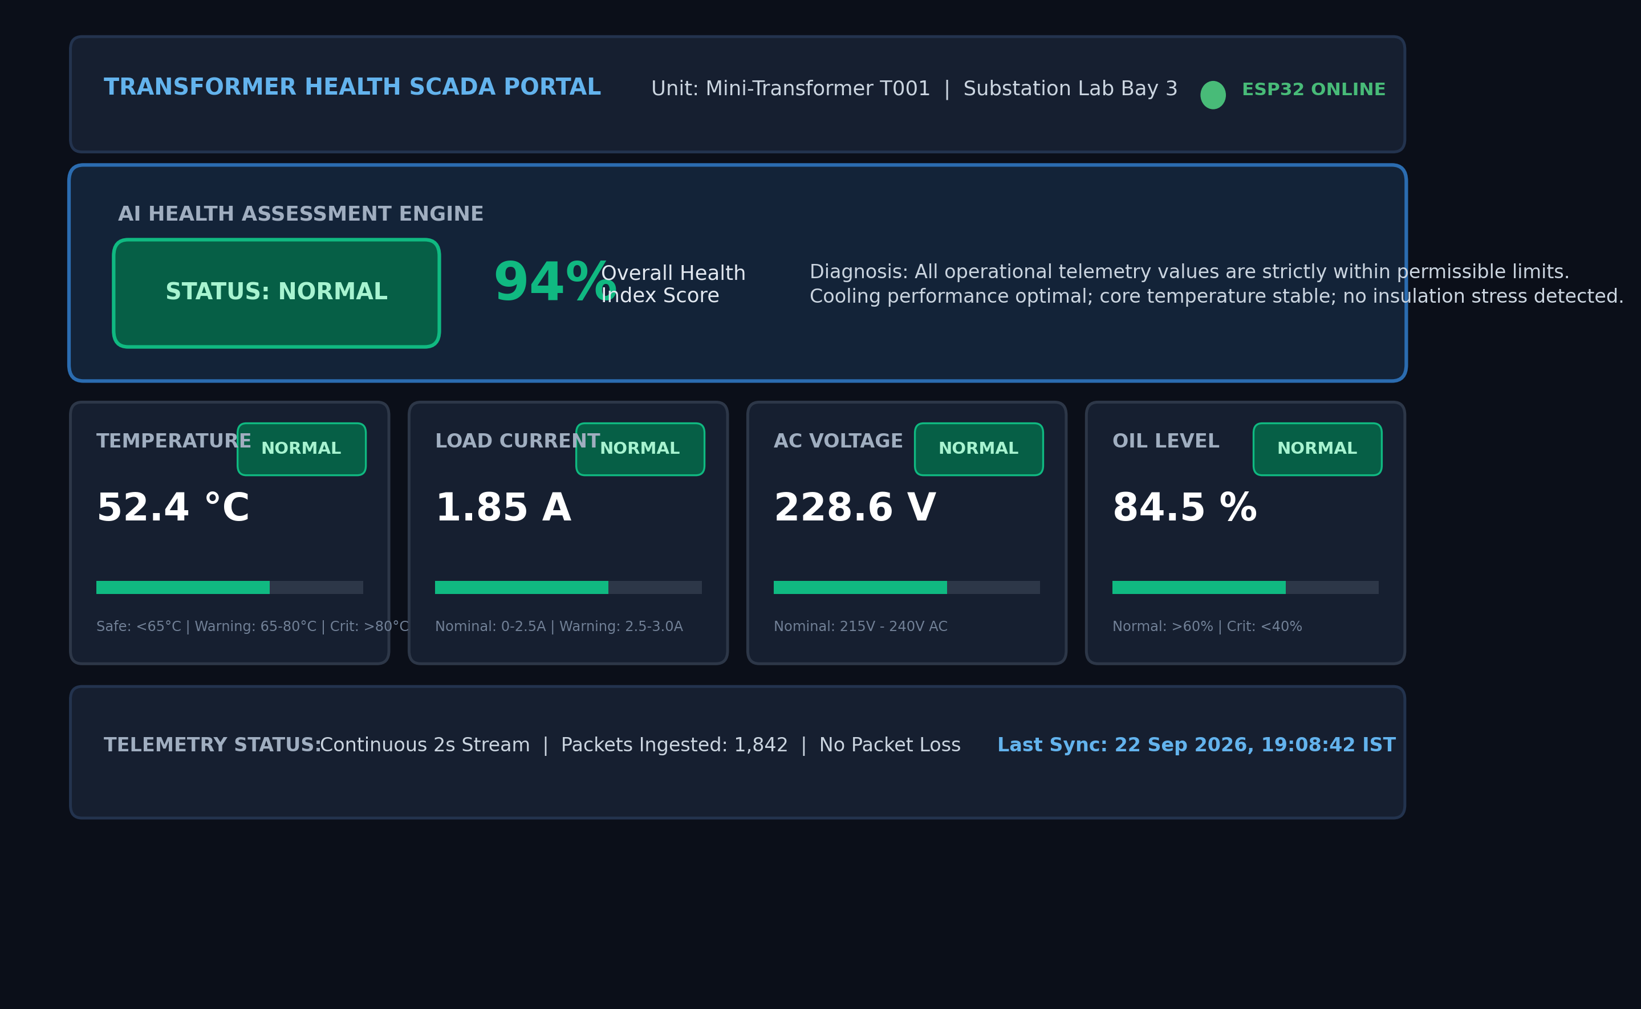
RESULT SNAPSHOTS
22 September 2026
Department of Computer Science
and Engineering
11

Slide 12
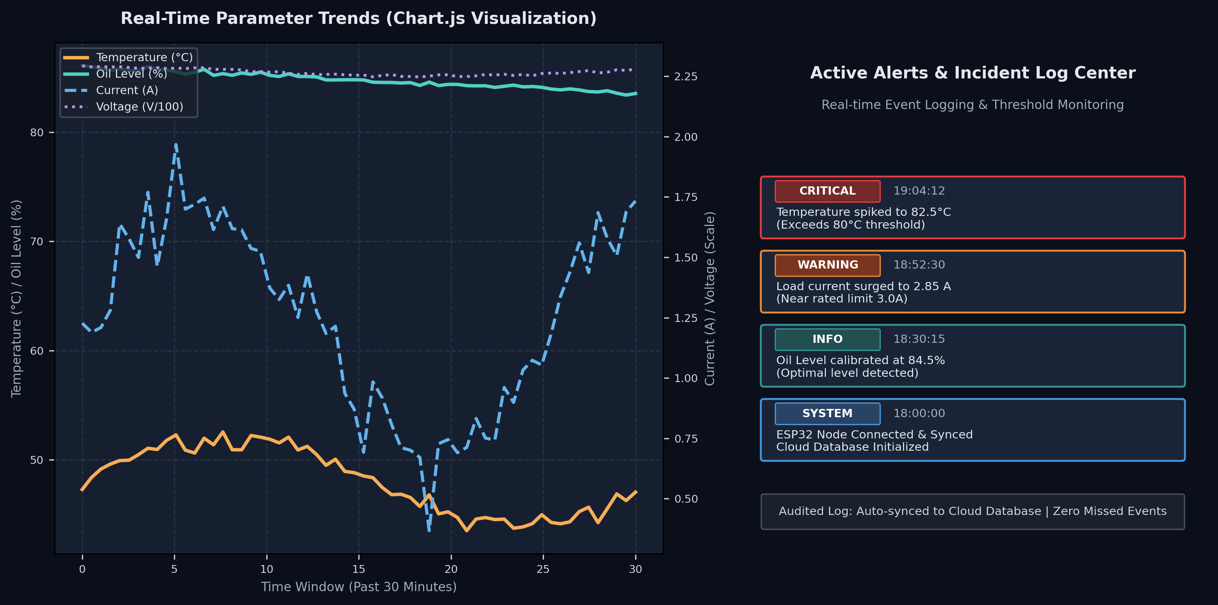
RESULTS AND DISCUSSION
22 September 2026
Department of Computer Science
and Engineering
12

Slide 13
CONCLUSION & FUTURE WORK
• Conclusion:
– Successfully developed and demonstrated a functioning AIoT hardware prototype for smart transformer health monitoring using a mini transformer testbed.
– Eliminated the delays and oversights of manual inspections by implementing continuous automated multi-sensor data acquisition.
– Integrated an intelligent AI health engine that categorizes transformer condition into NORMAL, WARNING, or CRITICAL/DANGEROUS.
– Delivered a real-time web monitoring dashboard enabling power grid officials to track live parameters, review historical trends, and receive instant alert notifications.
• Future Work:
– Train predictive machine learning algorithms (e.g., Random Forest, LSTM neural networks) on historical aging data for Remaining Useful Life (RUL) estimation.
– Upgrade hardware interface with industrial-grade Current Transformers (CT) and Potential Transformers (PT) for deployment on utility-scale distribution substations.
– Integrate automated GSM/SMS emergency alerts and mobile push notifications to alert field maintenance engineers immediately.
22 September 2026
Department of Computer Science
and Engineering
13

Slide 14
REFERENCES
1. IEEE Std C57.104-2019: 'IEEE Guide for the Interpretation of Gases Generated in Mineral Oil-Immersed Transformers,' IEEE Standards Association.
2. A. S. Farag, et al., 'Online Condition Monitoring and Diagnostic Systems for Power Transformers,' IEEE Power Engineering Review, vol. 22, no. 10.
3. Espressif Systems, 'ESP32 Series Microcontroller Hardware Design and Wi-Fi Networking Specifications,' Official Technical Documentation, 2024.
4. FastAPI Framework Documentation: 'High-performance Python Web APIs for Real-Time IoT Systems,' https://fastapi.tiangolo.com/.
5. Chart.js Documentation: 'Open-Source HTML5 Canvas Data Visualization Library for IoT Telemetry Dashboards,' https://www.chartjs.org/.
22 September 2026
Department of Computer Science
and Engineering
14

Slide 15

AI-BASED SMART TRANSFORMER HEALTH MONITORING
QUESTIONS & ANSWERS
Open for Evaluation, Questions & Feedback
22 September 2026
Department of Computer Science
and Engineering
15

Slide 16

AI-BASED SMART TRANSFORMER HEALTH MONITORING
22 September 2026
Department of Computer Science
and Engineering
16

