Slide 1

Data Management Project
NBA Data Warehouse Implementation - Spring 2025
Najeh Alhalawani - 2223737
Jamil Nassar - 2224424

Slide 2
Outline
Introduction of Data Warehouse Implementation
Dataset Discussion
Er-Model
DFM Model
ETL
DFM schema (star schema…)
OLAP Queries

Slide 3

Introduction
Use of Data warehouse:
Centralized Data Storage
Improved Data Quality & Consistency
Multidimensional View of Data
This project focus on:
integrating multiple NBA-related datasets into a unified Data Warehouse
Notes:
Combines data from different sources (e.g., sales, operations, marketing) into a single, unified repository.
Cleans and transforms data into a consistent format for reliable reporting and analytics
This project focus on integrating multiple NBA-related datasets into a unified Data Warehouse

Slide 4
Dataset
games.csv : all games played with the date, teams and some details like number of points scored, etc.
games_details.csv : details of games dataset, all statistics of players for a given game
players.csv : players details (name, team)
ranking.csv : ranking of NBA given a day (split into west and east on CONFERENCE column)
teams.csv : all teams of NBA
Players_data.csv : data on each player who has been part of an NBA teams

Slide 5
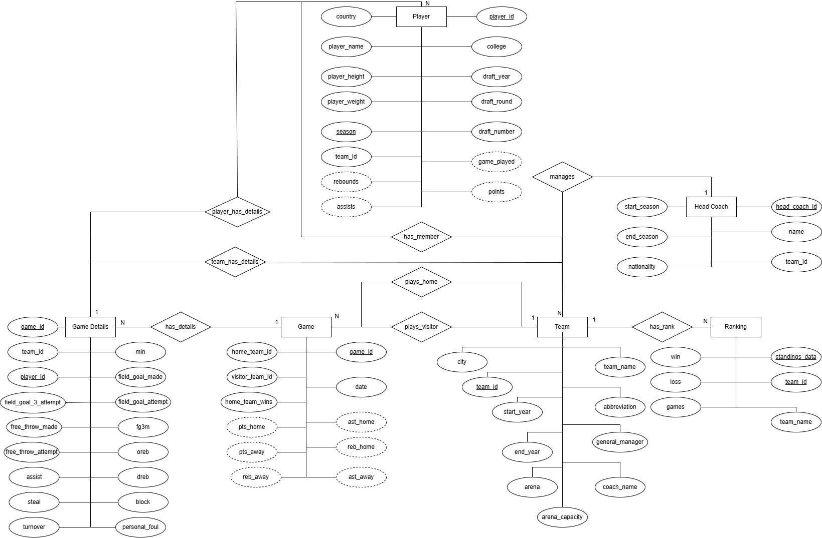
ER-Model
put
Notes:
CHECK IF ANY CHANGE SHOULD BE DONE IN THE PHOTO

Slide 6
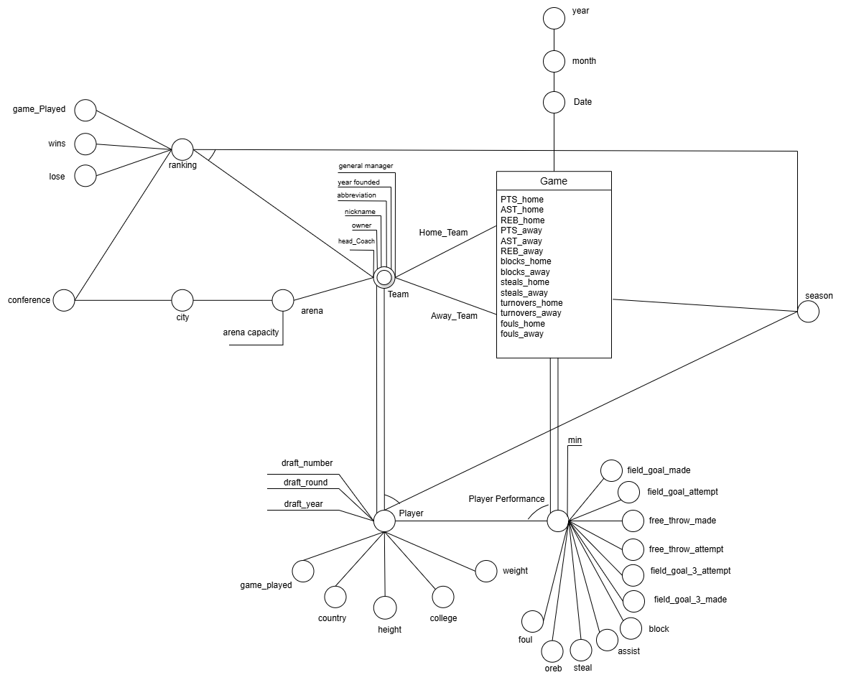
DFM Model
Fact : Games
Dimensions:
Home_Team
Away_Team
Date
Season
player_ performance
Cross dimension Attributes:
Ranking
Player

Slide 7
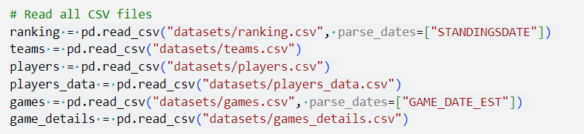
ETL
Extract : Read data from CSV files

Slide 8
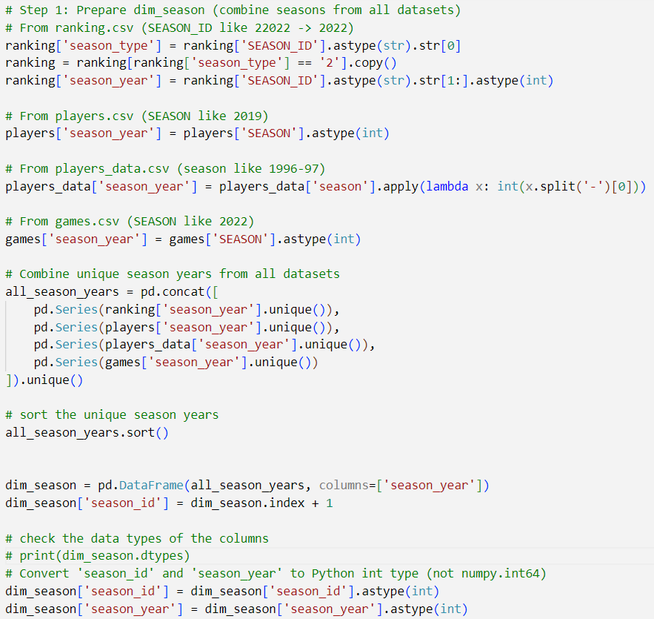
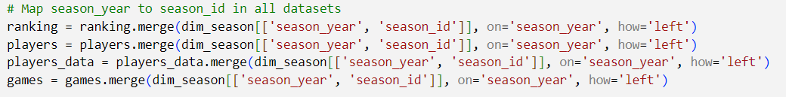
ETL
Transform the data
Create new tables
Attribute Standardization
Data Normalization
Surrogate key generation
Dimension Mapping

Slide 9
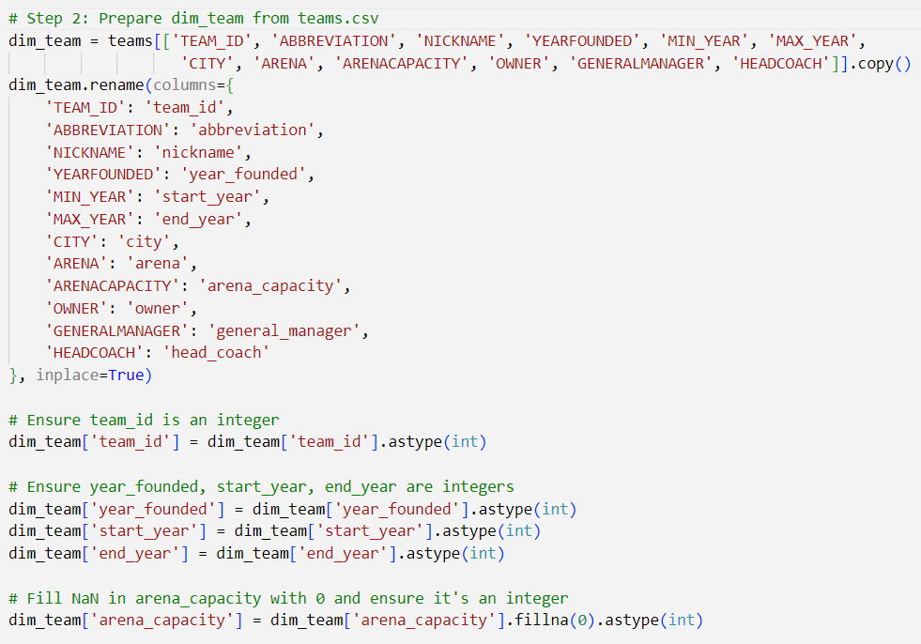
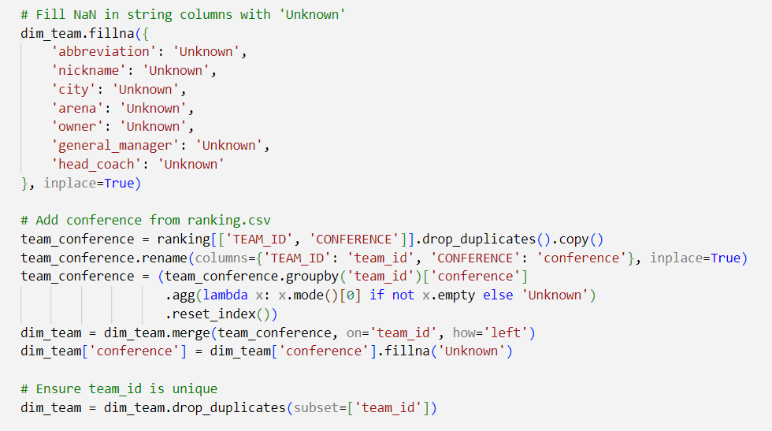
ETL
Transform the data
Create new tables
Attribute Standardization
Data Normalization
Surrogate key generation
Dimension Mapping
Data Type Conversion and Validation
Add/ Drop columns
Missing data handling

Slide 10
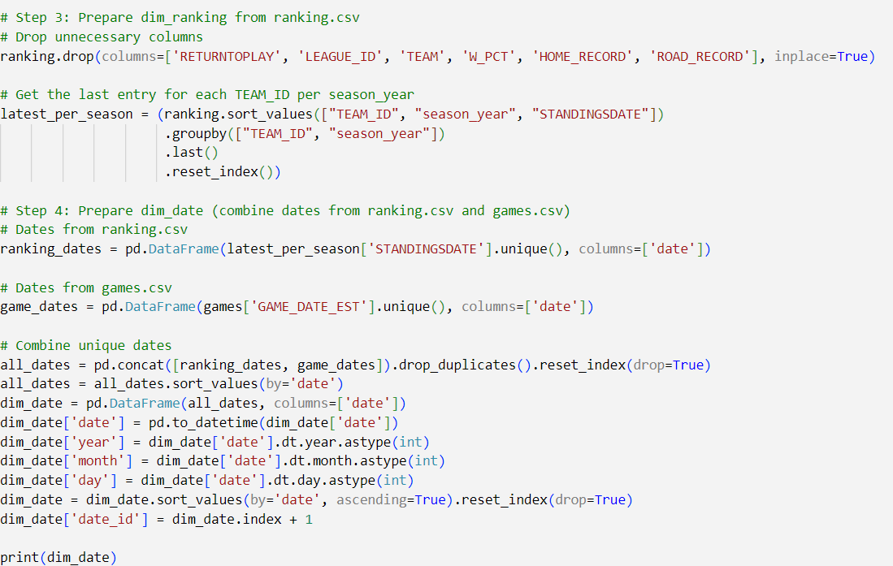
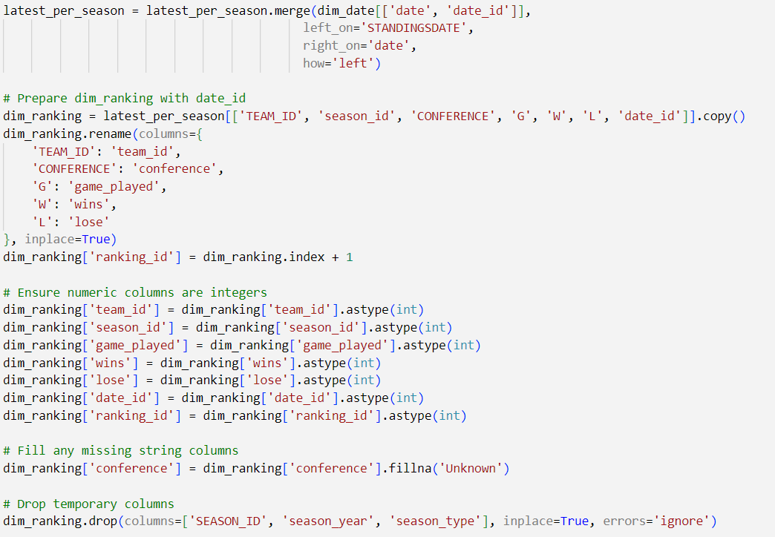
ETL
For the ranking:
Drop some columns
Convert data
Create a date table
Insert a surrogate key
Assure uniqueness of Data
Mapping of keys
Standardization process
Data type validation
Handle missing data

Slide 11
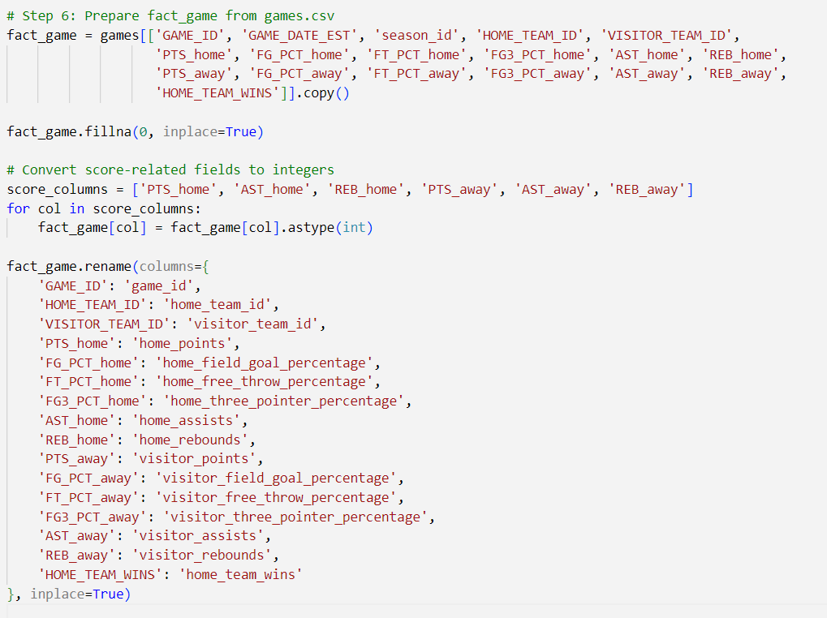
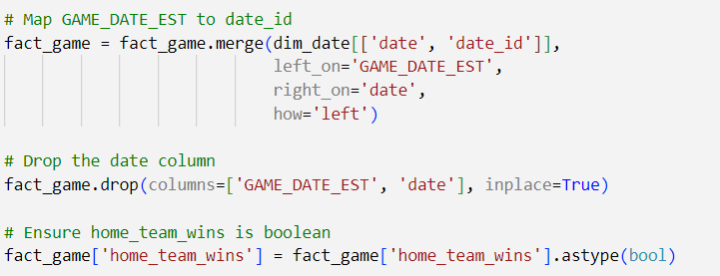
ETL
For the fact_game
Assure Data Types
Attribute Standardization
Mapping of keys
Drop columns
11

Slide 12
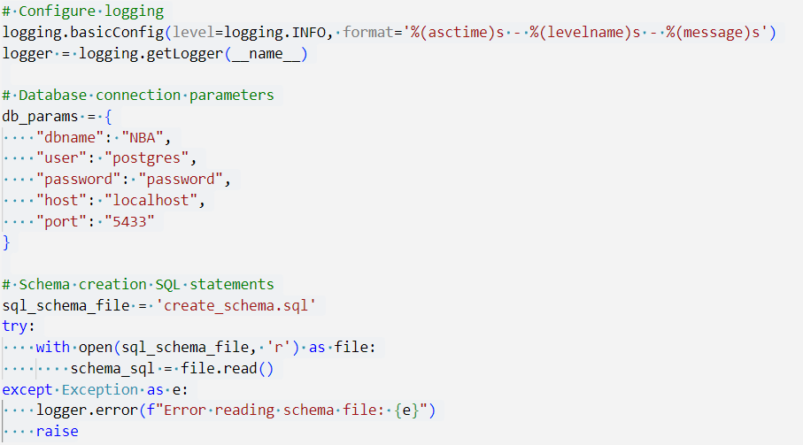
ETL
Load: Insert the cleaned data into appropriate tables in the Postgres database
Configure Logging and DB Parameters
Read SQL Schema File (contains the SQL code to create the tables)
Notes:
of each dimension and fact in SQL language)

Slide 13
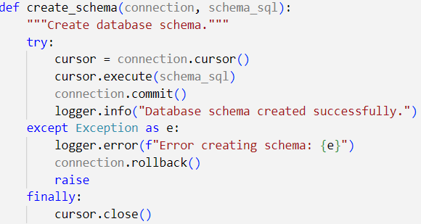
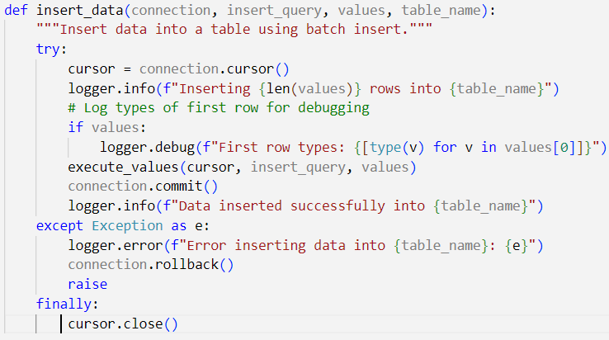
ETL
Design a Function to Create Schema
Design a function to insert the data

Slide 14
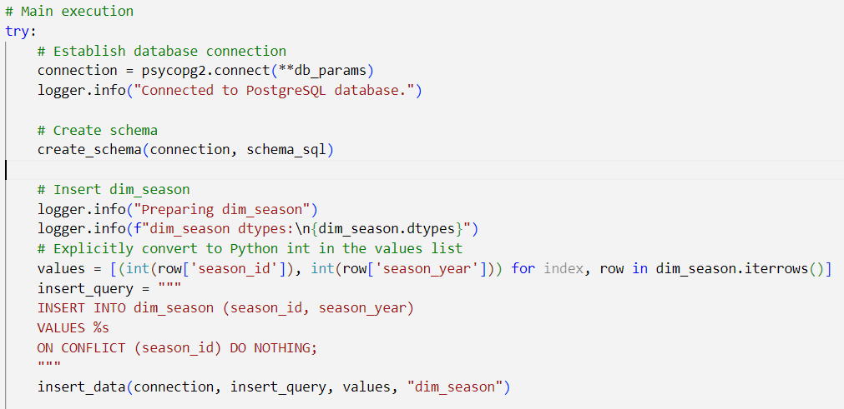
ETL
Main Execution
Connect
Create Schema
Insert Data

Slide 15
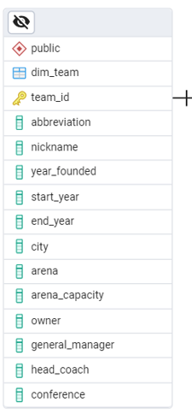
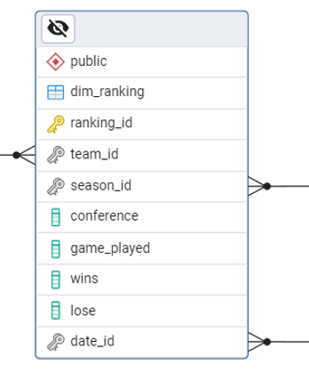
Schema
Galaxy Schema: Hybrid Schema which is a mix of star schema and snowflake
Use of Star Schema:
Flat, denormalized data
Direct Relationships
Notes:
No create of key and link the two table to this key for the conference

Slide 16
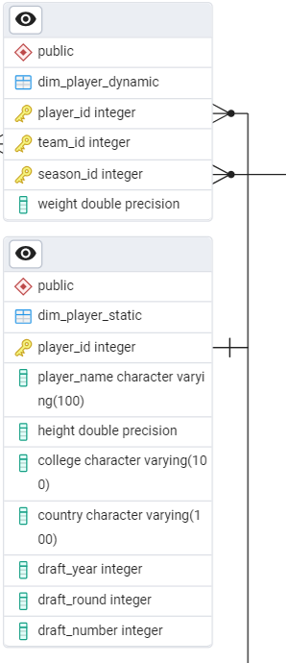
Schema
Use of Snowflakes:
Normalized lookups
Tables decomposed into sub-dimensions
Avoid redundancy
The Player dimension is split across two tables (dynamic and static)
Notes:
player_dim split into 2 tables
Main which is player dynamic (contain player id ) data decencies
The subyable used to avoid the redundancy of info:
College
Country
Draft_year
Draft_round
Draft_numbet

Slide 17
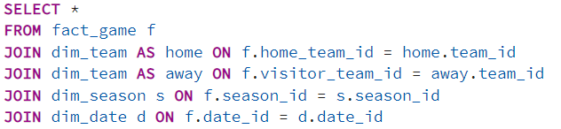
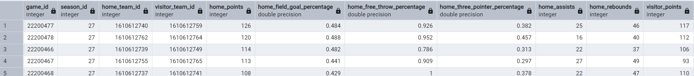
OLAP Queries
Query of building basic cube
Result

Slide 18
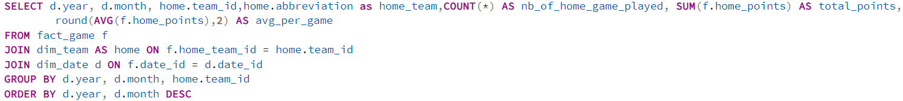
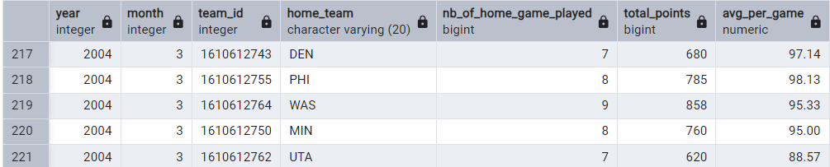
OLAP Queries
Roll up: Compute the Monthly Home Team Performance This means the sum of the points scored by each team in each month.
Result

Slide 19
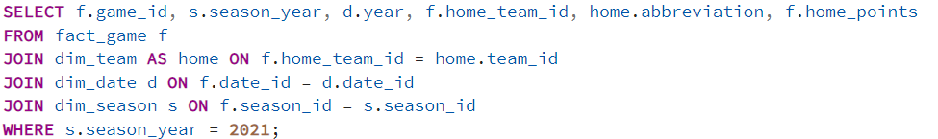
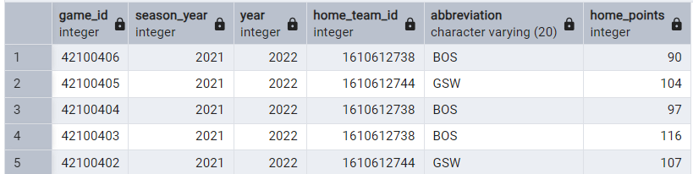
OLAP Queries
SLICE: Compute the query to get all the games in the season
Result

Slide 20
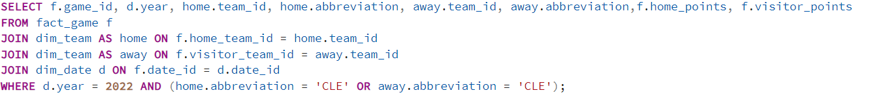
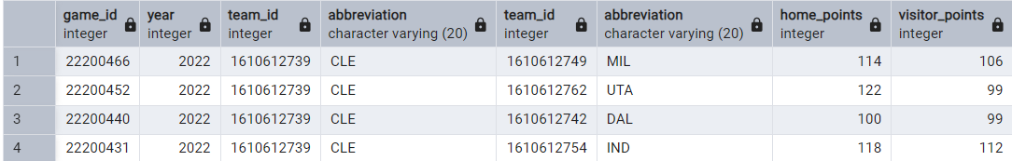
OLAP Queries
DICE : filter based on the year and the team abbreviation (ALL game played by the Cavaliers in the year 2022)
Result

Slide 21
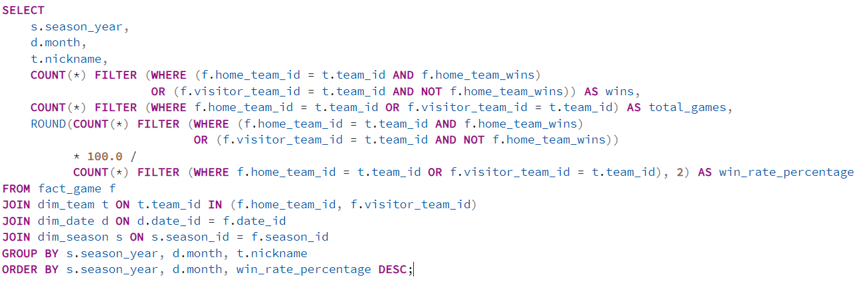
OLAP Queries
Analyze how win rates evolve per month over the seasons for each team

Slide 22
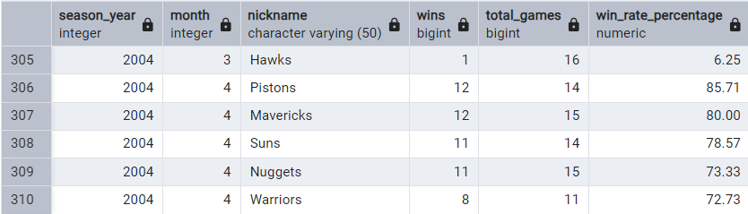
OLAP Queries
Result

Slide 23
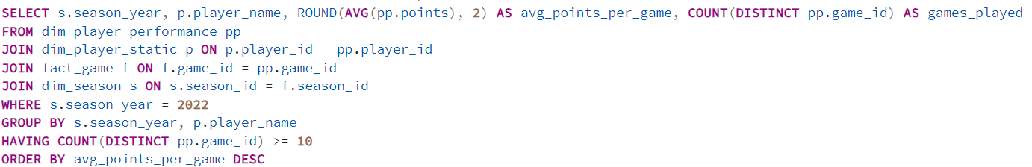
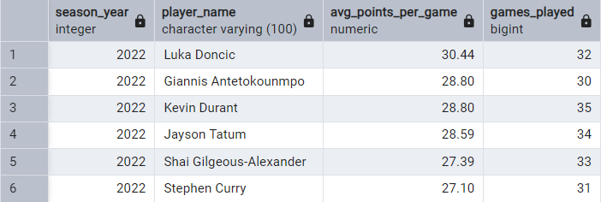
OLAP Queries
Returns the most efficient scorers over a season / over all seasons
Result

Slide 24
Conclusion

Slide 25
References
https://www.researchgate.net/publication/237622501_Chapter_I_Conceptual_Modeling_Solutions_for_the_Data_Warehouse DOI:10.4018/978-1-60566-232-9.ch002
https://www.kaggle.com/datasets/nathanlauga/nba-games?resource=download&select=games.csv
https://www.kaggle.com/datasets/justinas/nba-players-data

